Slide 1
Project Management Professional Development Series
January 24, 2024
Facilities and Campus Services Engineering and Project Management

Slide 2
Today’s Agenda
Revamped Knowledge Management System Update
Taylor Sitko
New Prompt Payment Law/Retainage Impacts Presentation
Brenda Frank
Dig Safe Process Presentation
Emily Mix and Letty McFall

Slide 3
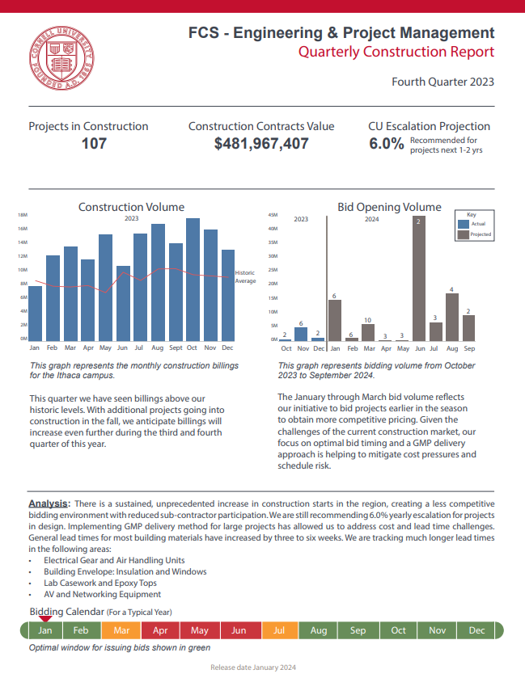
Quarterly Construction Report Q4 2023
Construction Volume
Bid Opening Volume

Slide 4
PMPD and Facilities Directors Round Table
NYS Prompt Payment Law - 756
Facilities and Campus Services
January 2024

Slide 5
NYS Prompt Payment Law 756 Overview
On November 17, 2023, NYS amended
State Law 756 – Prompt Payment Law
This Law affects ALL Construction Contracts

Slide 6
NYS Prompt Payment Law
New legislation that amends New York’s Prompt Payment Act by making two major changes:
Retainage is capped at no more than 5% of the contract price.
Contractors are now permitted to invoice for release of retainage (final invoice), upon achieving substantial completion of the work.
Notes:
Construction projects that hold retainage – Short Form Contracts would not be affected on the retainage aspect but would on the 12 day approval

Slide 7
NYS Prompt Payment Law
Effective Date is November 17, 2023.
Applies to all commercial construction projects valued at $150,000 or more.
Interest will be due on any retention that is not paid upon Substantial Completion.
The impact of these changes flow downstream, affecting owners, contractors, and subcontractors.

Slide 8
NYS Prompt Payment Law
Payment Applications need to be approved within 12 Business days.
Any items in the Pay App that are rejected by Cornell need to have a written explanation that includes justification with backup documentation.

Slide 9
NYS Prompt Payment Law
Money may be withheld from the Contractor Payment Application for the following:
Unsatisfactory or disputed job progress;
Defective construction work or material not remedied;
Disputed work materials;
Failure to comply with other material provisions of the construction contract;
Other items related to Contract Terms

Slide 10
NYS Prompt Payment Law
Note that “substantial completion” is used with varied definitions and interpretations in our documents.
We are currently reviewing what the Law defines as substantial completion and what our contracts define the term as.

Slide 11
NYS Prompt Payment Law
Current status:
All contracts issued after 11-17-2023 have been updated in eB to have 5% retainage.
All projects out for bid have had the percentage rate adjusted to 5% in the documents.
Contracts, Counsel’s Office, and Project Management will be meeting to review this change and what needs to be addressed in our contract documents.

Slide 12
NYS Prompt Payment Law
Contracts has issued an email to all contractors who have contracts that this new law affects noting that the retainage has been reduced to 5%.
Once we have completed our review of the new law, we will issue a formal change order to all of them noting the new retainage and any contractual language changes that will be required.

Slide 13
NYS Prompt Payment Law
TAKE AWAY
ONLY affects contracts fully executed from
November 17, 2023.
If you have a project that falls under this, and you have not seen a letter go out to the contractor please email Facilities Contracts.

Slide 14
Questions?

Slide 15
Thank you
272133
Notes:
Introduction

