Slide 1
Facilities Management
Organizational Overview

Slide 2
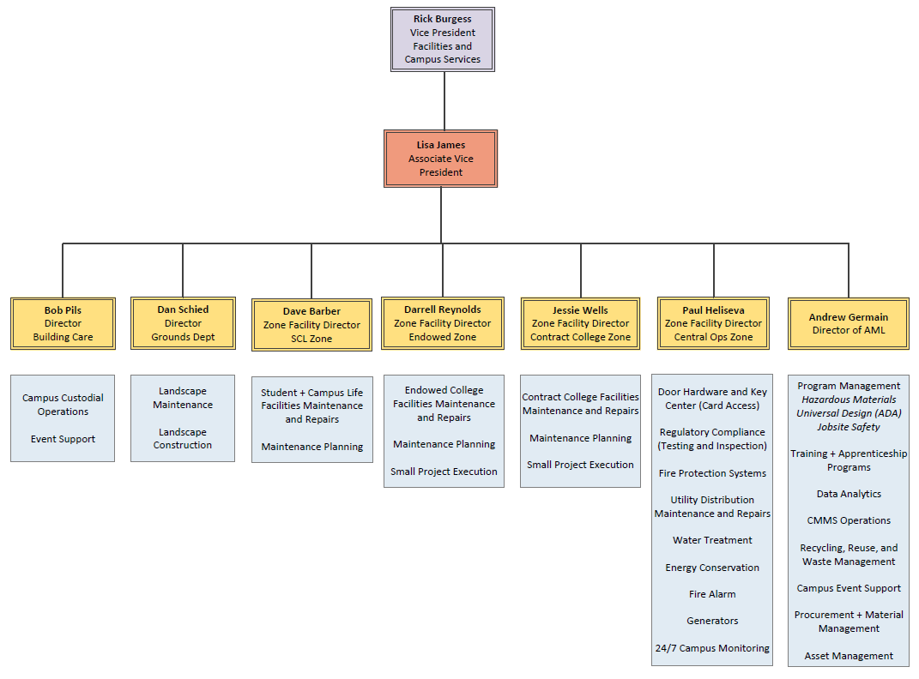
FM Org – High Level

Slide 3
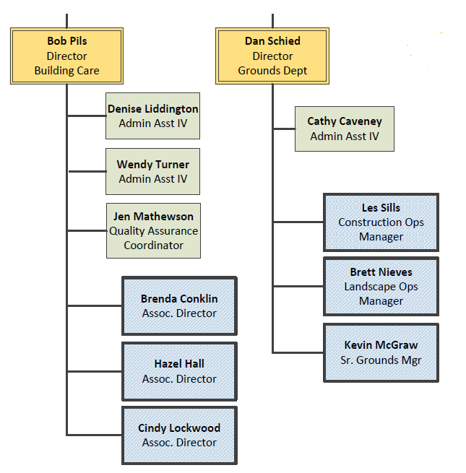
Building Care + Grounds Departments

Slide 4
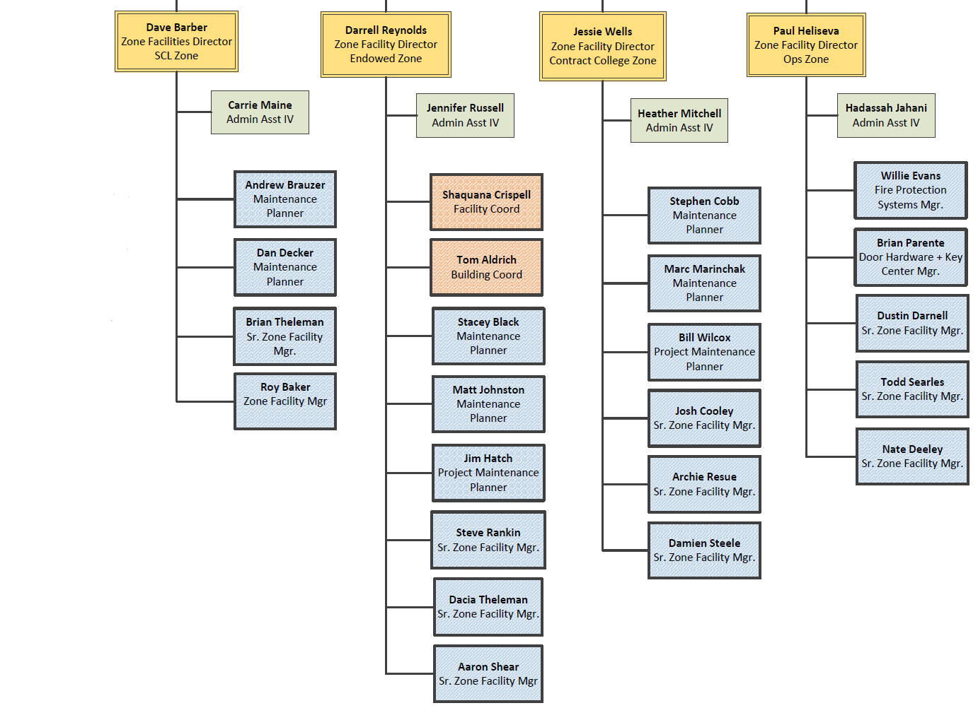
Zone Organization

Slide 5
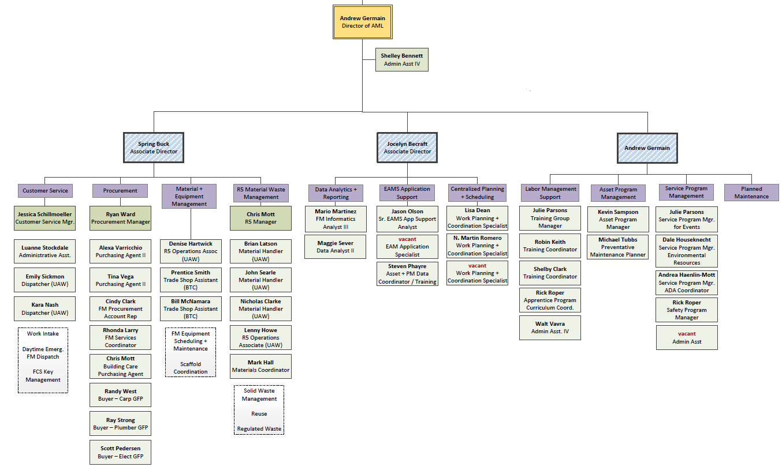
Asset Management + Logistics

Slide 6
How FM should be engaged
Design Reviews
Contact your Maintenance Planner
Establish a page-turn session, do not expect trades to look at eBuilder
Project Support (ie: exploratory work in design or construction)
Submit a service request… please don’t call your favorite plumber
Make the request well before you need it, and give specific dates
Construction phase quality assurance inspections
Contact your Maintenance Planner
Frustrated?
Contact the ZFD for the facility
We would prefer you continue to engage FM on projects

Slide 7
FM…your response time stinks
Will FM be hiring more trades?
Maybe one day… but not right now
Our funding comes from two primary sources
Corrective and Preventative Maintenance
Departmental (College/Units, Utilities, Events, Projects)
The CM/PM budget comes through an assessment model
Current headcount is not supported by this budget
Departmental work is primarily supported by temp trades
In future years we are looking to ‘right-size’ our trades staffing

Slide 8
Questions?

