Slide 1
Project Management Professional Development Series
October 25, 2023
Facilities and Campus Services Engineering and Project Management

Slide 2
Today’s Agenda
Contracts Office Intros
Brenda Frank
Quarterly Construction Report
Paul Stemkoski
Loadshed Testing Announcement
Jason Collins
QA Program Snapshot
Liesl Margolin and Hung Tran
Required City of Ithaca Inspections and Updates to Permit Applications and Fees Presentation
Mike Niechwiadowicz

Slide 3
Q3 Quarterly Construction Report

Slide 4
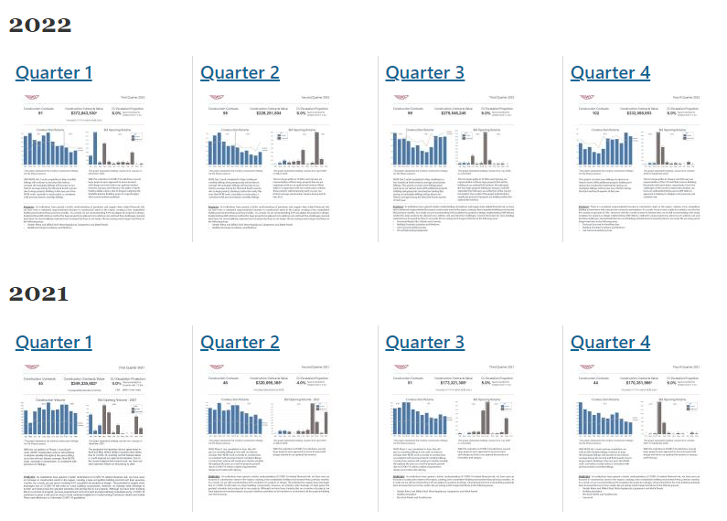

Slide 5
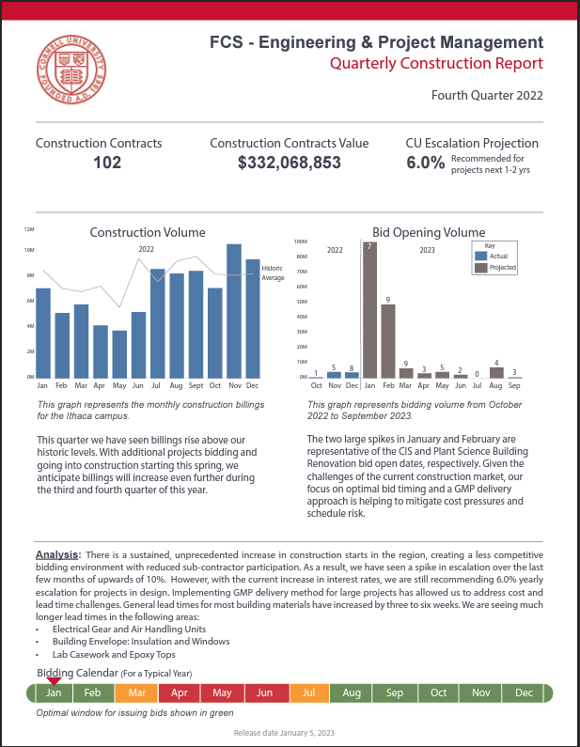
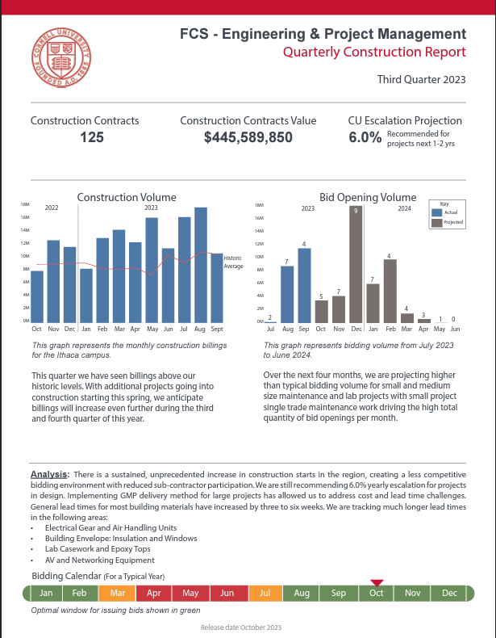
Q3 2023 Report
Key Takeaways:
125 construction contracts in place
Total $445M in construction
Volume higher than historic average
6% recommended escalation
Long Lead Item Challenges:
Electrical gear & air handling units
Insulation and window
Lab casework and epoxy tops
AV and networking equipment

Slide 6
Loadshed Testing Announcement

Slide 7
QA Program Snapshot

Slide 8
Required City of Ithaca Inspections and Updates to Permit Applications and Fees Presentation

Slide 9
Update – City Code Process
Michael Niechwiadowicz
Building Code Program Manager
Facilities Engineering
Oct0ber 25, 2023
272133
Notes:
Introduction

Slide 10
Changes in the City of Ithaca
Permit applications
Permit Fees
But first, reminder on inspections…

Slide 11
Code Required Inspections
NYS law requires code officials to inspect for code compliance
NYS has an oversite division that audits municipalities for compliance.
Owner is responsible for setting up the inspections.
But the contractor does that…
If the owner has set it up so the contractor is responsible for the inspections, owner must make sure contractor does it.

Slide 12
Code Required Inspections
NYS law requires the AHJ to require the work remain exposed until inspected
Each authority having jurisdiction shall include in its code enforcement program provisions requiring work for which a permit has been issued to remain accessible and exposed until inspected and accepted by the authority having jurisdiction and requiring building permit holders to notify the authority having jurisdiction when construction work is ready for inspection.

Slide 13
What Is Required To Be Inspected
Another acronym to add to the Cornell world of acronyms
EBC
Email before covering
In the City, email Mike Aiken – maiken@cityofithaca.org
This is the simplest way.
Inspection list can be provided but it is general.

Slide 14
Back to Changes in the City of Ithaca New Process for Permit Applications in the City of Ithaca
All permit applications must be submitted through OpenGov
Requires that you setup an account
Town of Ithaca is already using OpenGov
If you have an account on the Town’s OpenGov, same account with work for the City
Lansing will likely also move to OpenGov

Slide 15
Permit Applications in the City of Ithaca Continued
The Tuesday City Code meetings will continue
If a building permit application is submitted through OpenGov, you must come to the City Code meeting and present the project.
Bring a hard copy of plans to the meeting. Attach a soft copy of plans and specifications to the application through OpenGov.
If over 100MB, you will have to bring a copy of the plans and specifications on a flash drive to the meeting.

Slide 16
Permit Applications in the City of Ithaca Continued
Link to OpenGov
https://ithacacityny.portal.opengov.com/categories/1071
Project managers have to setup an account
Contractor and others can also set up an account
Project managers or contractors can apply for the permit
Whoever applies for the permit has control of the project
Can add ‘guests’ to the project, guests must have an account
If contractor applies, have the contractor add the project manager as a guest, subcontractors can also be added
If the project manager applies, add the contractor as a guest
Whoever applies for the project and all the guests can monitor the project and get notifications

Slide 17
Permit Applications in the City of Ithaca Continued
Add Paula Slocum to the project
Paula has to complete some administrative tasks
Upload to eBuilder, archive documents
You can keep Paula as a guest until the permit is issued
Paula will not get flooded with notifications
But you will have to put Paula back on at the time of completion so that she can upload and archive close out documents
Or you can email all the documents to Paula

Slide 18
Permit Applications in the City of Ithaca Continued
Whoever fills out the building permit application
Put the eBuilder number in the ‘Notes’ field
Put Cornell in the owner’s field
The owner’s address will self populate
The program will provide a box number as the address for Cornell
Overwrite the box number with the address for Humphreys Service Building
639 Dryden Road
Use your email address for the contact email

Slide 19
Permit Applications in the City of Ithaca Continued
Whoever fills out the building permit application
Attach a copy of the drawings
Attach a copy of the specifications
Attach a copy of any other project documents
Attach a copy of your insurances
Documentation of insurance must be attached to the application every time
Workers compensation, disability and liability insurance
There is a 100MB limit on attachments
If you exceed the limit, bring a copy on a flash drive to the City Code meeting

Slide 20
Permit Applications in the City of Ithaca Continued
Some difference between the City application and the Town
Once the application is filled out you will be asked to pay
Payment is by credit card or check
There is a third-party fee for using a credit card – 2.99% plus $0.99
Electric Permits may be different
Pay the base fee at time of application
Invoice sent after completion of the work
Town sends an invoice after they review the application

Slide 21
Permit Applications in the City of Ithaca Continued
Permit applications through OpenGov:
Building permit applications
Demolition permit applications
Electrical permit applications
Plumbing permit applications
Tent or membrane permit applications
Sign permit applications
Temporary structure permit applications
Water heater permit applications

Slide 22
Permit Applications in the City of Ithaca Continued
Not yet:
Fire protection system permit applications
Site plan review applications
Applications for Certificates of Appropriateness (Historic approval)
Street permit applications
For Site Plan Review and Historic Review, a building permit number is required
Permit number is generated when the building permit application is submitted

Slide 23
Permit Fee Changes in the City of Ithaca
Fees have increased
Building permit fees
Base fee for construction cost $0 to $5,000 going up from $35 to $50
Construction cost between $5,001 - $50,000 = 1%
Construction cost between $50,001 - $500,000 = 0.9%
Construction cost between $500,001 - $5,000,000 = 0.8%
Construction cost over $5,000,000 = 0.7% no change
Electrical permit fees
Simplified
Plumbing permit fees

Slide 24
Back to Changes in the City of Ithaca
There is a guidance document on this.
When is all this happening
It already happened on September 18th
Questions about OpenGov
First, try to figure it out
Mike Aiken is willing to try to answer questions
Please be considerate, he is learning the program same as you and he has his regular job to do

Slide 25
Update On 2024 NYS Code Adoption
NYS Codes Division official statement
2024 NYS Codes will be adopted by the early 2025
New NYS Energy Code will be basically the current NYS Energy Stretch Code
2026 Updated local energy code supplement

Slide 26
Thank you
272133
Notes:
Introduction

