Slide 1
Environment, Health and Safety
9/21/23
Tim Fitzpatrick
Senior Director, Environment, Health and Safety
m. 717-682-4031, o. 607-254-4482
tpf29@cornell.edu
AskEHS@cornell.edu

Slide 2
EHS Leadership
Tim Fitzpatrick, Senior Director of Environment, Health and Safety
Ron Flynn, University Fire Marshal-Manager Fire Protection and Emergency Services rmf9@cornell.edu, 607-254-1627
Johnathan Bootland, Associate Director of Occupational Health, Safety, and Injury Prevention. jb2742@cornell.edu, 607-882-1357
Pat McNally, Director of Enviromental Compliance and Hazardous Waste Services pom1@cornell.edu, 607-255-2304
Christine Rogers, PhD CIH, Director of Research Safety christine.rogers@cornell.edu, 413-345-8408

Slide 3
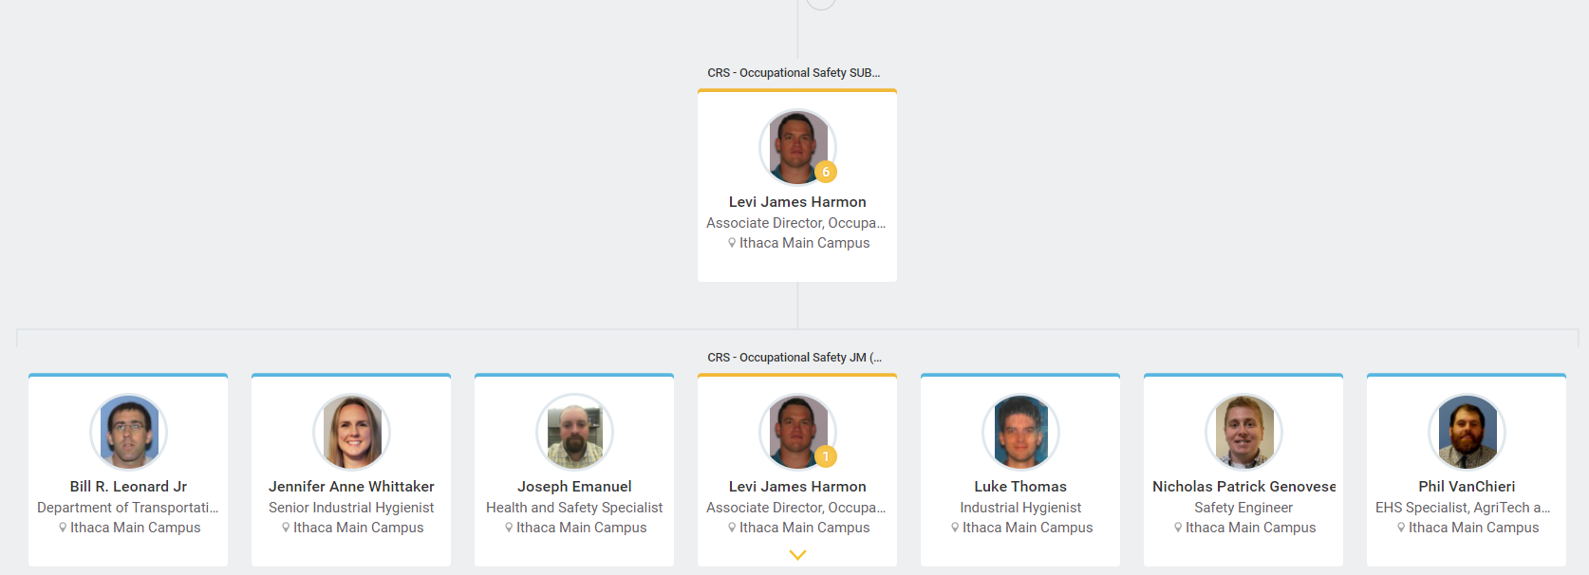

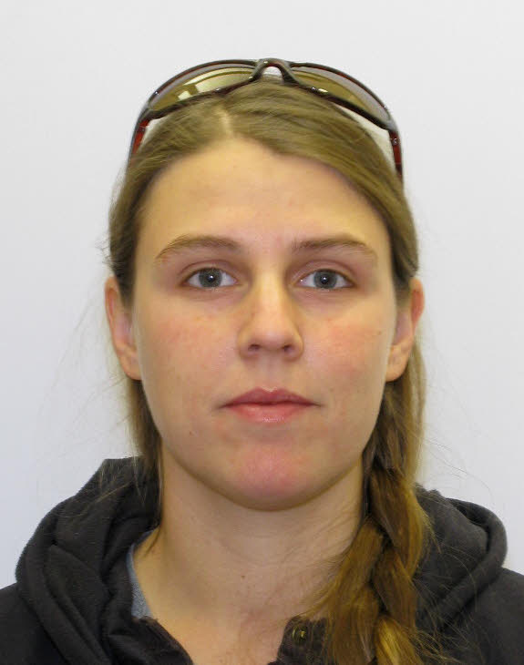
Occupational Health, Safety, and Injury Prevention
Johnathan Bootland
Associate Director, Occupational Health and Safety
Ithaca Main Campus
Amy Fox
EHS Specialist, AgriTech and Satellite Locations
Ithaca Main Campus
Vacant Position
Safety Engineer
Ithaca Main Campus
Intern Position
Ithaca Main Campus

Slide 4
Occupational Health, Safety, and Injury Prevention
Department of Transportation Programs:
Commercial Motor Vehicles
  325 drivers (62 CDL) and 163 vehicles
Hazardous Materials Shipping
  100 full hazmat, 1500 excepted, 2000 dry ice / year.
Passenger Transport Compliance
Bill Leonard (wl68), Department of Transportation Specialist
AgriTech and Satellite Locations EHS Programs:
Responsible for all aspects of EHS programs and processes.
Amy Fox (atf38), EHS Specialist, AgriTech and Satellite Locations

Slide 5
Occupational Health, Safety, and Injury Prevention
Safety Programs:
Confined Space,
Contractor Safety,
Cranes and Hoists,
Electrical Safety,
Excavations,
Fall Prevention,
Hot Work and Welding Safety,
Incident Reporting,
Incident Investigation and Lessons Learned documents,
Lock Tag Verify,
Mobile Equipment (forklifts, aerial lifts),
OSHA Recordkeeping and Reporting
Personal Protective Equipment,
Pressure Vessels (Boilers),
Hand and Power Tools,
Machine Shops,
Window Washing,
Winter Weather
Open Position, Safety Engineer
Joe Emanuel (je299), Health and Safety Specialist

Slide 6
Occupational Health, Safety, and Injury Prevention
Health Programs:
Asbestos,
Bloodborne Pathogens,
Hero Act,
Ergonomics,
Hazard Communications,
Noise and Hearing Conservation,
Indoor Air Quality,
  50 investigations/year
Industrial Hygiene
Cority IH Suite in Early 2023
Incident Reporting and Investigation
Lead,
Legionella,
Respiratory Protection,
  783 employees in the program
Silica,
Smoking Policy.
Jennifer Whittaker (jaw549), Senior Industrial Hygienist
Luke Thomas (ltt26), Industrial Hygienist

Slide 7
Occupational Health, Safety, and Injury Prevention
HOT PAGES:
Severe Injury alert
  Scope: 1. Severe injuries, or illnesses to employees, contractors, and visitors that occur in university owned or leased facilities, or on campus grounds. 2. Employees transported by ambulance during their work shift.
Industrial Hygiene alert
  Scope: IH services to support Emergency Services or Spill Response Team in determining odors, leaks, spills, and/or exposure to make informed decisions.
OHSIP supports Confined Space Rescue alert
  Employee or contractor confined space incidents.

Slide 8
Environmental Compliance
The Environmental Compliance Group focuses on regulations, permits and policies related to the protection of the outdoor environment and to minimize the legal and reputational risk to the university. In addition, we manage the disposition and fate of materials to ensure their impacts are minimized

Slide 9
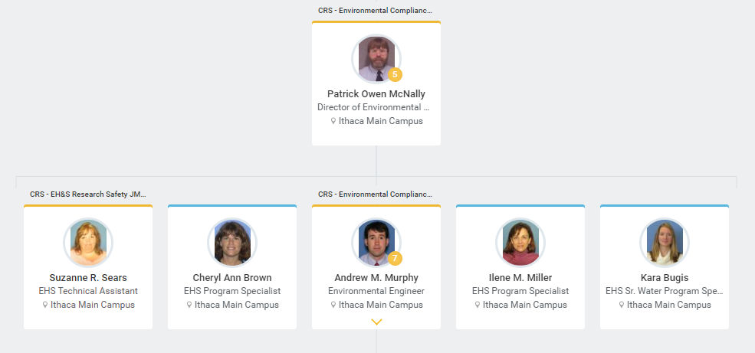
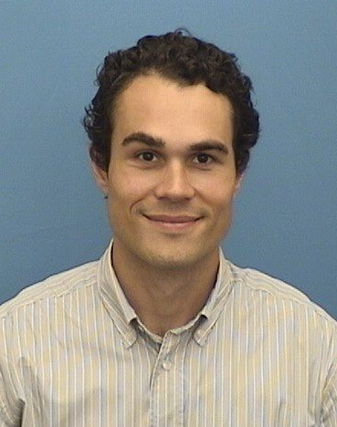
Environmental Compliance Section
Environmental Compliance
Jaron Khoury
Environmental Engineer
Ithaca Main Campus

Slide 10
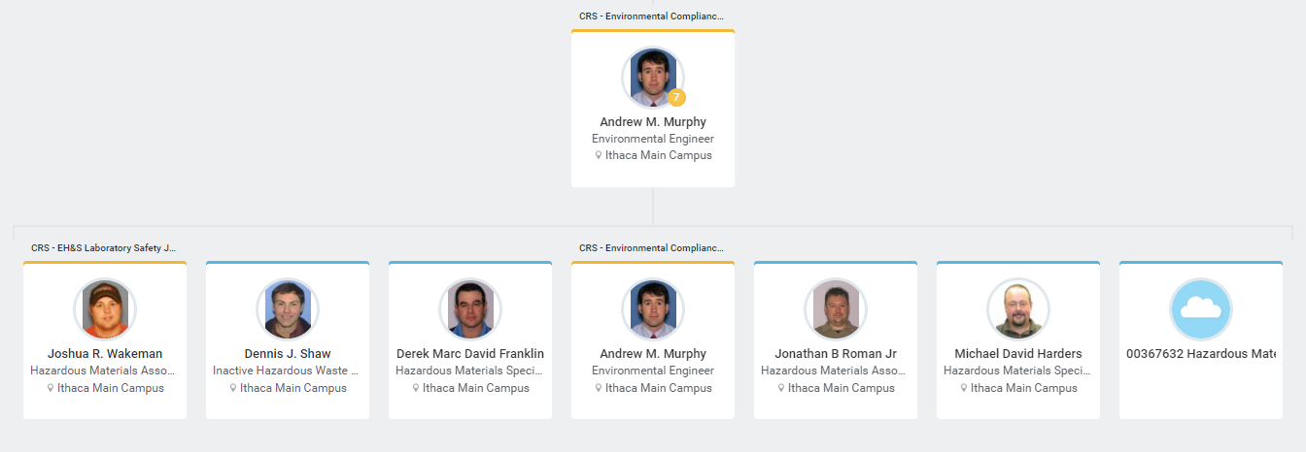
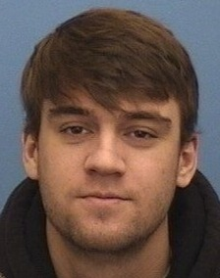
The Hazardous Materials Services Section
Jaron Khoury
Environmental Engineer
Ithaca Main Campus
Jaron Khoury
Environmental Engineer
Ithaca Main Campus
Jonah Kasnitz
Hazardous Materials Associate
Ithaca Main Campus

Slide 11
The Hazardous Waste Services Section
Handle, manage and dispose of hazardous waste to protect the health and safety of all personnel on campus.
Meet hazardous waste management regulatory requirements and be protective of the outdoor environment.
Provide hazardous materials shipping oversite for the campus.
Management of the chemical and radiological remediation sites owned by the university.
Manage the university’s Hazardous Materials Spill Response Team.
Manage Petroleum and Chemical Bulk Storage Programs.

Slide 12
Project Support
Upon request and definition of project scope from university Project Managers, conduct recommendations for applicable permitting and regulatory compliance requirements in the siting, design, permitting, construction, and building commissioning process.
Ensure O&M incorporates on-going requirements into facility management.
This is a collaborative process with early notification responsibilities for the prospective PM team and compliance services (permitting, design, municipal approvals, inspections and certification) funded by the respective project.

Slide 13
Air Program
Clean Air Act (CAA) and university-wide air quality program
  CAA Title V Permit (Ithaca) & Facility Registration (CU Agri-Tech)
  Annual Emission Statements (Ithaca campus only)
  CAA Part 98 Mandatory Greenhouse Gas Reporting
  Small boiler (GACT) compliance – Ithaca and outlying facilities
  NOx RACT Compliance (Ithaca campus only)
  Emergency Generator inventory and compliance
  Surface Coating & Paint Stripping
  Gasoline Dispensing
  Risk Management Planning
Ozone Protection
  Stationary A/C
  Motor Vehicle A/C
Radioactive air Emissions
  Monitor emissions
  Document exemption from permitting

Slide 14
Water Program
On Site Wastewater Discharge – SPDES, BMPs, UICs
Stormwater – Const Permits, Infrastructure O&M, LSC TP Offsets
IAWWTF Industrial Pretreatment Permit (aka Municipal Sanitary Sewer Program) – Inspections, sampling, self-monitoring reports
Concentrated Animal Feed Operations – CAFO)
Water Withdrawal – WFP, CURC, Local CU Farms
Protection of Waters – stream disturbance, wetland protection
Notes:
Water Compliance Management
Concentrated Animal Feed Operations (CAFO)
Cornell University Ruminant Center (CURC)
Vet School Teaching Dairy Barn
On Site Wastewater Discharge
Water Filtration Plant State Pollution Discharge Elimination System (SPDES)
Campus-wide SPDES – coordinate compliance with campus greenhouses
Septic Systems (SPDES GP)
Underground Injection Control (UIC)
Water Withdrawal
CALS 40 Mile Facilities
CURC
Water Filtration Plant
Stormwater
Construction General Permit (stormwater compliance for all construction projects)
Permanent Practice O&M compliance and reporting – Town of Ithaca OMRA
Lake Source Cooling Enhanced Phosphorus Removal Stormwater requirements
Protection of Waters
Stream disturbance – Water Filtration Plant intake, sailing center dredging
Wetlands – liaison for PM’s and projects for joint application process
Industrial Pretreatment Permit with IAWWTF (aka Municipal Sanitary Sewer Program)
Lead laboratory permit compliance inspections with IAWWTF
Manage semi-annual campus sampling
Self-monitoring reports for Campus, Radiological discharges, Teaching Dairy Barn and Vet Waste Management Facility

Slide 15
Hazardous Waste Program
Chemical Waste (RCRA)
Radioactive Waste
Regulated Medical Waste
PCB Caulk
Solid Waste
Project waste (C&D, exempt fill, PCB, etc.)
Novel research (pyrolysis, compost, human waste)

Slide 16
Disposal Sites
CDS – Chemical Disposal Site
  Contains chemicals disposed by the university from the 1940s into the 1970s.
  Located on Snyder road adjacent to the RDS.
RDS – Radiological Disposal Site
  Contains low level radioactive materials.
  NYS DEC in process of dropping control limit of 1-4, dioxane as part of their efforts on emerging contaminants.
  Includes the building at the exposure field.
FReDS – Former Refuse Disposal Site
  South of Library Annex.
  Capped with NYS DEC approval with no permanent treatment.
  NYS DEC in process of installing monitor wells due to concerns over emerging contaminants (1-4, dioxane, PFAs, PFOAs).

Slide 17
Petroleum and Chemical Bulk Storage
Petroleum Bulk Storage (PBS)
  SPCCs (Spill Prevention Controls & Countermeasures) – 20+ (update every 5 years and signed off by a PE)
  ASTs – 131 – (~half are EDGs)
  USTs – 1 (Upson Hall) NYS Issued Certificates – 10
  CEP tanks 1 – 665,000 gal distillate fuel tank (with well monitoring & liner testing) and 4 other petroleum tanks
  UNREG Sites (Farm Exempt) – 5
  Facility Inspectors (Unit Specific – Monthly Inspections) – 60+
  Online Inspection tracking Tool – PBS Online Application
  Tank Inventory Tool – EHS Application Suite
Chemical Bulk Storage (CBS)
  CVM Waste Management Facility – 1 tank, Potassium Hydroxide
  Water Filtration Plant – 4 tanks, Sodium Hypochlorite
  Central Energy Plant – 5 tanks – 12,000 gal aqueous ammonia and boiler chemicals.
  SPRs (Spill Prevention Reports) – (5 year 3rd party inspections and PE signoff)

Slide 18
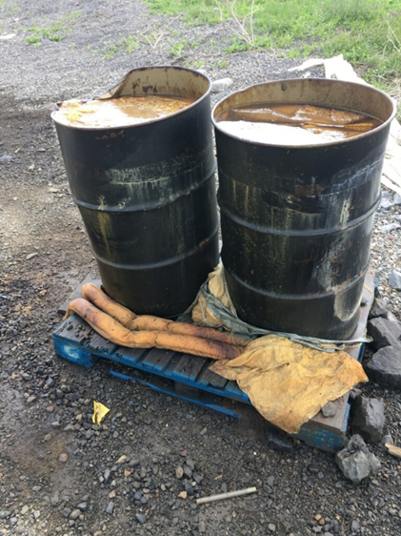
Spill Response, Reporting, and Cleanup
Typically, 2-4 spill team “hot pages” and responses per month
  Interior – lab bio/chem/rad spills (Hg spills are still common – ongoing efforts to encourage alternatives
  Exterior – usually require reportiing with 2 hrs (e.g., hydraulic leaks, other petroleum, sewage)
  Typically, 1-3 larger environmental remediations per year (e.g., petroleum spill, mercury)
Roster of trained staff across the department (on call 24/7)
  Currently 5 active, 6 pending staff members
  Initial 40-hour training
  Annual 8-hour refresher training
  Medical monitoring necessary (baseline and annual)
  Respiratory Protection Program
Maintain spill response vehicle, equipment inventories (e.g., sorbents and containers), training program, and personal protective equipment (PPE)
Make full attempts to recover cleanup costs from entities responsible

Slide 19
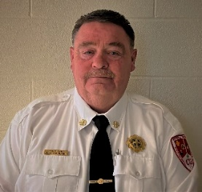
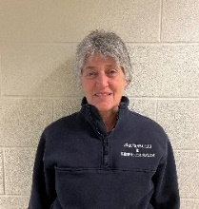
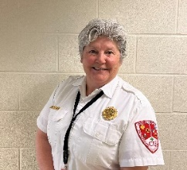
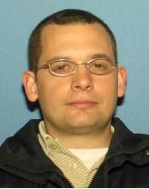
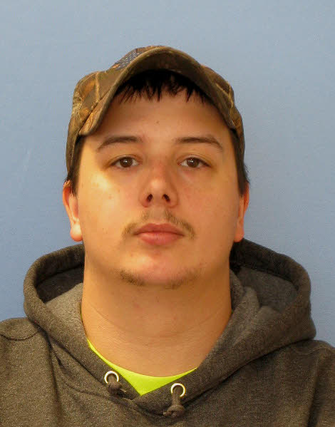
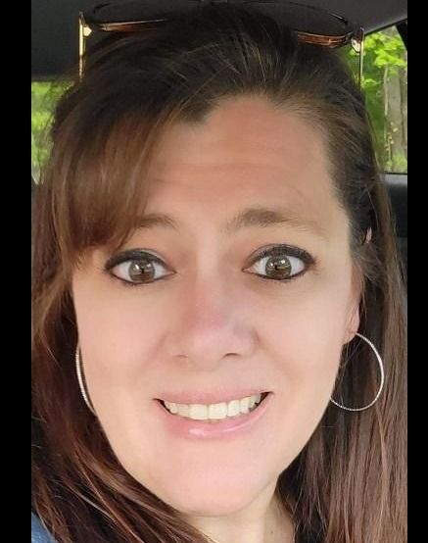
University Fire Marshal Office Staff
Ron Flynn, University Fire Marshal
Manager Fire Protection and Emergency Services
Open Kathy MacCheyne Kate VanLoke John Jelliff Kyle Bellinger Tracy Havlik
Asst. Fire Marshal Asst. Fire Marshal Asst. Fire Marshal Supervisor Fire Compliance Specialist Administrative Assistant
Emergency Services
Notes:
The responsibilities of the University Fire Marshal Office has grown significantly since its inception 23-years ago.
The responsibilities and growth attempts to parallel the growth of the University, Campus Community and needs of our Stakeholders

Slide 20
What Does The Fire Marshal Office Do?
Enforcement of codes and standards
NYS Codes
NFPA Standards
F.M. Global
ADA
Code consultations
Fire, Sprinkler and Life Safety System Plan Reviews
Acceptance Testing Coordination w/AHJ’s
Schedule and participate in all acceptance testing of Fire Alarm, Sprinkler and Life Safety System Testing
Subject Matter Expert (SME) for Fire Alarm, Sprinkler and Life Safety Systems
Single Point of Contact for C.U. Project Management, Design Teams, Engineers, and Contractors
Maintain Cornell’s Alarm Reduction Program and information
Maintain Inventory of Fire Alarm Systems, devices, and device location maps
Oversight of Cornell’s Fire Alarm Digitize Reporting System and Records
Monthly Reports for Fire Alarm Activations
Coordinate compliance testing of all Third-Party vendors for Semi & Annual Kitchen Hood Suppression Systems and Gas Suppression Systems and distribution of reports

Slide 21
What Does The Fire Marshal Office Do?
Knox Box Inventory & Key(s) Management
Maximum Occupancy review & Placards
Impairment Coordination
Impairment Notification
Fire Watch requirements
Documentation
Liaison and Single point of contact for Emergency Response Agencies
Bang’s Ambulance
Cayuga Heights
Ithaca Fire
Lansing Fire
Dryden, Freeville, Harford & Varna Emergency Services
Tompkins County Department of Emergency Response
Coordinate Annual Fire Inspections
Scheduling
Distribution of inspection documentation
Tracking of violations & data
Negotiation Abatement Extension requests and Compliance Plans
Inspection Close Out
● Maintain all Fire Code Compliance
Documentation
University Event Management Team
25Live Event Registration approval
Collaborate with Student Groups

Slide 22
What Does The Fire Marshal Office Do?
Designated Hot Work Annual Permits, Inspections and Hot Work Training
Provide Training
CPR/AED
First Aid
Fire Safety Education
Fire Extinguisher Use
Commercial Kitchen Safety
Fire Safety consultations
Develop and maintain building level Fire Safety and Evacuation Plans
Events Management
Safety Management
Planning
Site logistics review
Resource coordination
Scheduling of EHS Event Safety Staff
Tent Inspections
Emergency Evacuation Plans
Develop Incident Action Plans (IAP)

Slide 23
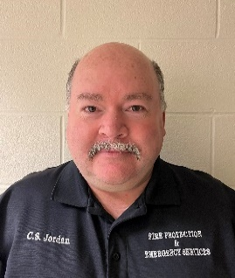
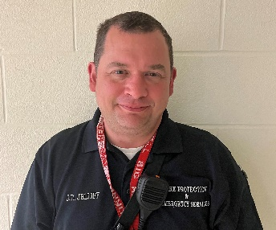
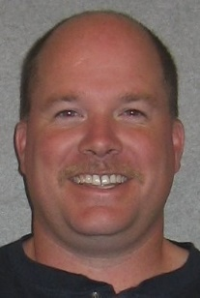
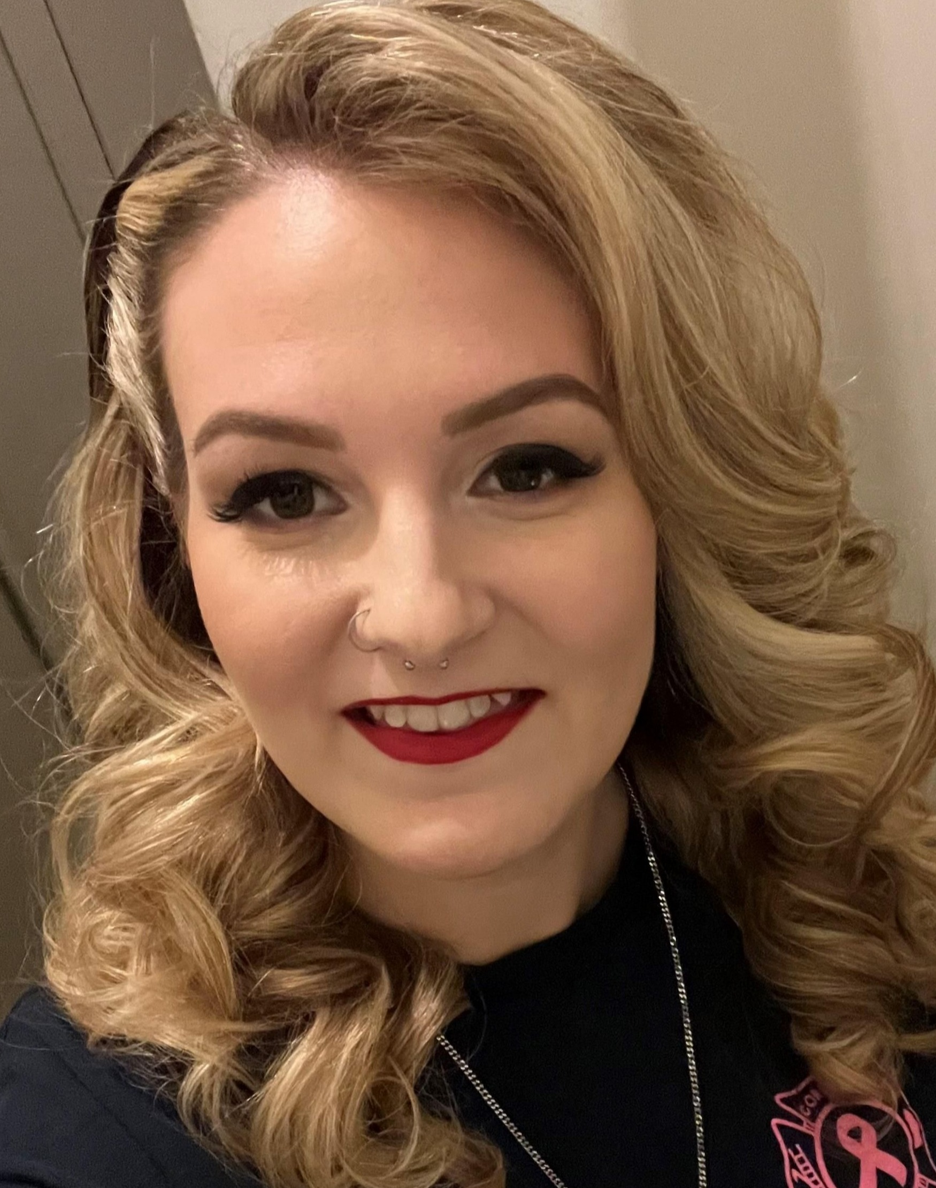

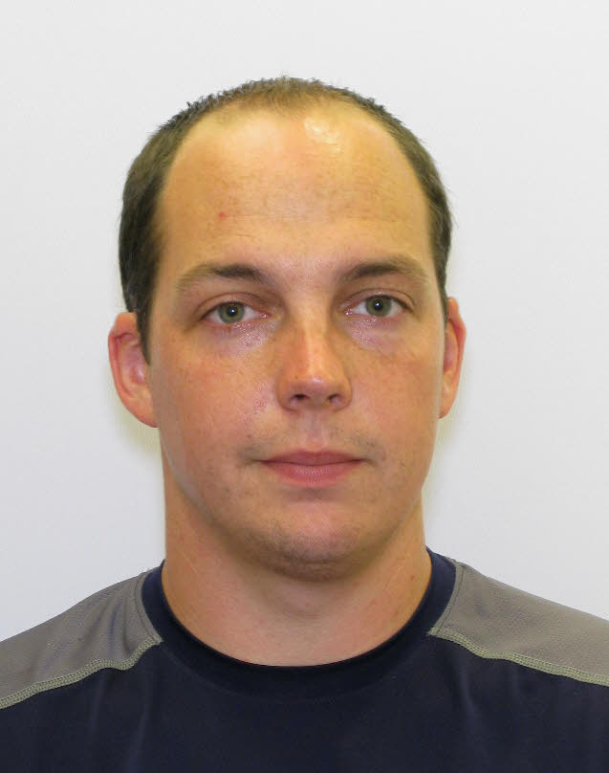
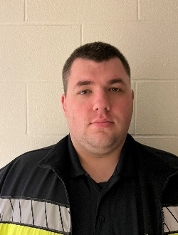
Emergency Services Team- Supervised by John Jelliff
Chris Jordan
30-Years of Service
Emergency Services Specialist
Certified NYS EMT
John Jelliff
21-Years of Service
Emergency Services Specialist
Certified NYS EMT
Steve Jordan
31-Years of Service
Emergency Services Specialist
Certified NYS EMT
Laura Shields
Emergency Services Specialist
Certified NYS Paramedic
Brian Wendel
Emergency Services Specialist
Certified NYS Paramedic
Dustin Brunner
Emergency Services Specialist
Certified NYS Paramedic
Anthony Whitaker
Emergency Services Specialist
Certified NYS EMT
Notes:
Meet the current Emergency Response Team (ERT) who play a vital role in safe-guarding and protecting Cornell’s critical infrastructure, students and staff by providing 24/7-365 Emergency and Non-Emergency Response to campus
(2) Positions are vacant and will be filled in July 2022
Additionally, the ERT plays a major role in compliance by conducting over 29,000 inspections and tasks each year consisting of monthly and quarterly Sprinkler Valve Inspections, over 900 Evacuation Drills and over 6,000 tasks making certain that the 150 Automatic External Defibrillators (AED) deployed around campus as part of the University’s PAD Program are always in a ready state
In Calendar Year 2021, the ERT were dispatched to over 2,800 calls for assistance that encompassed Fire Alarm activations, Medical calls, Hazmat Incidents, Fires, Elevator Entrapments, Odor Complaints, Floods from broken pipes, just to identify a few
The ERT are the initial department liaison with the Campus Community and Emergency Response Agencies

Slide 24
What does the Emergency Response Team Do?
Emergency Response Coverage 24/7- 365
Respond to all Fire Alarm activations
Respond to all Medical Calls supporting CUEMS which is a Student Organization not always in service
Respond to All Fire Alarm System Troubles and Supervisory Troubles and initiate Service Requests for repairs
Responds to all local smoke detector & CO detector activations in Residential & Academic buildings
Initiate required Campus Fire Incident Reporting for all fires
Perform all fire alarm and sprinkler system shutdowns and restorals for shops and contractors
Primary Response for all Elevator Entrapments
Provide initial indoor Air Quality Monitoring
Investigate explosions, odor complaints, accidents, and other safety incidents
Respond to Chemical, Biological and Radiation incidents, and initiate clean-up
Incident notification to University Fire Marshal, EHS SME’s, create and maintain incident reports, documentation and photos
Respond to “Suspicious Material” reports and work with Cornell Police to mitigate
Provide specialize and non-specialized support to CUPD and Shift Mechanics
Respond to and assist CUEMS with EMS calls. Primary EMS when CUEMS is not in service
During a response, act as the University Liaison with outside EMS and Fire agencies responding to the campus
Coordination of EHS Confine Space Rescue Team

Slide 25
What does the Emergency Response Team Do cont’d?
Conduct Evacuation Drills in all Residential, Academic, and Staff buildings
Perform all compliance required Monthly Sprinkler Valve Inspections
Perform all compliance required Quarterly PIV Inspections
Coordinate the Campus Public Access Defibrillation Program
Perform Monthly inspections on AED units and Stop the Bleed Kits
Conduct Site Safety Inspections for Open Burn Permits and Smaller Campus Events
Assist CUPD and IFD with Campus Geography training and familiarization
Notify University Fire Marshal of any non-code compliant situations
Initial liaison with all Campus Partners and Cornell Community

Slide 26
What Does Emergency Service Do?
2,897 CALLS FOR ASSISTANCE
in 2021
29,297 Compliance Tasks Completed
in 2022
Notes:
Much of what the Emergency Services Team does is tied to campus population and number of fire protection related devices on campus. The number of devices obviously grows as we build new buildings but also grows as older buildings are renovated with improved fire protection systems (e.g., Bradfield).

Slide 27
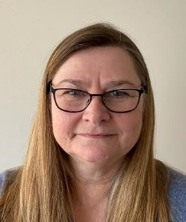
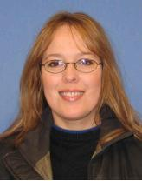
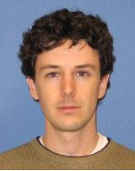
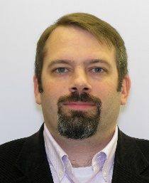
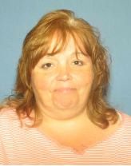
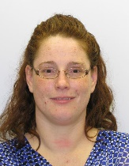
Research Safety
Safety initiatives and resources for all teaching and research programs, personnel, and facilities
Christine Rogers Director Research Safety
Brenda Coolbaugh
Chemical Hygiene Officer
Darren Dale
Radiation Safety Officer
Joshua Turse Biosafety Officer
Sue Sears
Admin Assistant
Tracy Their
Training Manager

Slide 28
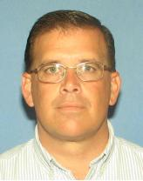
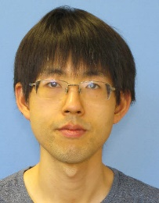
Radiation Safety
Darren Dale
Radiation Safety Officer
Kevin Fitch
Radiation Safety Specialist
Jiefu Yin
Radiation Safety Specialist

Slide 29
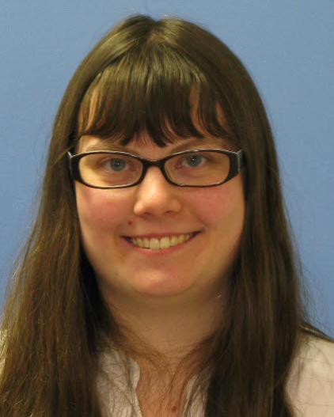
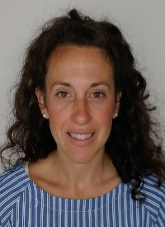
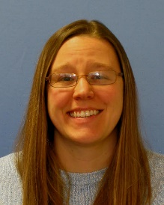
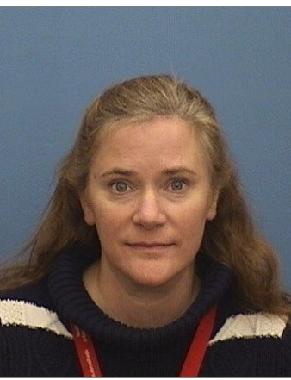
Chemical Hygiene
Brenda Coolbaugh
Chemical Hygiene Officer
Rachael Hodgdon
Laboratory Safety Associate
Christine Meck
Associate Chemical Hygiene Officer
Trista Thorn
Laboratory Safety Associate
Ellen Gordon
Ventilation Specialist

Slide 30

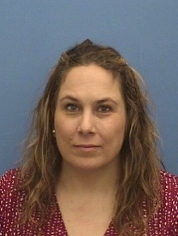
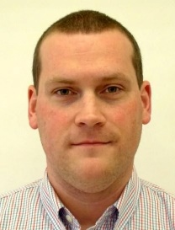
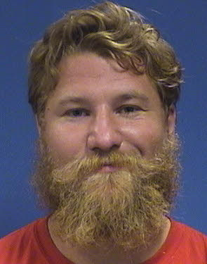
Biosafety
Joshua Turse
Biosafety Officer
Julie Conyer
Associate Biosafety Officer
Brendan Chandler
Biosafety Specialist
Richard Gaisser Jr.
Biosafety Specialist

Slide 31
Research Safety Scope
Partner with 672 Faculty and Laboratory Directors
>2,000 Staff, Visiting Scientists, Postdocs, Graduate and Undergraduate Researchers
Liaise with Department Safety Reps, College Safety Reps for broad communications and department engagement
Provide services in >3200 Research and Teaching Laboratories and Animal Facilities
Work with Facilities Engineering on Building Systems for Research and Teaching spaces
Liaise with External Agencies (e.g. Ithaca Fire Dept, FBI, CDC, DOH, Vendors etc)

Slide 32


Research Safety
Lab & Chemical Safety - Brenda Coolbaugh (blc32), Chemical Hygiene Officer
Safe Chemical Practices, Procedures, and Handling
Laboratory Safety Training
Chemical Inventory and Security
Lab Door Sign - Hazard Assessment Signage Program
Laboratory Safety Assessments/Inspections
Laboratory Ventilation and Fume Hood verifications
Pre-Operational Safety and Environmental Reviews
Controlled and Regulated Substances
Drench Shower and Eye Wash verification
Laboratory Design for Safety
Physical Hazard evaluations
Compressed and Cryogenic Gas Safety
Emergency Laboratory Procedures
Laboratory Incident Investigation

Slide 33


Research Safety
Radiation Safety – Darren Dale (dd55), Radiation Safety Officer
Oversight of all ionizing radiation, with Radiation Safety Committee
Radioisotope Use, Practices, Procedures and Handling
Radioactive Package Receipt, Survey, and Delivery
Dosimetry
Radiation Safety training
Radioactive Waste Practices
Laser Safety
X-ray Producing Equipment Safety
Magnet safety
Irradiator safety and Security Systems
Laboratory Safety Assessments/Inspections
Incident and Emergency Response for Radioactive materials
Radiation Incident Investigations
Laboratory Decommissioning Survey
Liaison with state and federal regulators

Slide 34
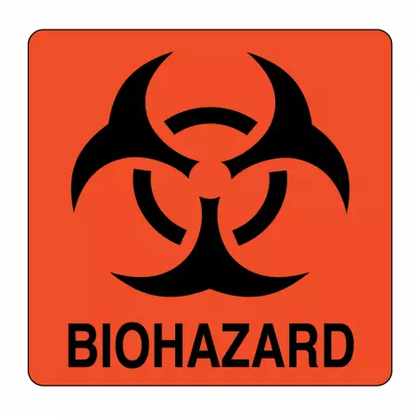
Research Safety
Biosafety – Joshua Turse (jt559), Biosafety Officer
Biological Inventory and Biosecurity
Biosafety Training, Bloodborne Pathogen Training
Biosafety and Biosecurity Practices, Procedures and Handling
Institutional Biosafety Committee protocol review
Animal Biosafety, Institutional Animal Care and Use Committee reviews
High Containment Laboratory (BSL-3 & Select Agent) procedures, practices and oversight
Liaison with federal regulatory agencies (NIH, CDC, USDA) including select agent program oversight
Consult on Institutional Review Board reviews of research on human subjects
Ensure Biosafety Cabinet and Autoclave verifications
Laboratory, Vivarium, Clinical Facilities Safety Assessments/Inspections
Exposure control plans, Incident and Emergency Response for Infectious Agents & Toxins
Biohazard Incident Investigations
COVID response and protocols for testing sites

Slide 35

Training – Tracy Thier (tlt67), Training Manager
Training development in Adobe for all EHS trainings
Safety Training Consortium Contributing Member
Training implementation in CULearn
Training completion tracking >30,000 per year
RSS Group | # in 2021
Bio | 1,711
Rad | 469
Chem/Lab | 4,170
Total | 6,350
OSH Group | # in 2021
OSHIP | 22,249
DOT | 496
Total | 22,745
Other | # in 2021
Waste | 1,529
FPES | 1,259
EM | 94
Total | 2,882

