Slide 1
Transformer Lead Time Issues
Erich Reichard(ETR33)
Facilities Engineering
August 2023

Slide 2
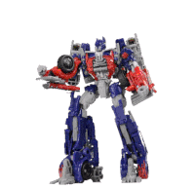
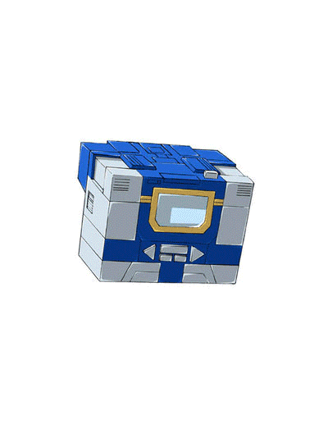
What is a Transformer?

Slide 3
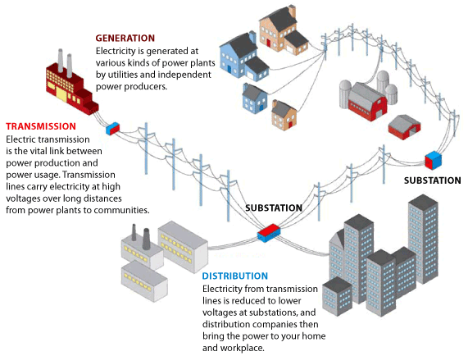
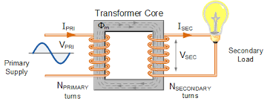
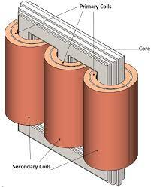
Transformers and Power Delivery
Notes:
Transmission – Higher voltage, longer range, cable size
Distribution Campus 2,400V and 13,200V

Slide 4
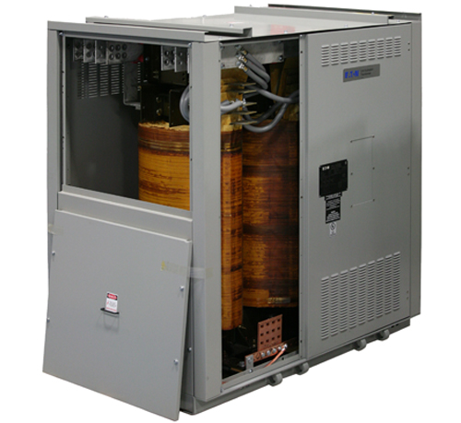
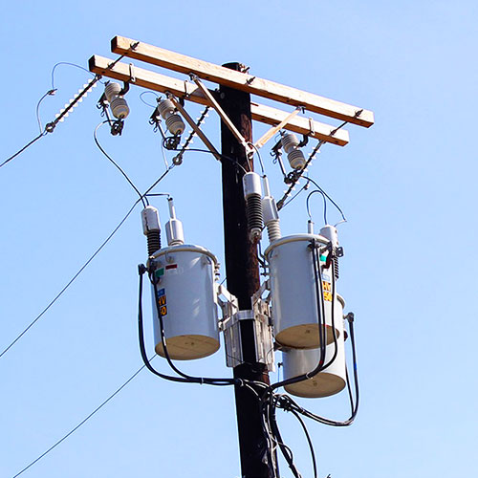
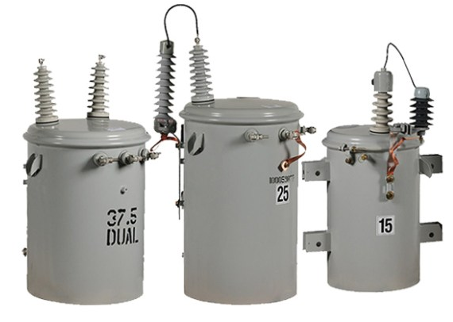
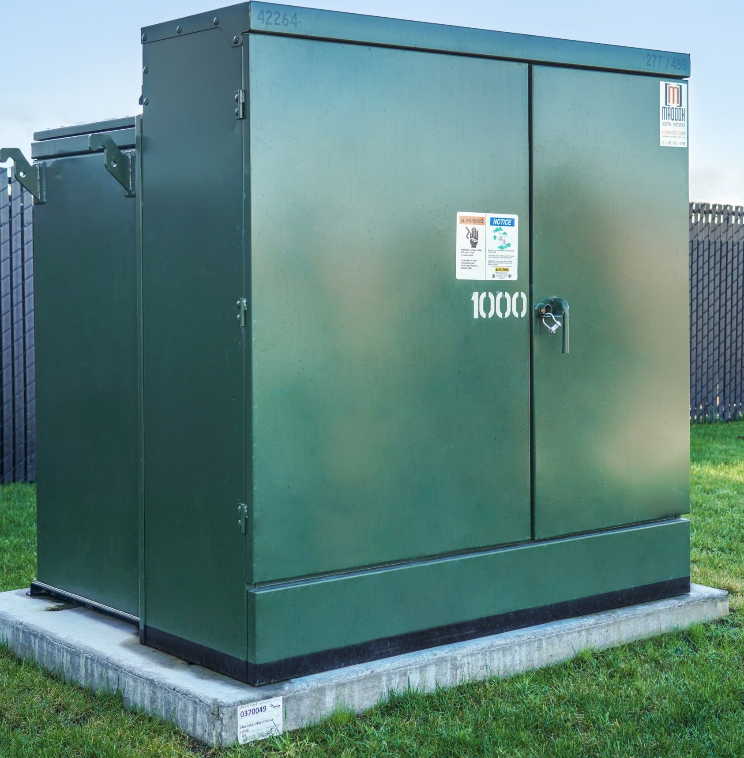
Types of Distribution Transformers on Campus
Dry Type
No oil, air cooled only
Hard to keep clean
Very few exterior installations on campus, most are indoors
Pole Mounted
Oil Filled
Size limitations
Pad Mounted
Oil Filled
Most exterior installations on campus

Slide 5
History and Current Issue
Previously (pre-pandemic) pad mounted transformer lead time was 8-12 weeks
Due to factory shutdowns, made to order/lack of stock, lack of employees, supply chain delays, lead times have continued to increase for pad mounted transformers once construction picked up in 2020 and 2021.
Shackelton Point transformers just arrived on site May 2023, ordered September of 2021.
Current lead times are as long as 120 weeks on new oil-filled pad mount transformers

Slide 6
Exploring Options – Current Projects
Other manufacturers
Historically our pad mount transformers are manufactured by Eaton, Cooper (now Eaton), or Howard.
In light of extended lead times we are looking at different options:
Reconditioned Transformers
Alternative Manufacturers we traditionally haven’t used
Other possible manufacturers we are using or considering:
Maddox – New and reconditioned
T&R – Reconditioned

Slide 7
Cost and Lead Time Comparisons: EV Project
Supplier | Size | New/Reconditioned | Price | Lead Time | Warranty
T&R | 225 kVA | Reconditioned | $19,757 | 36-38 Weeks | 3 Years
Eaton | 225 kVA | New | $42,700 | 120 Weeks | 1 Year
Maddox | 300 kVA | New | $27,100 | 4-6 Weeks | 3 Years
T&R | 300 kVA | Reconditioned | $20,000 | 56-58 Weeks | 3 Years
Eaton | 300 kVA | New | $45,900 | 120 Weeks | 1 Year
Maddox | 500 kVA | Reconditioned | $26,230 | 4-6 Weeks | 3 Years
Maddox | 500 kVA | New | $77,378 | 4-6 Weeks | 3 Years

Slide 8
Reconditioned Cost Implications, Installation Impacts
Reduce up-front cost and lead time
Reconditioned transformers cost less
Usually ship sooner than new due to being in stock
Extended lead time for 600 amp bushings
Extended lead time to fill with FR3 fluid

Slide 9
Future Needs
The utility medium voltage distribution masterplan is making the 2.4kV distribution replacement a priority. This priority is based on life safety and reliability concerns.
Near future 2.4kV pad mounted transformers to be upgraded:
Stimson – 225kVA , 208V Secondary
Friedman - 300kVA, 480V Secondary
Noyes Lodge – 150kVA, 208V Secondary
Risley - 300kVA, 208V Secondary
Carpenter Shop – 225kVA, 208V Secondary

Slide 10
Recommended Path Forward
Projects in design phase:
Purchase T&R and Maddox transformers to keep project schedules on track
Projects in the capital plan beyond the FY24/FY25:
Prepurchase Eaton, Hammond, GE transformers now to accommodate future schedules

Slide 11
Standard Update Reminder
Lighting Control Standard Updated December 2022
Any Questions Contact FE Electrical

Slide 12
Thank you! Questions?
Please contact me with questions or comments:
Erich Reichard
etr33@cornell.edu
607-255-3934

