Slide 1
e-B Minute
PMPD April 2023

Slide 2
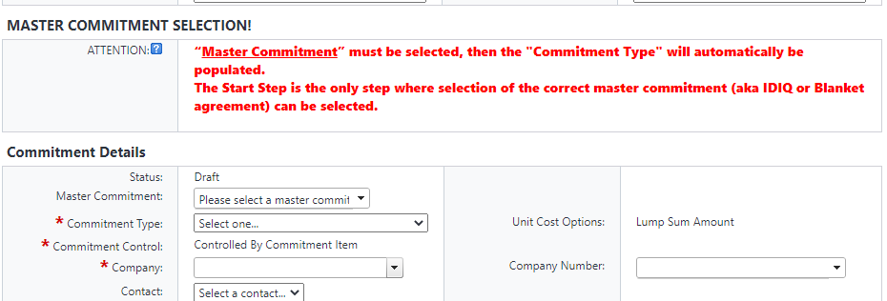
TaSK AUTHORIZATION – Master commitment selection
Notes:
There have been 129 TAs executed in the system that were not properly tagged to the intended Blanket or IDIQ Contract.

Slide 3
TaSK AUTHORIZATION – Master commitment selection
Notes:
Must select on Start Step, Master Commitment cannot be selected in a subsequent step of the process. If not entered or if the wrong blanket/idiq contract is selected, the Task Authorization will need to be voided and a new one started.
Must select a Master Commitment (and the correct MCA) from drop down menu at the start of the TA.
It is imperative that this be selected prior to completing any other data fields.

Slide 4
TaSK AUTHORIZATION – Master commitment selection
Notes:
Commitment Type, Commitment Control and Company will be automatically populated. Do Not Change these fields.

Slide 5
TaSK AUTHORIZATION – Master commitment selection
√ - CORRECT
X - INCORRECT
Notes:
Commitment is tracked against the Blanket or IDIQ Master Commitment.
If Master Commitment Selection is completed correctly, there will be a Master Commitment item column in your cost grid.

Slide 6
TaSK AUTHORIZATION – Master commitment selection
RECAP
Must select on Start Step, Master Commitment cannot be selected in a subsequent step of the process. If not entered or if the wrong blanket/idiq contract is selected, the Task Authorization will need to be voided and a new one started.
Must select a Master Commitment from drop down menu at the start of the TA.
It is imperative that this be selected prior to completing any other data fields.
Commitment Type, Commitment Control and Company will be automatically populated. Do Not Change these fields.
Commitment is tracked against the Blanket or IDIQ Master Commitment.
If Master Commitment Selection is completed correctly, there will be a Master Commitment item column in your cost grid.

