Slide 1
Ebuilder closeouts
FIG Archiving
FIG Archiving: facilitiesarchiving@cornell.edu

Slide 2
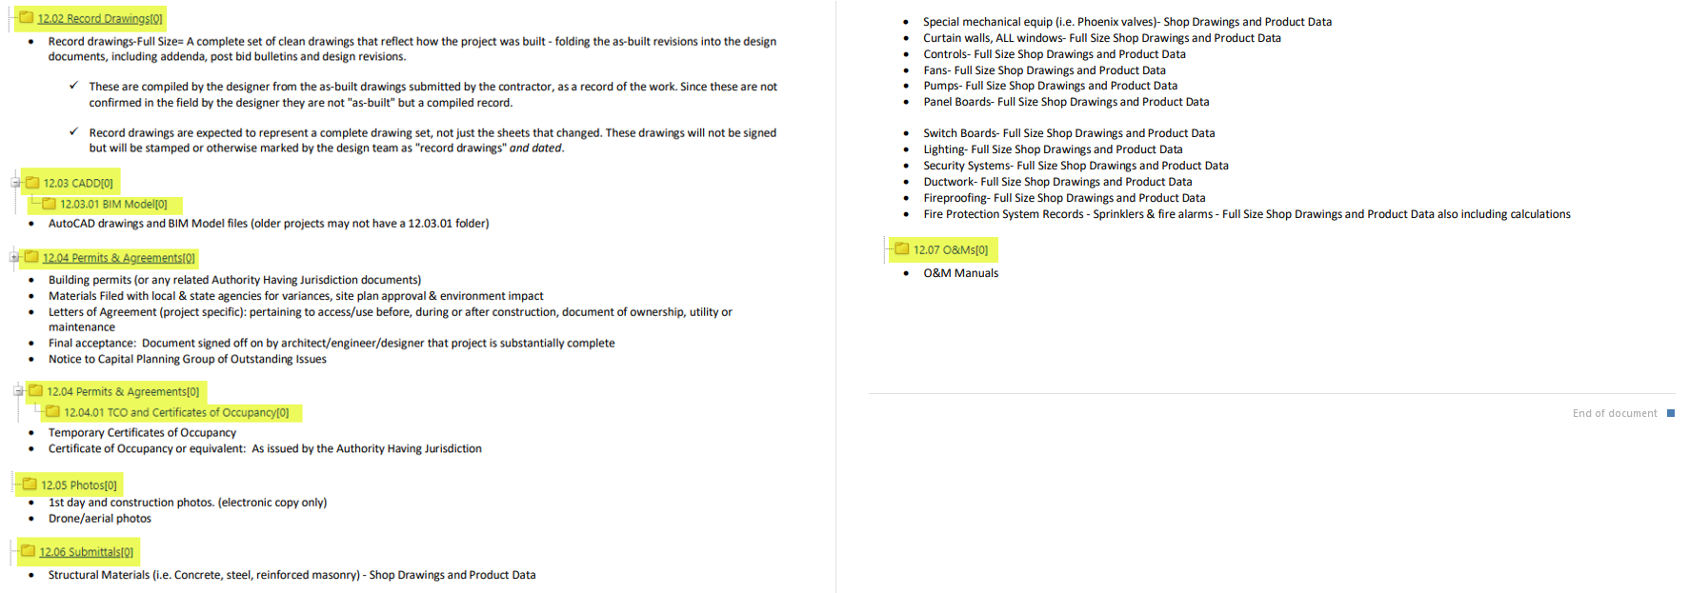
00007 - *e-Builder Resources

Slide 3
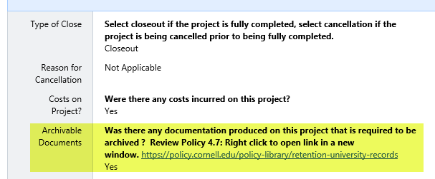
Close Out process - Submit
Archiving

Slide 4
Actors will receive an email notifying “Action is Required”:
Jane Van Derzee and Rebecca Merritt

Slide 5
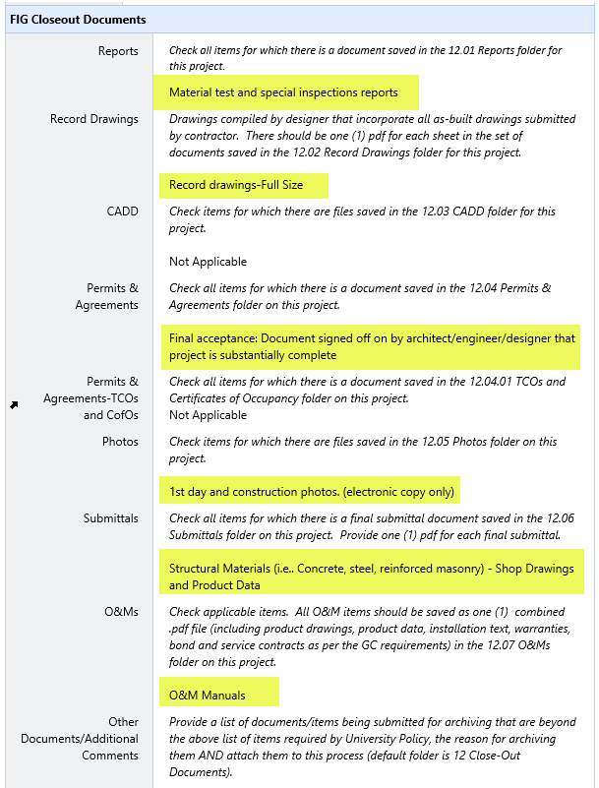
Email notice will identify the documents you have selected to be archived

Slide 6
Additional Comments Or
Specialty Documents to Archive
Example: we typically do not archive Paint Submittals. Your project used special Paint or if the paint colors are important for historic reasons and the paint submittal should be archived; you would enter that information in the “Other” field.

Slide 7
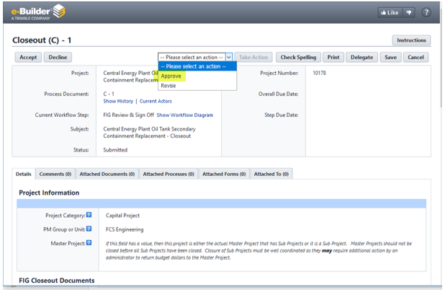
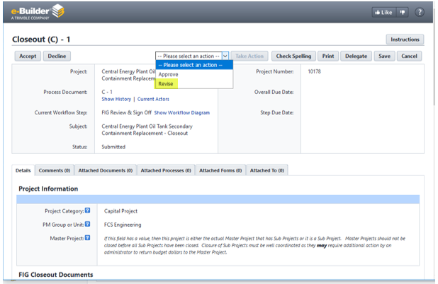
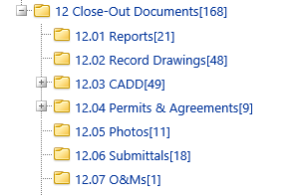
If Selected items are in closeout folders: FIG Approve
If Selected items are missing or questions: FIG Revise
FIG Archiving Close-Out Folders

Slide 8
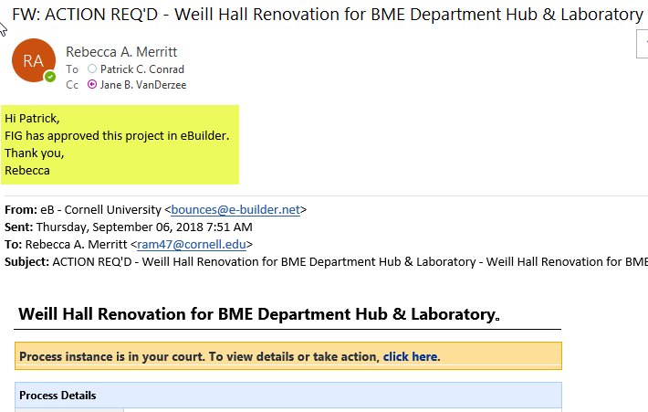
Email notice when FIG has Approved

Slide 9
If “Revised” project will be back in your court
FIG will also send an email with the same comment, examples:
This project is being revised because construction drawings were uploaded but the archives require Record Drawings. Please upload the Record Drawings and resubmit.
This project is being revised because you have selected to archive Schematic Design Report, but the report is not in the 12_Close Out Report Folder. Please place Schematic Design Report in the reports folder and resubmit.

Slide 10
FIG Archiving: facilitiesarchiving@cornell.edu
What’s New?
BIM – Copy files to 12.03.01 BIM Model
MultiVista Photos – In “Other Documents/Additional Comments” field type MultiVista Photos

