Slide 1
PMPD March 2023 Status Update and Impact Statement
Status Update and Impact Statement
Project Status Update Process (PSU)
Status Update and Impact Statement
Facilities and Campus Services
Engineering and Project Management

Slide 2
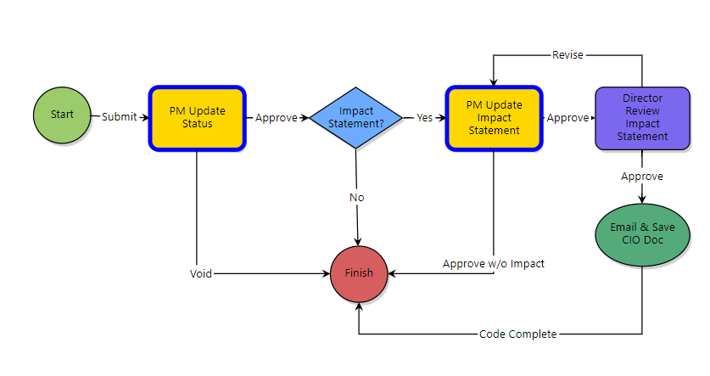
Project Status Update Process (PSU)
Status Update
Impact Statement
Monthly
When Needed
Notes:
Project Status Update Process provides the PM with an opportunity each month to provide:
Status Update
Impact Statement
Each are completed in separate steps

Slide 3
Definitions
Status Update
A brief description of the current status of the project relative to success criteria, budget, recently completed or upcoming high-level milestones, and high-level key issues/challenges including mitigation strategies. (updated monthly)
Impact Statement
A brief description of the impact that the construction phase of the project will have on the overall operation of the campus. (As needed, and schedule module Construction master task should be as accurate as possible)
Notes:
Status Update: New update every month; unless nothing is new, then you may VOID the process
Impact Statement: Opt to include this whenever impact to campus operations becomes know; remember to update construction phase tasks in the schedule module before including an impact statement on a PSU.

Slide 4
Examples
Status Update
One-month construction delay, substantial completion now 07/15/2023 due to long lead items (storefront systems and associated hardware). College is aware and potential impact has been addressed. Project bid $200k over OPC (5 bidders), stakeholders have agreed to fund increase and Construction Authorization PAR will include a Project Budget Variance. Contractor has identified fume hoods and casework as long-lead items that may impact substantial completion date. Evaluating ready-to-ship lab casework and alternate fume hoods to mitigate issues.
____________________________________________________
Bids received (including agreed upon selected alternates); increased the budget to $4.9M. The CAS agreed to fund the additional costs beyond what will be funded by the Provost. Schedule is a concern as some AV component deliveries were delayed beyond the completion date (8/4/23). Working with CIT and the AV integrator on solutions to make the space functional in time for fall semester.
____________________________________________________
EDR is providing the design services. Welliver is performing the construction. A construction kick-off meeting has taken place. Contractor mobilization is planned for March 13, 2023. Construction is scheduled to continue through August 2023
Notes:
Use clear, concise sentences or phrases.
Don’t include headings for each key point.
Do not enter blank rows between items.
Avoid entering text such as “See previous update” or “No change since last month”

Slide 5
Examples
Impact Statement
The ILR Upper Courtyard between King-Shaw Hall and Ives Hall East will be closed to pedestrian traffic starting March 13, 2023, and is scheduled to re-open mid-August 2023. Construction traffic will come and go through the parking lot between the ILR Research Building and Barton Hall off Garden Ave.
____________________________________________________
Pedestrian rerouting and building access will be via Bard and Kimball Halls while construction is ongoing and access to the site via Campus Road onto Engineering Quad.
____________________________________________________
The north parking lot is the project staging area. Parking (including an accessible parking space and access aisle) will not be available for the duration of the project. An alternate location has been identified. Transportation will provide temporary signage. A dumpster on the eastern edge of the entry drive will remain in place until project completion.
Notes:
1.Clear, concise
2. Not intended for building or system shutdowns or short duration interruptions within a building; those should be communicated to stakeholders in progress meetings and/or via constant contact communications.
3. Do not reference the attachment in the statement – the attachment is not available for viewing with the statement on dashboards and reports.
4. Do include info if an entire building will be unusable for the duration of construction.
5. Avoid entering text such as “See previous update” or “No change since last month” – and here’s why!

Slide 6
Status Update and Impact Statement – Used on Dashboards
Notes:
Used on the following dashboards:
Project Details Page
College and Units Dashboard
PM Dashboard
Projects Dashboard and Map

Slide 7
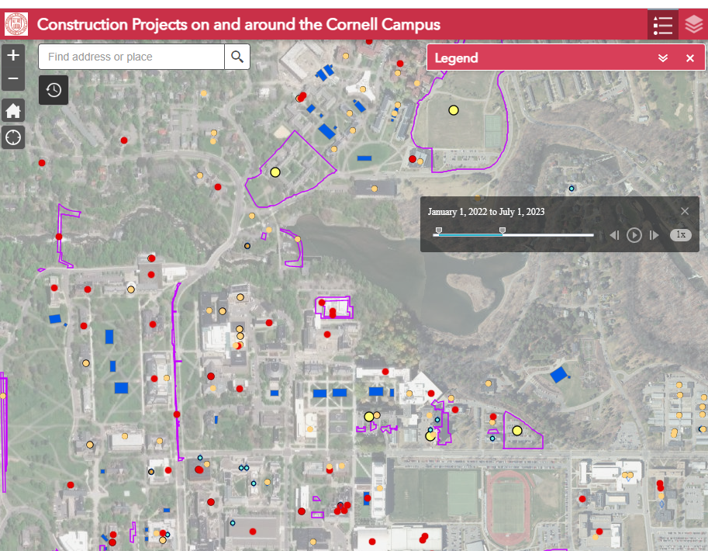
Impact Statement – Used on Maps
Notes:
Map - Construction Projects on and around the Cornell Campus

Slide 8
Project Status Update Process
eB Resource: Documents \ User Resources \ PSU - Project Status Update Process Help
Updated PM GDoc coming soon
Questions?

