Slide 1
Cornell Sprinkler Retrofit Initiative
Tom Jordan FPE, PMSFPE
Facilities Engineering
March 23, 2023

Slide 2
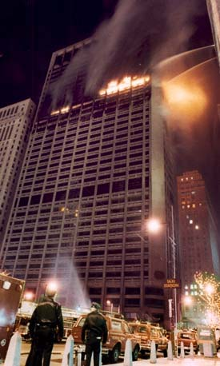
Cornell Sprinkler Retrofit Initiative
Ithaca & Geneva Campuses, and all other Cornell Owned and Operated Facilities
February 23rd, 1991
ONE MERIDIAN PLAZA, PHILIDELPHIA
Built in 1973
38-stories
Non-sprinklered
Fire began on 22nd floor around 8:20PM
Source - construction-related linseed oil rags
Multiple factors lead to an out-of-control fire:
Delayed reporting to Fire Department
Water supply issues
Improperly inspected, tested and maintained standpipe system
Improperly separated shafts/floors allowed smoke and fire to pass from floor to floor
Three fire fighters perished
Fire fighting continued for 11 hours - had to be abandoned at 7AM, the next day, due to structural failure concerns
Retrofitted sprinklers on 30th floor stopped the fire the next day at around 3PM
Prompted creation of sprinkler retrofit laws

Slide 3
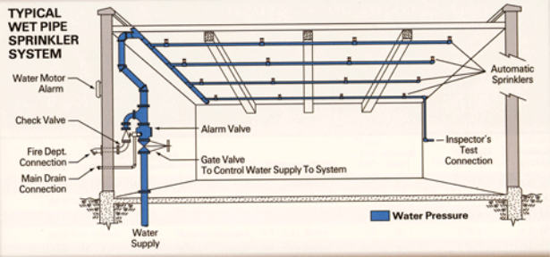
Cornell Sprinkler Retrofit Initiative
Ithaca & Geneva Campuses, and all other Cornell Owned and Operated Facilities
Fire Protection Systems Overview
On the Ithaca campus there are:
Over 200 sprinkler systems (Archives, Athletics, Classrooms, Dorms, Offices, Labs, Storage)

Slide 4
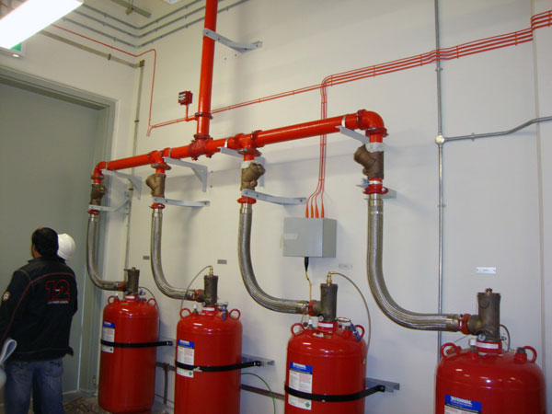
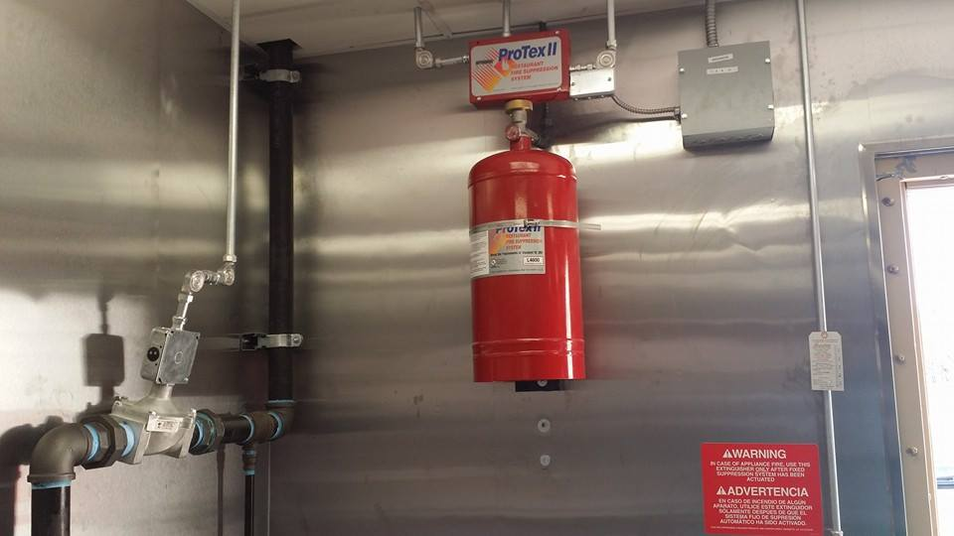
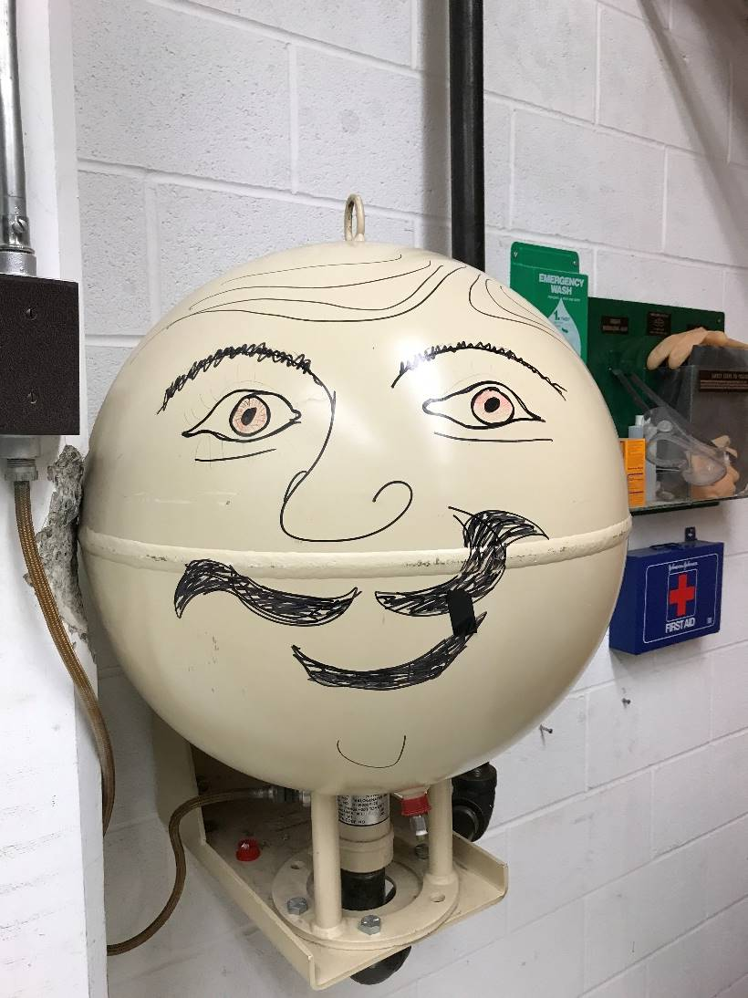
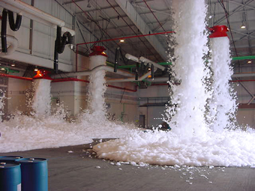
Cornell Sprinkler Retrofit Initiative
Ithaca & Geneva Campuses, and all other Cornell Owned and Operated Facilities
Fire Protection Systems Overview
On the Ithaca campus there are:
A mix of wet- & dry-chemical, gaseous, & foam systems (Fuel Dispensing and Storage, Kitchens, Ornithology, Server Rooms)

Slide 5
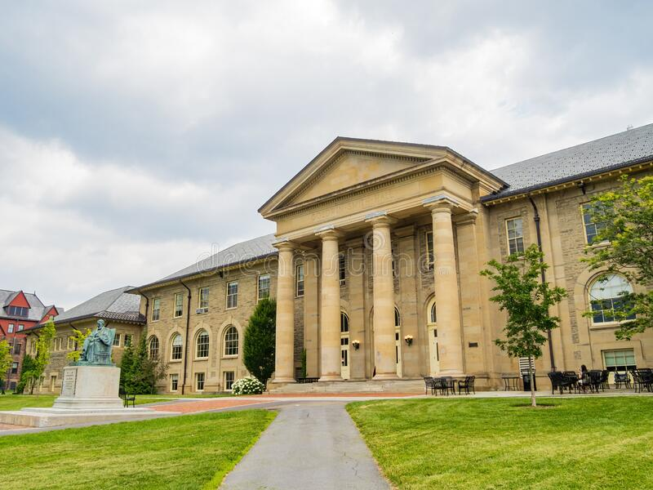
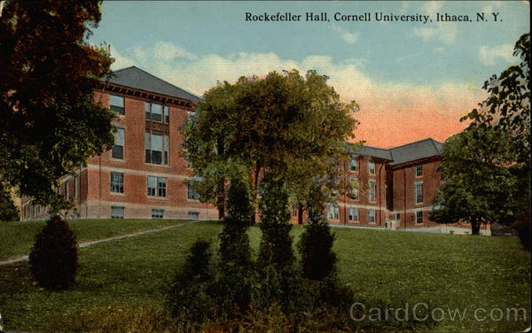
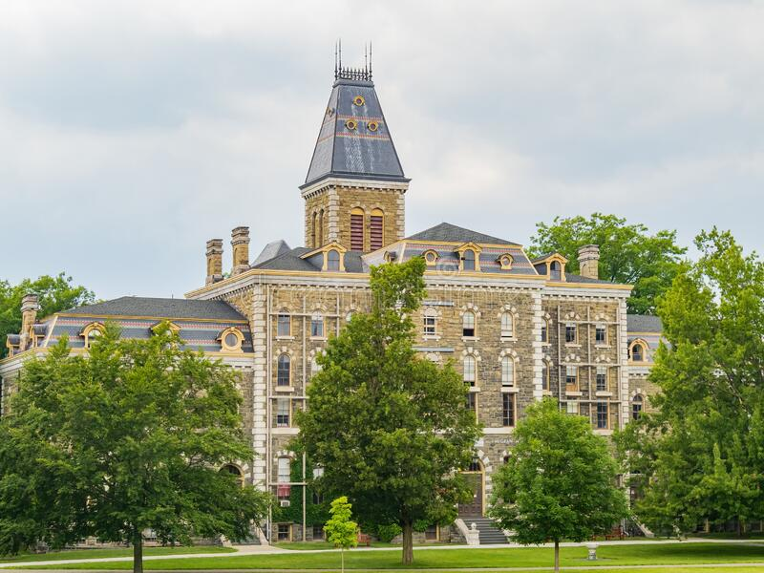
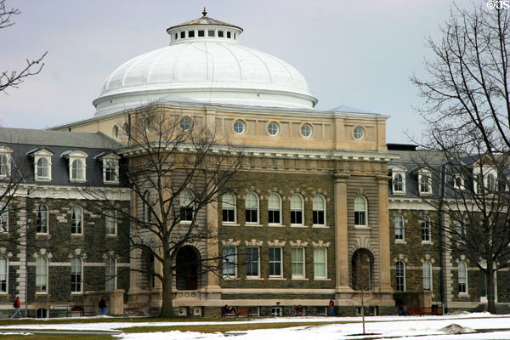
Cornell Sprinkler Retrofit Initiative
Ithaca & Geneva Campuses, and all other Cornell Owned and Operated Facilities
A Brief Code History
In early to mid 20th century sprinklers were provided consistently in older buildings with combustible construction.

Slide 6
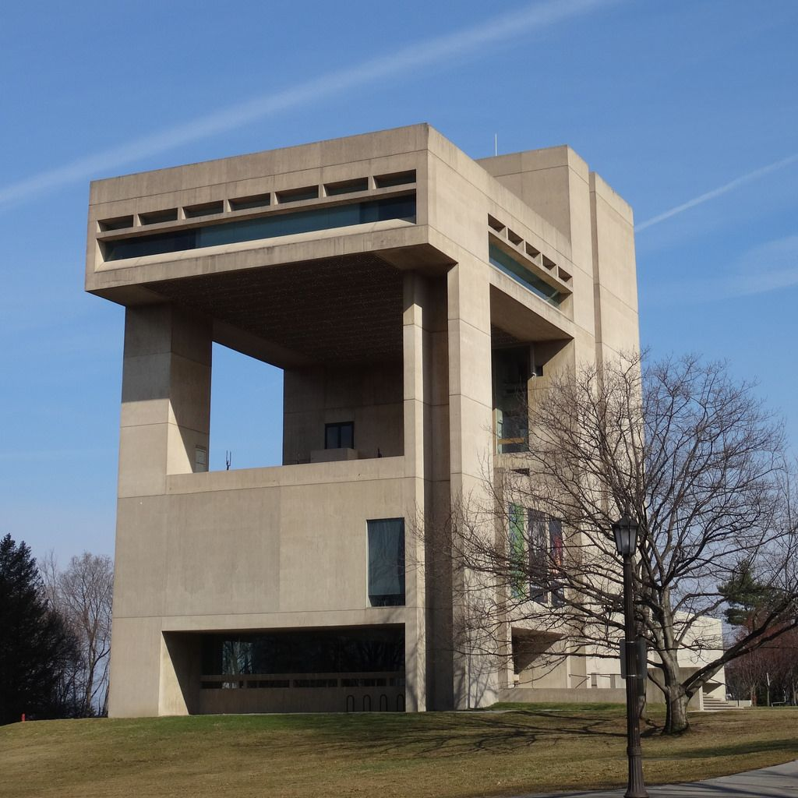
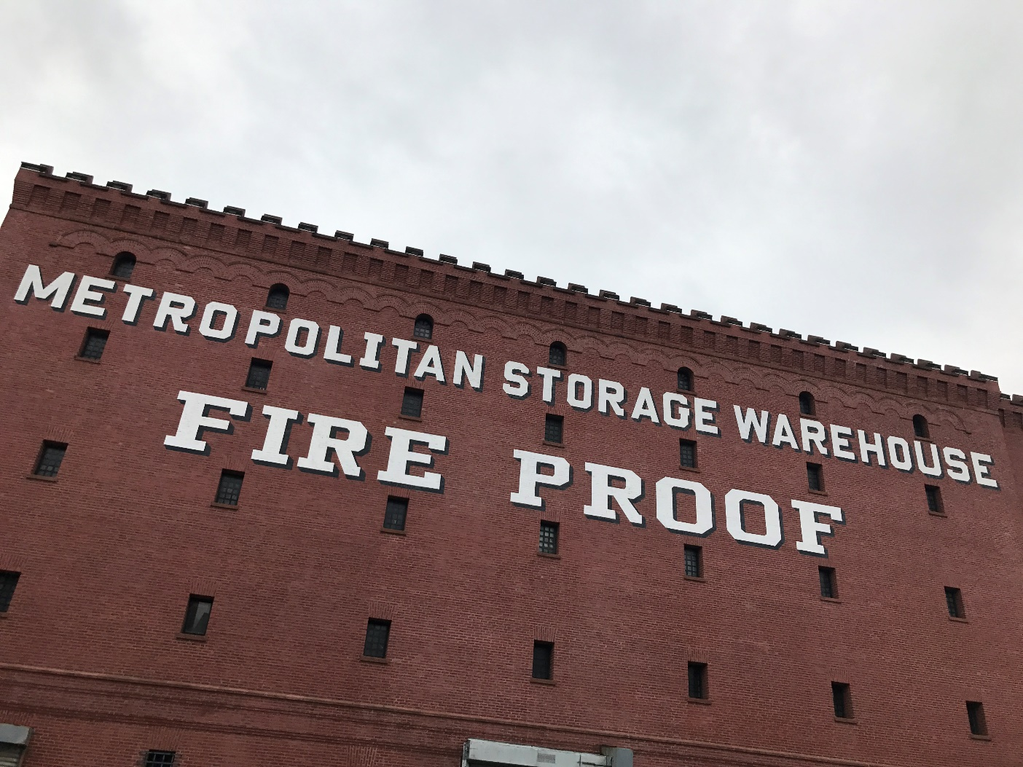
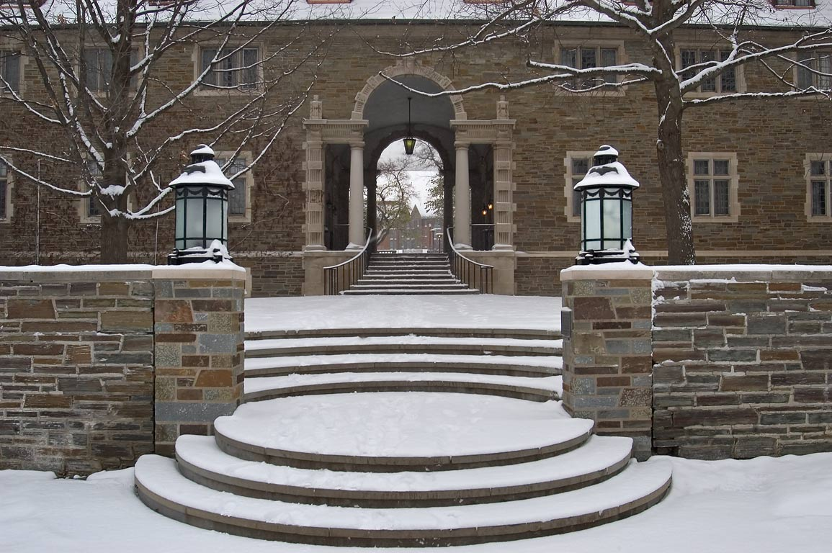
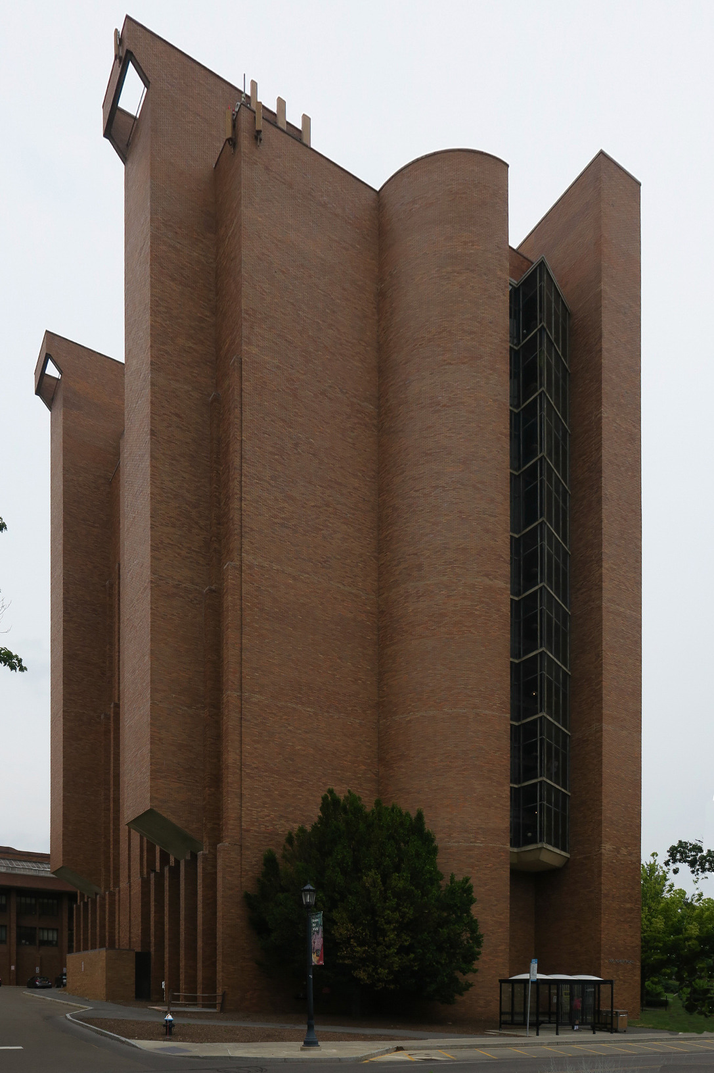
Cornell Sprinkler Retrofit Initiative
Ithaca & Geneva Campuses, and all other Cornell Owned and Operated Facilities
A Brief Code History
With the advent of non-combustible “fire-safe” construction - Codes required sprinklers only in specific areas (storage, exits).
The majority of buildings from that era were either non-sprinklered or partially sprinklered.

Slide 7
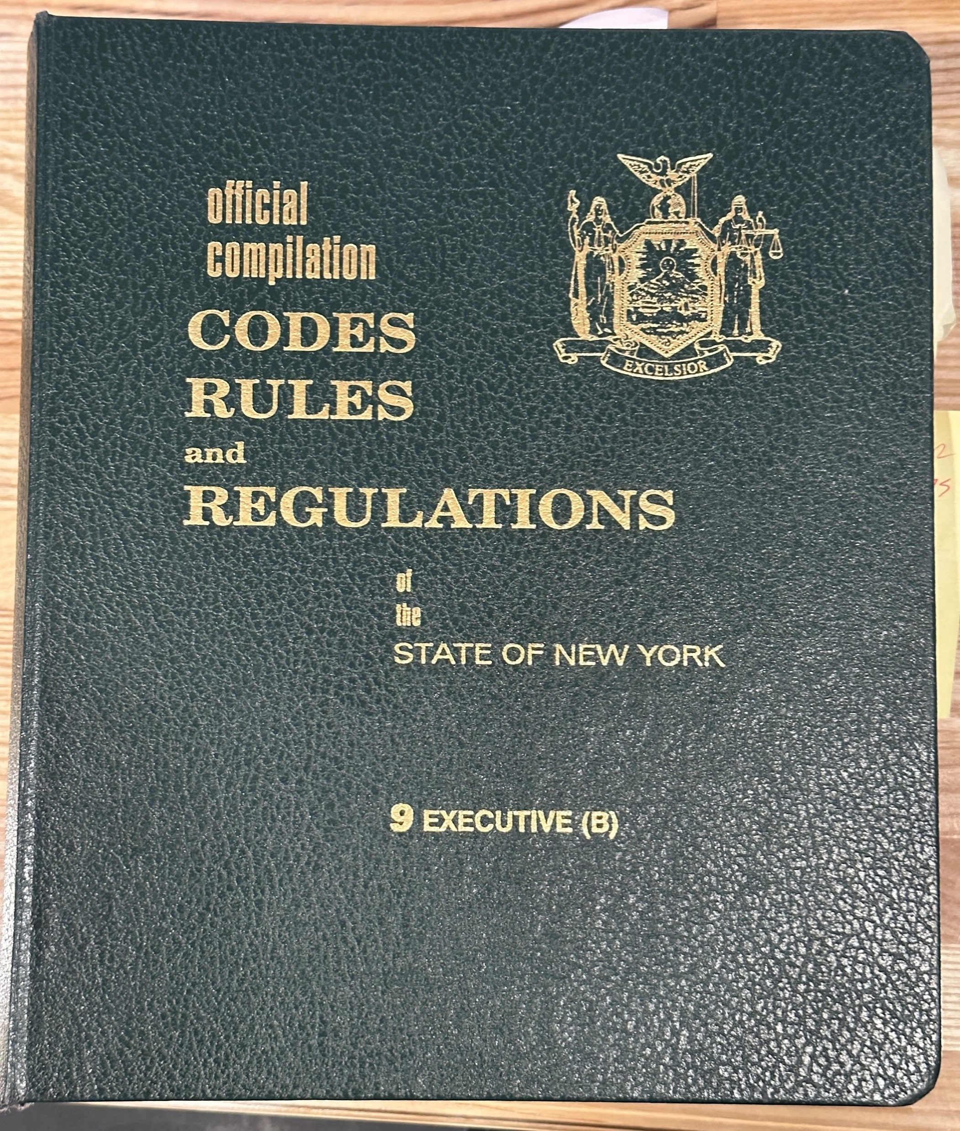
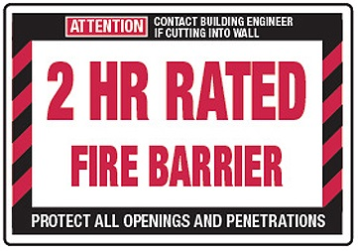
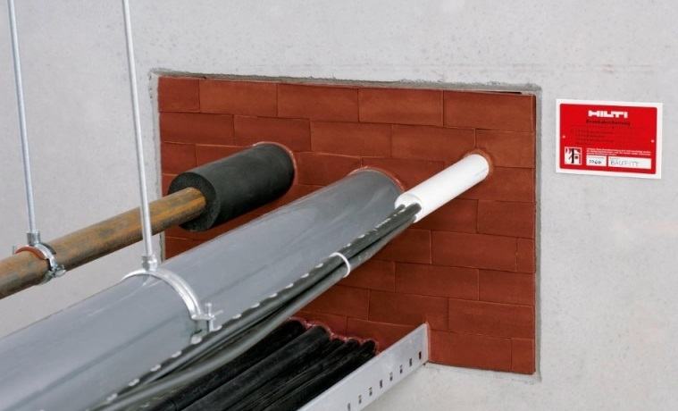
Cornell Sprinkler Retrofit Initiative
Ithaca & Geneva Campuses, and all other Cornell Owned and Operated Facilities
A Brief Code History
1980s - Code requirements were focused more on compartmentalization and fire separation.

Slide 8
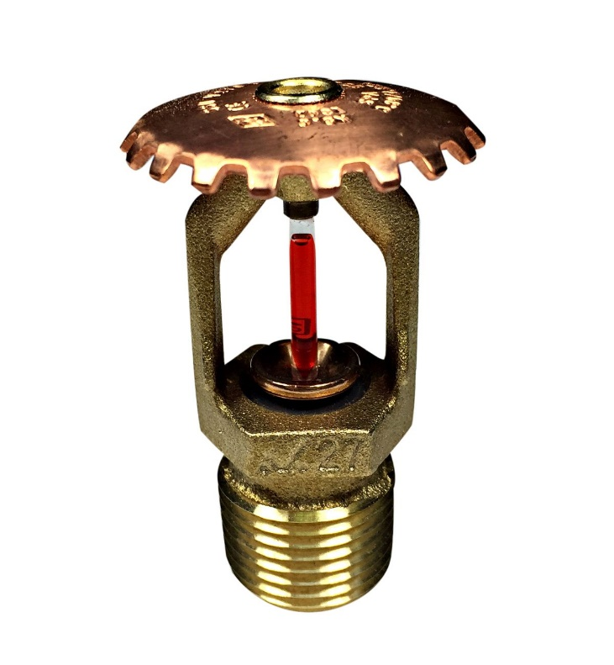
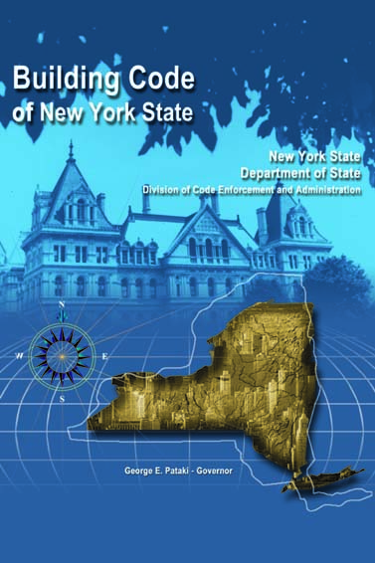
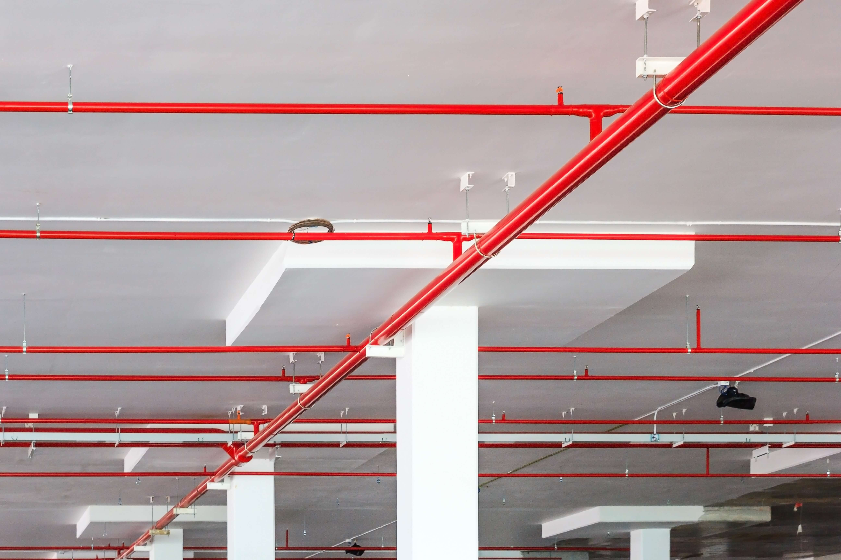
Cornell Sprinkler Retrofit Initiative
Ithaca & Geneva Campuses, and all other Cornell Owned and Operated Facilities
A Brief Code History
Early 2000s – Significant changes to building construction codes placed more importance on sprinkler protection and provided incentives to the owner (code advantages) when sprinkler protection is provided throughout.

Slide 9
Cornell Sprinkler Retrofit Initiative
Ithaca & Geneva Campuses, and all other Cornell Owned and Operated Facilities
A Brief Code History
Most buildings on campus are classified by Building Code as Business Occupancy, which are not required to have sprinkler protection.
However:
Cornell has been proactively providing sprinkler protection in all new construction and in renovated areas when feasible.
Factory Mutual Global (Cornell’s insurance underwriter) desires sprinklers in all facilities.

Slide 10
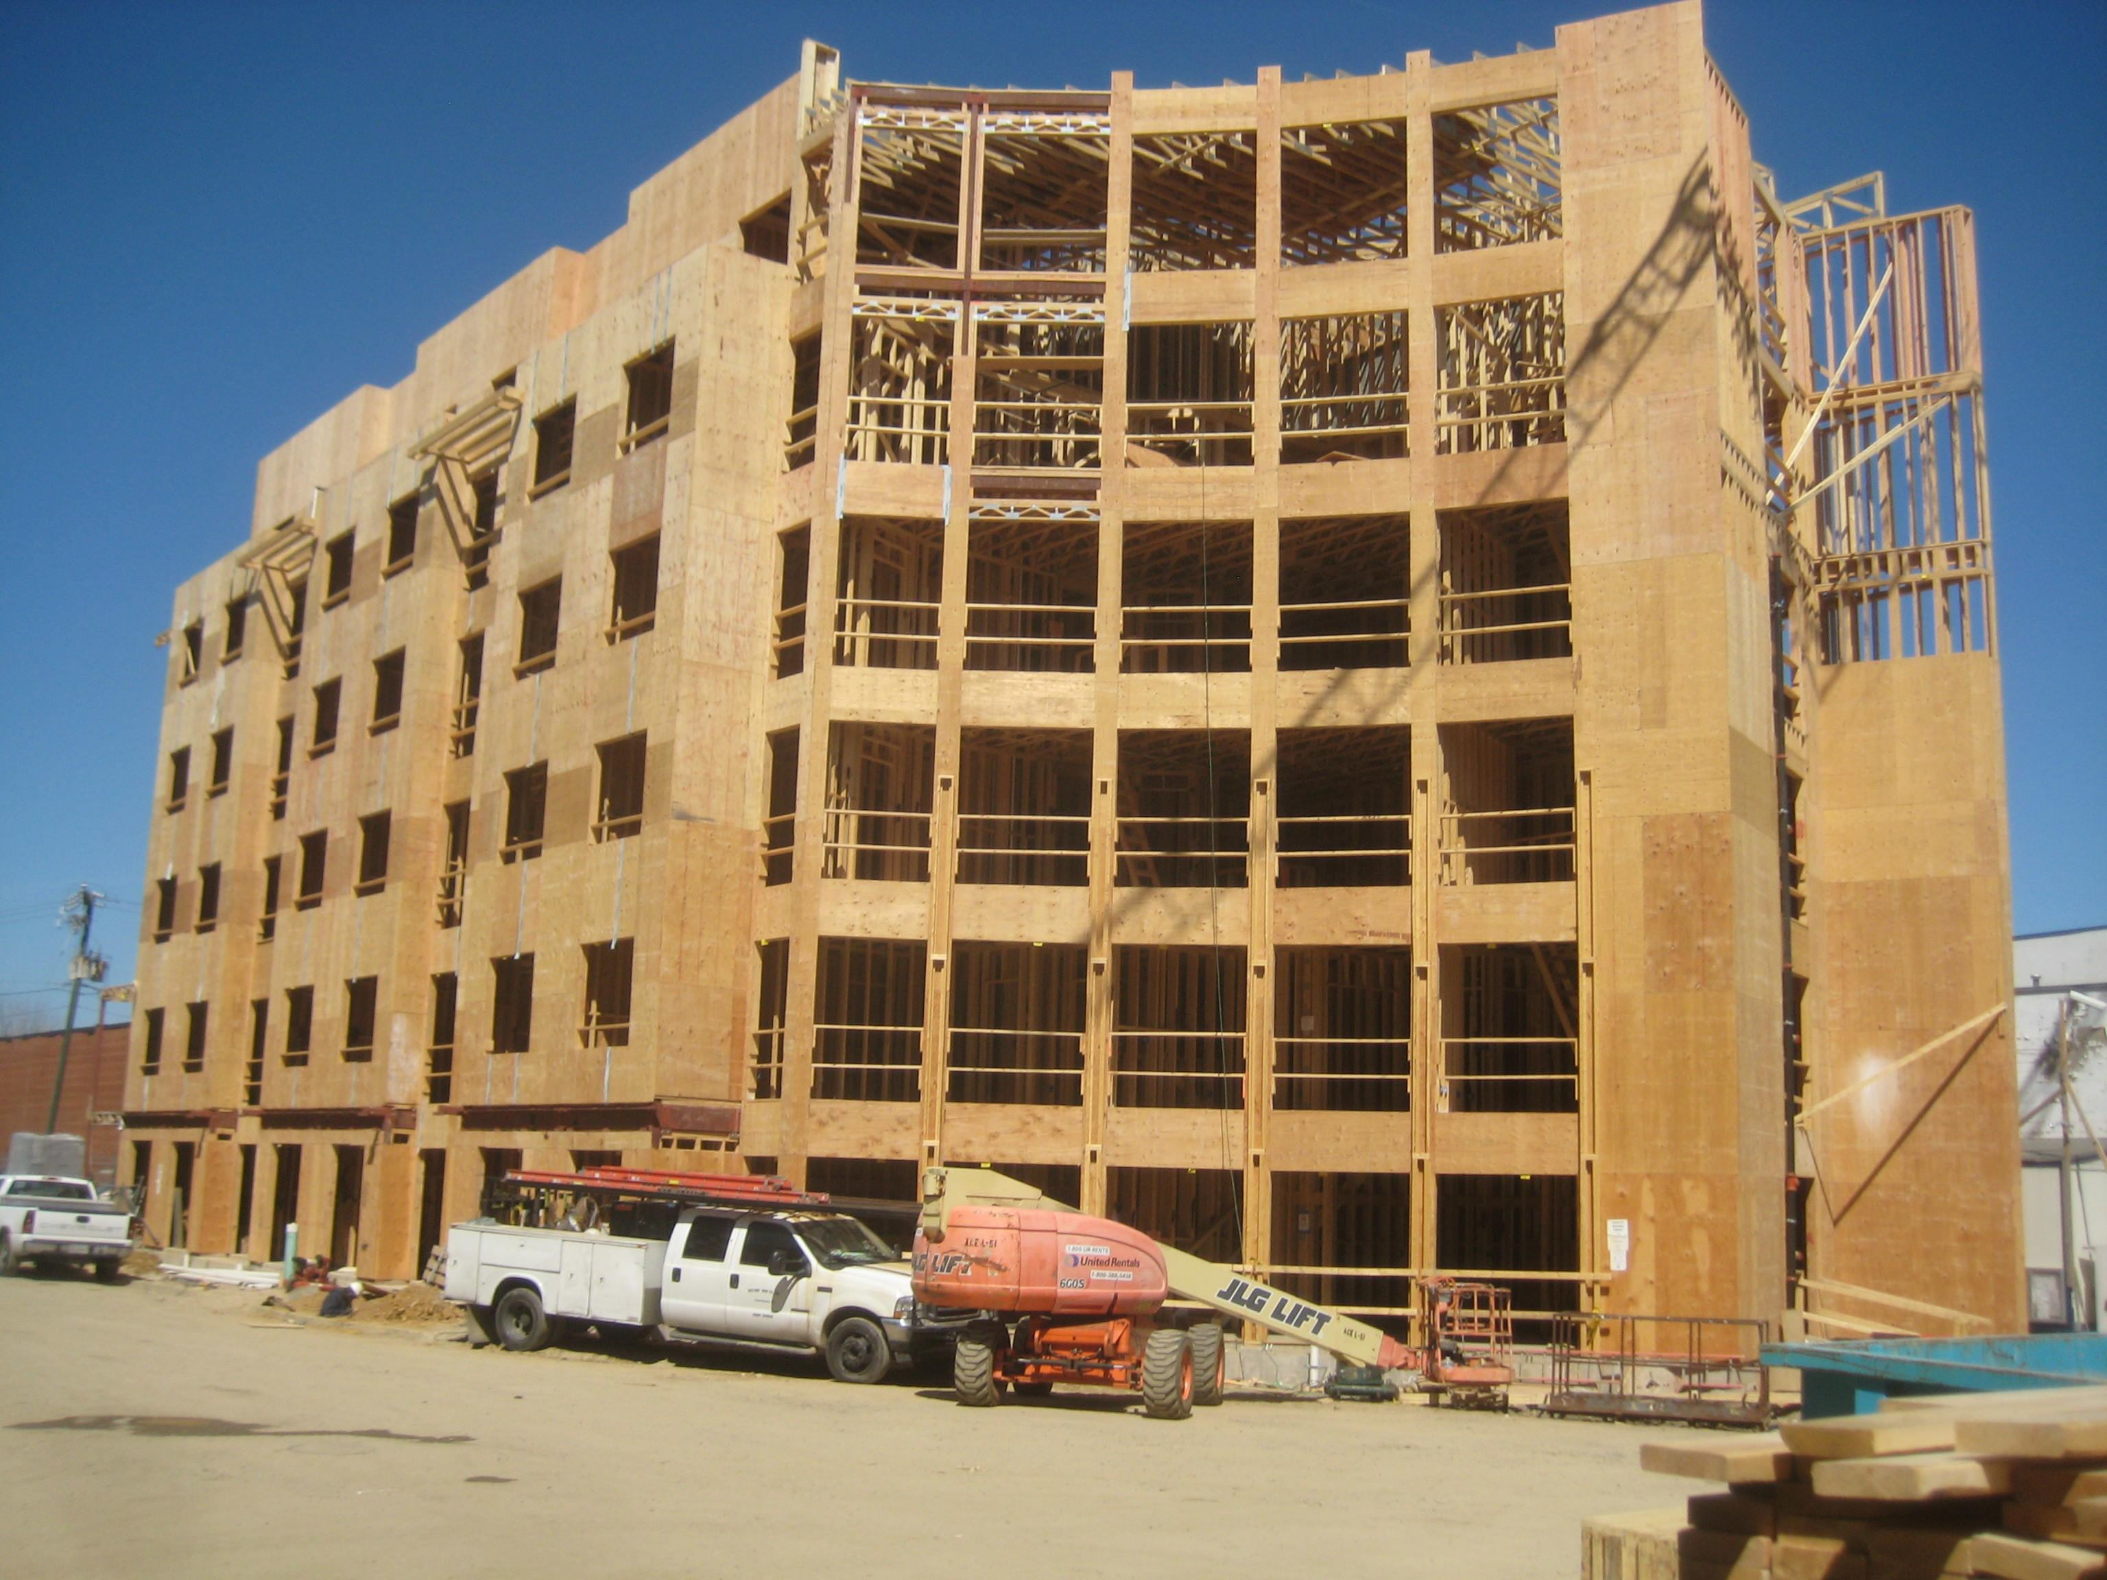
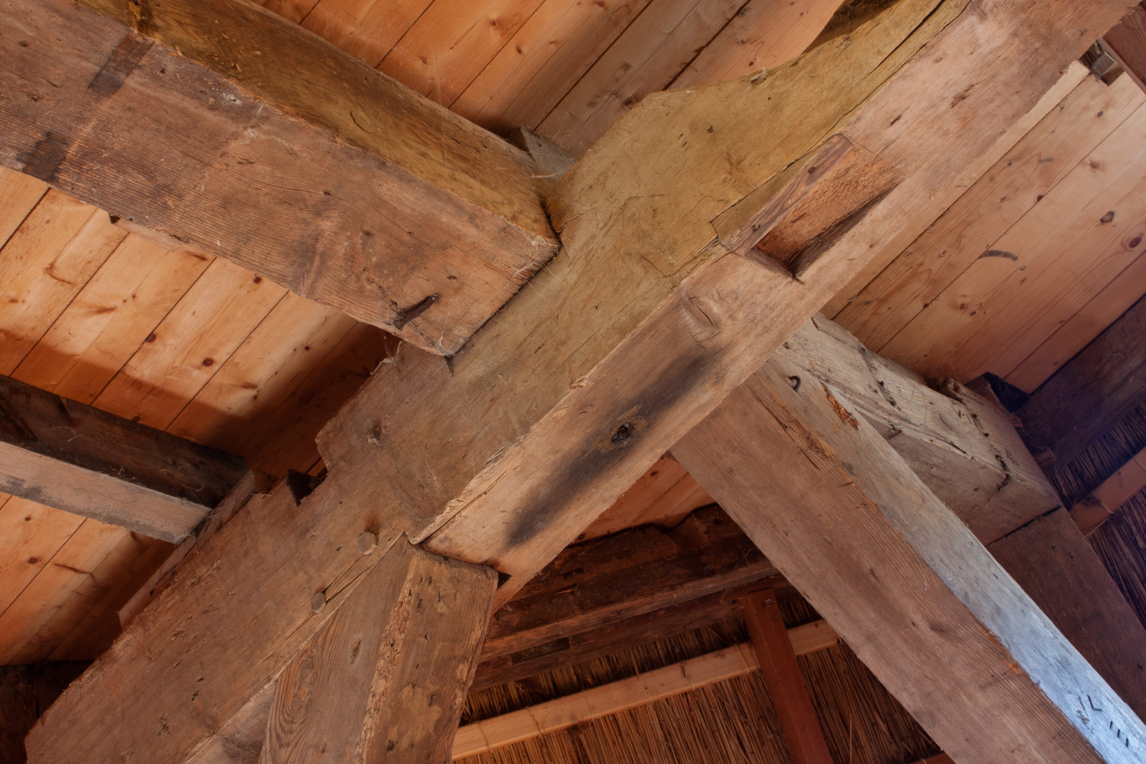
Cornell Sprinkler Retrofit Initiative
Ithaca & Geneva Campuses, and all other Cornell Owned and Operated Facilities
What Makes a Building High-Risk?
Construction Type
Combustible structures (wood) are more suspectable to fire spread and premature structural failure

Slide 11
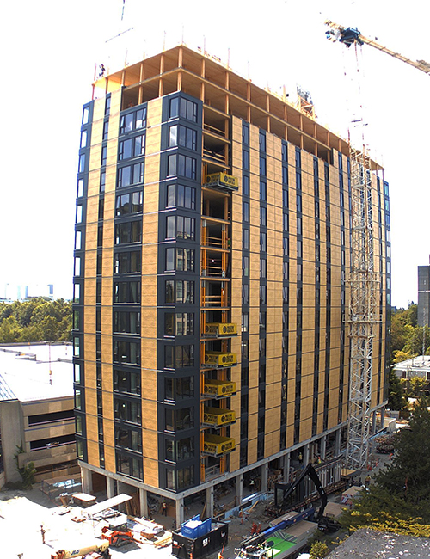
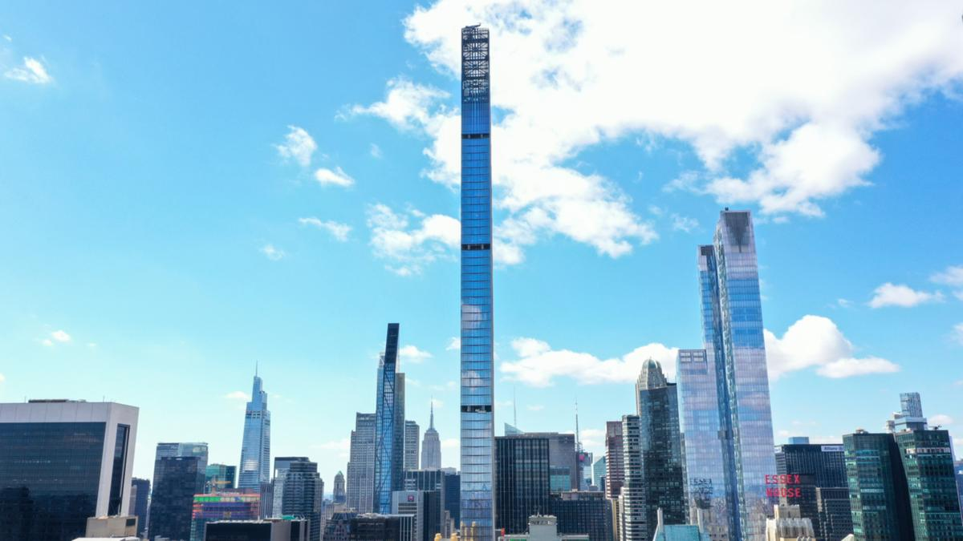
Cornell Sprinkler Retrofit Initiative
Ithaca & Geneva Campuses, and all other Cornell Owned and Operated Facilities
What Makes a Building High-Risk?
Height
Taller buildings act like chimneys, which promotes smoke and fire spread to the upper floors
More difficult for occupants (and fire fighters) to escape and be rescued

Slide 12
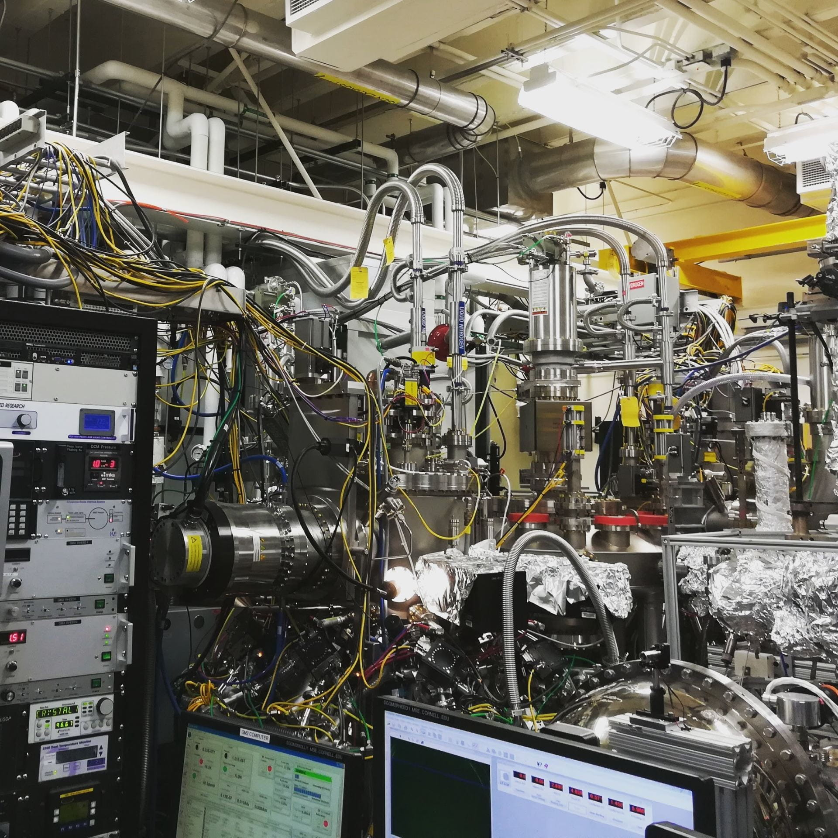
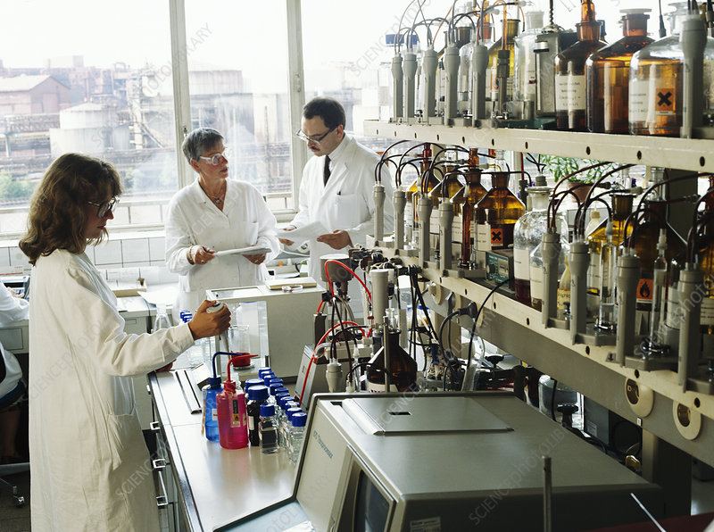
Cornell Sprinkler Retrofit Initiative
Ithaca & Geneva Campuses, and all other Cornell Owned and Operated Facilities
What Makes a Building High-Risk?
Occupancy Type
Lab buildings contain hazardous flammable/combustible solids, liquids, and gases
Increases probability of a fire occurring and accelerated fire growth

Slide 13
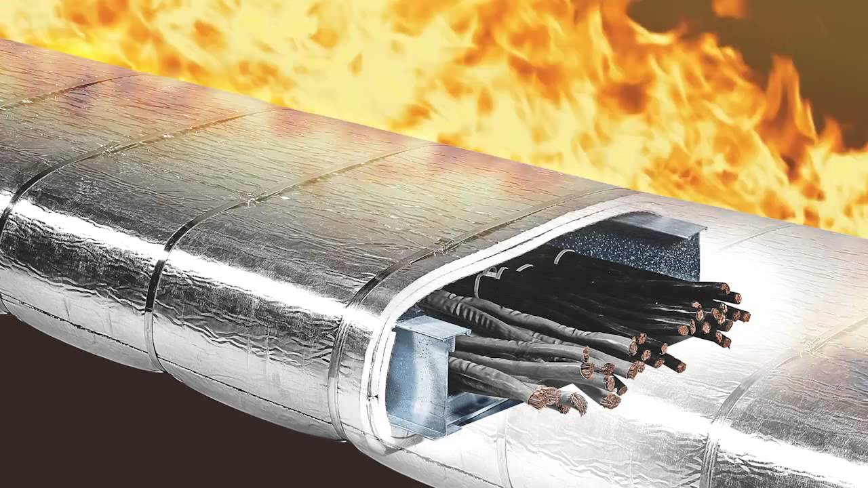
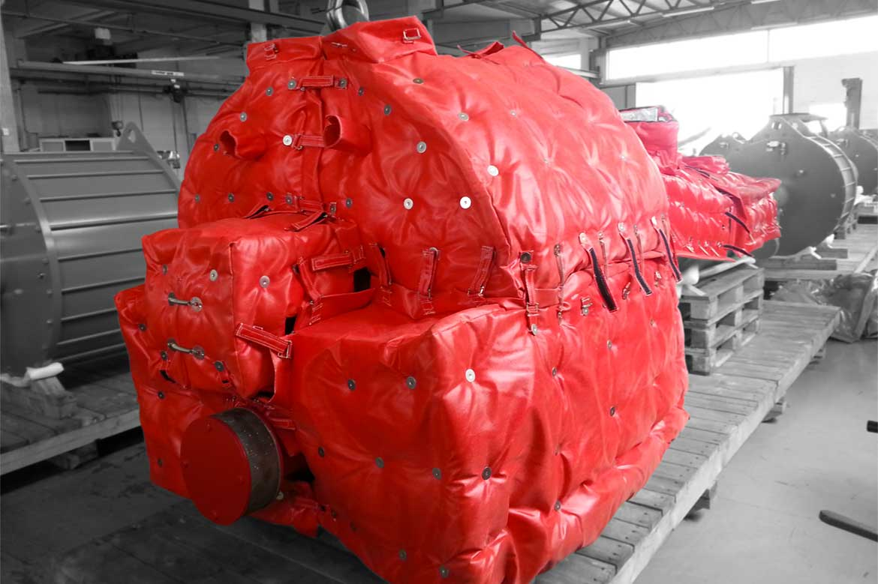
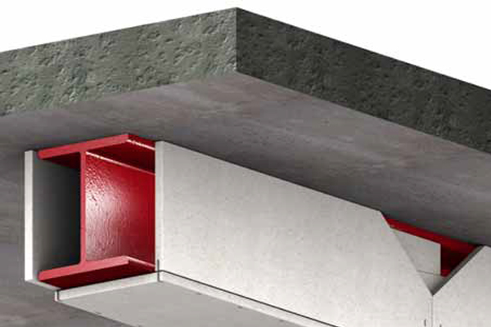
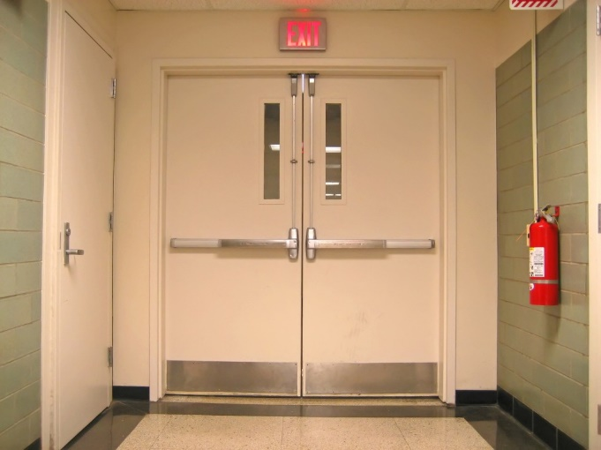
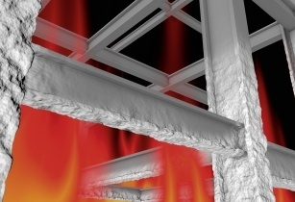
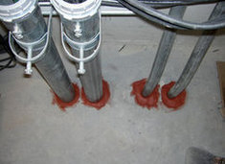
Cornell Sprinkler Retrofit Initiative
Ithaca & Geneva Campuses, and all other Cornell Owned and Operated Facilities
What Makes a Building High-Risk?
Smoke & Fire Separations
Older buildings tend to promote the passage of smoke and fire more-easily to other parts of the building

Slide 14
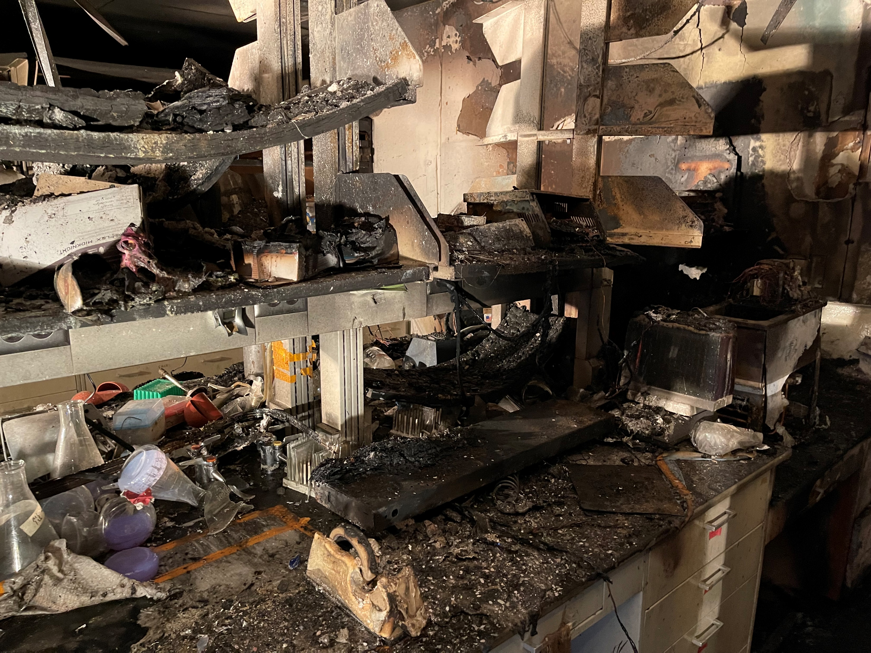
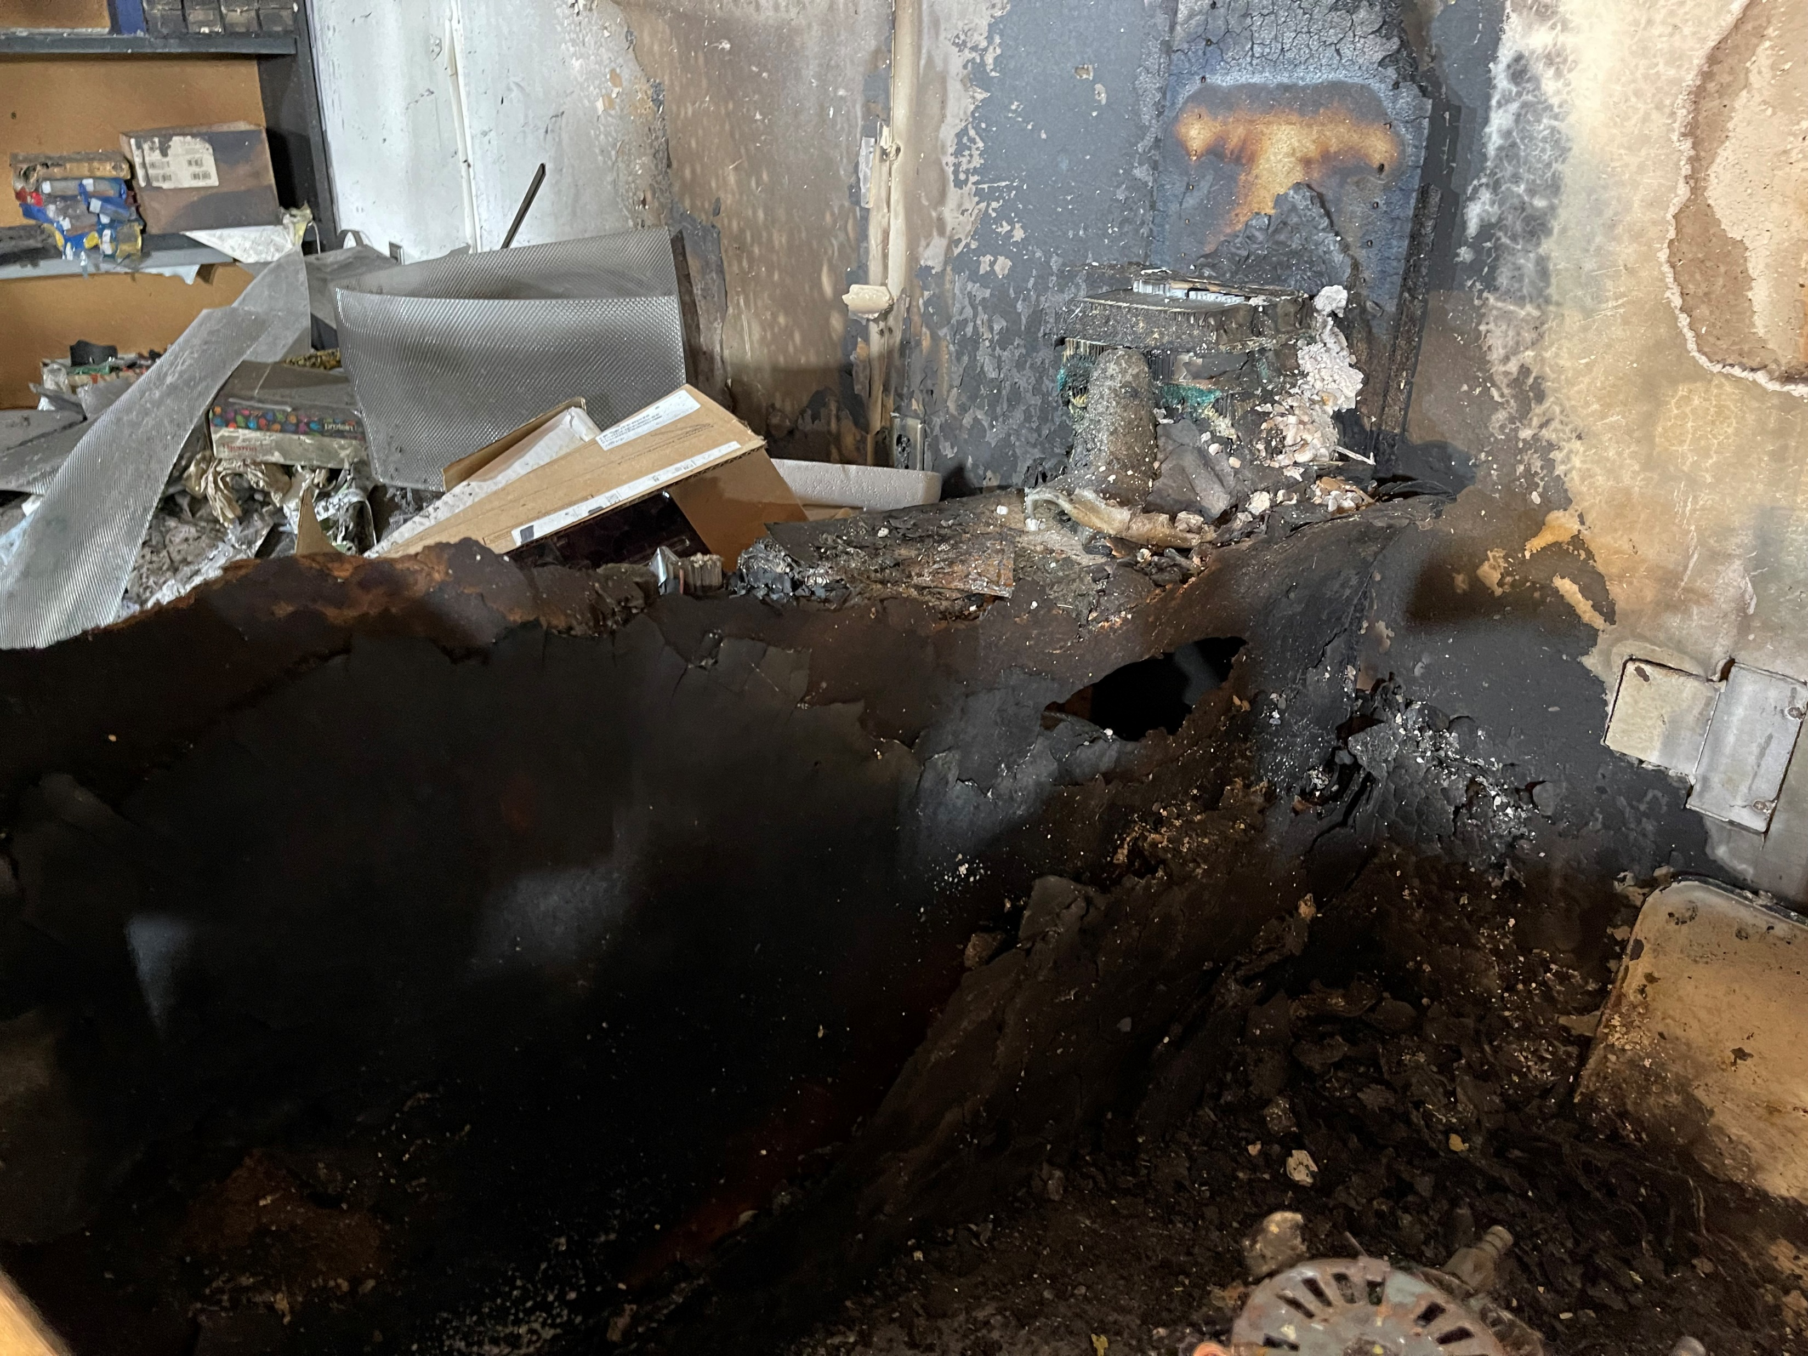
Cornell Sprinkler Retrofit Initiative
Ithaca & Geneva Campuses, and all other Cornell Owned and Operated Facilities
What Makes a Building High-Risk?
Sprinkler Protection
A building without a sprinkler system has a much greater probability of experiencing a total loss

Slide 15
Cornell Sprinkler Retrofit Initiative
Ithaca & Geneva Campuses, and all other Cornell Owned and Operated Facilities
Purpose of Initiative
Update sprinkler/standpipe database for all Cornell owned & operated buildings.
Identify buildings with greatest fire hazards and greatest impacts to operation, via collaboration with EH&S.
Advocate for the retrofitting of sprinklers in Cornell’s riskiest buildings.
Provide support to the project management teams tasked with implementing sprinkler retrofits

Slide 16
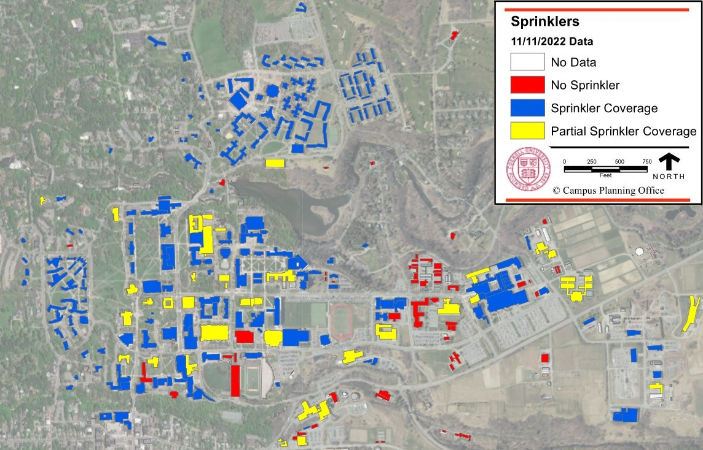
Sprinkler Status for Ithaca Campus (All Buildings)

Slide 17
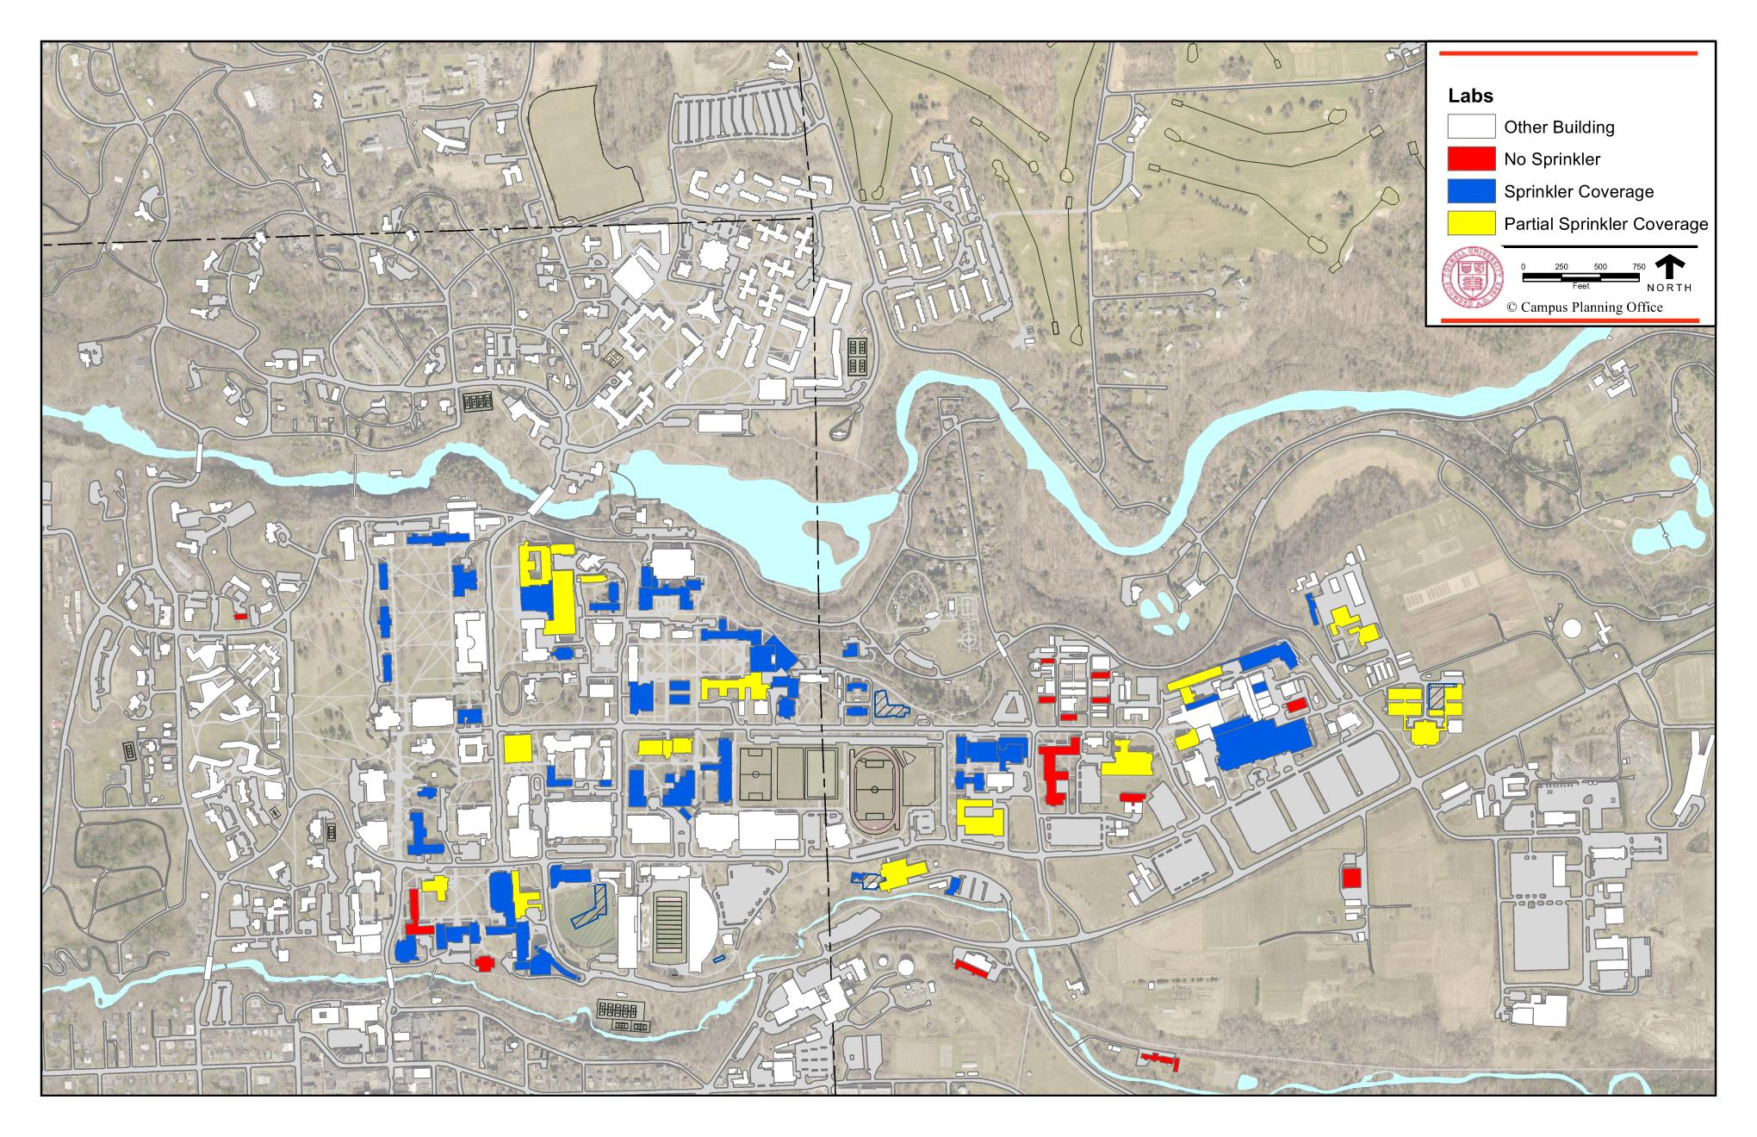
Sprinkler Status for Ithaca Campus (Laboratory Buildings)

Slide 18
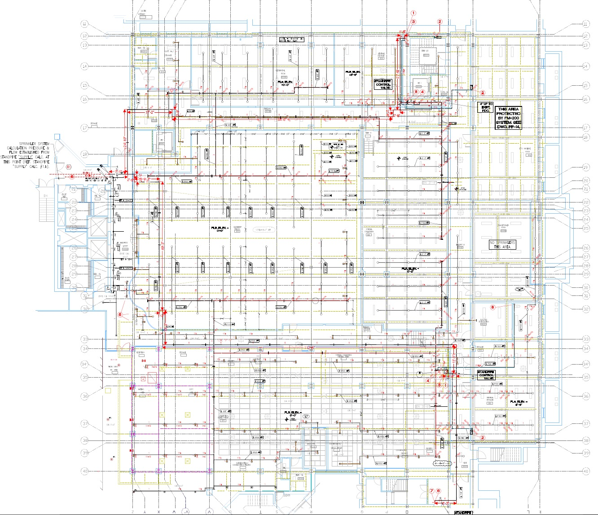
Cornell Sprinkler Retrofit Initiative
Ithaca & Geneva Campuses, and all other Cornell Owned and Operated Facilities
Top Ten Buildings and Current Status
ST Olin – Sprinkler System In design
Vet Research Tower – Consultant selection underway
Baker Lab – Retrofitted on an as-renovated basis
Boyce Thompson – Forthcoming study
Clark Hall – Retrofitted on an as-renovated basis
Morrison Hall – No activity as of yet
Barton Hall (Geneva) – Consultant selection underway
Corson-Mudd – Sprinkler System In design
Phillips Hall – Forthcoming design
Hollister Hall – No activity as of yet
Wilson Lab – Sprinkler System In design

Slide 19
Cornell Sprinkler Retrofit Initiative
Ithaca & Geneva Campuses, and all other Cornell Owned and Operated Facilities
One Two Last Things…
SUBMITTALS
&
INSPECTIONS

Slide 20
Cornell Sprinkler Retrofit Initiative
Ithaca & Geneva Campuses, and all other Cornell Owned and Operated Facilities
QUESTIONS?

