Slide 1
Engineering & Project Management
Quality Assurance Program
March 2023

Slide 2
Who is Responsible for Quality?
Owner
  Design Team Selection
  Contractor Selection
  Clear Expectations
Designer
  Excellent Construction Documents
  Inspections Defined During Construction
Contractor
  Execution of Construction
  Contractor Quality Control Process

Slide 3
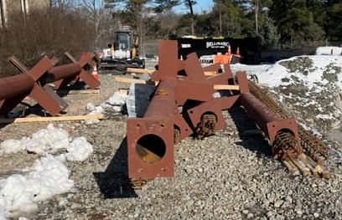
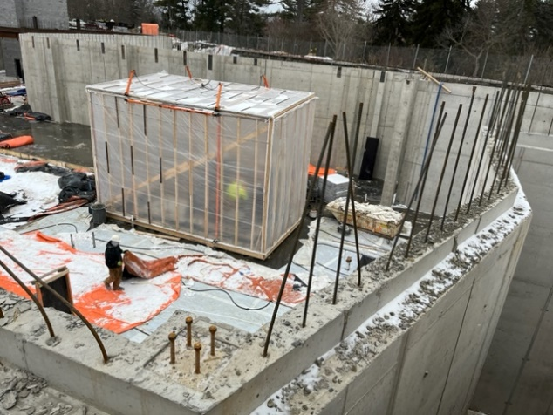
A Case for Quality Assurance
Cornell buildings & renovations are complex
Construction schedules are aggressive
Architect/Engineer team variability
1930s. 84 architectural drawings, 7 electrical , 3 mech, 10 site drawings

Slide 4
Quality Assurance
Engineering & Project Management priority
Allocated funding
New position created at beginning of 2023
  Liesl Margolin – Manager
  Based in Facilities Engineering (often on jobsites)

Slide 5
Cornell Quality Assurance
Supplements our Project & Construction Managers
Engages Subject Matter Experts in FE, working towards engagement across FCS
Interfaces with designers of record, commissioning agents, and third-party testing in concert with PMs
A job-specific approach for each Cornell project

Slide 6
Quality Assurance Outcomes
Increased connectivity across Cornell project teams, within Central Facilities, and across campus
Focused Cornell and design team attention on critical project components to ensure success
Strengthened feedback loop to inform future projects via design & construction standards

Slide 7
Engineering and Project Management
Integrated Project Delivery
Building Code Experts
Breakdown silos between Project Managers & Subject Matter Experts
Leverage the expertise within FCS
Integrated Teams will deliver even higher performing projects and satisfied stakeholders
Integrated Teams focus efforts on the early stages of a project to optimize change management
Subject Matter Experts
Project Management
Trades/
Maintenance

Slide 8
Engineering and Project Management
Integrated Project Delivery
Project Managers, Construction Managers, Facilities Engineering, and
Facilities Management collaborate to infuse quality management throughout the life cycle of a project.
Design Quality Assurance (Design Review)
Window of Opportunity
Window of Opportunity
Construction Quality Assurance
Window of Opportunity
Learn and Update Design Standards
DESIGN
CONSTRUCT
OCCUPY
Primary Area of Intervention
(to-date)

Slide 9
Quality Assurance
In Action

Slide 10
Weekly Hub Meetings
QA Hub Team as regular point of contact
Rob Murray Eric LePore Hung Phi Tran
Shane Dunn Emily Mix
Updates on upcoming meetings; current progress
Feedback across disciplines, building collective knowledge base

Slide 11
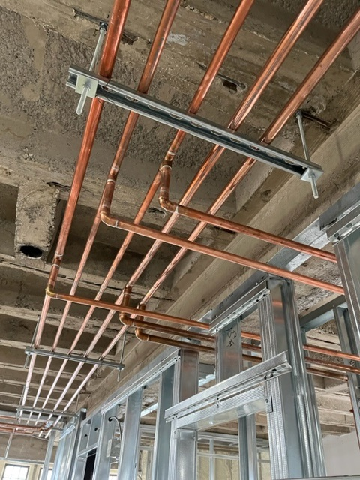
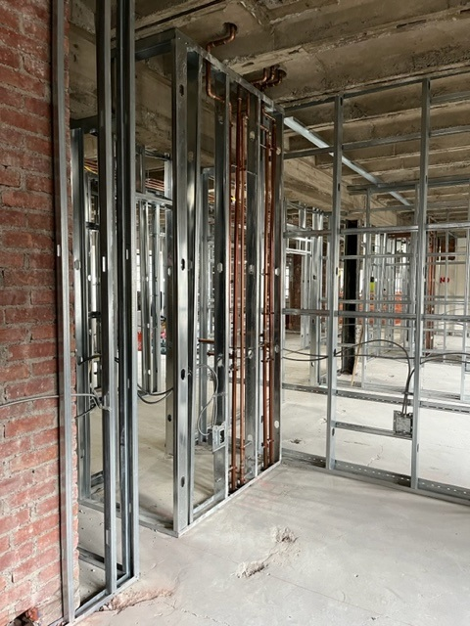
First Work
QA Manager support to schedule interested Cornell personnel
Allows consistent messaging to contractor
Sets expectations for project
Goal to avoid additional asks

Slide 12
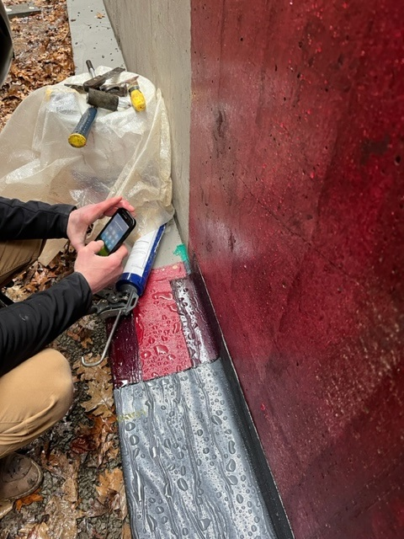
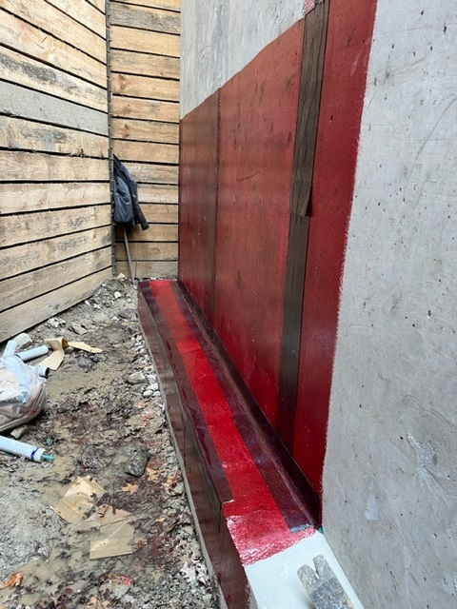
Observation of Work
QA Manager scheduling of subject matter experts as work is installed
Allows Cornell eyes on work
Opportunity for influence as materials are installed
Especially important for elements that will become concealed or buried

Slide 13
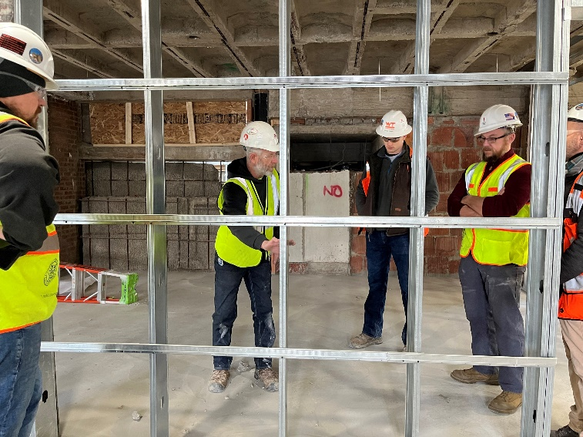
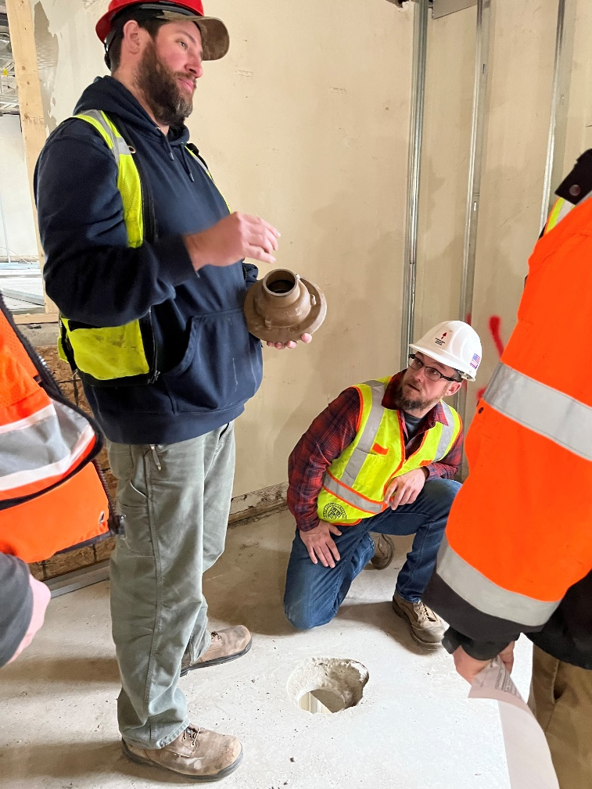
Shops Walks
Regular walks of project site by Facilities Management
QA Manager support to schedule overlap with Subject Matter Experts
Opportunity to hear concerns and relay as needed

Slide 14
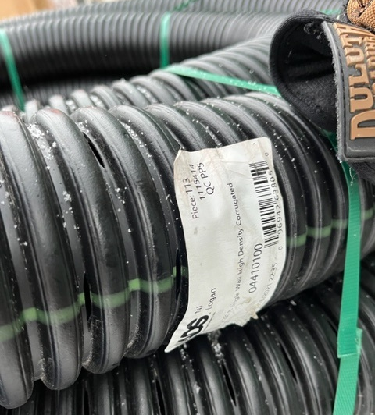
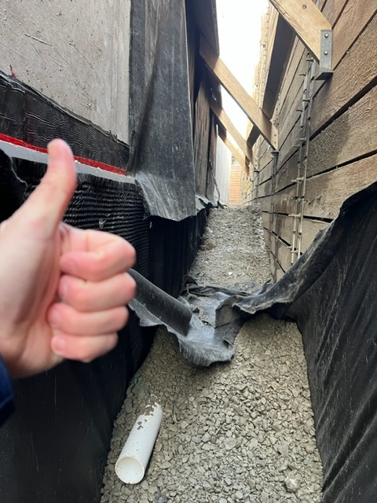
Cornell Standards
Drainage pipe on-site was specified material
Pipe not preferred by Grounds
CU Project Team discussed impact of change with contractor
Cornell standards updated to reflect preferred pipe

Slide 15
Project Consultants
QA Manager available to engage Commissioning Agents
Help communicate project progress so Commissioning Agents can plan visits and testing at right time

Slide 16
Goals/Next Steps
Documentation strategy for field observations
Refine process to update campus standards
Updated PM Checklist incorporating QA

Slide 17
Quality Assurance Program Manager
Liesl Margolin
lsm232@cornell.edu
cell: (607) 277-0103
Humphreys – 2nd Floor
(or on a jobsite near you)

