Slide 1
Restroom Signage Variance from NY Department of State
January 25, 2023
Notes:
JS and JY Intro

Slide 2
Restroom Signage Variance Discussion Topics
Introduction of Cornell University Team
Jim Yarbrough
J Shermeta
Mike Niechwiadowicz
Andrea Haenlin-Mott
Inclusive Restroom Standard Location and Background
Variance from NY Department of State
Interior Signage Standard Update
Questions
Notes:
JS

Slide 3
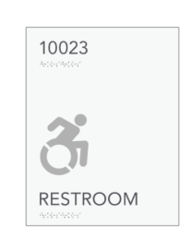
Inclusive Restroom Signage
The Cornell standard states “RESTROOM” for signage at single occupant toilet rooms:
013011 INCLUSIVE RESTROOM AND LOCKER/SHOWER FACILITIES
1.02 RECOMMENDED EQUIPMENT AND SPECIFICATIONS
F. Space shall have an ADA pictogram on the room signage and meet all ADA signage requirements. Typically the inclusive restroom would be signed as “RESTROOM” and include the ADA pictogram when those requirements are met. (Sign mounting location and height, contrast of color, raised characters and Braille shall all be ADA and code compliant)
Any deviations or conflicts with these standards and existing field conditions shall be brought to the immediate attention of The Office of the University Architect and Planning Office and the designated Project Representative for resolution.
Figure 1: Standard Sign - color, finish and size can be modified to align with facility signage system
Figure 2: Include ADA pictogram to restrooms that meet requirement
Figure 1: Example from North Campus Residence Halls
Notes:
JS

Slide 4
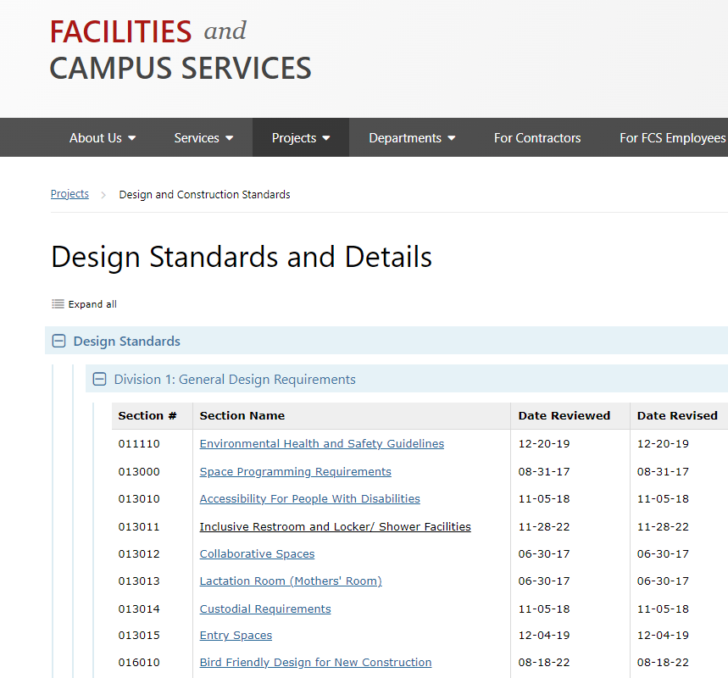
Inclusive Restroom Standard Location
Notes:
JS

Slide 5
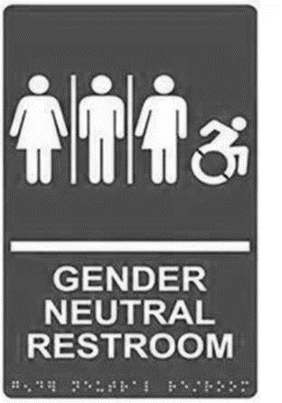
Inclusive Restroom Signage Background
The decision to use the term “restroom” resulted from a 2015 campus wide deliberative process that included input from the student body, staff, and numerous advocacy groups including the Office of Inclusion and Workforce Diversity and the LGBT Resource Center.
The intent of this effort was to develop inclusive language that was broadly accepted by the Cornell population. It was determined that the typical gender neutral restroom signs depicting women by a character in a dress and men by a character in pants are based on outdated values that are no longer relevant and to some discriminatory.
The decision to use the term “restroom” was approved by the University Assembly in Resolution #3 and approved by President Garrett.
The signage description was reviewed again in 2019-2020 and the Director of Inclusion and Workforce Diversity approved maintaining the current standard “restroom.”
Outdated pictogram
Notes:
JS

Slide 6
Inclusive Restroom Signage Background
Cornell has converted and continues to convert existing gender specific toilet facilities into accessible single-user gender neutral toilet facilities. All these existing facilities are signed “restroom” along with the symbol for accessibility.
Cornell is also providing accessible single-user gender neutral toilet facilities in new buildings such as Atkinson Center, New Experimental Hall and the Computing and Information Science Building, as well as the renovated Plant Science Building and the Thurston Hall Addition.
Notes:
JS

Slide 7
Restroom Signage Variance
The 2015 Building Code and Plumbing Code read as follows regarding gender designation for male or female, or the use of single user toilet rooms beyond a family or assisted-use toilet facility:
2015 Building Code
[P] 2902.2.1 Family or Assisted-Use Toilet Facilities Serving as Separate Facilities Where a building or tenant space requires a separate toilet facility for each sex and each toilet facility is required to have only one water closet, two family or assisted-use toilet facilities shall be permitted to serve as the required separate facilities. Family or assisted-use toilet facilities shall not be required to be identified for exclusive use by either sex as required by Section 2902.4.
[P] 2902.4 Signage Required public facilities shall be provided with signs that designate the sex as required by Section 2902.2. Signs shall be readily visible and located near the entrance to each toilet facility. Signs for accessible toilet facilities shall comply with Section 1111.
Notes:
JY

Slide 8
Restroom Signage Variance
The 2020 BCNYS provides explicit language regarding the use of single-user and multi-user toilet and bathing facilities serving all genders.
The language in 2020 code states that single-user facilities “shall be” designated as “gender neutral”. The code does not appear to give options to, or exceptions from, gender neutral.
[NY] 2902.2 Separate Facilities Where plumbing fixtures are required, separate facilities shall be provided for each sex.
Exceptions:
5.Single-user toilet and bathing rooms provided in accordance with Section 2902.1.2 shall be designated as gender neutral.
[NY] 2902.4 Signage Required public facilities shall be provided with signs that designate the sex, as required by Section 2902.2. Signs shall be readily visible and located near the entrance to each toilet facility. Signs for accessible toilet facilities shall comply with Section 1111.
Exceptions:
Single-user facilities shall be designated as gender neutral.
Multi-user facilities designed to serve all genders shall not be designated by sex.
Notes:
JY

Slide 9
Restroom Signage Variance Summary
In June 2022 Facilities and Campus Services submitted a variance application to the New York State, Department of State that included a list of buildings throughout NYS except NYC, regardless of ownership.
In September 2022 the University was given a variance to allow the use of the term ‘restroom’ on toilet and bathing facility signage and omit the gender pictogram.
The variance applies to existing, new and future buildings where gender neutral facilities are provided.
Furthermore, the variance approves “restroom” signage for accessible multi-user gender neutral toilet and bathing facilities in future projects.
The variance is located at the end of Inclusive Restroom in Division 1 : General Requirements--013011 INCLUSIVE RESTROOM AND LOCKER/SHOWER FACILITIES STANDARD.
Notes:
JY

Slide 10
Interior Signage Standard Update
Pictograms for gender are still required by code for new accessible gender specific rooms and those undergoing an alteration.
The dynamic symbol for accessibility and gender pictograms are still required for family, assisted-use, and lactation rooms.
The updated standard includes the following pictograms:
Dynamic
Accessible
Men
Women
Family
Lactation Room
Notes:
JY

Slide 11
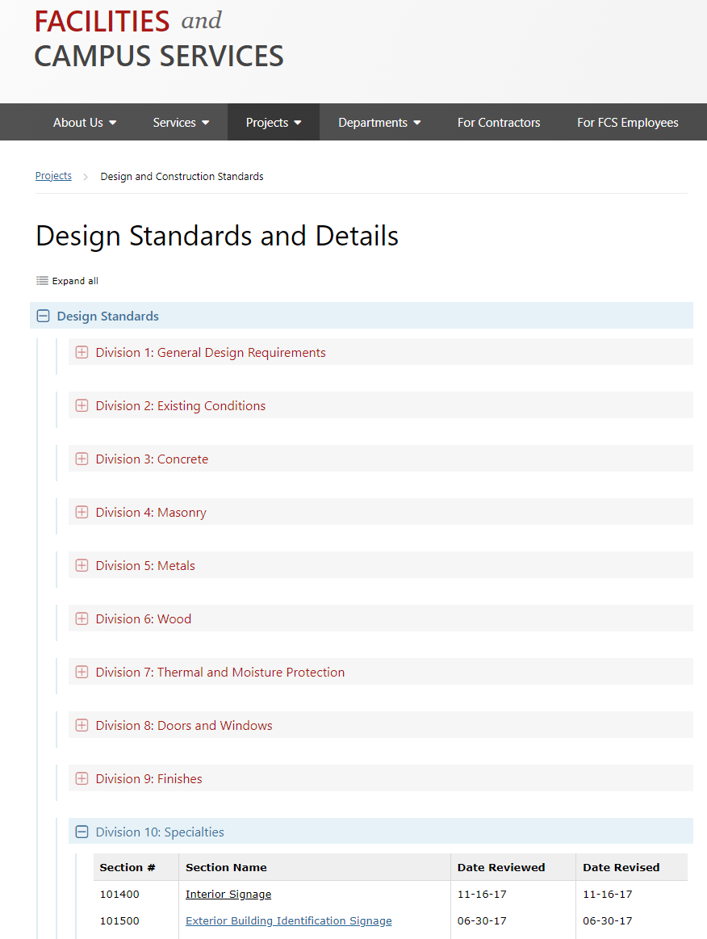
Interior Signage Standard Update
Update underway
Notes:
JS

Slide 12
Questions ?
Notes:
JS/JY

