Slide 1
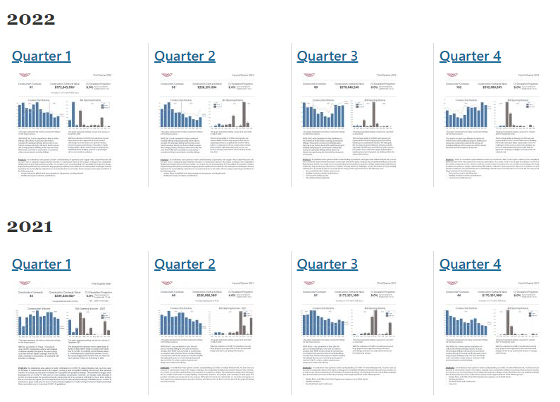

Slide 2
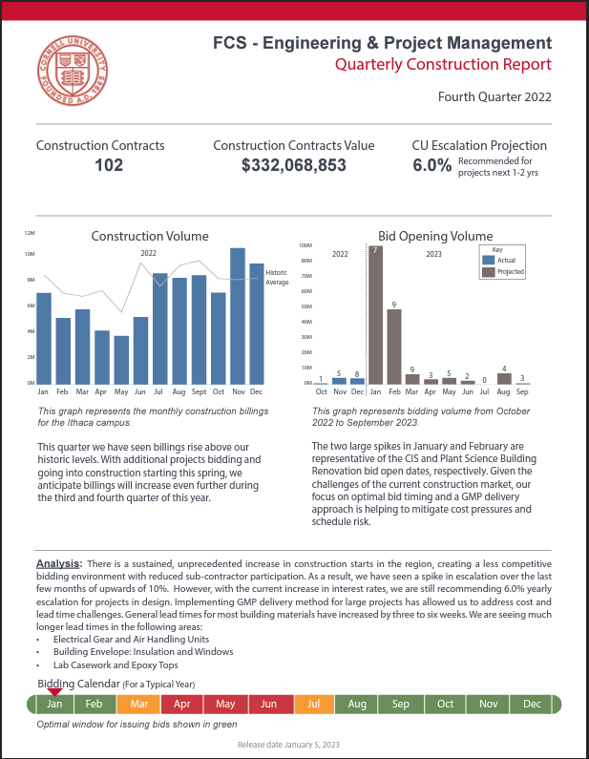
Q4 2022 Report
Key Takeaways:
102 construction contracts in place
Total $330M in construction
Volume higher than historic average
Successful early bidding effort
6% recommended escalation
Long Lead Item Challenges:
General building materials
Electrical gear & air handling units
Insulation and window
Lab casework and epoxy tops

