Slide 1
FPAR Process
PMPM – January 2023

Slide 2
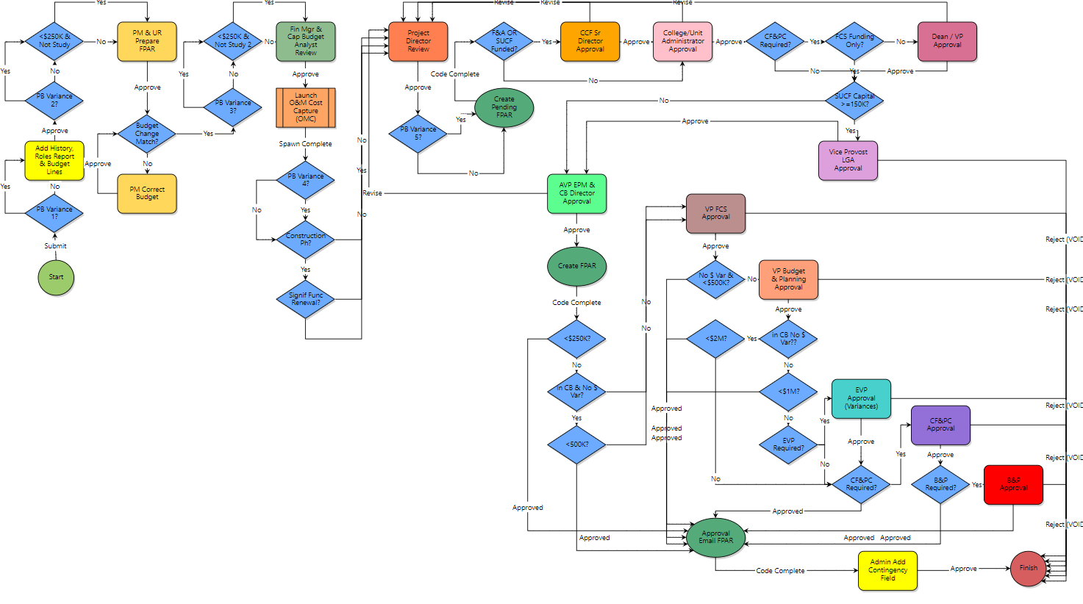
FPAR – Process Workflow Diagram
2023

Slide 3
FPAR – What You Need To Know
FPAR is more automated and streamlined than PAR
No manual intervention required
Blue diamond steps automate some data entry and/or route the process based on many variables.
48 data entry fields (reduced ~50% from 98 in PAR process)
7 to 16 actionable steps (reduced ~30% from 10 to 22 in PAR process)
New Sources & Uses template and Guidance Documents are available in *e-Builder Resources - User Resources folder here:
For eB users: Private URL FPAR - Facilities Project Approval Request Help
For non-users: Public URL FPAR - Facilities Project Approval Request Help
Roles That May Take Action in FPAR (depending on variables)
PM, Unit Rep, Finance Mgr, Capital Budget Analyst, Project Director, CCF Sr Director, College/Unit Administrator, Dean/VP, Vice Provost for Land Grant Affairs, AVP E&PM, Capital Budget Director, VP FCS, VP Budge & Planning, EVP, CF&PC Representative and VP FCS Executive Assistant (for B&P).
Users in Roles for FPAR Process Action - Use this report to see who is assigned to the roles that MAY take action in FPAR (work with eB admin for any missing)

Slide 4
FPAR – What You Need To Know
Start step (PM Only)
Contains only a portion of the FPAR data entry items
Does not require the Sources & Uses spreadsheet be attached
PM’s should not add the budget change items – that will be done in a later step
Pulls several data fields from the PDP upon submission
PM & Unit Rep Prepare FPAR step
PM and Unit Rep are the only roles
All actors must take action to move it forward
Collaboration is key as required fields must be populated before any actor can take the approve action.
Collaboration with finance managers on the sources & uses is highly recommended in this step – PMs are responsible for the expenditure projections at the bottom of the sources & uses sheet
Both PM steps contain new/modified fields in the Institutional Context and Direction section.
For each radio button selection field there is a corresponding statement that will be automatically added to the FPAR pdf
PMs should read the corresponding statement – if it does not make sense relative to the project, a different radio button may need to be selected
2023

Slide 5
FPAR – What You Need To Know
TIP: There is a corresponding Sentence (on the right) that will automatically be selected. This sentence will appear on the pdf version of the FPAR.
Additionally, there is an explanation field that may be required based on the answer selected.
Please leave blank if an explanation is not required.

Slide 6
FPAR – What You Need To Know
Finance Manager/Capital Budget Analyst step
These roles are responsible for capital budget data fields and the majority of the sources & uses sheet
Collaboration among all actors is key
One actor may take approve action to move the process forward
Project Director step
PD will have full edit capabilities, except for fields designated for Finance Mgr/Cap Budget Analyst
Mary-Lynn/Andrew Magre step may revise back as far as PD Step only
Three New Roles (PAR Approver role to be retired):
CCF Senior Director
College/Unit Administrator
Dean/VP (required only for CF&PC level FPARs)
Each role will take action in separate steps (automatic routing based on criteria in blue diamond conditional steps)
Assigned to projects based on funding sources, so if there are multiple funding college/units there may be multiple users in the College/Unit Admin and Dean/VP steps

Slide 7
FPAR - Remaining Timeline
January: Training and Pilot
Go Live for FPARs Slated for 2/13 CF&PC
February: Training All
Go Live All Capital Projects (2/13/2023)
March-June: Evaluation/Updates
July: PAR Initiative Work Group Final report to Sponsors
2023

Slide 8
Questions?

Slide 9
Institutional Context and Direction Section Fields
Project Delivery Risk
Critical Project Goals
Municipal, State and/or Federal Approvals
Space Usage
Unique Operating & Maintenance Costs
Campus Master Plan
Notes:
Requires identifying thresholds for significant projects, and material impacts on operating

