Slide 1
Facilities Engineering Imaging Technology

Slide 2
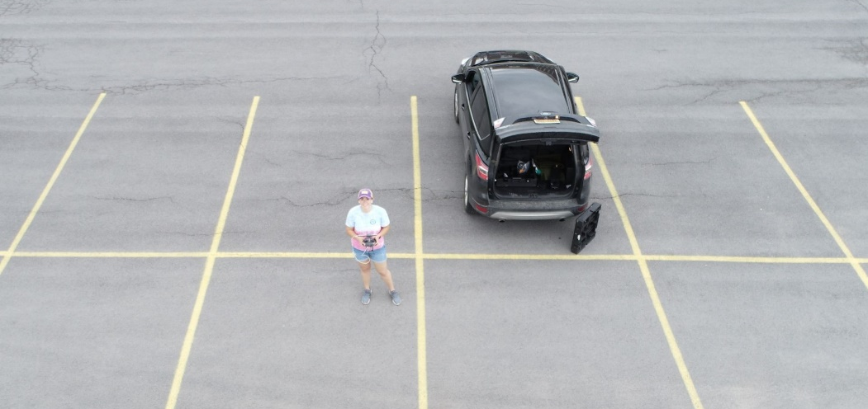
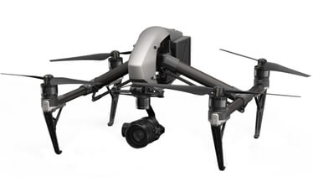
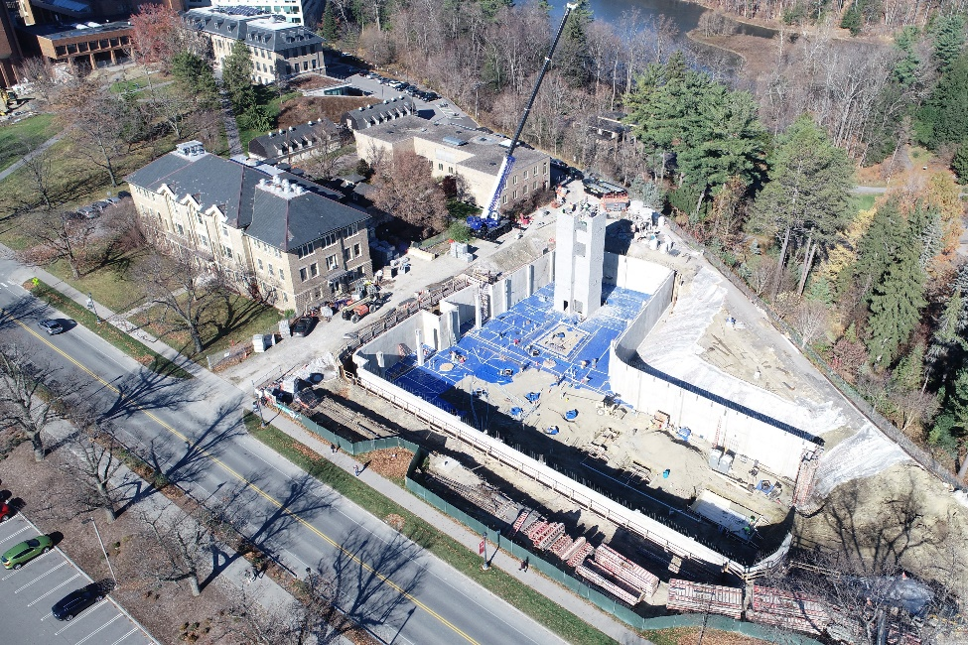
Unmanned Aerial Vehicle
Mary Colomaio
DJI Inspire 2
Grease Duct inspection at Carl Becker
Overhead November 2022 Atkinson Center
Overhead images/video of ongoing projects for progress reporting
Capture data on hard-to-reach locations to kickoff project planning/insight
Notes:
The Unmanned Aerial Vehicle (UAV) owned by FCS. The primary applications to date are:
• Project Investigation
• Quick response building inspections/assessment
• Aerial imagery
• Event/project planning

Slide 3
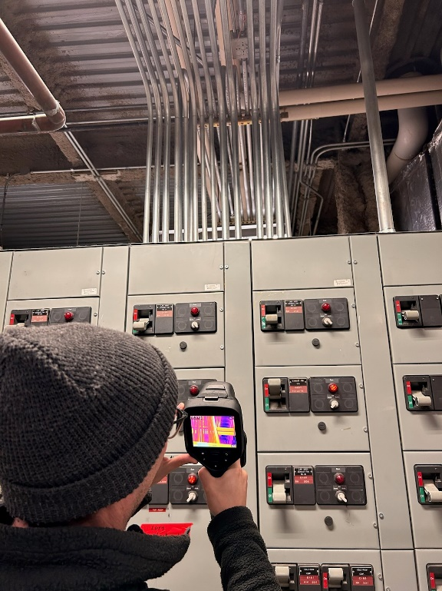
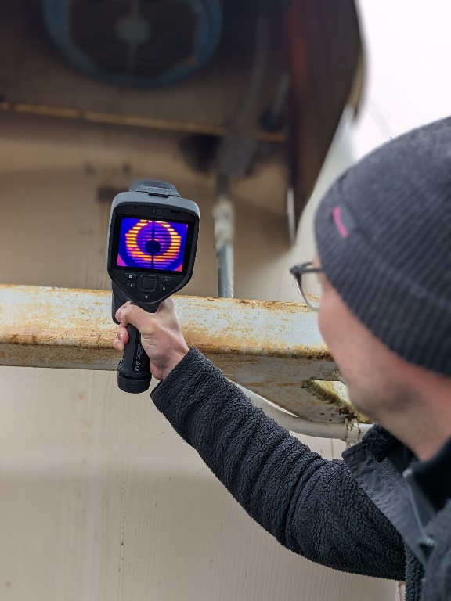
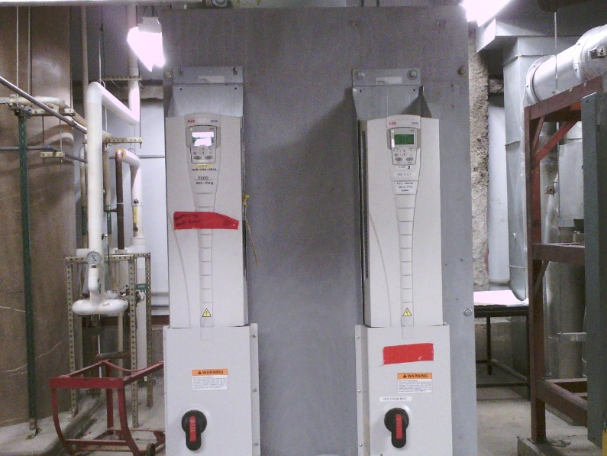
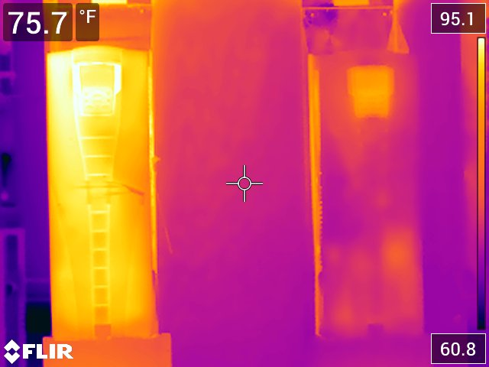
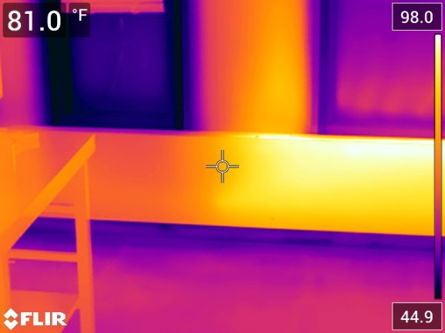
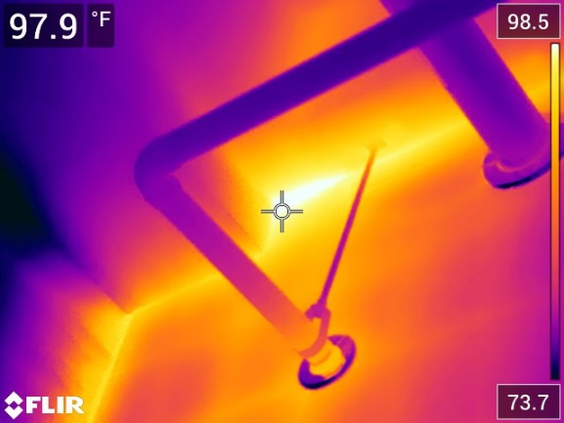
Thermal Imaging Camera
FLIR E75 (76,800 pixels/24 Degree Lens) - optimally used in the 15 foot or closer range.
Used for investigations. evaluations, trouble shooting, baseline measurements
Notes:
Electrical Section
• Trouble shooting panel boards to identify loose connections and defective breakers
• Reviewing transformer terminations and panel board conductor terminals for localized hot spots
Mechanical Section
• Trouble shooting pumps that are overheating – identifying warm spots in adjacent piping, couplings and bearings
• Verifying point of use heat exhaust requirements for equipment in conditioned spaces
• Establishing temperatures profiles in lab spaces and cleanrooms
• Investigating potential for coils in makeup air units to freeze
Architectural/Structural Section
• Review temperature gradients across windows and exterior walls to identify source of air leakage
• Evaluating discontinuities in roof membrane
• Reviewing internal temps of interior finishes when troubleshooting condensation
Envelope evaluation– 44°F window frames, 100°F radiator, 65°F space temp

Slide 4
Insta360 / Lapentor Introduction
Notes:
Started in FE in the Mechanical Group in September of last year.
Finished my 3+2 Engineering Program in Spring of 2019.
Bachelor’s Degree in Mathematics from St. Lawrence University.
Bachelor’s Degree in Mechanical Engineering from Clarkson University.
Started working for a Engineering Consulting Firm immediately after graduation, where I later learned about the Insta360.
Multivista (who will be presenting later) is a more powerful tool for documenting buildings and construction progress.
Mainly a design tool for recording existing conditions and tracing out MEP systems.

Slide 5
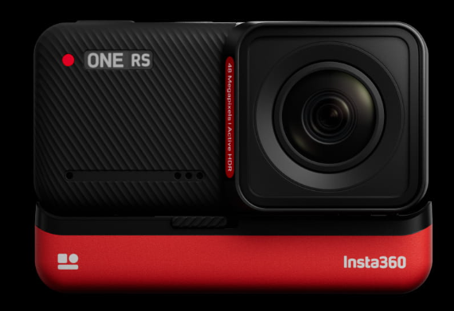
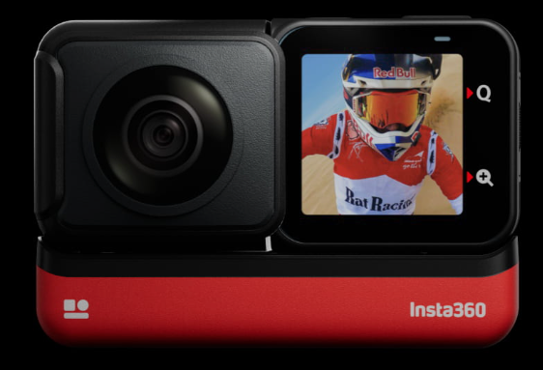
How does the Insta360 work?
Lens on either side of camera.
Takes 2 panoramic photos / videos simultaneously and then stitches them together to create an .insp / .insv file.
Insta360 Studio software converts .insp / .insv files to .jpg / mp4 files.
Comes with extension rod to get photos of hard-to-reach utilities and/or above ceilings.
Notes:
Lens on either side of the camera.
Takes 2 panoramic photos / videos and simultenously stiches them together to create .insp and .insv.
Can’t use these files, so Insta360 Studio is used to covert them into .jpg / .mp4 fiels.
Cost effective option in comparison with other 360 cameras and services out there.
Comes with 4’ extension rod to take field photos and videos in hard to reach areas.
Does not have lidar; cannot be used to take measurements.
Still have to do our due diligence and take measurements in the field.
Used as a coordination / design tool for FE.

Slide 6
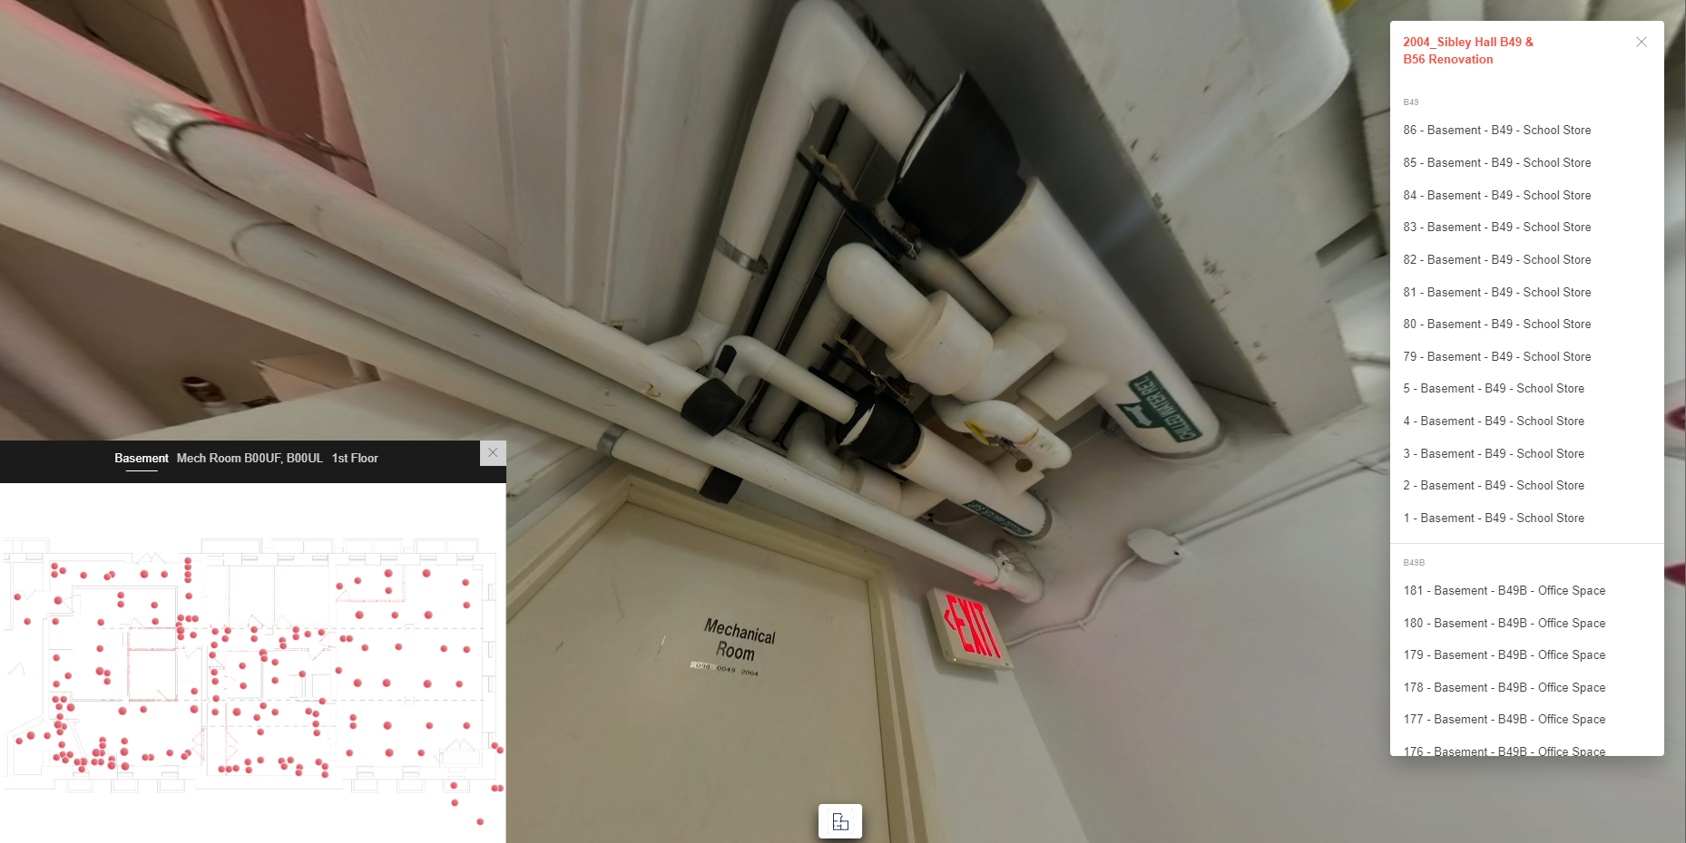
How does FE use the Insta360 / Lapentor?
How does the Insta360 work?
360 Photos / Videos are taken on site and are used to coordinate throughout the project.
360 Photos are uploaded to our Lapentor web-based software where they can be linked to floorplans for the perspective projects.
Notes:
- Take 360 photos in the field to record existing conditions.
Photos are then uploaded to Lapentor.
Easier to organize photos (no scrolling through file explorer).
You can see where the photo was taken in the building.
Easier to trace out systems through multiple areas.
Easier to coordinate during coordination meetings with stakeholders, contractors, design team members from different trades, etc.

Slide 7
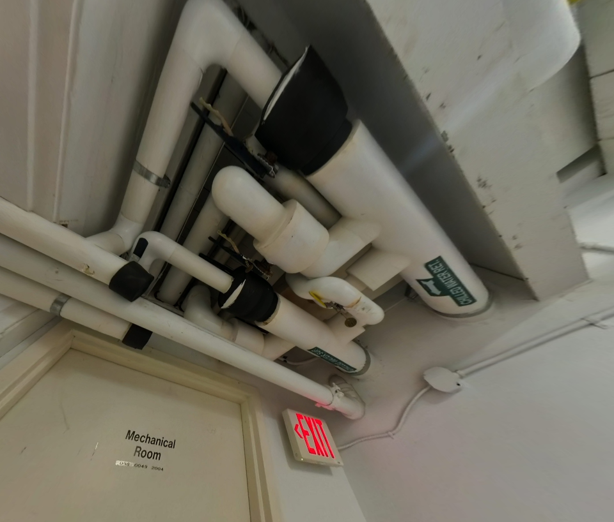
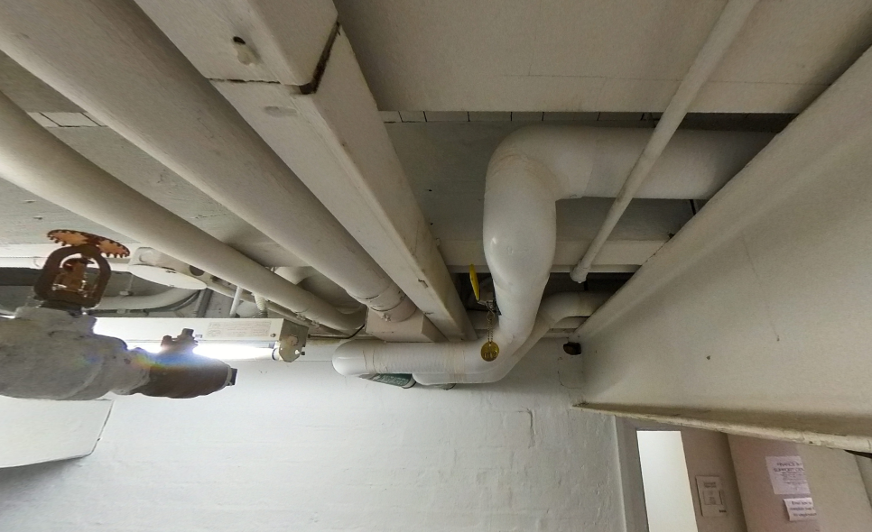
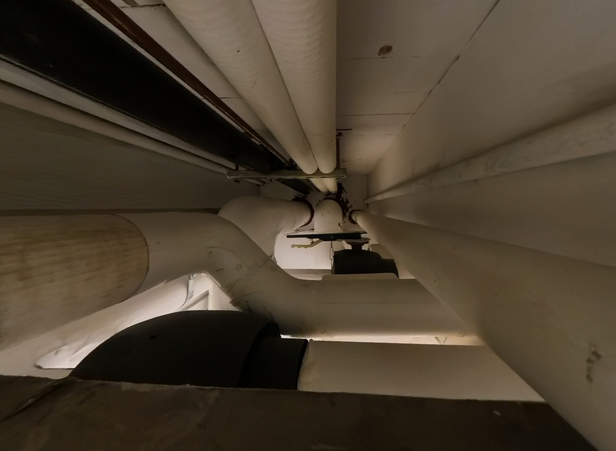
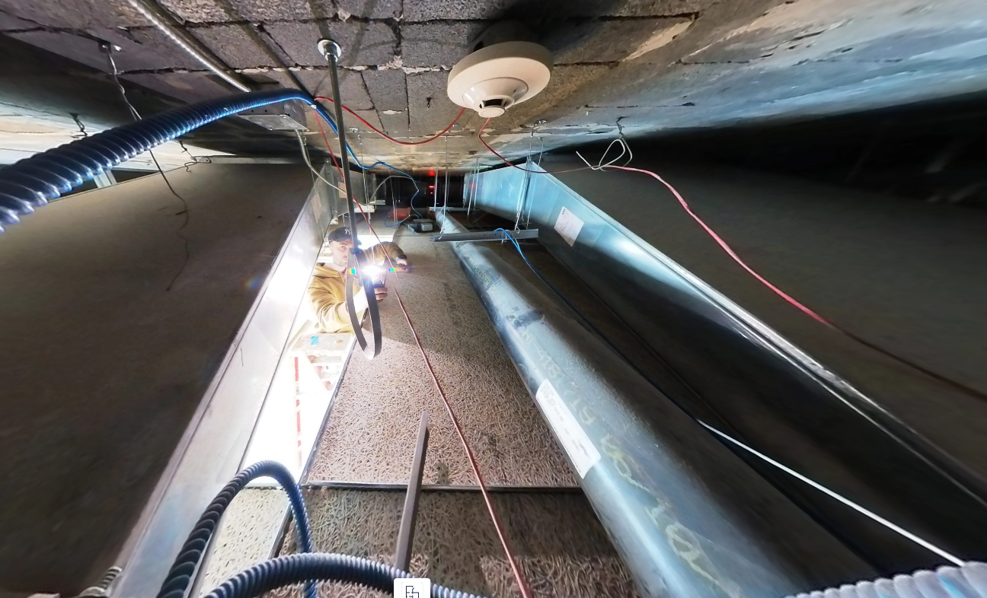
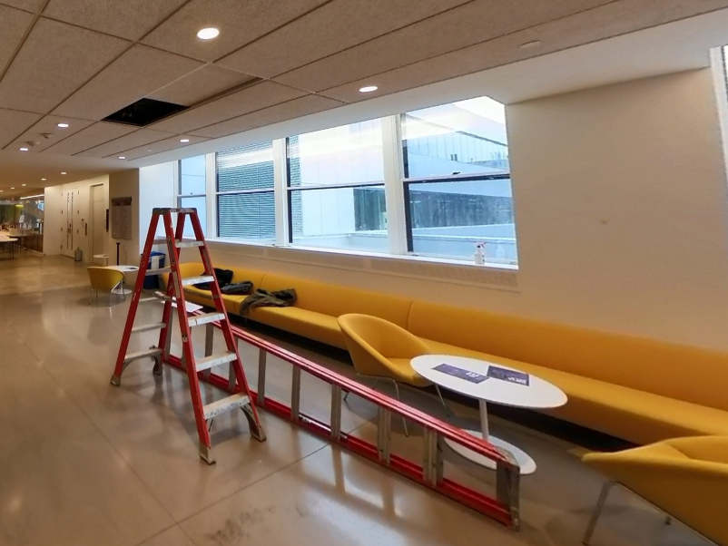
Recent Examples
How does the Insta360 work?
Sibley Hall
CVM – Schurman Hall
Notes:
Sibley Hall
Go through Mess of piping outside of Mech Room (purple)
Go through FP main serving multiple floors (red)
Mention HHW and CHW through multiple rooms.
__________________________________________________________________________________________
CVM-Schurman Hall
Mention missing CHWS/R that was never installed.
Did some more research and found a new location to tie into.
Existing DWGs are always accurate.
***SAVED CHANGE ORDER***
Mention inaccurate routing of FP Piping.
During construction, changes are made and are not always recorded.
Verifying existing utilities on ither side of beam when we couldn’t get ceiling tiles down.
_____________________________________________________________________________________________________________
Barnes Hall
Mechanical Engineer off campus able to view scope of building without driving up from NYC.

Slide 8
Questions?

