Slide 1
Project Management Professional Development Series
January 25, 2023
Facilities and Campus Services Engineering and Project Management

Slide 2
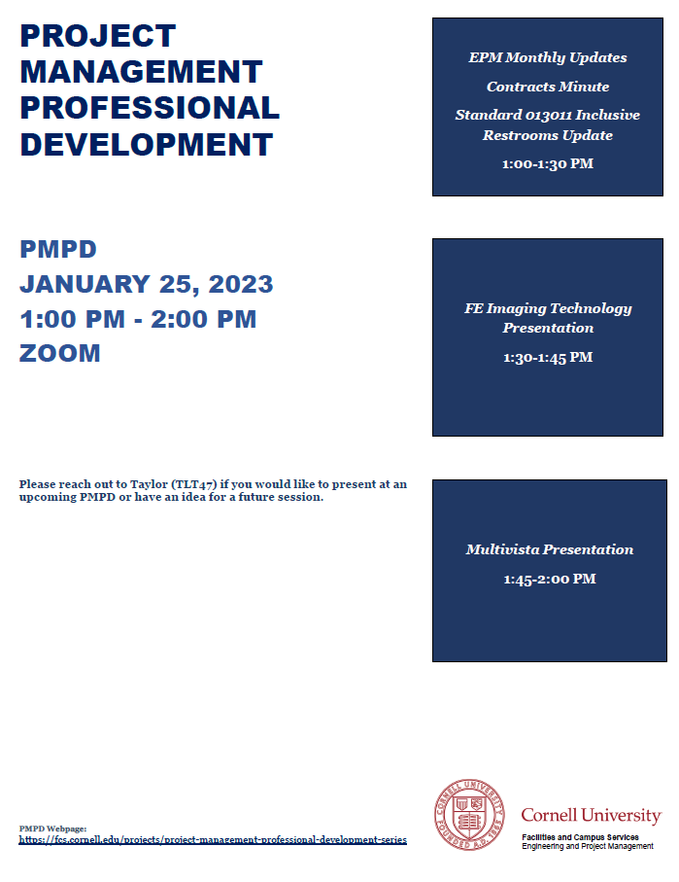
Today’s Agenda
Quarterly Construction Report
Andrew Magré
New FPAR Go-Live Update (10 min)
Donna Sutliff
Contracts Minute (10 min)
Brenda Frank and Jessie Dimick
Standard 013011 Inclusive Restrooms Update (10 min)
J Shermeta and Jim Yarbrough
FE Imaging Technology Presentation (15 min)
Jim Feeley and Tyler Kost
Multivista Presentation (15 min)
Brad Roos

Slide 3
Q4 Quarterly Construction Report

Slide 4
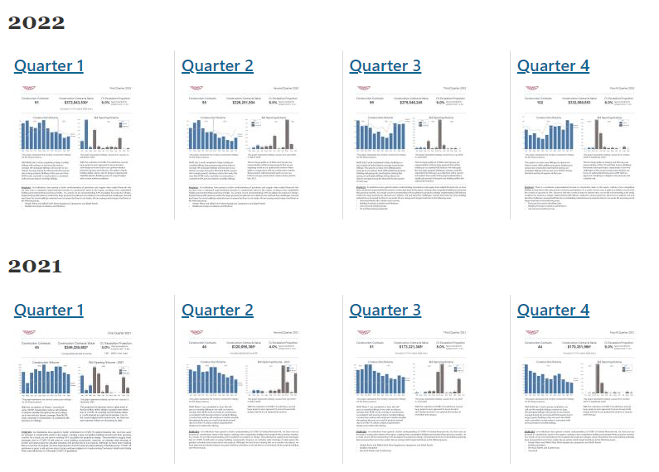

Slide 5
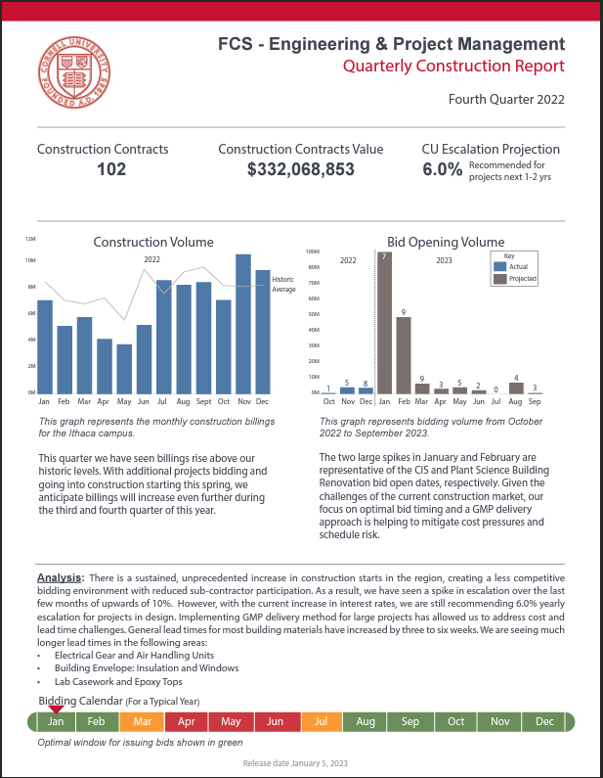
Q4 2022 Report
Key Takeaways:
102 construction contracts in place
Total $330M in construction
Volume higher than historic average
Successful early bidding effort
6% recommended escalation
Long Lead Item Challenges:
General building materials
Electrical gear & air handling units
Insulation and window
Lab casework and epoxy tops

Slide 6
New FPAR Go Live Update

Slide 7
Contracts Minute

Slide 8
Agenda
General Requirements (GR) Updates
Bid Package Reminders
Bid Package - Common Omissions

Slide 9
GR Updates
GR’s are being updated and will be posted to eBuilder soon
Reminder to always download the documents from eBuilder for each project as they are always the most updated version (links are in the BP Process)
Notes:
Brenda to speak to this slide

Slide 10
Bid Package Reminders
An asbestos survey is required for every project, please contact Dale Houseknecht about your project prior to submitting your BP to Contracts
See the Gdoc and the August PMPD presentation for references Bid Prep GDoc
All Tech Specs should have the A/E’s Company Name on each page, not just the cover page
This way it is clear who prepared them

Slide 11
Bid Package Common Omissions
Asbestos Survey/Report
MWBE Goal Setting Template (Campus Let/SUCF)
Incorrect Issue Date on Drawings
Front End Titles need to match Title on Drawings
For Campus Let Title needs to match SUCF Project Name (can be found on Project Details Page)
# of Bid Sets Requested and to whom
Technical Specs Formatting: Firm Name, Project Name, Date, Section/Page #
OPC/Estimate
Use Checklist B2 or B3 for guidance

Slide 12
Questions?

Slide 13
Standard 013011
Inclusive Restrooms Update

Slide 14
FE Imaging Technology Presentation

Slide 15
Multivista Presentation

