Slide 1
PAR Revision Initiative Leadership Council Update
November 2022

Slide 2
PAR Revision Initiative - Timeline and Process
Discovery Phase May - Jun
Working Group & Stakeholders Jun - Jul
Confirm Approach Aug
FPAR Document Design Aug - Oct
FPAR Guidance Document Oct - Nov
Build eBuilder Process Oct – Nov
Confirmations with Stakeholders Nov
PMPD, FDR & COG Updates Dec
eBuilder Testing Complete Dec 23rd
Implementation, Training & Pilot Jan
Report to CF&PC Jan 11th
FPAR Go Live for CF&PC Feb 1st
Evaluate Implementation Feb - Jun
2023

Slide 3
Vision and Goals of Initiative
Reimagine and reengineer the PAR, and PAR process from the ground up
Reflect current business needs
Leverage and acknowledge expertise of staff subject matter experts
Design for decision-making, analysis, and reporting
Notes:
Charge of committee - back in April, based on a charge from Rick and Laura Syer, a team was assembled to Look at Opportunities to Improve the PAR and PAR process
Core Team assigned to this effort is Mary-Lynn, Jessie Dimick, Donna Sutliff and me.
The process started with a discovery phase that included a survey that went out to everyone who interacts with PARs
Working groups were assembled and provided feedback Jun - Jul
Then Findings and Recommendations were presented to Rick and Laura in August
Over the Last few months - the New FPAR was designed based on feedback and a supporting guidance documents developed
Next steps are shown in grey and I’ll circle back to this at the end of presentation after I’ve shared with you the vision and goals of this initiative and shown you our new FPAR mock-up

Slide 4
Re-Affirmed: Purpose and Need of PARs
Substantiates the expectations and limitations for a financial authorization, at the thresholds and approvers as determined by Policy 4.2, Transaction Authority and Payment Approval
Communicates to transactional authorities the scope, schedule, financial commitment and impact considerations for a facilities–related capital project executed by Cornell staff and/or external parties
Serves as the data of record for capital accounting activities, consistent with Policy 3.9, Capital Assets
The PAR is not intended, nor to be used, as a substitute for advocates and project managers to communicate with each other and with stakeholders.
Notes:
Survey responses indicated a lack of understanding of why PARs exist; PARs are not going to go away, need to understand the primary purposes of authorization of funds, communication of key conditions, and recordkeeping for reporting and analyses
Keith: Once agreement is reached, I think we also need to highlight the need to communicate this to those involved and provide initial and recurring training on the importance of the PAR, e.g., this is not a block-checking exercise, we are entrusted with stewardship of Cornell’s resources and others need to approve

Slide 5
Process and Approach to Re-design
Keep what is valuable and working
Keep what is valuable and working
Revise what is valuable but not working
Revisit and consider removing what appears not-valuable
Add what is valuable but currently missing
Leverage System Capabilities: Pull data from other modules and data fields rather than data re-entry

Slide 6
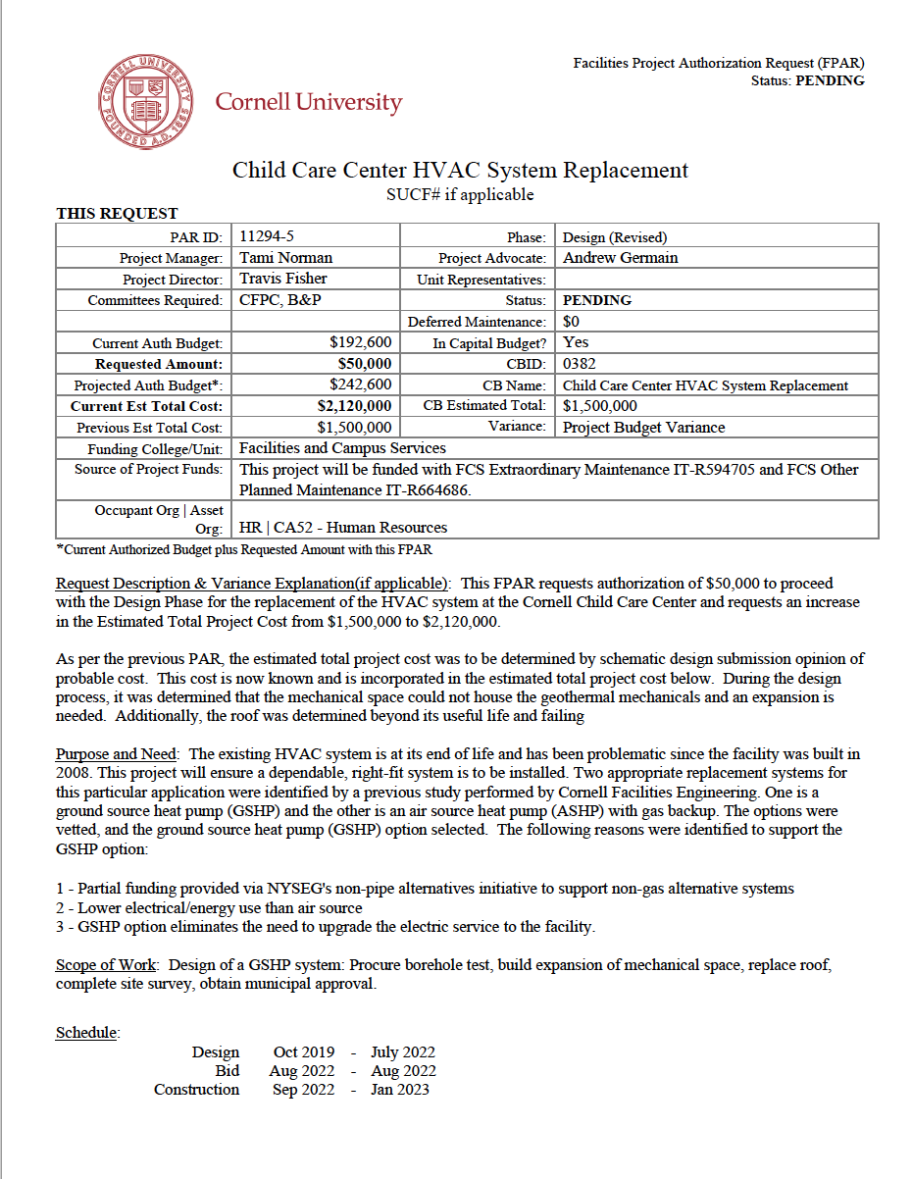
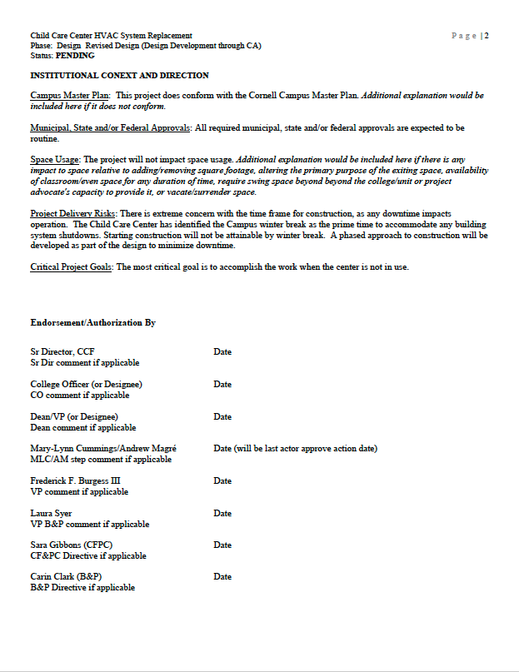
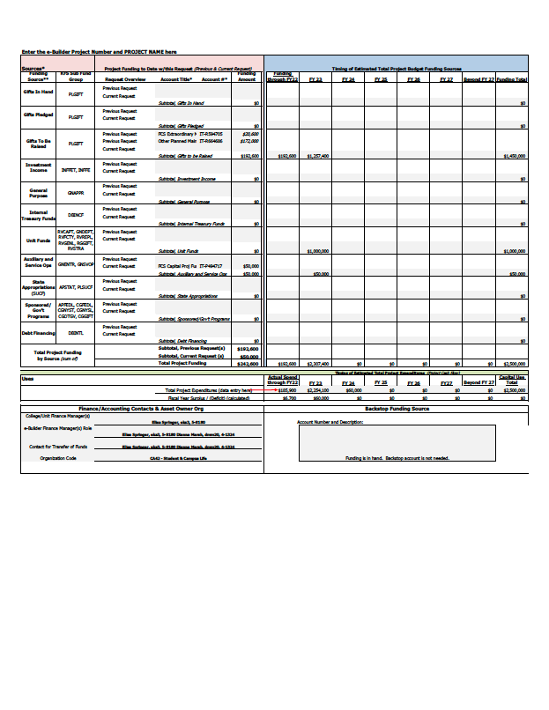
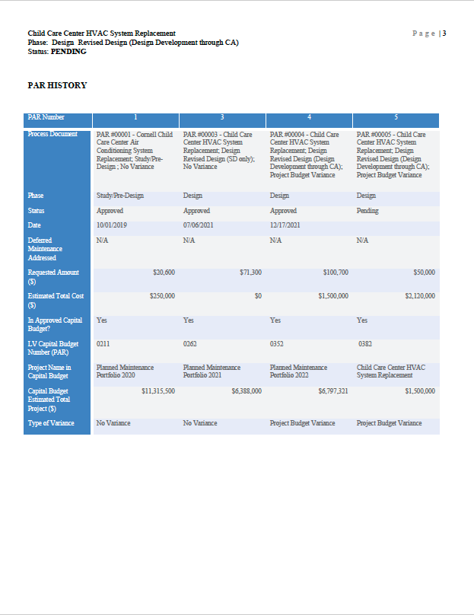
Draft PAR Mockup
Grid with key information
Request description
FPAR Page 1
FPAR Page 2
Variance explanation
Purpose & need
Scope of work
Sources & Uses Table
PAR History
Simplified schedule
Notes:
Finance manager role much clearer for filling in

Slide 7
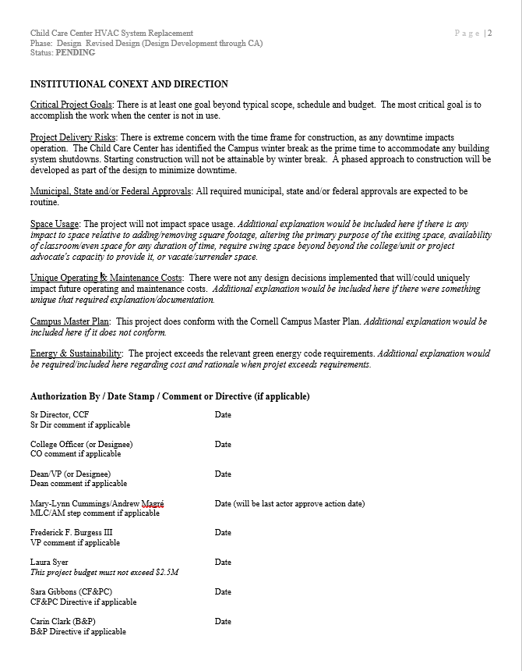
Draft PAR Mockup
Institutional context and direction
FPAR Page 1
FPAR Page 2
Authorizations
Leadership & committee direction (documented)
Sources & Uses Table
PAR History

Slide 8
PAR Revision Initiative - Timeline and Process
Discovery Phase May - Jun
Working Group & Stakeholders Jun - Jul
Confirm Approach Aug
FPAR Document Design Aug - Oct
FPAR Guidance Document Oct - Nov
Build eBuilder Process Oct – Nov
Confirmations with Stakeholders Nov
PMPD, FDR & COG Updates Dec
eBuilder Testing Complete Dec 23rd
Implementation, Training & Pilot Jan
Report to CF&PC Jan 11th
FPAR Go Live for CF&PC Feb 1st
Evaluate Implementation Feb - Jun
2023

Slide 9
Questions

