Slide 1
Standard Update/Changes Cornell Design and Construction Standards 260923 Lighting Controls Design Standard
Erich Reichard(ETR33)
Facilities Engineering
November 2022

Slide 2
History
Previous version – dating back to 2016
FE collaboration with former Director of Utilities and Distribution and Energy Management Lanny Joyce
Goal was to remove proprietary systems, specifically Lutron Quantum
Gates Hall
Lutron Quantum wanted to charge for software upgrade, server hardware, single workstation for control
Legacy systems installed in Gates as well as other buildings
Cornell refused to pay for the upgraded software
Created conversation for all controls on Building Automated Control System (BACS)
Lighting control on BACS gave Cornell control of any changes

Slide 3
Types of Systems – Previous Terminology
Integrated
Connected and controlled through BACS
Stand alone
Controlled by individual components using low voltage or wireless
No connection to any other rooms or spaces. No internet, building control connections
Networked
Stand alone systems connected through hubs/nodes to network devices together using ethernet, wireless or proprietary networks

Slide 4
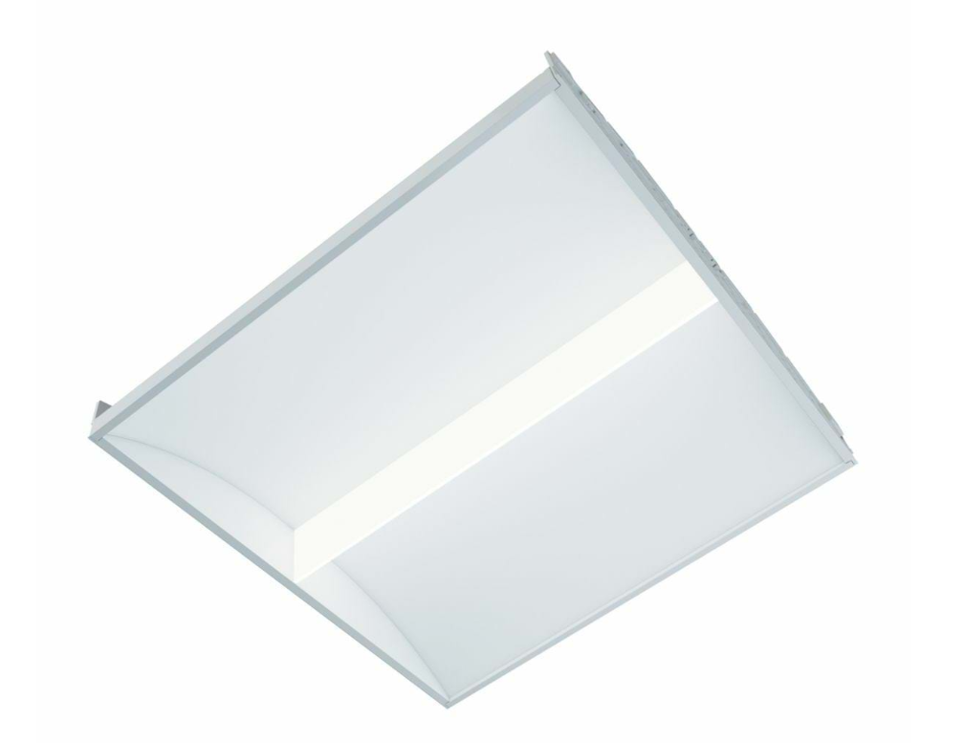
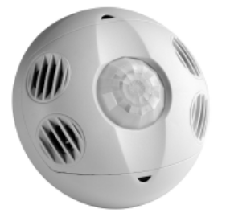
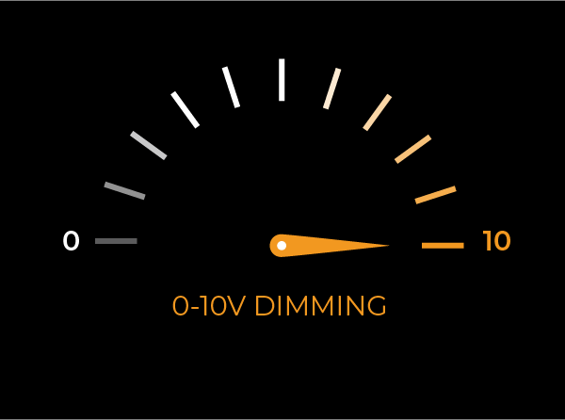
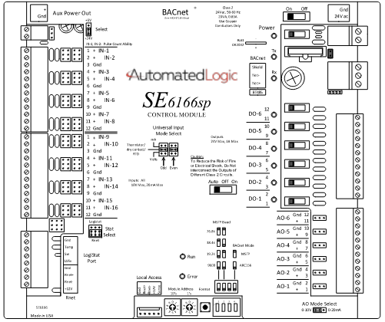
BACS Controlled Lighting System
Occupancy/Vacancy Sensor
Relay
Power Wiring
Power Wiring
Light Fixture
Control Wiring
Control Wiring
Control Module
Control Wiring
Control Wiring
To Building Automation Control System
Wall Switch

Slide 5
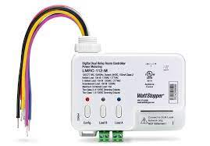
Stand Alone System
Occupancy/Vacancy Sensor
Power Pack/Relay
Control Wiring
Power Wiring
Power Wiring
Light Fixture
Control Wiring
Control Wiring
Wall Switch

Slide 6
260923 Lighting Controls Design Standard
Who were the primary authors/editors of the revised standard?
FE Electrical Engineer Chris Wayman and myself were primary authors in collaboration with:
FE Mechanical – Senior Mechanical Engineer Elizabeth Kolacki and Mechanical Section Leader Jim Feeley
Utilities/E&S – Former Director of Utilities and Distribution and Energy Management Mark Howe and current interim Director of Utilities and Distribution and Energy Management Cole Tucker
FCS Control Shop – Controls Shop Manager Dustin Darnell and Controls Shop DDC Applications Designer Jason Arnold

Slide 7
260923 Lighting Controls Design Standard
Why did we update the standard?
FE reviews all standards every two years
Cost implications
Maintenance implications
Applying lessons learned NCRE and other recent projects
Confusion over previous standard
University Stewardship

Slide 8
Cost Implications, Installation Impacts
Reduce up-front cost
Less wiring for control points
No programming for input/output
Recently BACS control was valued out of most spaces in CIS, which greatly lowered upfront cost for lighting control
Less Maintenance
Less troubleshooting and programming for changes in future by Controls Shop
Devices replaced by Zone Electricians, will not require reprogramming

Slide 9
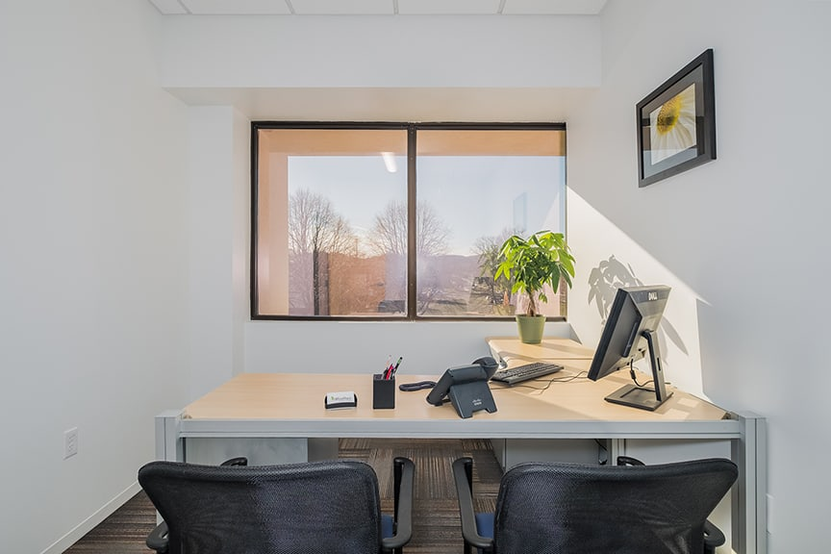
260923 Lighting Controls Design Standard
Major Changes:
Simplified control in most spaces – Offices, classrooms, laboratories, etc.
BACS controlled lighting only in specific spaces – animal rooms, plant growth rooms, atriums and corridors

Slide 10
Thank you! Questions?
Please contact me with questions or comments:
Erich Reichard
etr33@cornell.edu
607-255-3934

