Slide 1
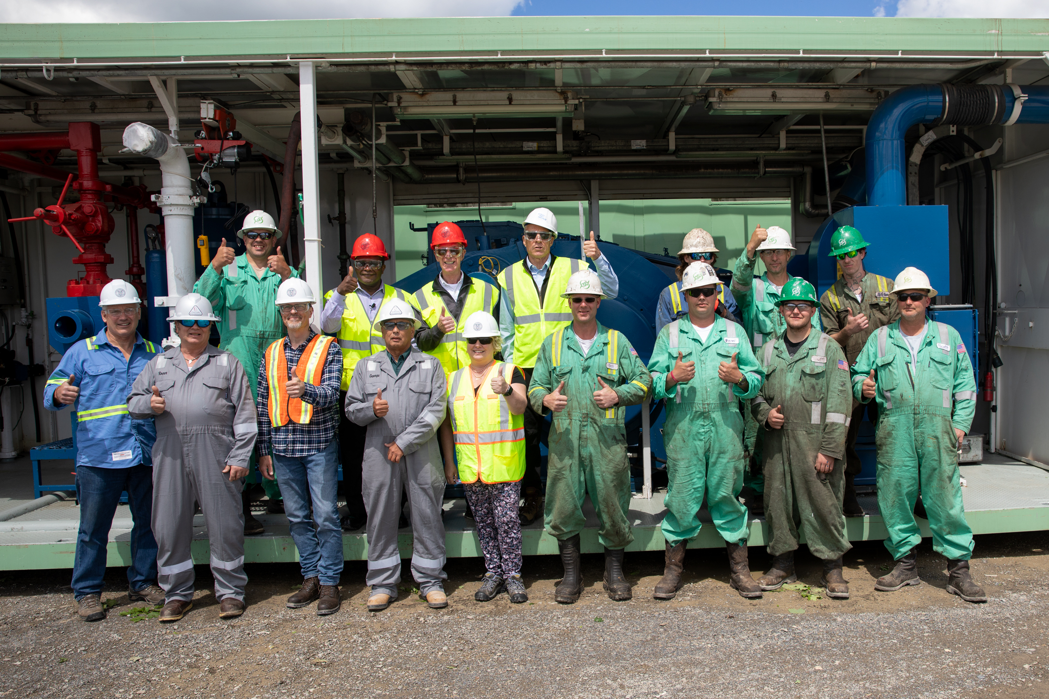
CUBO
Cornell University Borehole Observatory
PMPD Update
October 24, 2022

Slide 2
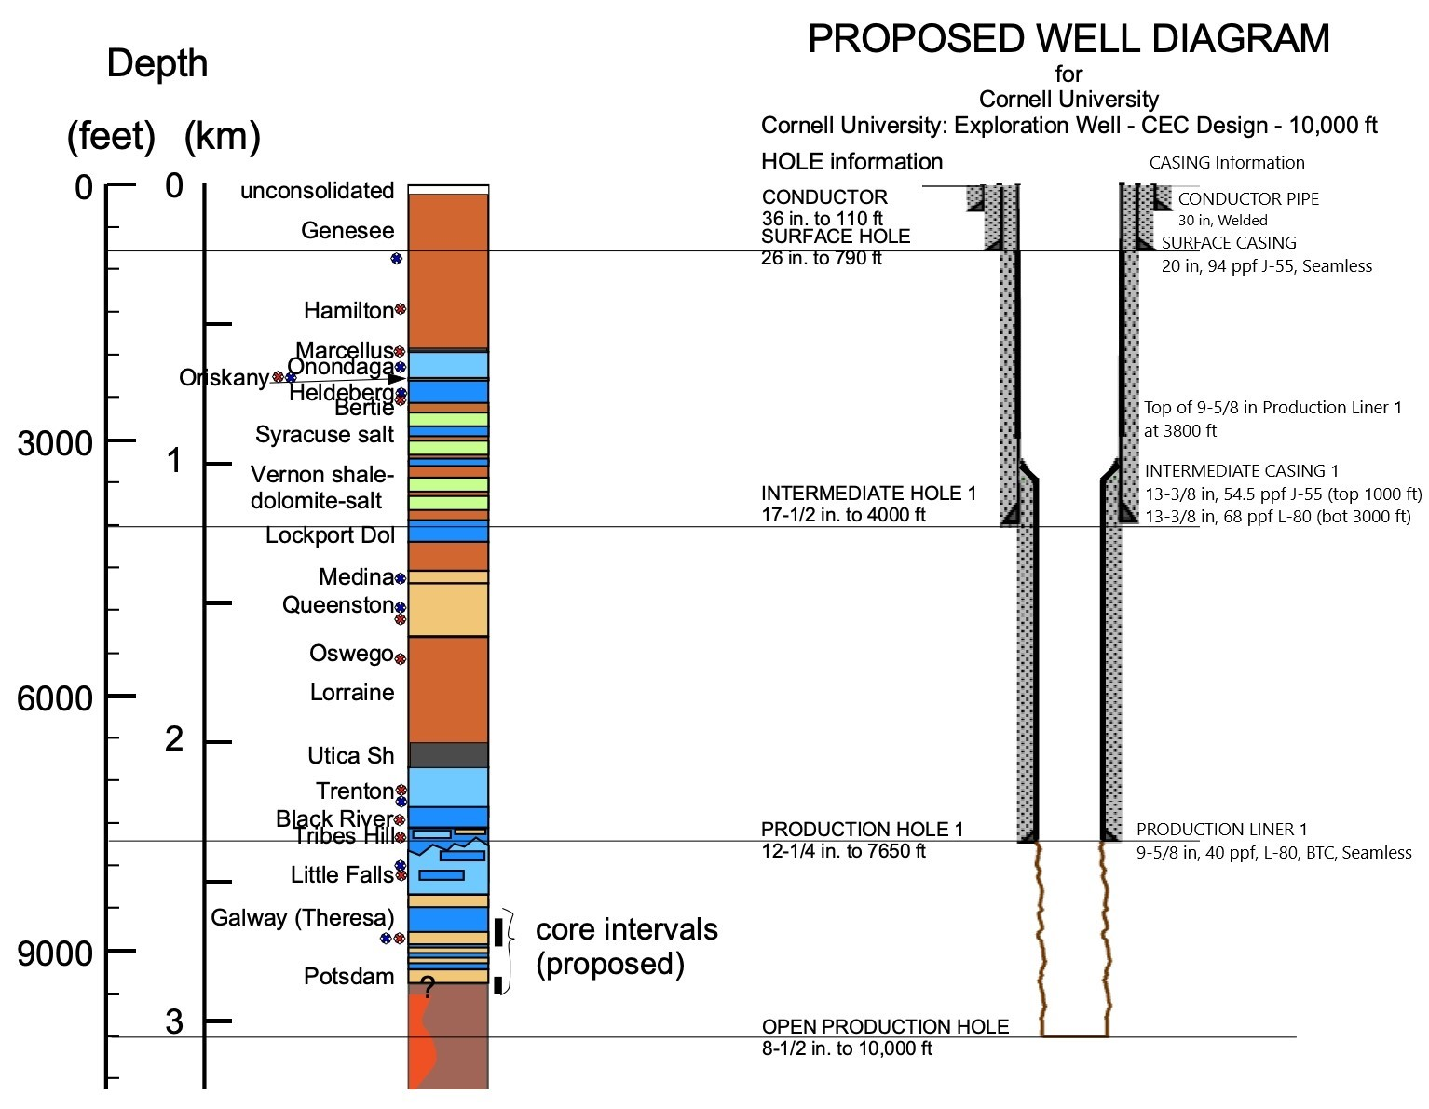
The CUBO Well
Final Depth 9790’
or 1.8mi
Temperatures between
167-212F
Low permeability

Slide 3
Contracts and Budgeting
ZERO DOLLAR CONTRACTS FOR DRILLER AND INTEGRATED WELL SERVICES FIRMS
USED ESTIMATES AND QUOTES TO PREPARE TASK AUTHORIZATION FOR EACH SPECIFIC SCOPE OF WORK
FIRMS SUBMITTED PAYMENT APPLICATIONS AGAINST EACH SPECIFIC TASK AUTHORIZATION
CONTRACTS
2
SHORT FORM CONTRACTS
6
PURCHASE ORDERS
44
PARS
8
TASK AUTHORIZATIONS
76
PAYMENT APPLICATIONS
118

Slide 4
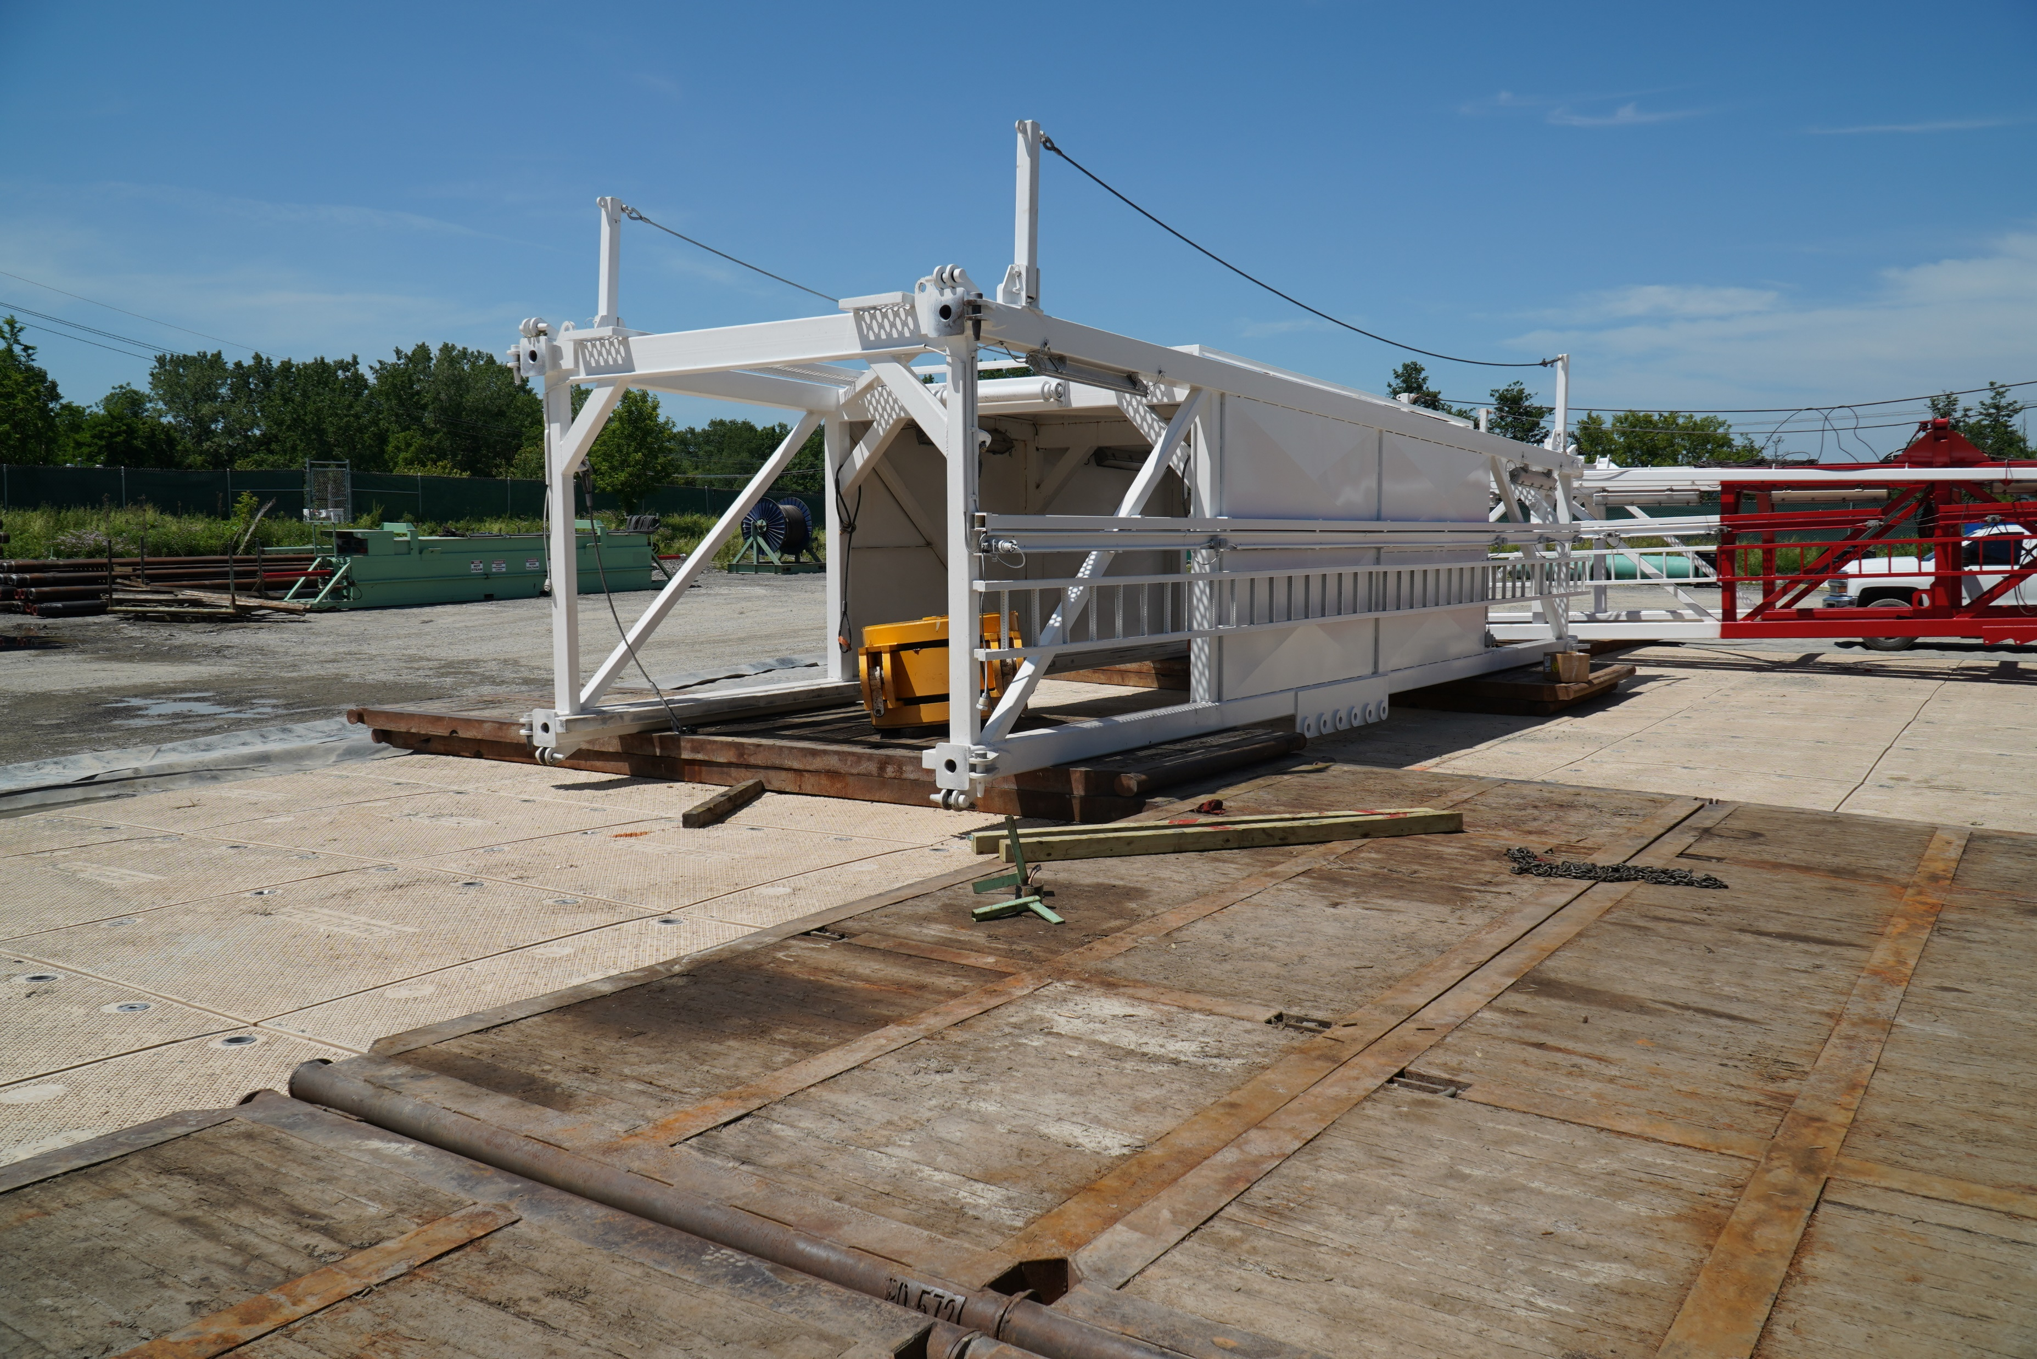
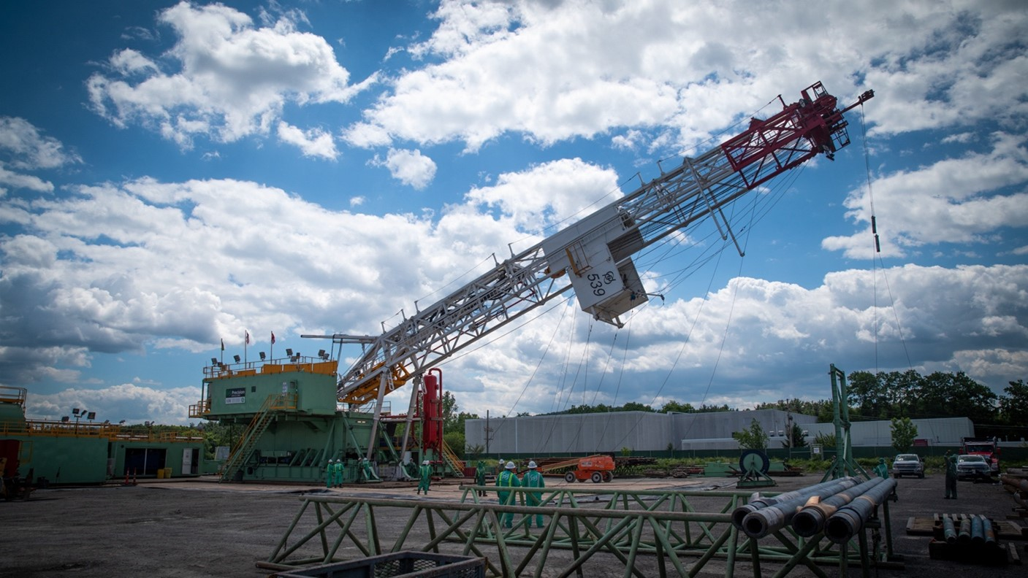
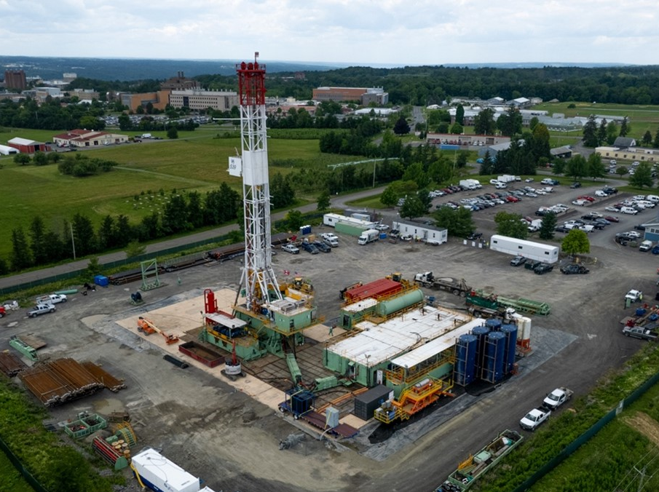
Construction
FIELD SITE SUPERVISOR
Capuano
OWNER-OPERATOR
Cornell
SITE CONTRACTOR
JP Reilly
DRILLER
Precision
WELL SERVICES
Schlumberger

Slide 5
Owner-Operator
OWNER-OPERATOR
Cornell University
CORNELL UNIVERSITY AS GENERAL CONTRACTOR
DOE Grant/DEC/Town Approval
Pre-Purchase
Casing/Casing Equipment/
Wellhead/Sitework/Fencing
CONDUCTOR PIPE AND CELLAR
Trailers and Trailer Services
Provided Trailers for All Business Lines with Weekly Service
Portable Restrooms with Weekly Service
Power/Data
CU Electric Shop/CIT/Transformer Rental
MIFI 2 Trailers
Water
CONRELL PROVIDED WATER FROM NEARBY HYDRANT
TOTAL WATER USE LESS THAN 1 DAY OF CAMPUS USE
Waste
HIRED IEDC TO DESIGN AND CASELLA TO PERFORM WAST REMOVAL
ALL OTHER “DUTIES AS ASSIGNED”
Fr Ppe, SIGNAGE, supplies, moving, community engagement, arrangements for fiber optics, provide fuel for all required machinery

Slide 6
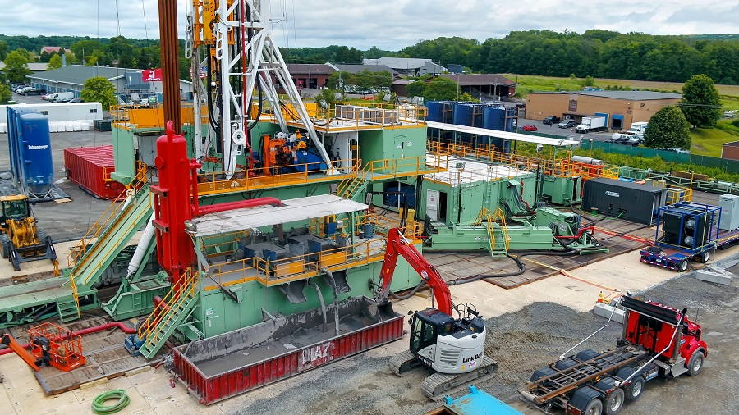
Drill Site

Slide 7
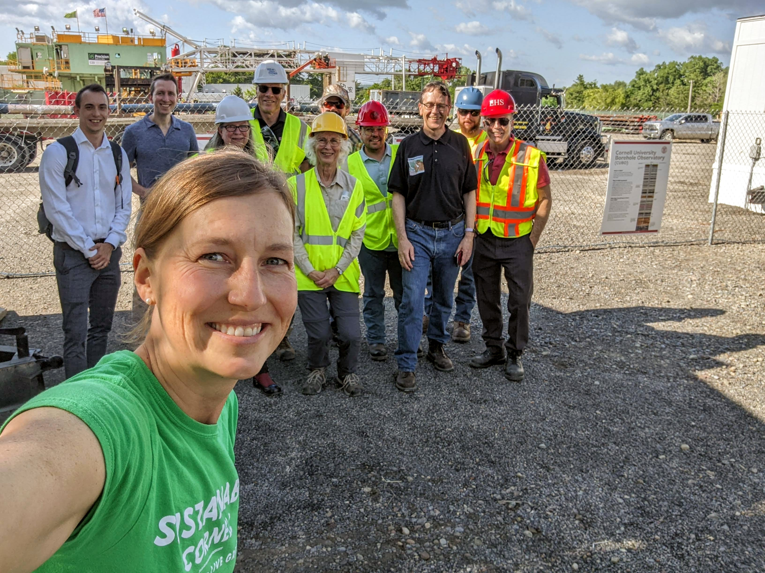
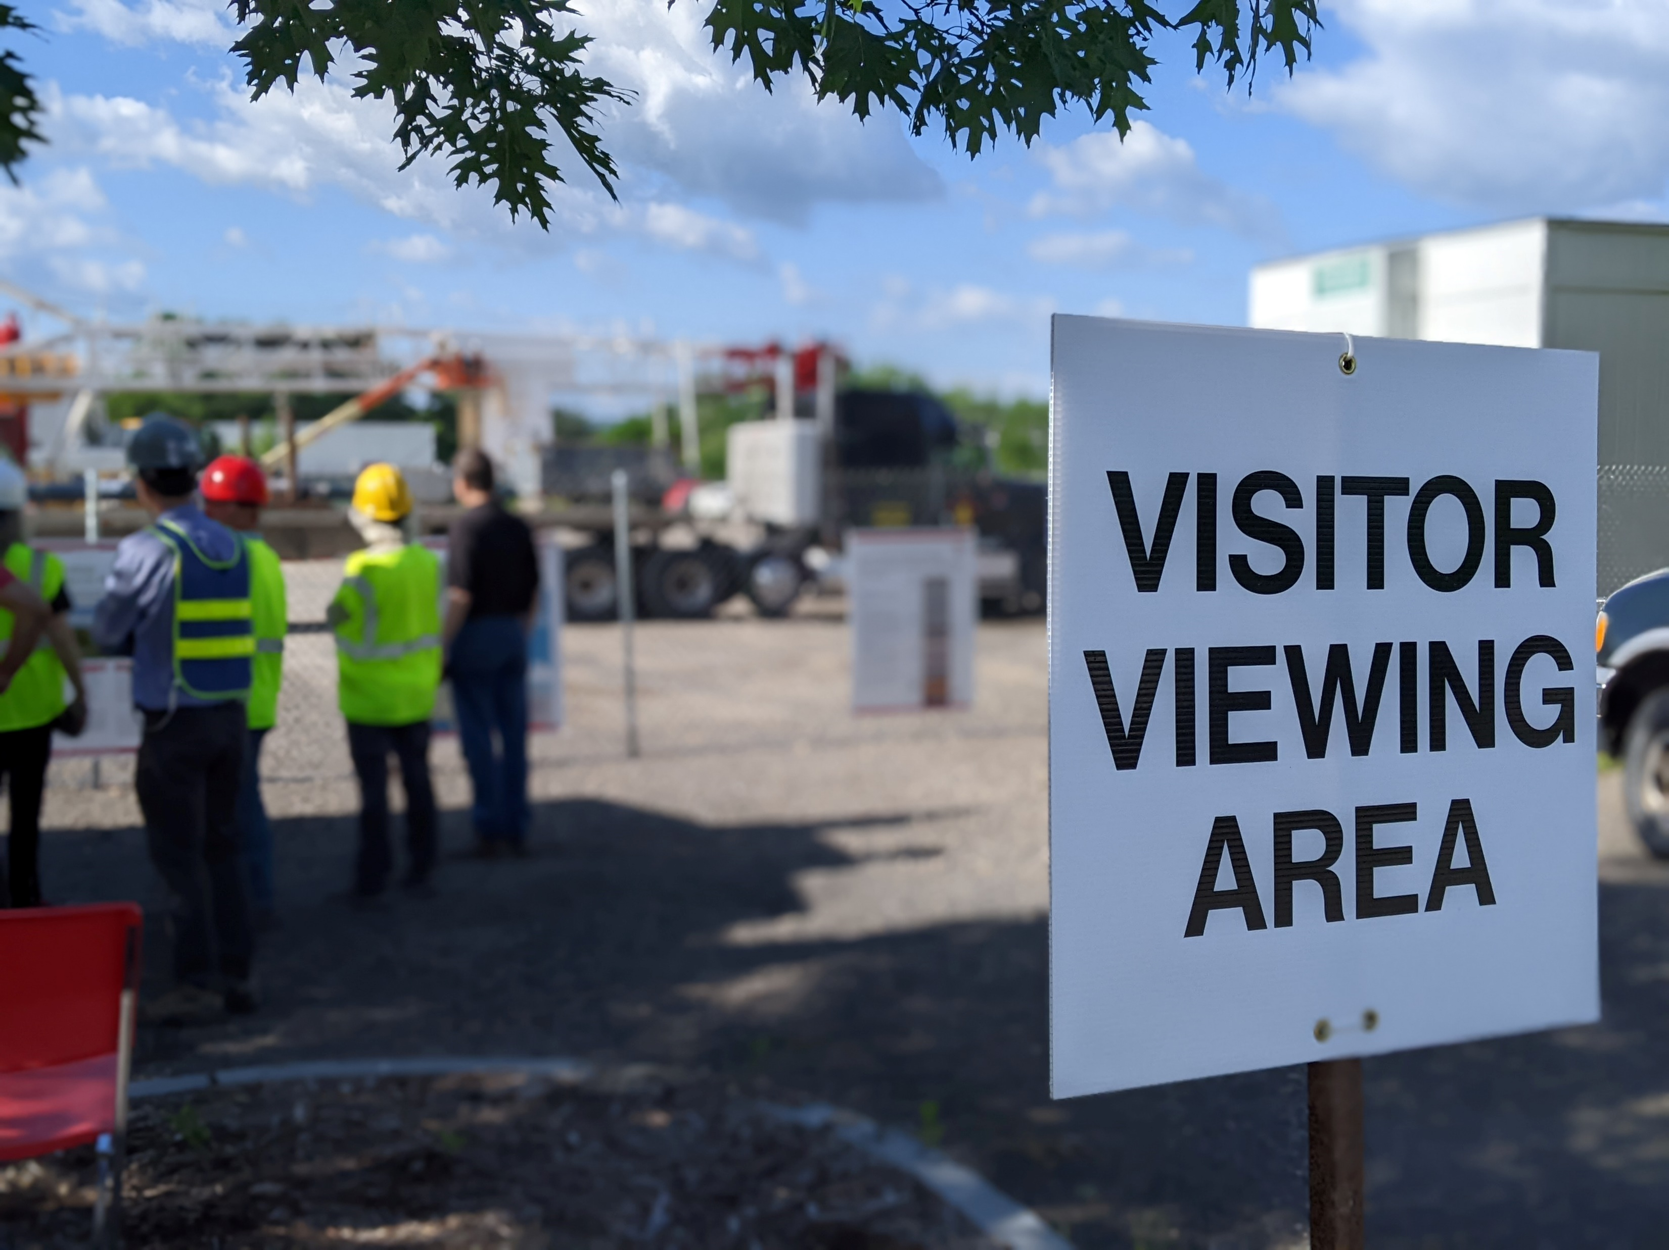
Living Lab
Community Engagement

Slide 8
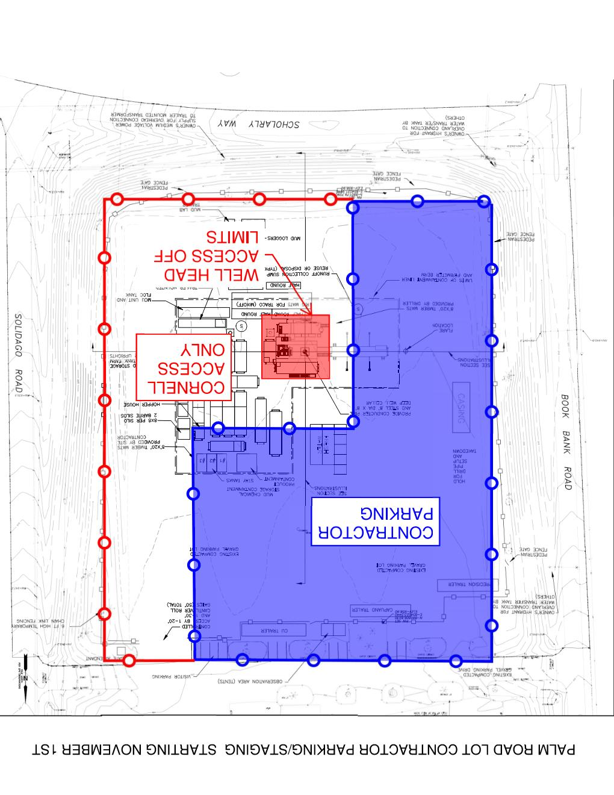
Coming
November 1st

