Slide 1
What is the estimated total cost of my project?

Slide 2
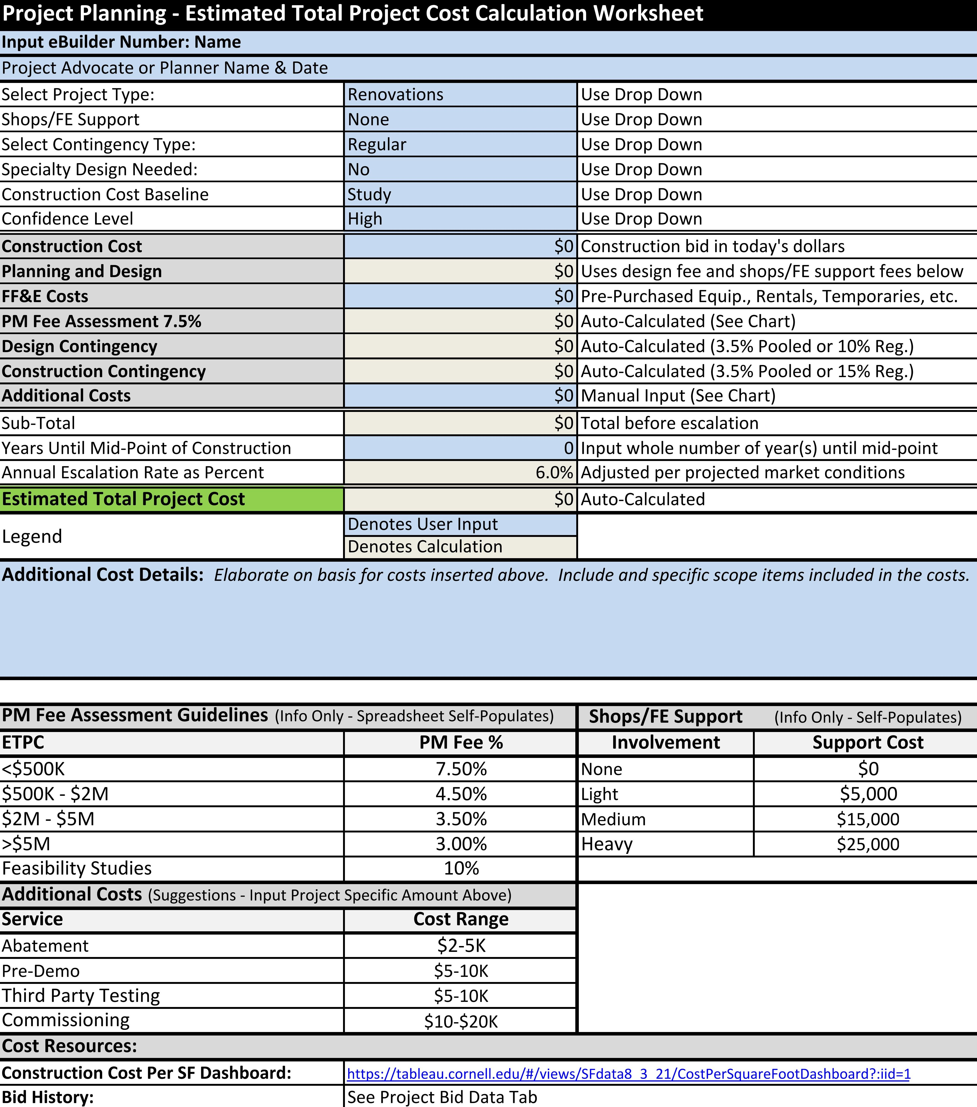
Project Planning - ETPC Calculation Worksheet
Purpose
Create a tool to estimate total project costs prior to execution.
Create a "starting point" to establish a ETPC baseline.
Users
Project advocates and maintenance planners
Benefits
Defines the proposed ETPC
Provides a documented baseline cost with backup, not just a number
Includes bid data for reference
Easy to use
Auto-calculates design, PM, and contingency costs
Notes:
Audience:
Who is this for?
Stakeholders, Project Directors, and Administration
Goal of the Project Status Update is to fully inform the project directors / Executives and Stakeholders of your project's status and overall direction without having to get involved themselves.
Directors/Stakeholders should be able to read the project status without having to reach out to the PM directly to find out where things are. A project manager is to create clarity from confusion for the project team and for management. Essentially, the task of a project status update is one of analysis and communication.
Minor tweaks to improve the tool for the Project Managers
Project Phase: Added to the Process Page:
Previous Months Update is Shown for PM to provide consistency from month to month:
Monthly PSU push has been established from our PM admin to provide a consistent reminder to update the status of our projects.
Colleges and Unit PM Centers have adopted the process to help with their reporting.

Slide 3
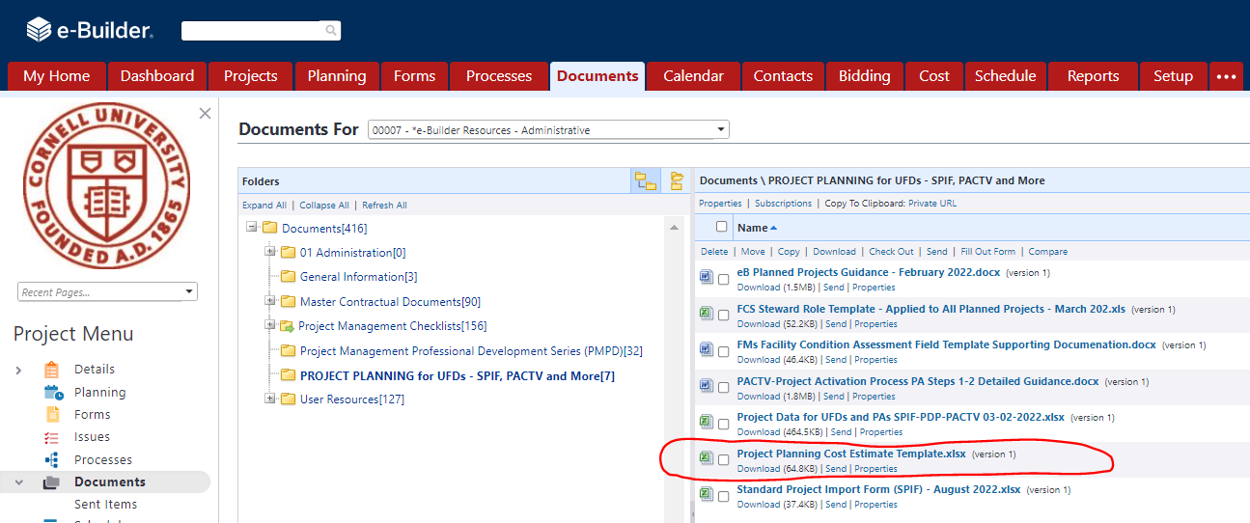
Project Planning - ETPC Calculation Worksheet
Use
Once a construction cost is established
Attach to project activation process
Location
eBuilder resources
Notes:
Audience:
Who is this for?
Stakeholders, Project Directors, and Administration
Goal of the Project Status Update is to fully inform the project directors / Executives and Stakeholders of your project's status and overall direction without having to get involved themselves.
Directors/Stakeholders should be able to read the project status without having to reach out to the PM directly to find out where things are. A project manager is to create clarity from confusion for the project team and for management. Essentially, the task of a project status update is one of analysis and communication.
Minor tweaks to improve the tool for the Project Managers
Project Phase: Added to the Process Page:
Previous Months Update is Shown for PM to provide consistency from month to month:
Monthly PSU push has been established from our PM admin to provide a consistent reminder to update the status of our projects.
Colleges and Unit PM Centers have adopted the process to help with their reporting.

Slide 4
Project Planning - ETPC Calculation Worksheet
Example – Chiller Replacement
FE provided a study which identified a construction cost to replace your chiller of $300K.
Anticipate heavy involvement by the shops to aid in the shutdown of connected equipment.
Abatement is anticipated as the insulation is old.
Construction funding won't be available until Q2 of FY24
Notes:
Audience:
Who is this for?
Stakeholders, Project Directors, and Administration
Goal of the Project Status Update is to fully inform the project directors / Executives and Stakeholders of your project's status and overall direction without having to get involved themselves.
Directors/Stakeholders should be able to read the project status without having to reach out to the PM directly to find out where things are. A project manager is to create clarity from confusion for the project team and for management. Essentially, the task of a project status update is one of analysis and communication.
Minor tweaks to improve the tool for the Project Managers
Project Phase: Added to the Process Page:
Previous Months Update is Shown for PM to provide consistency from month to month:
Monthly PSU push has been established from our PM admin to provide a consistent reminder to update the status of our projects.
Colleges and Unit PM Centers have adopted the process to help with their reporting.

