Slide 1
Project Management Professional Development Series
October 24, 2022
Facilities and Campus Services Engineering and Project Management

Slide 2
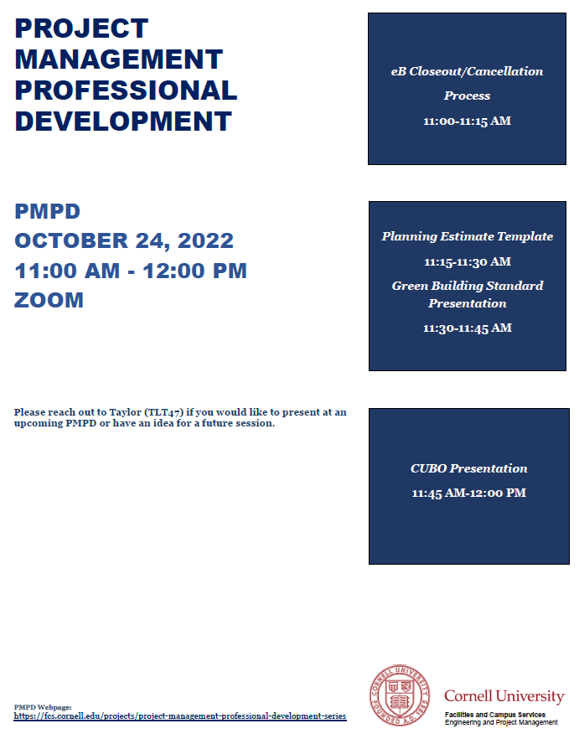
Today’s Agenda
Competitive Bid Process Reminders
Brenda Frank
eB Closeout/Cancellation Process
Donna Sutliff
Planning Estimate Template
Travis Fisher
Green Building Standard Presentation
Matthew Kozlowski
CUBO Presentation
Tammy Johnson

Slide 3
Competitive Bid Process Reminders
All Construction projects are competitively bid
During the process, all communication regarding the bid or with any bidder (or subcontractor) is restricted and should only be through Facilities Contracts until the Contract is executed
Cornell can not direct or interfere with the low bidder as to who they use as a subcontractor or supplier at any time

Slide 4
REMINDER
Campus Let Training
Thursday, October 27, 2022
8:30 – 1:00
140 East Hill Office Building
Breakfast Refreshments & Pizza

Slide 5
eB Closeout/Cancellation Process

Slide 6
Planning Estimate Template

Slide 7
Green Building Standard Presentation

Slide 8
CUBO Presentation

