Slide 1
PMPD Presentation on Project Communication
E&PM
Sept. 27, 2022

Slide 2
Project Communication - Opportunities!
PM and Project Communication – clearly and often!
While we would like to think information travels up/down/sideways with no color or spin – let’s not assume.
Work with the project team on an appropriate strategy for project communication.
PAR should not be a communication tool on projects – other conversations and meetings should have taken place prior to circulating.

Slide 3
Communication Plan:

Slide 4
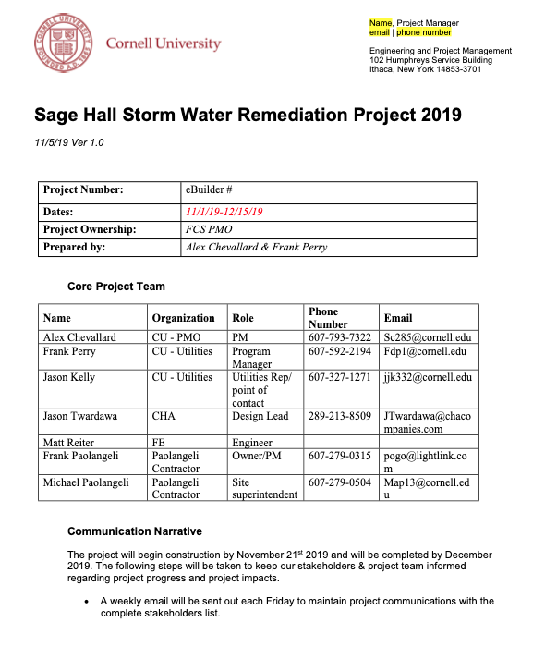
Project Communication Plan Template

Slide 5
Communication Beyond Meeting Minutes:
Constant Contact – E&PM Utilize Jessie’s group to provide these weekly
Notes:
Promote the great things that have happened and what to expect coming up.
PM to translate the 3 week look-ahead into a brief narrative.

Slide 6
Communication Beyond Meeting Minutes:
Constant Contact – E&PM Utilize Jessie’s group to provide these weekly

Slide 7
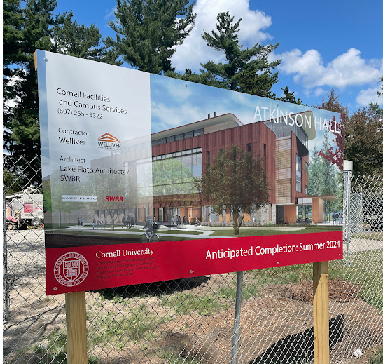
Communication Beyond Meeting Minutes:
Construction Sign:
(See Gdoc)
Notes:
Communicating to broader community

Slide 8
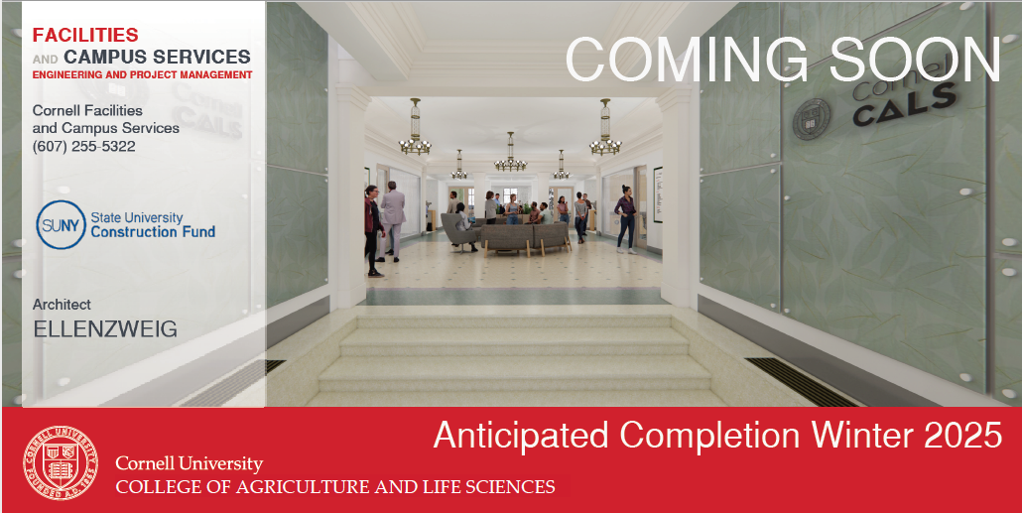
Communication Beyond Meeting Minutes:
Construction Sign:
Version of Exterior Construction Sign – applied to interior barriers at vacated space
Notes:
Communicating to broader community

Slide 9
Communication Beyond Meeting Minutes:
Directional Signage at Buildings / Sidewalks, etc.
Meetings to review upcoming shutdowns or impacts to circulation
Project Impact Statements in eB (Do them early – when known)
Department or College Presentations (PM may facilitate with AE, etc.) (Sometimes referred to as a “Town Hall Meetings”)
Keeping Building Manager and Maintenance Planner in the loop
Ensure project team knows where things are at – even if “spinning” in the background trying to get additional info from AE, Supplier, GC, etc.
What works for some may not for others – are they meeting focused, e-mail,or phone call people?
When info does not travel well (Up or down or across) – how can the PM facilitate or improve communication?
Notes:
Communicating to broader community

Slide 10
PMPD Presentation on Project Communication
Questions?
E&PM
Sept. 27, 2022

