Slide 1
Bird Friendly Building Design for New Construction Standard
September 27, 2022
Notes:
JS and Nadine Introduc

Slide 2
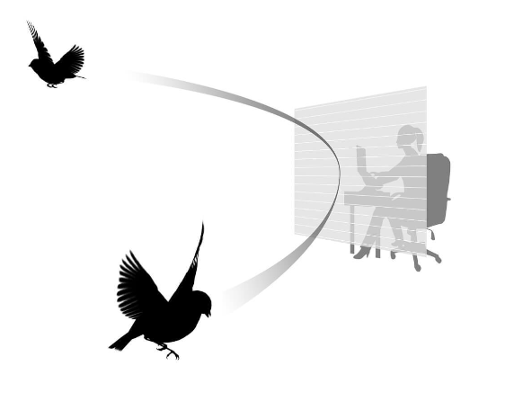
Bird Friendly Design for New Construction Standard
Introduction of Cornell University Standards Team
Purpose and Need
Precedents and Related Standards
New Construction Examples at Cornell University
Key Aspects of the Standard
Costs
Existing Conditions
Questions
Notes:
JS

Slide 3
Cornell University Bird Friendly Design Standards Team
Lab of Ornithology (Lab of O)
Miyoko Chu, Senior Director, Science Communications
American Bird Conservancy (ABC)
Christine Sheppard, Director, Glass Collisions Program
Bryan Lenz, Glass Collisions Program Manager
Facilities and Campus Services (FCS)
J Shermeta, Associate University Architect
David Cutter, University Landscape Architect
Nadine Hachmann, Section Manager Architecture & Civil Engineering
Notes:
JS

Slide 4
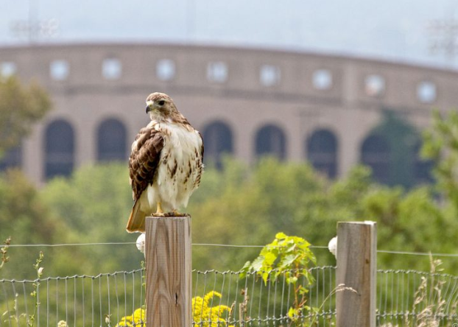
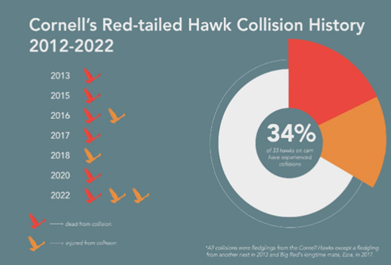
Purpose and Need
Collisions with glass claim the lives of millions of birds every year. Birds are unable to pick up clues that windows are present and frequently don’t survive the impact. Because of this, cities and states in North America are adopting bird-friendly guidelines to improve the bird safety of building materials and designs.
The Cornell campus is renowned for the wealth of the natural environment from the Botanic Gardens and the Arboretum to the gorge woodlands settings, birds of many varieties, consider Cornell their home.
The purpose of this standard is to reduce bird strikes on new construction on the Ithaca campus.
Notes:
Nadine

Slide 5
Precedents and Related Standards
General Services Administration P100
In June 2020, the House of Representatives passed H.R. 2, the Bird Safe Buildings Act, which mandates all public buildings managed by GSA to be designed or altered in a bird friendly manner.
LEED Credit #55: Reducing Bird Collisions
Leadership in Energy and Environmental Design (LEED) acknowledges the importance of bird-friendly design and related measures through an INNOVATION credit.
In addition, taking steps to reduce bird collisions with glass supports the intention of Executive Order 13186: Responsibilities of Federal Agencies to Protect Migratory Birds.
The Yale Bird-Friendly Building Initiative
Princeton University Bird Safe Building Design
University of Pennsylvania Bird-Friendly Design Guidelines
Notes:
JS

Slide 6
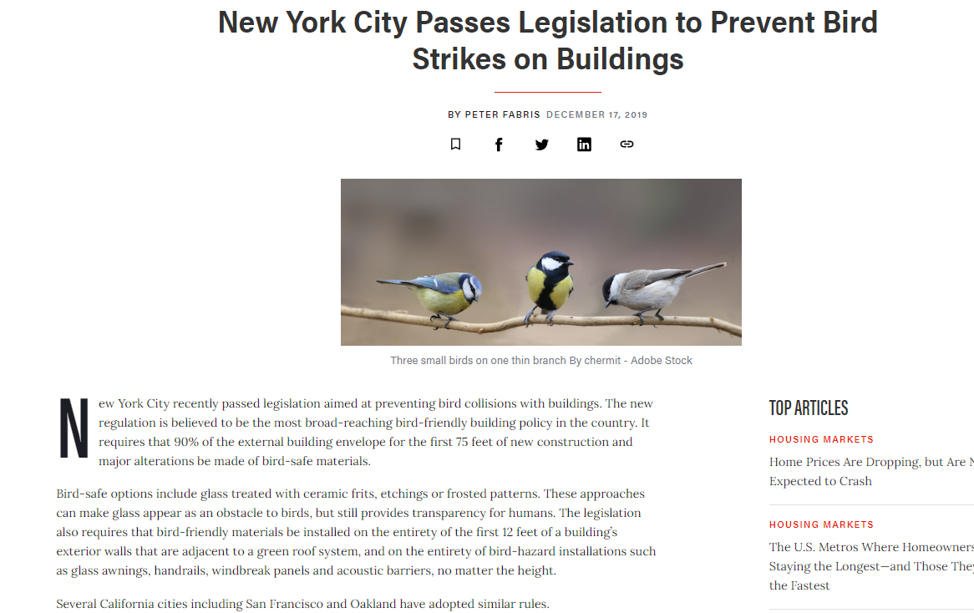
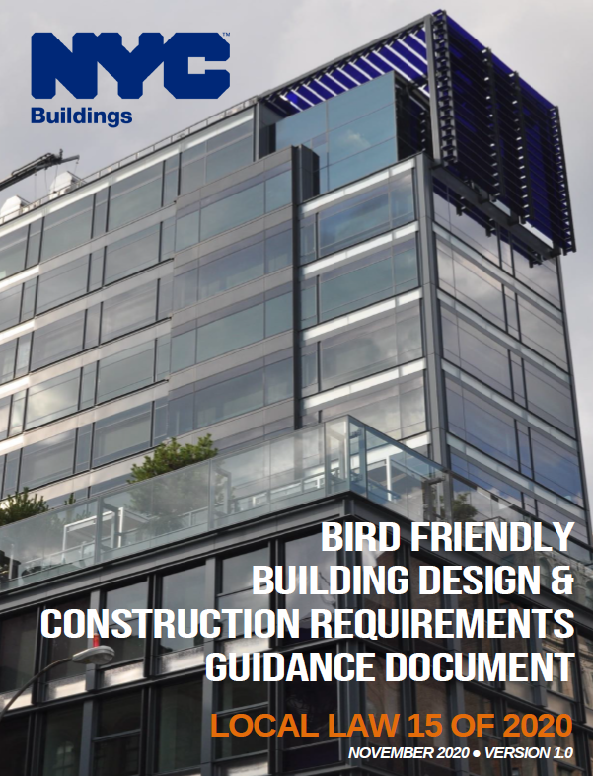
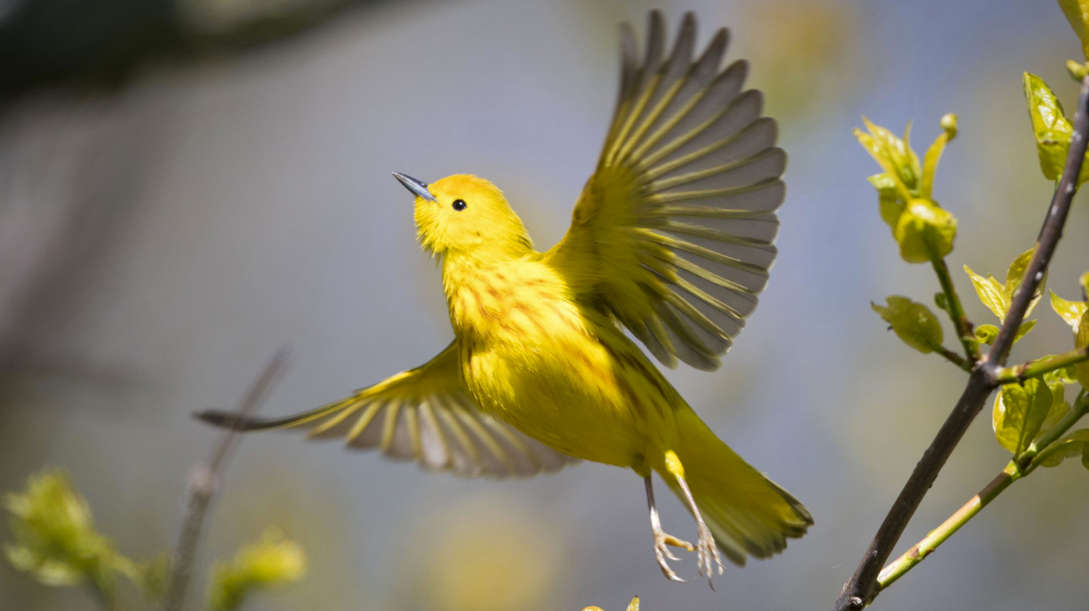
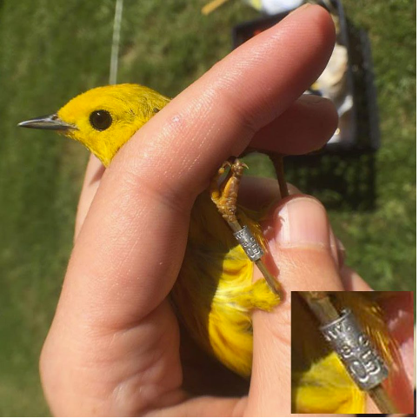
Thurston Hall Addition
Local Law 15 of 2020
Requires 90% of envelope for first 75 feet of new construction and major alterations that replace all exterior glazing be made of bird-safe materials
Effective January 10, 2021
Notes:
JS

Slide 7
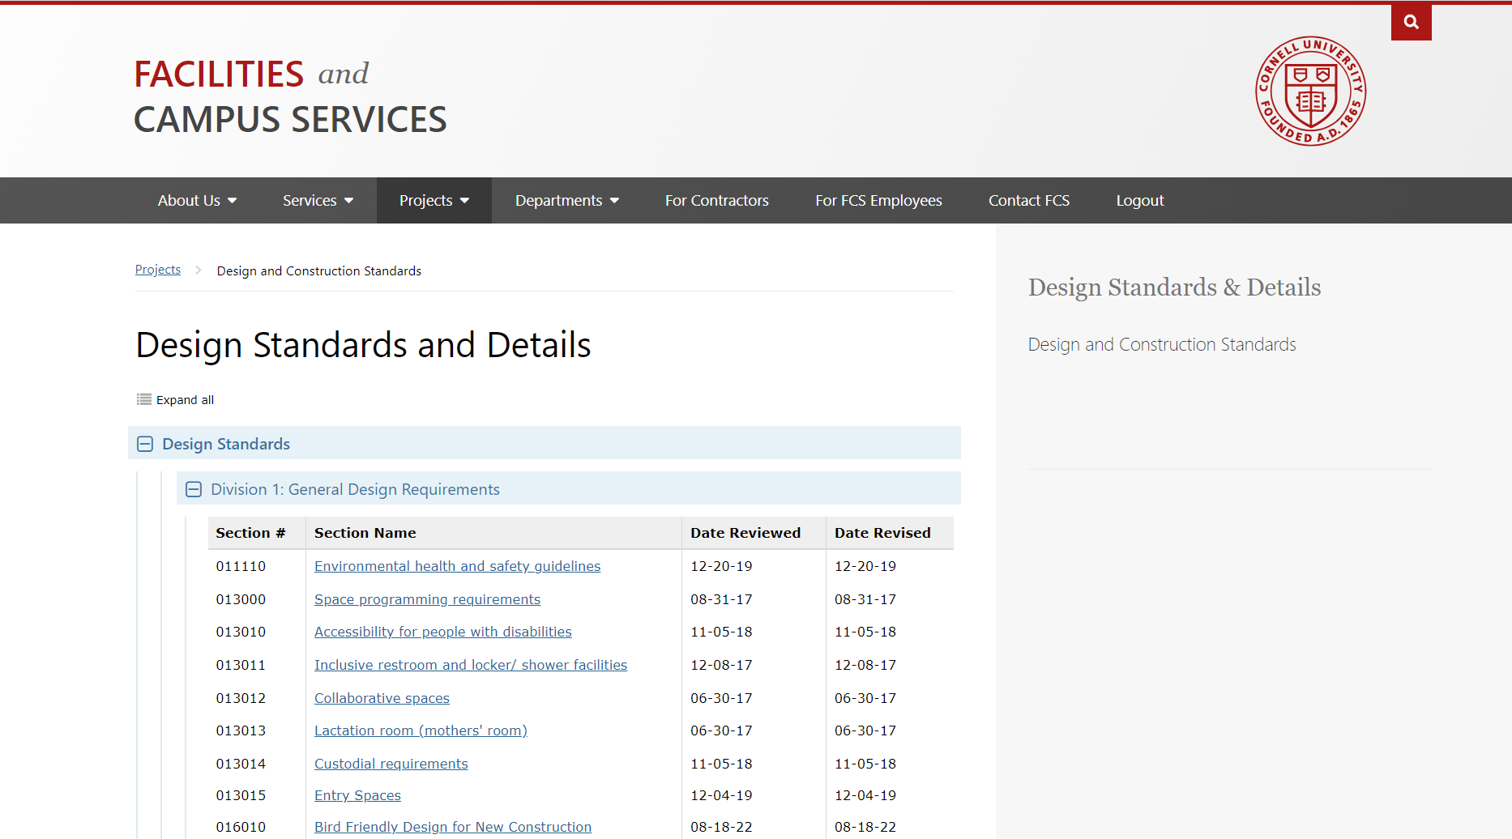
Bird Friendly Design for New Construction
Key Takeaways:
Develop site design and building shape to mitigate bird strikes
Fritted glass or UV reflective glass on large areas of glazing
Prioritize large glazed areas near landscaped elements such as roof gardens, glass corners, and glass building connectors for bird friendly materials
Design team to explore appropriate pattern based on building and material design
Cost for addition of frit pattern to be tracked through each phase
Notes:
Nadine

Slide 8
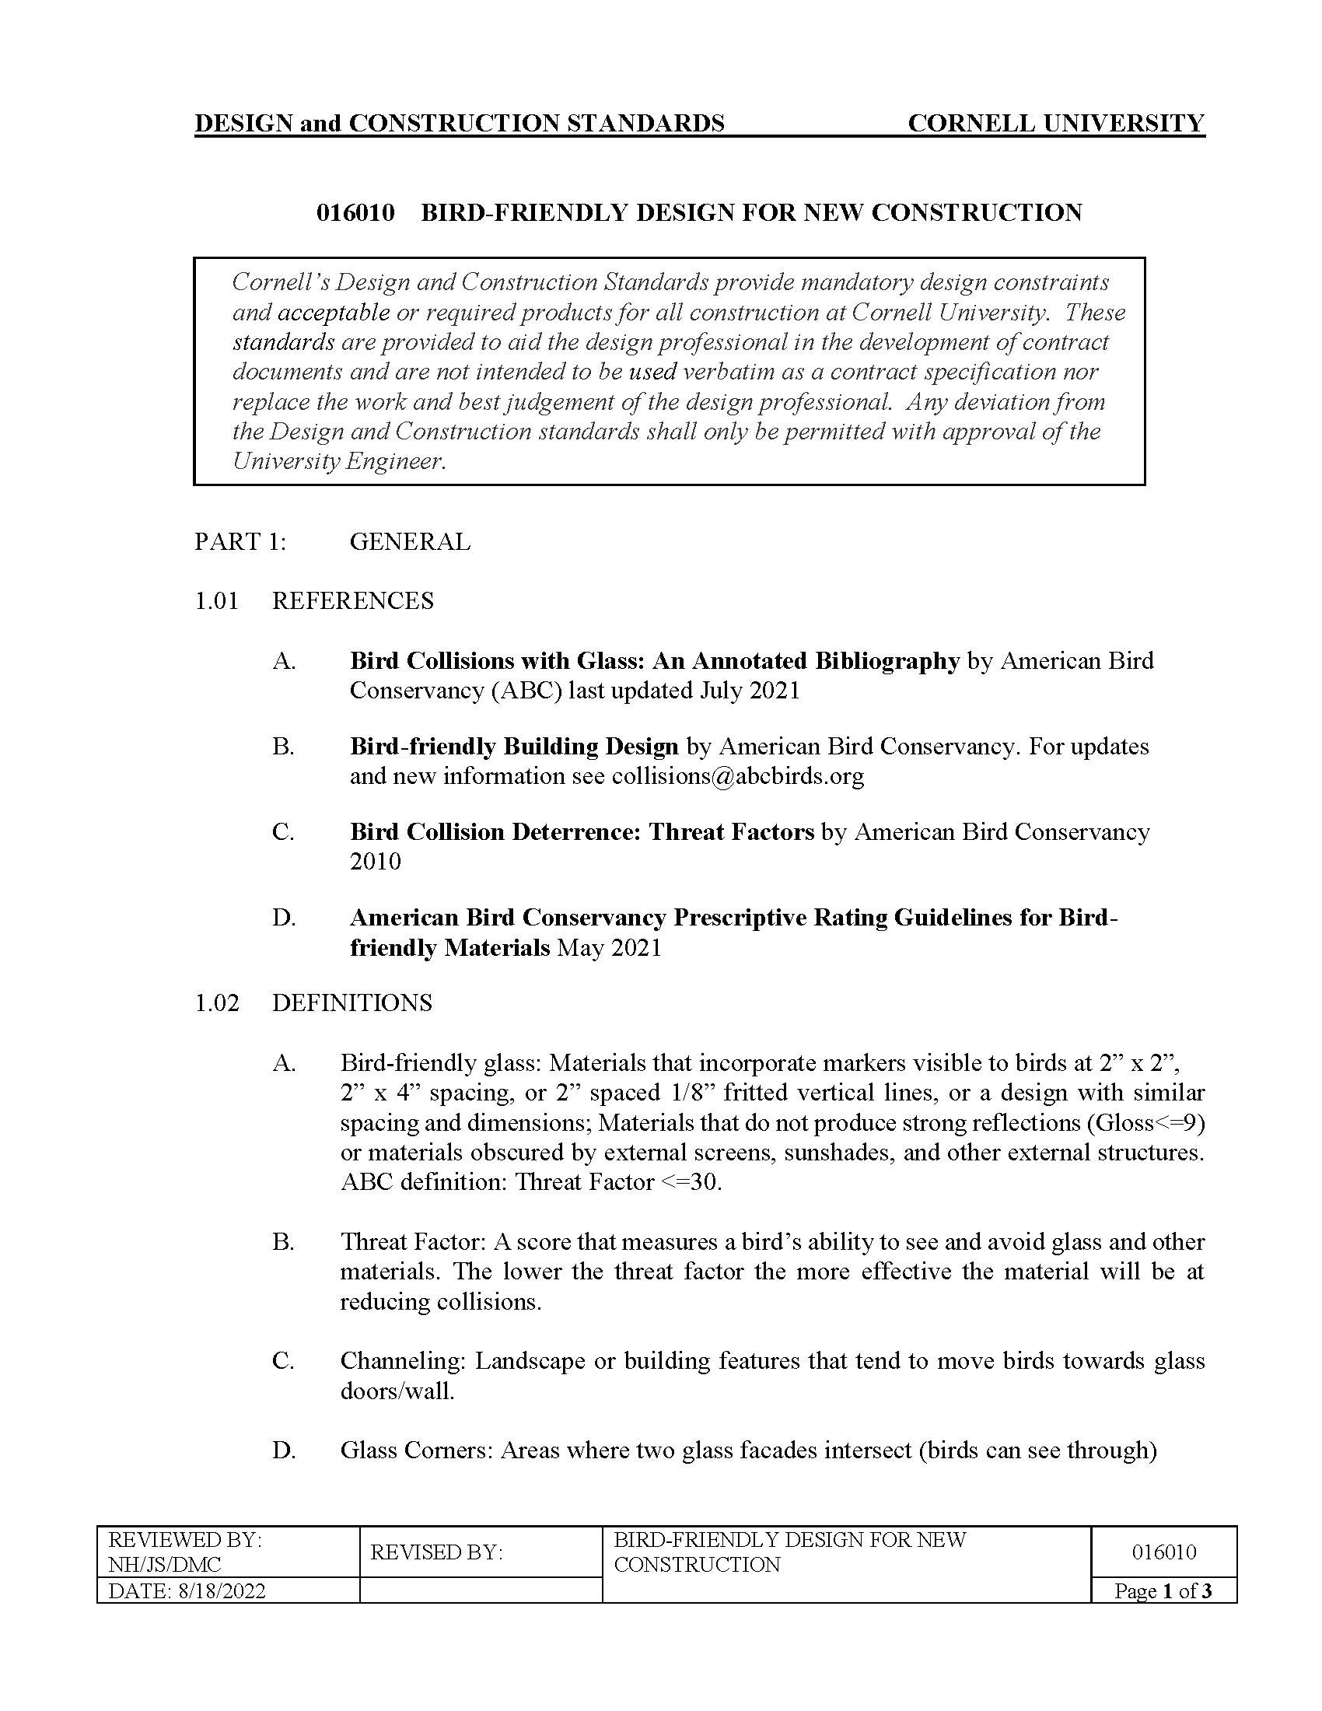
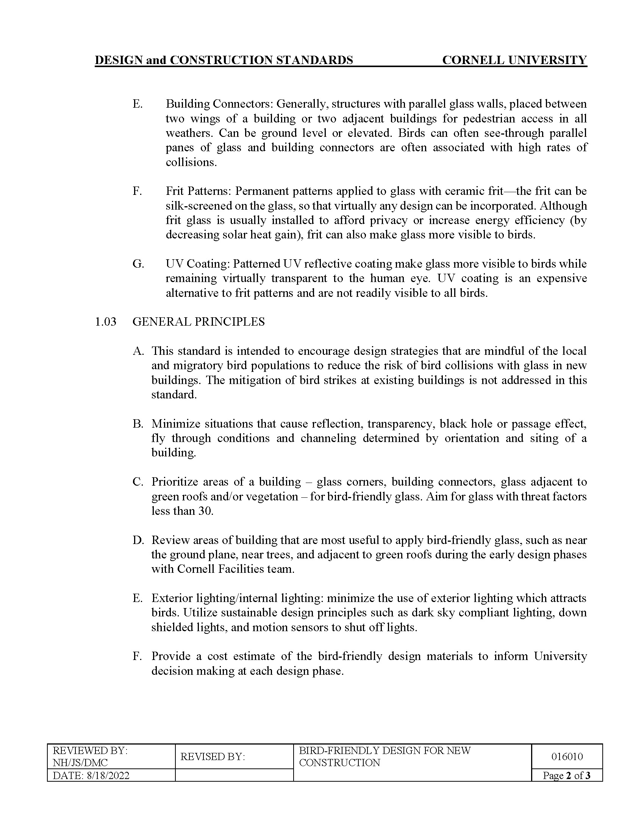
Bird Friendly Design for New Construction
Notes:
Nadine

Slide 9
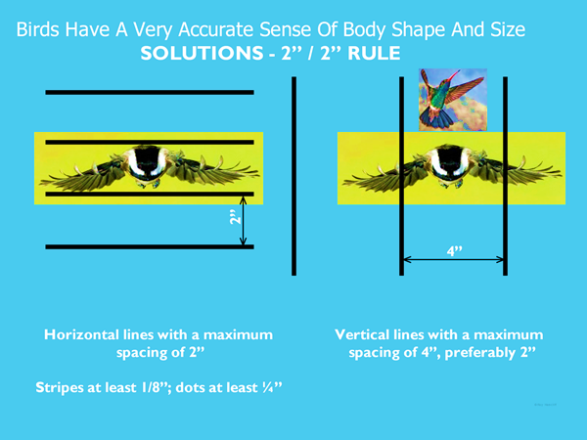
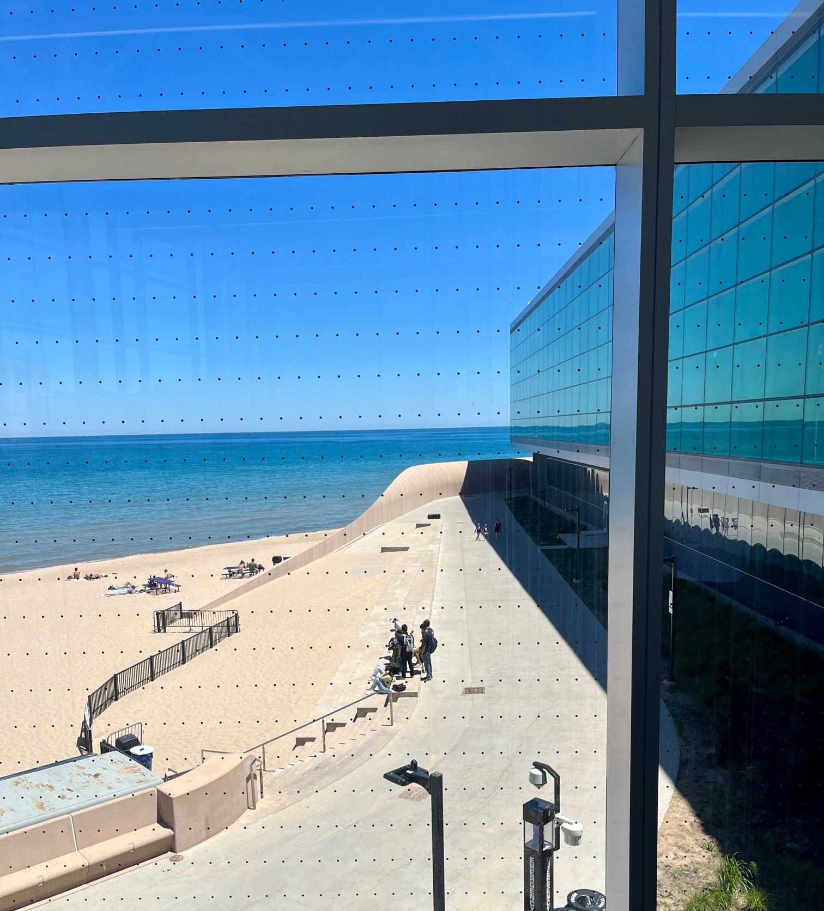
Frit Patterns
Northwestern University FieldHouse, Perkins + Will 2018
Notes:
Nadine

Slide 10
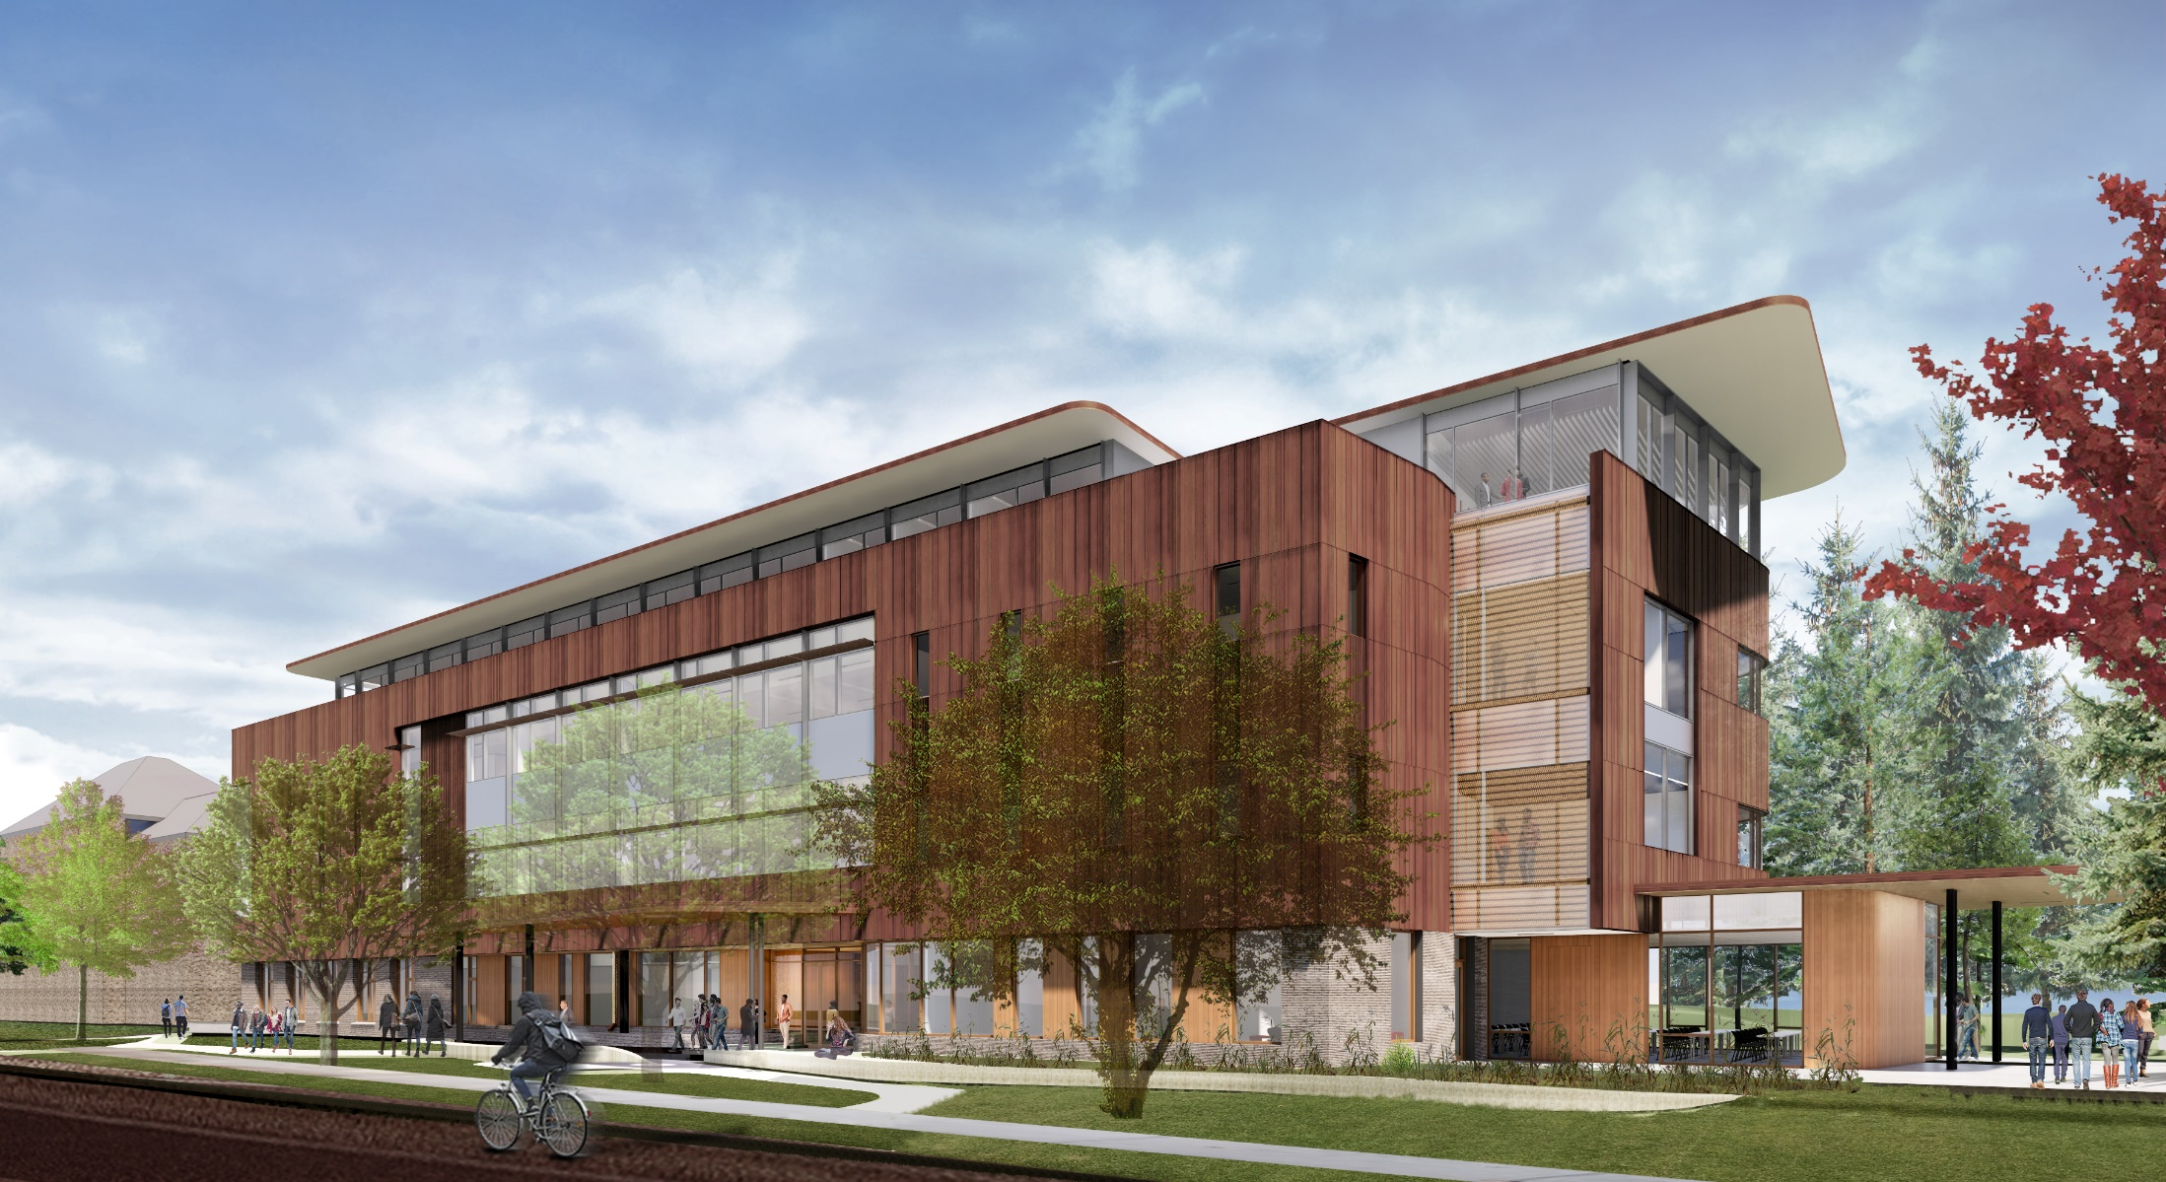
Multidisciplinary Building – Atkinson Hall
Notes:
JS

Slide 11
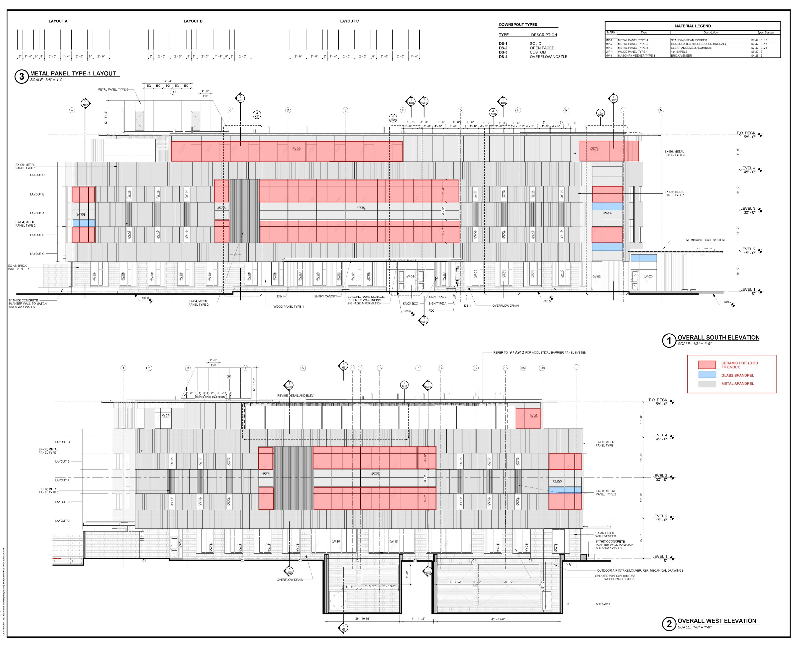
Multidisciplinary Building – Atkinson Hall
Glass ceramic frit pattern :
1/8” thick vertical lines on 2” centers on all large glazed openings
Notes:
JS

Slide 12
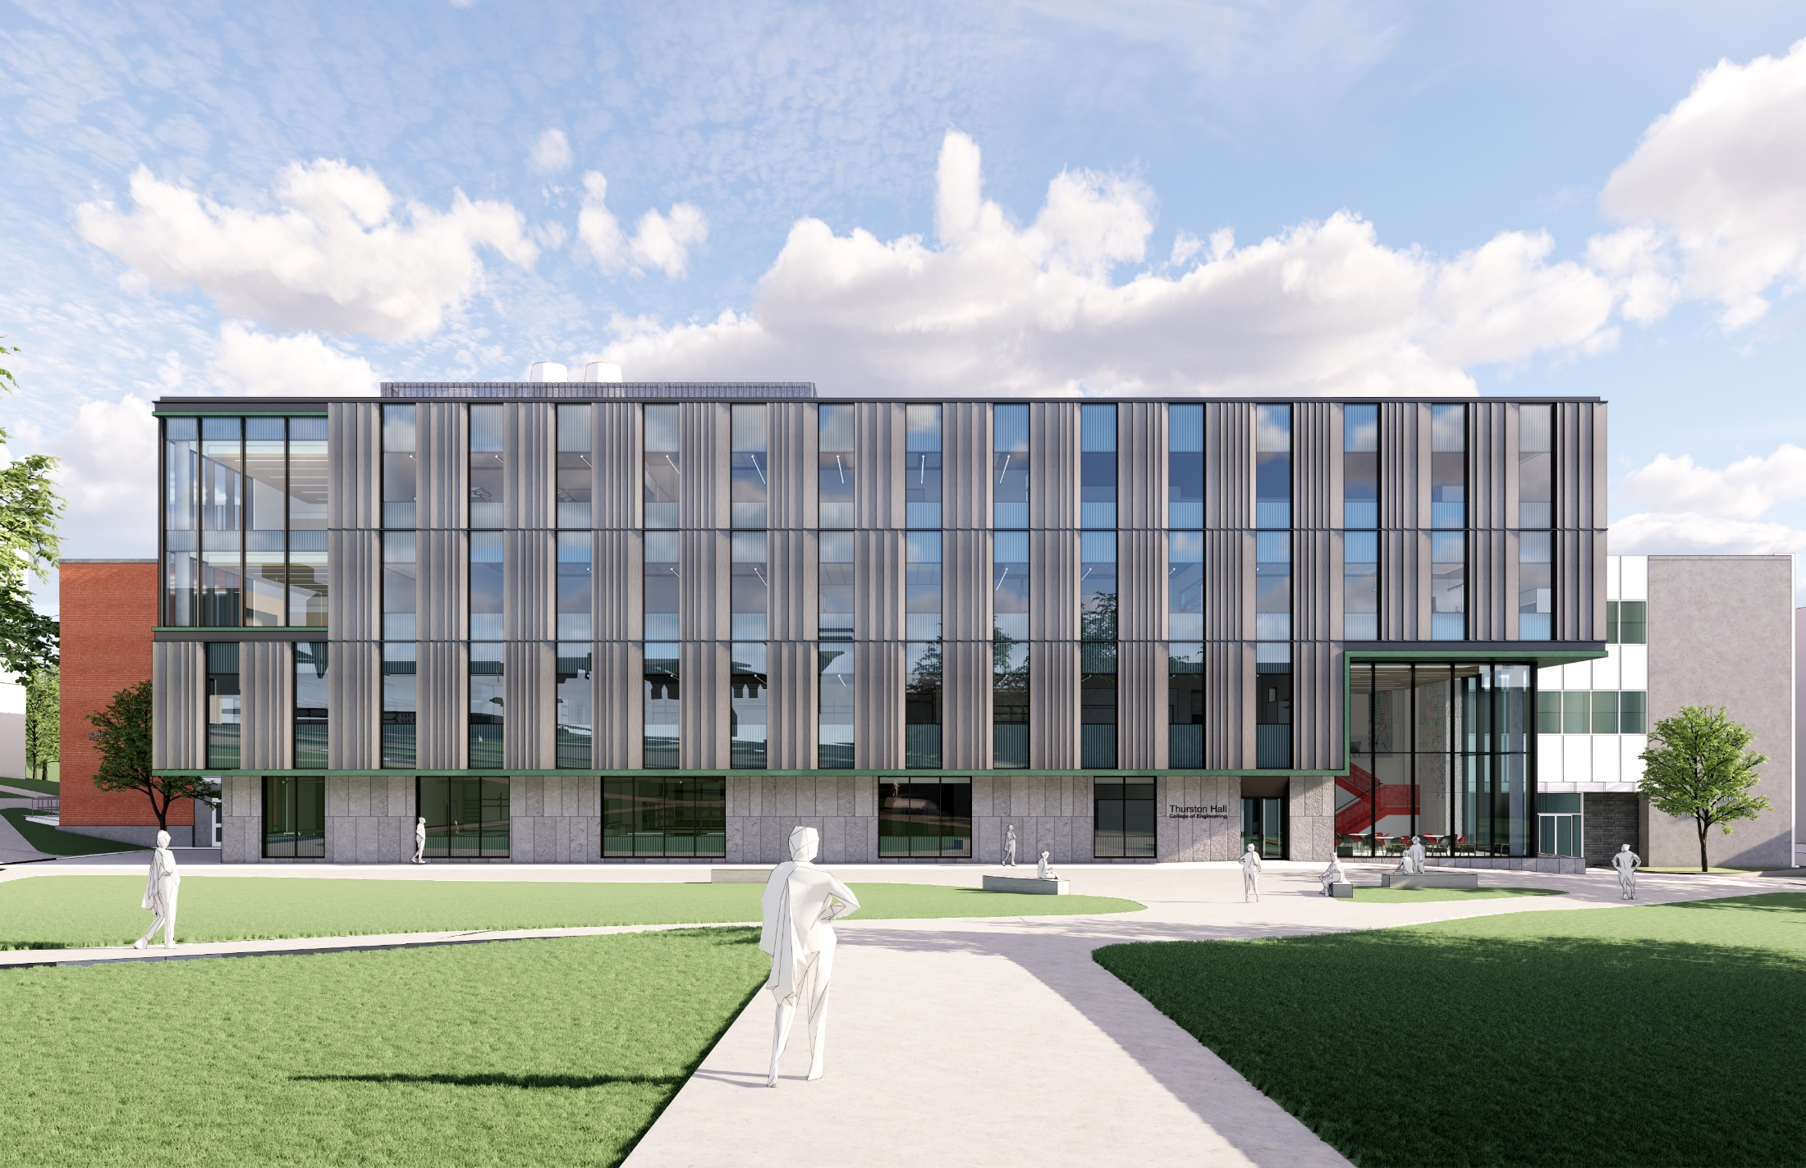
Thurston Hall Addition
Notes:
JS

Slide 13
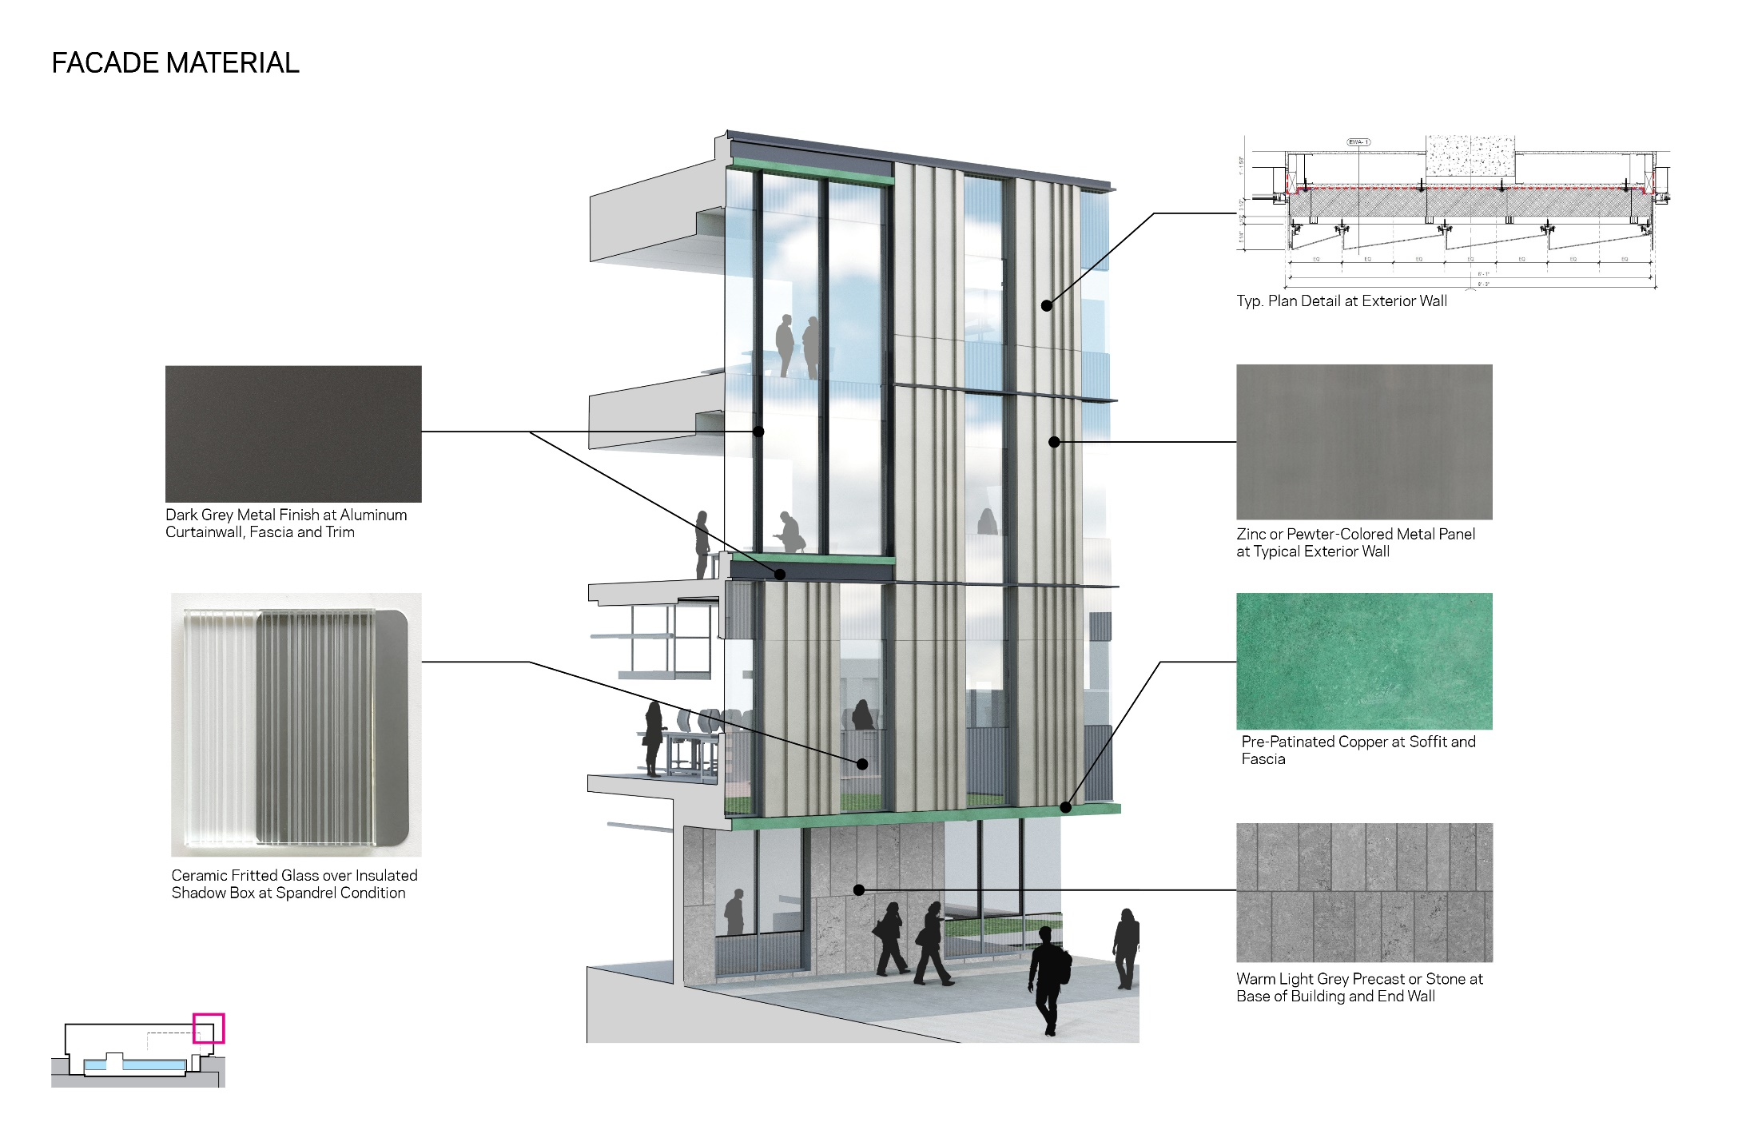
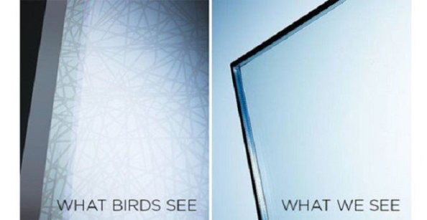
Thurston Hall Addition
Ornilux Glass with patterned UV reflective coating
Notes:
JS

Slide 14
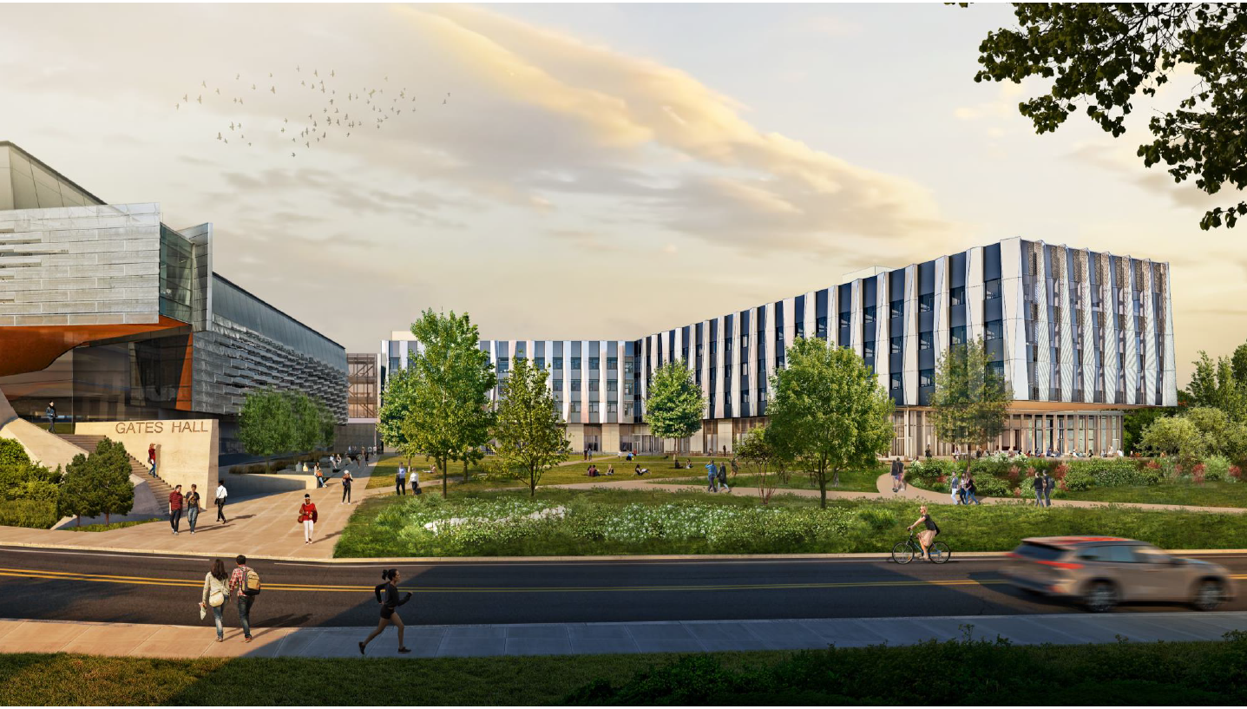
CIS Building
Notes:
JS

Slide 15
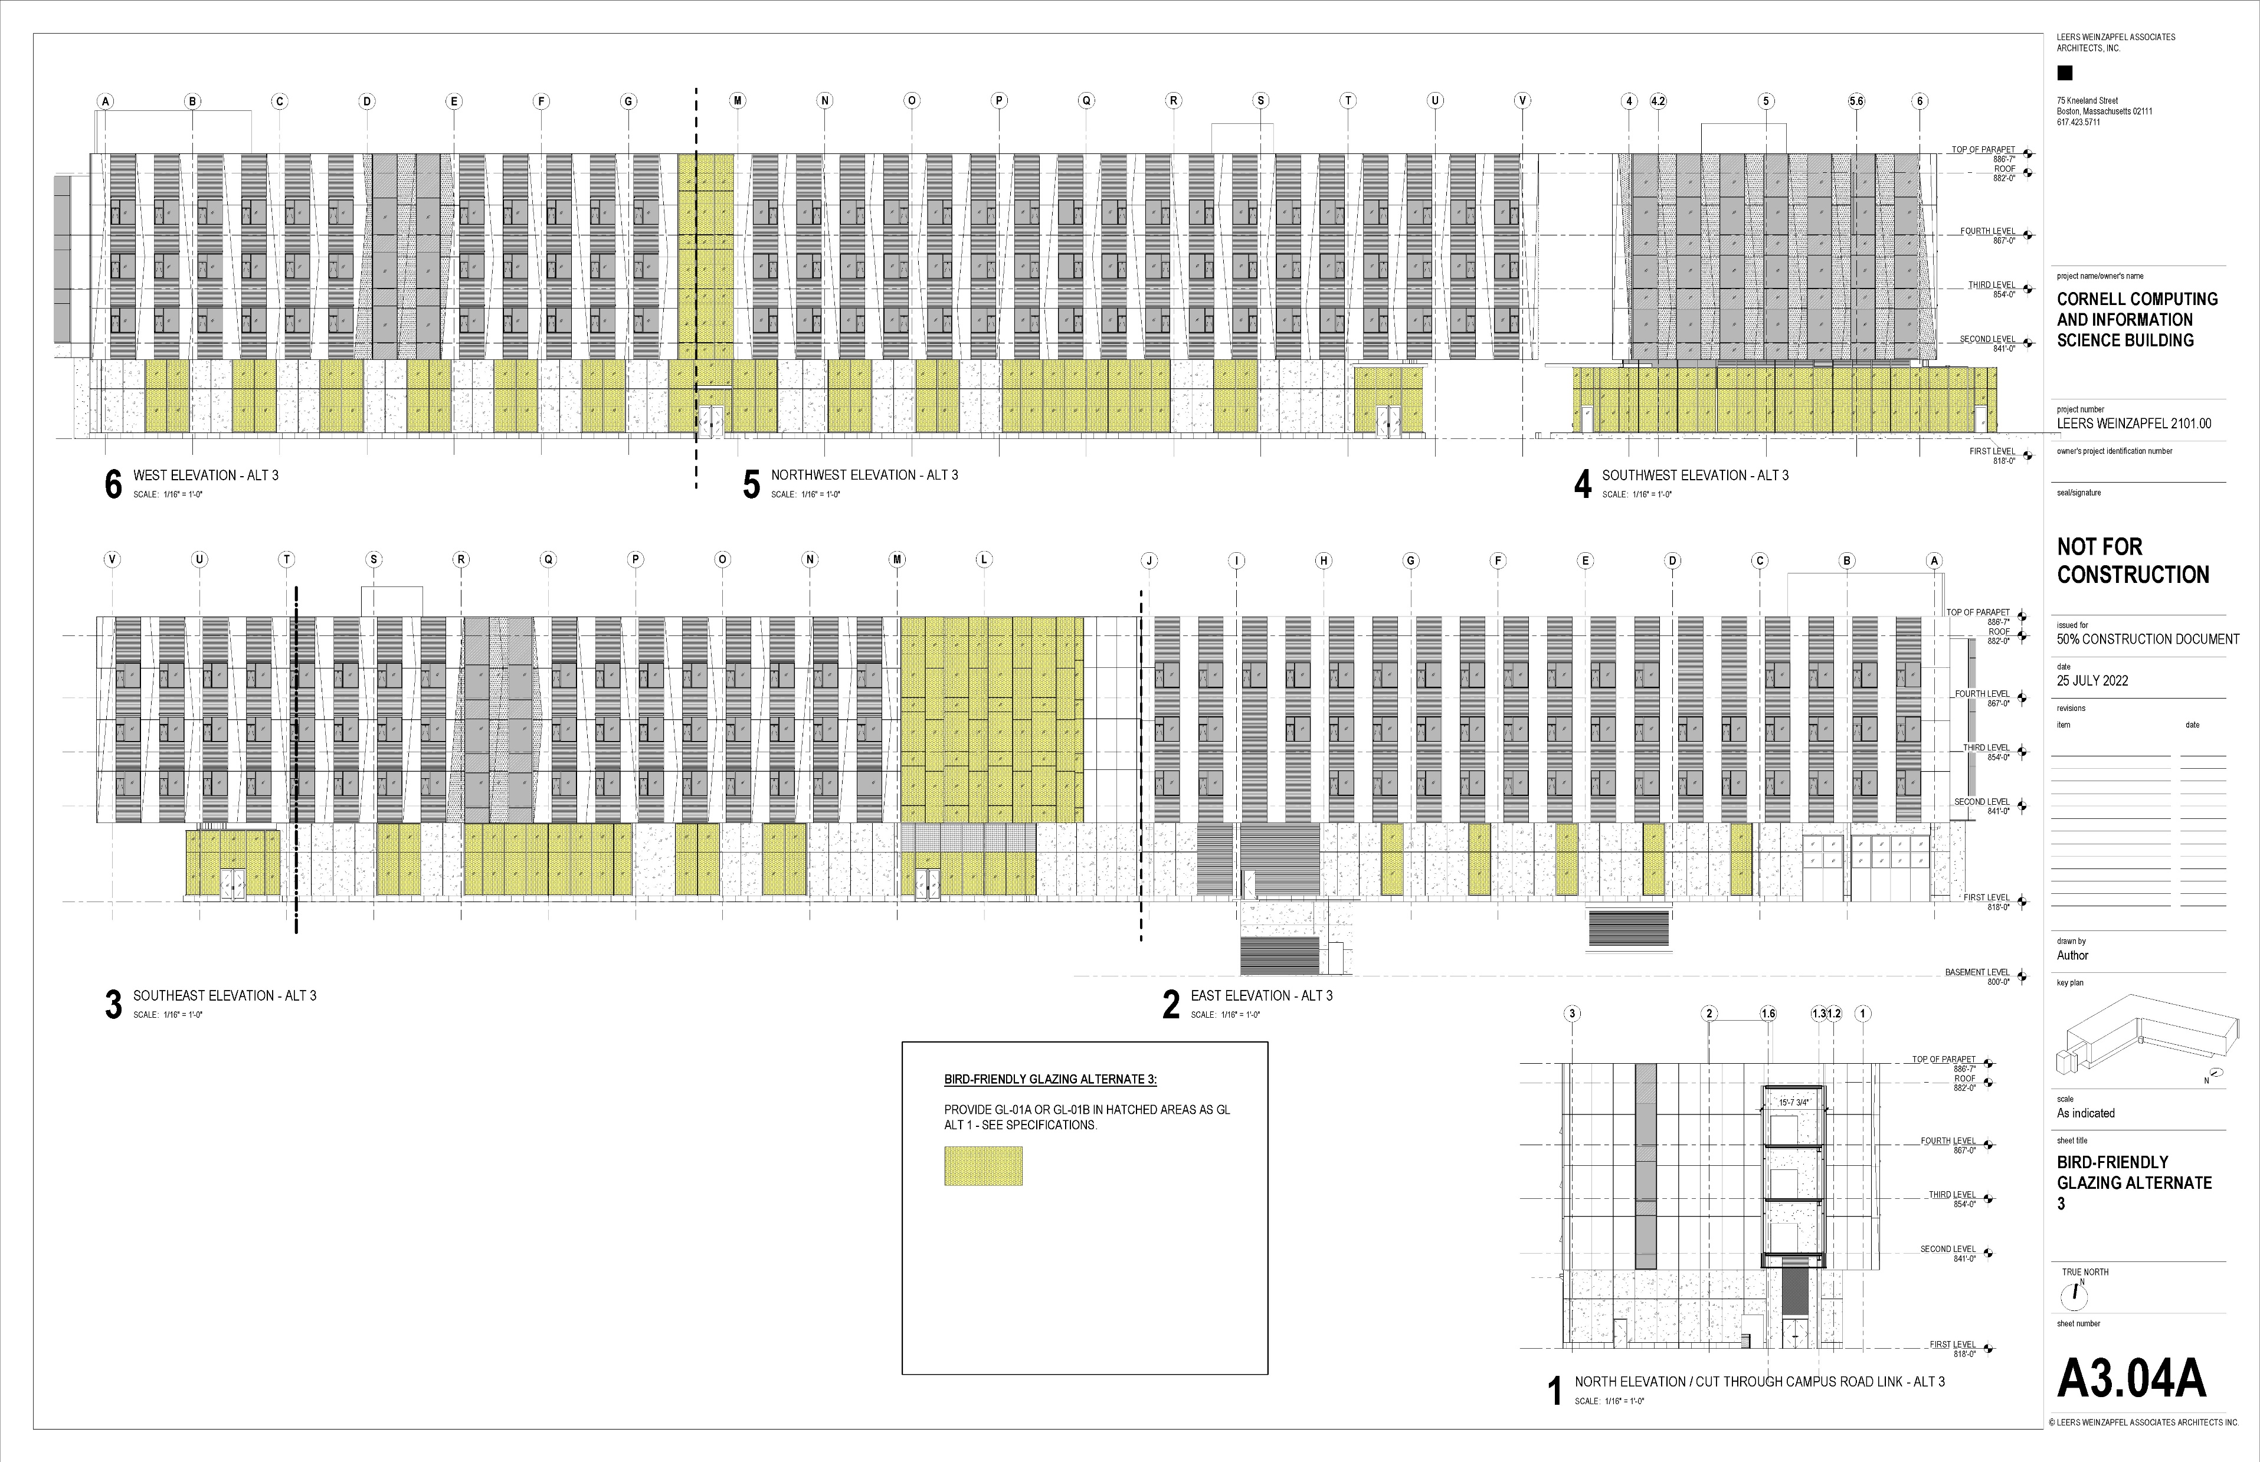
CIS Building
Glass ceramic frit pattern
1/8” thick vertical lines on 2” centers on all large glazed openings
Notes:
JS

Slide 16
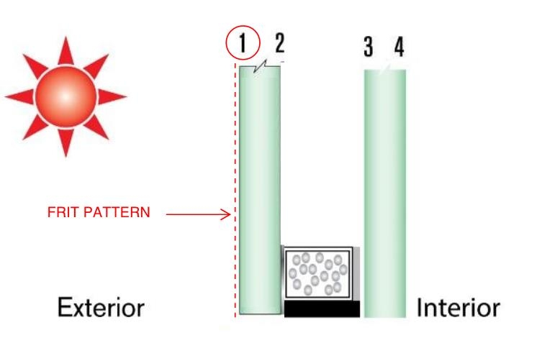
Cost
Standard commercial Double Insulated Glass Unit = $15/sf
Standard 6” curtain wall installed = $110/sf
With a frit pattern = add $20/sf for bird safe frit pattern = $130/sf
UV reflective coating = add $30/sf for bird safe UV reflective coating = $140/sf
10’ x 10’ area of standard 6” curtain wall with bird safe frit pattern = $13,000/100 sf
10’ x 10’ area of standard 6” curtain wall with UV reflective coating = $14,000/100 sf
Notes:
Nadine

Slide 17
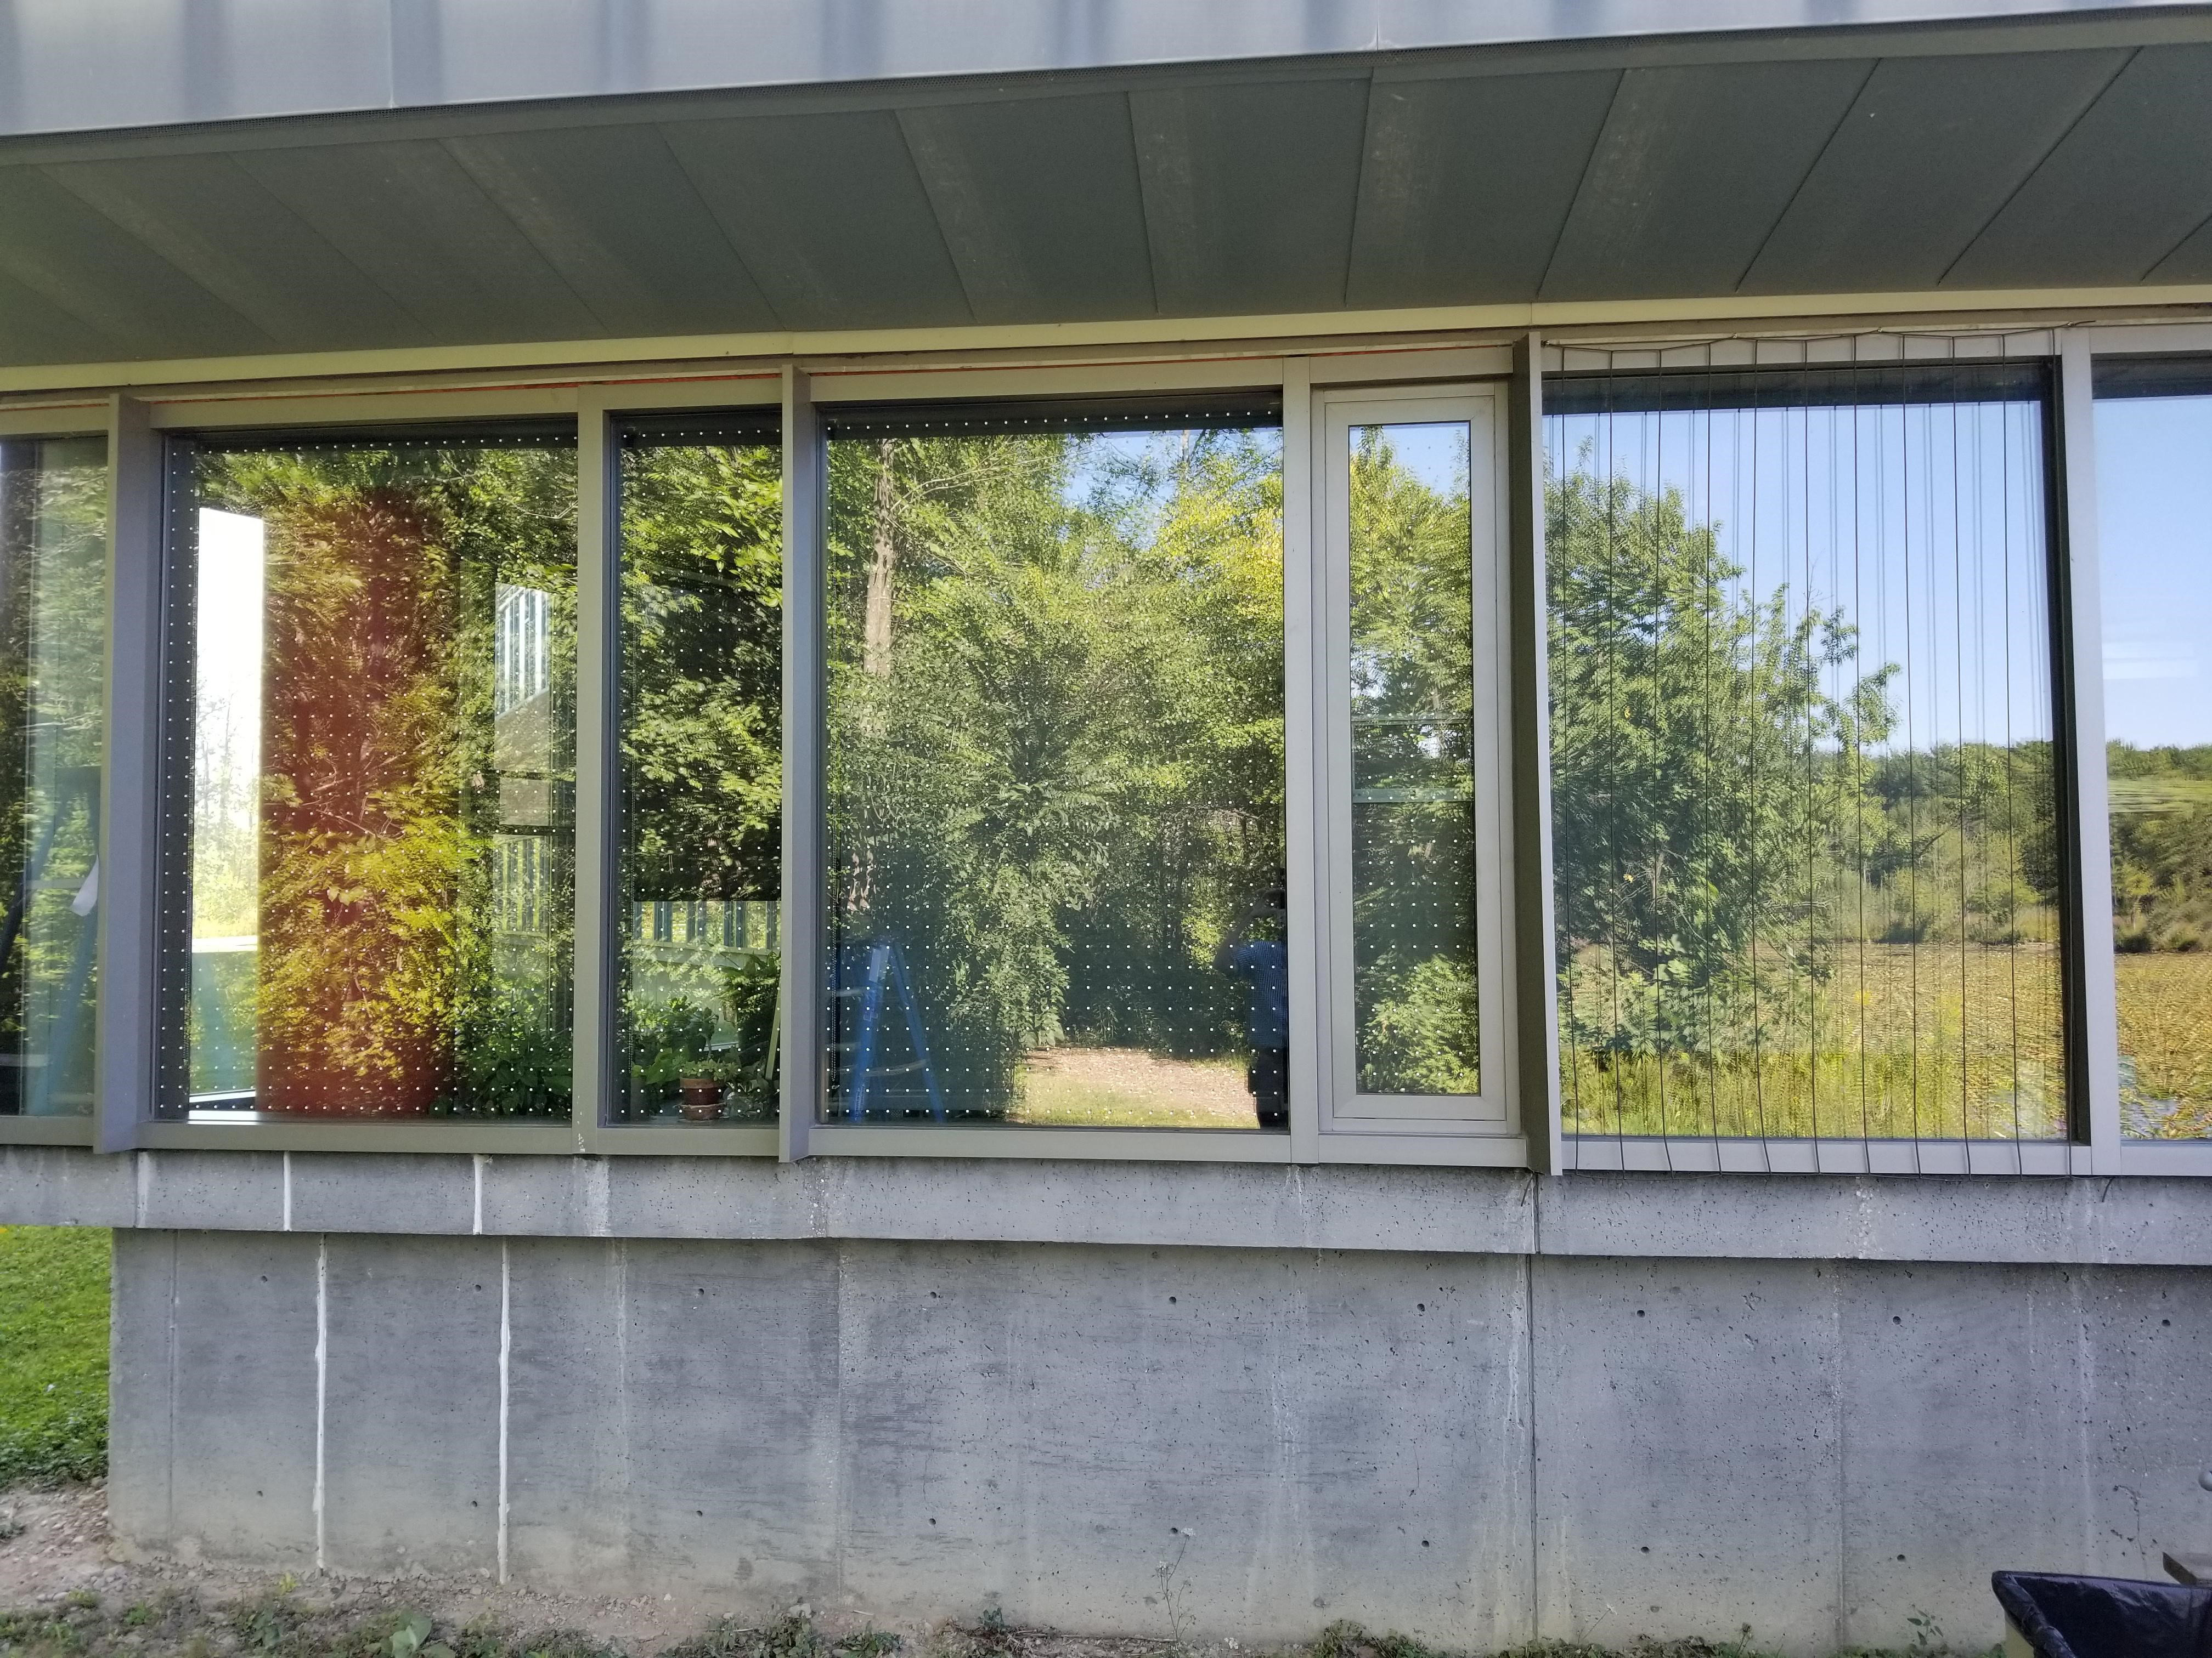
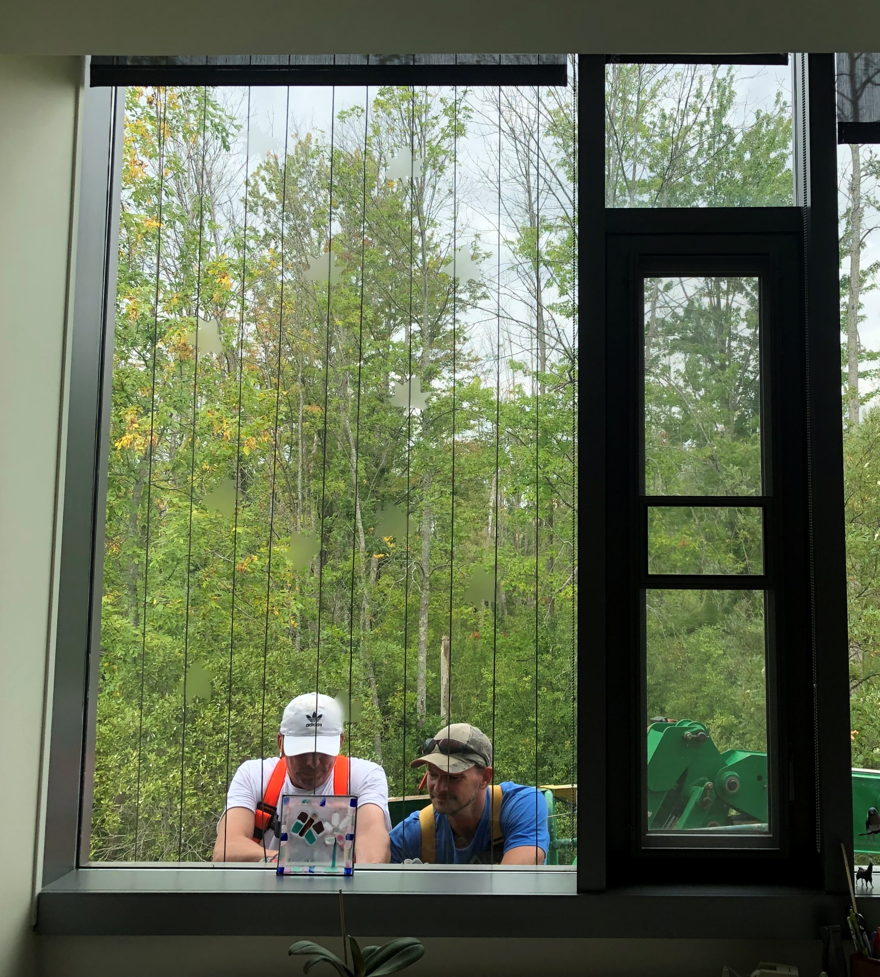
Existing Conditions
What are the opportunities on the Cornell University Campus to treat existing glass to reduce the hazards to birds?
Lab of Ornithology has completed a pilot program on glass facades at their facility and selected Acopian Birdsavers.
Notes:
JS

Slide 18
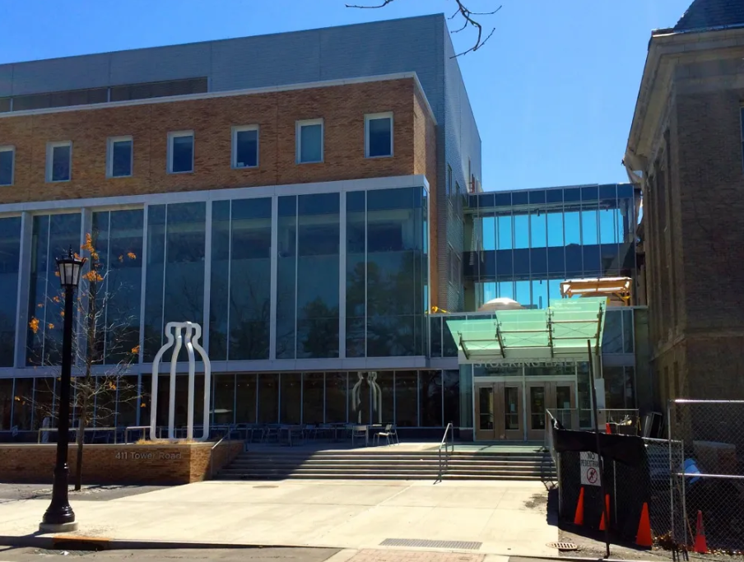
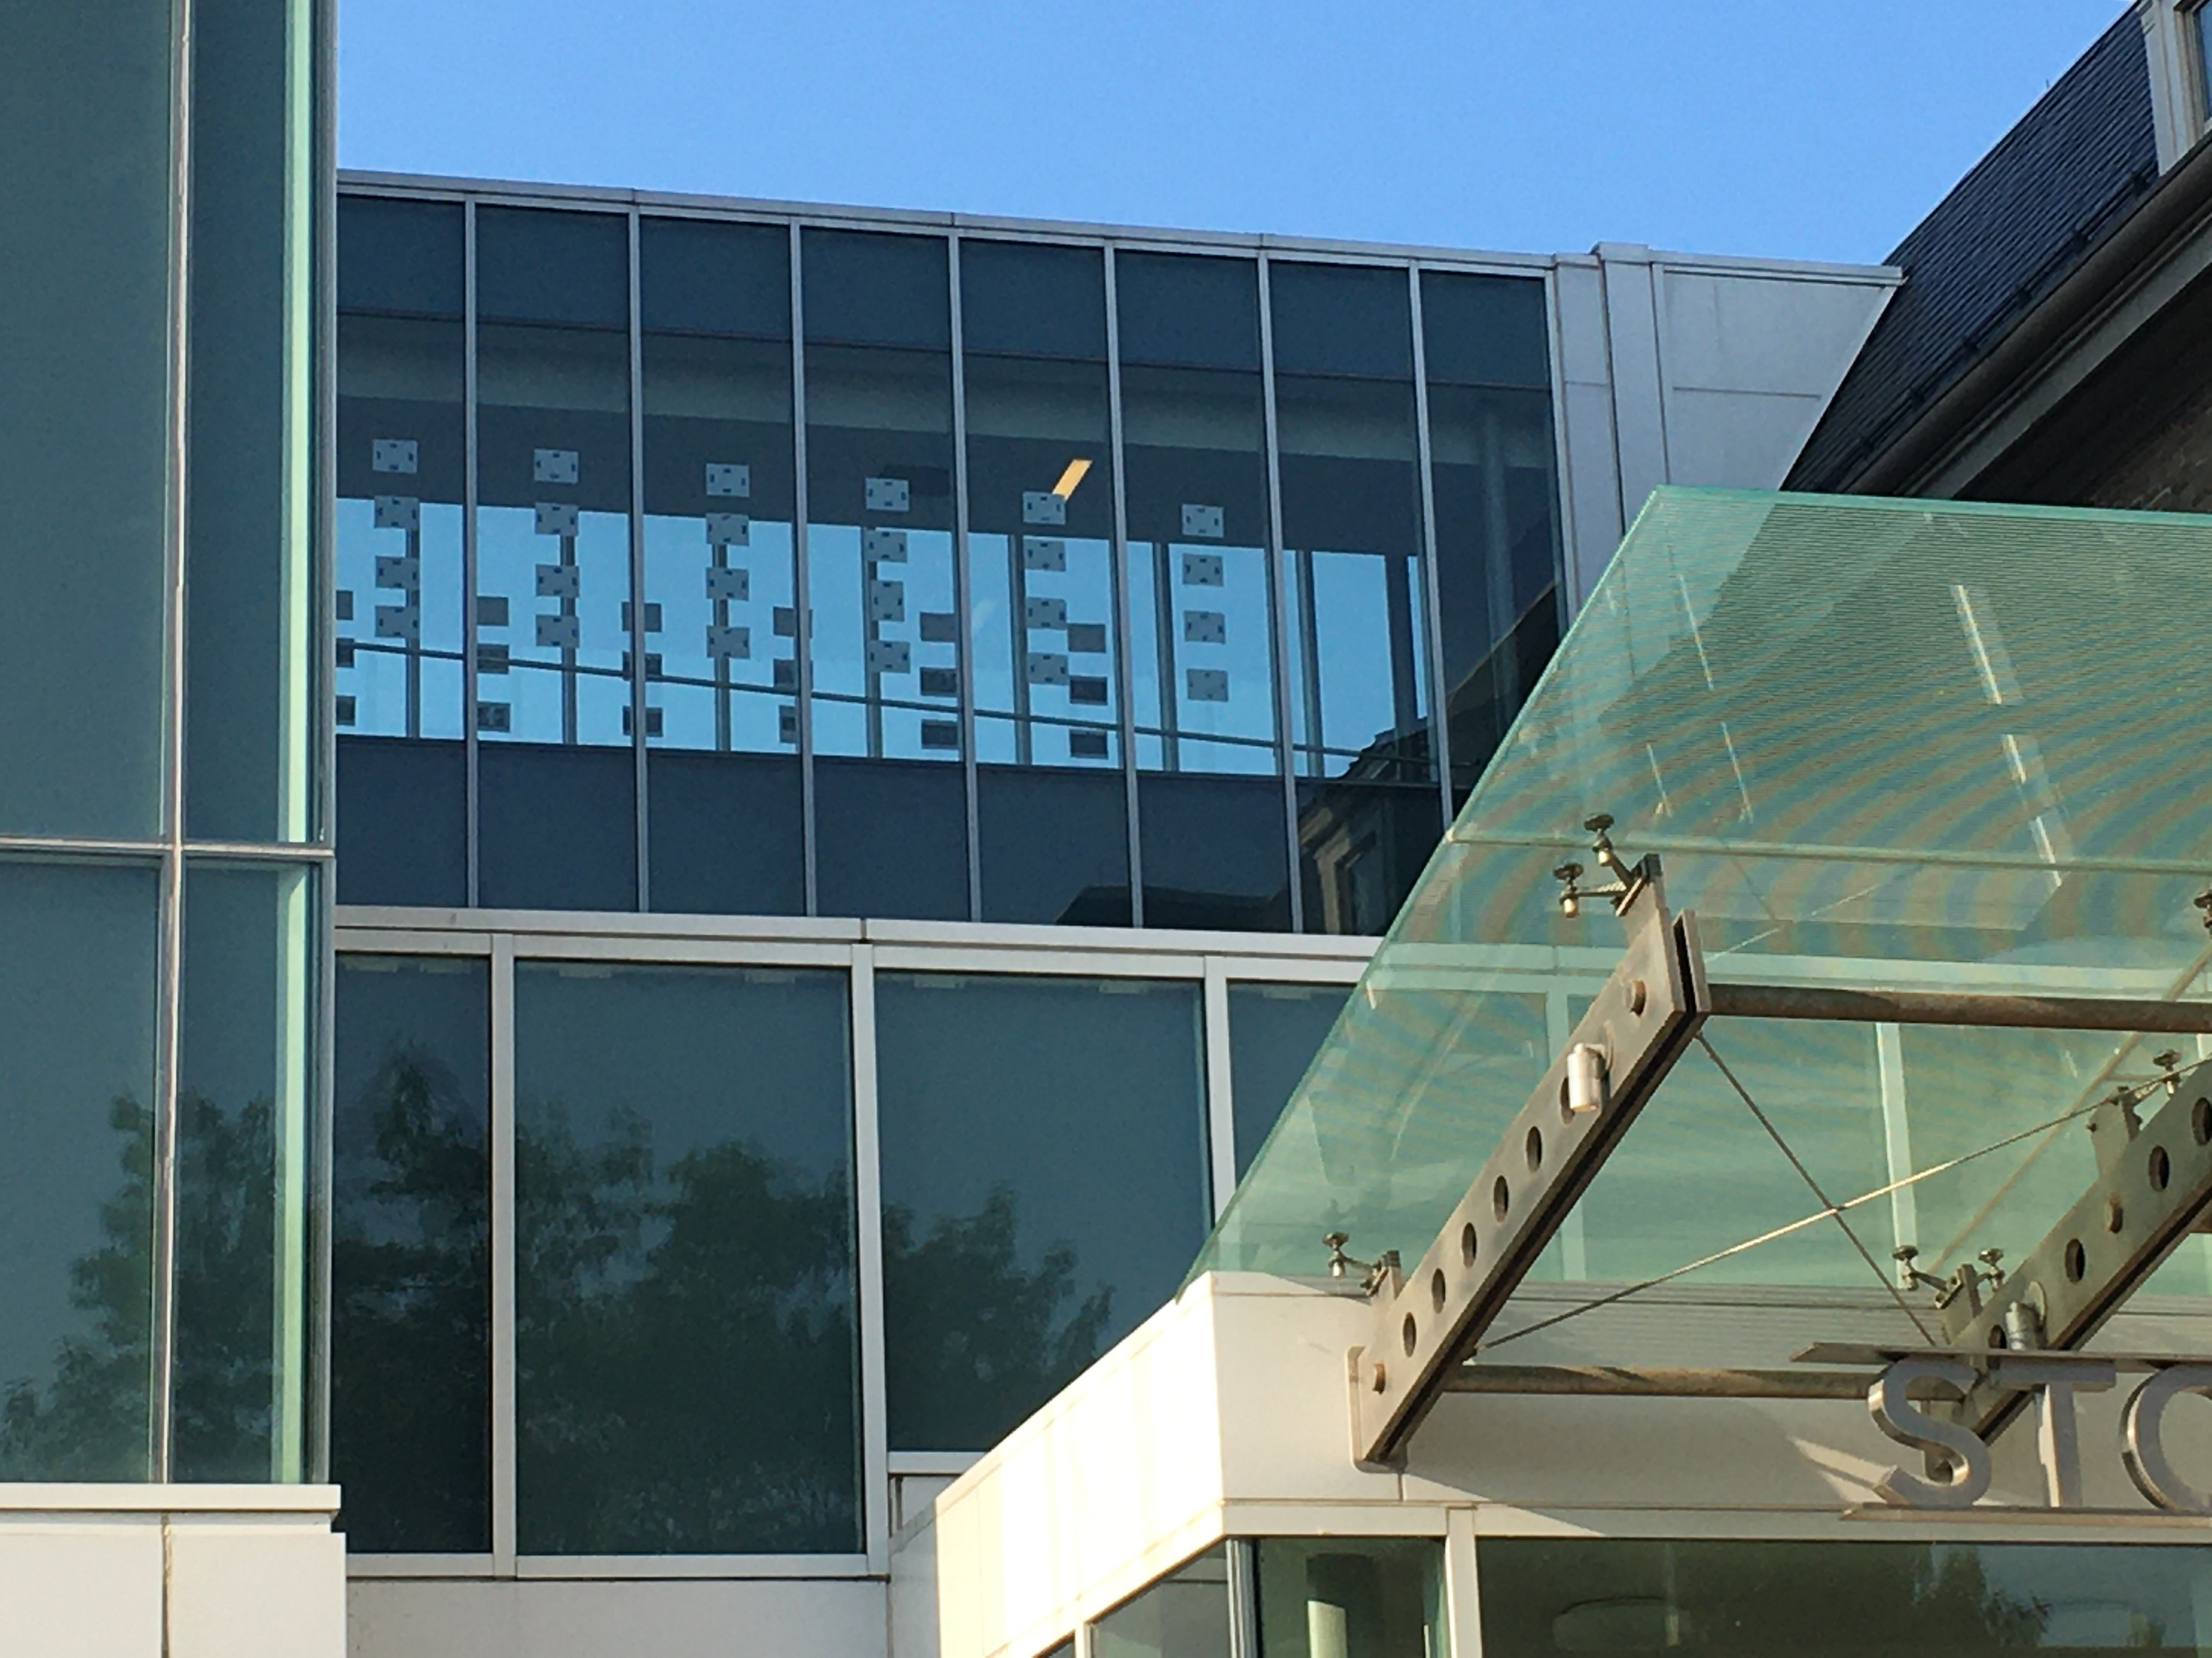
Existing Conditions
Following 4 bird strikes at Stocking Hall the Lab of O and ABC met with facilities directors and building managers to discuss the window strikes. Lab of O and ABC are providing an estimate for retrofits on the breezeway glass for two options, adhesive film and acopian birdsavers.
Lab of O and ABC are actively engaged with two donors interested in funding a student-led monitoring program and providing matching funds to help offset costs of retrofits—which could apply across different buildings.
If a pattern is applied to the interior surfaces of glass, it is only visible if the glass has less than 15% reflectivity. During design phase, discuss reflectivity of glass with design team.
Notes:
JS

Slide 19
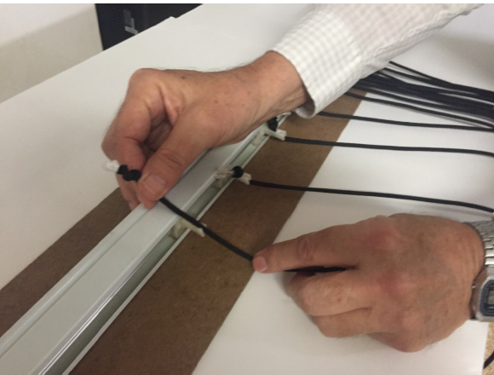
Cost Comparison
With acopian birdsavers = add $10/sf for paracord and installation
With bird friendly adhesive film = add $14/sf for bird friendly adhesive film
With a frit pattern = add $20/sf for bird safe frit pattern
Lifetime expectancy of adhesive film is +/- 15 years.
Advantage to frit patterned glass is no maintenance, frit pattern will last for the life of building. A frit pattern also decreases solar heat gain.
Acopian birdsavers has a higher effectiveness rating but not practical for many installations
Notes:
Nadine

Slide 20
2 takeaways
The Bird Friendly Building Design for New Construction Standard is in the General Design Requirements
The cost to retrofit far exceeds the first time cost for bird friendly design
Questions?
Notes:
JS

