Slide 1
Project Management Professional Development Series
September 27, 2022
Facilities and Campus Services Engineering and Project Management

Slide 2
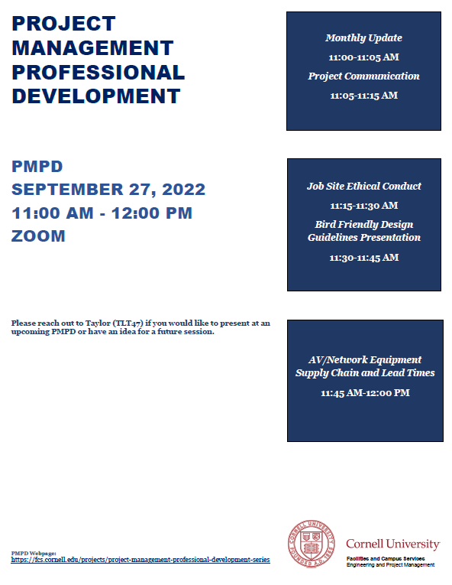
Today’s Agenda
Monthly Update
Taylor Thompson
Job Site Ethical Conduct
Brenda Frank and Rob Hoon
Project Communication
Brad Newhouse
Bird Friendly Design Guideline
Nadine Hachmann and J Shermeta
AV/Network Equipment Supply Chain and Lead Times
Joseph Blasz and Andrew Page

Slide 3
New Resources
Building Emergency Responder Radio Coverage (BDA) Systems Gdoc
Find it under Design and then Process
Defines what a BDA system is for PMs, explains when projects should consider them, and details how to scope, design, install, and test system
Project Labor Requirements Gdoc
Find it under Administration
Provides info for PMs regarding labor requirements when executing construction. Ensure projects are executed with appropriate labor and minimize grievances.
FCS EPM Tableau Dashboards Gdoc
PAR Chart – a dashboard created for FCS leadership and PMs to view all PARs per project and each PAR’s details
Find it under Administration
3

Slide 4
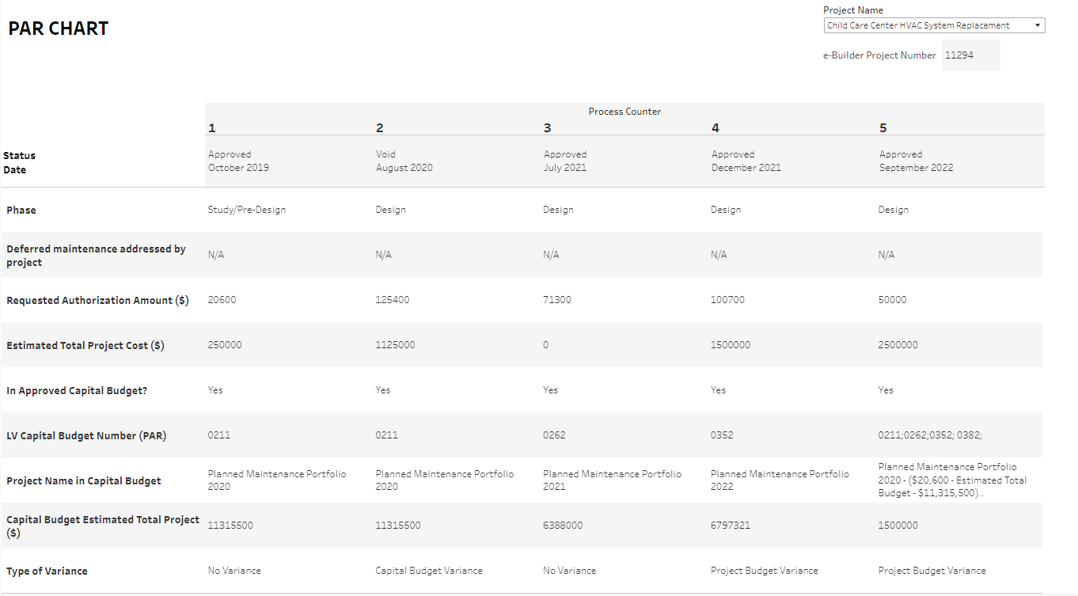
New Resources
4

Slide 5
Job Site Ethical Conduct

Slide 6
Project Communication

Slide 7
PMPD Presentation on Project Communication
E&PM
Sept. 27, 2022

Slide 8
Project Communication - Opportunities!
PM and Project Communication – clearly and often!
While we would like to think information travels up/down/sideways with no color or spin – let’s not assume.
Work with the project team on an appropriate strategy for project communication.
PAR should not be a communication tool on projects – other conversations and meetings should have taken place prior to circulating.

Slide 9
Communication Plan:

Slide 10
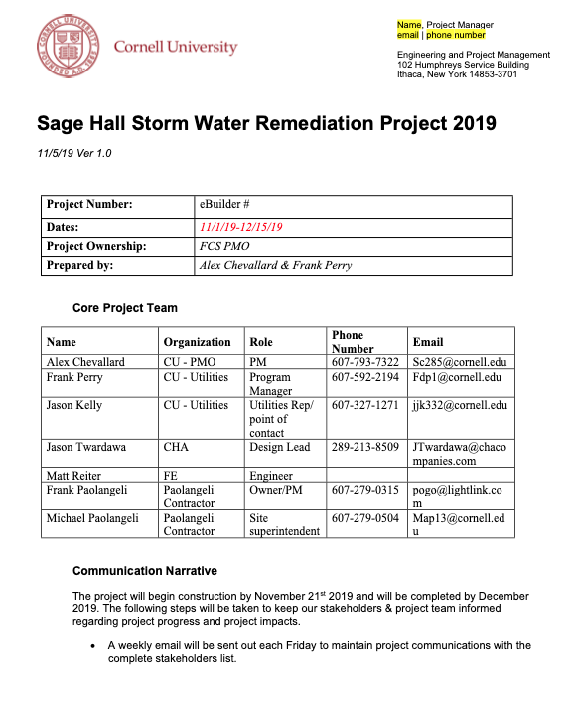
Project Communication Plan Template

Slide 11
Communication Beyond Meeting Minutes:
Constant Contact – E&PM Utilize Jessie’s group to provide these weekly
Notes:
Promote the great things that have happened and what to expect coming up.
PM to translate the 3 week look-ahead into a brief narrative.

Slide 12
Communication Beyond Meeting Minutes:
Constant Contact – E&PM Utilize Jessie’s group to provide these weekly

Slide 13
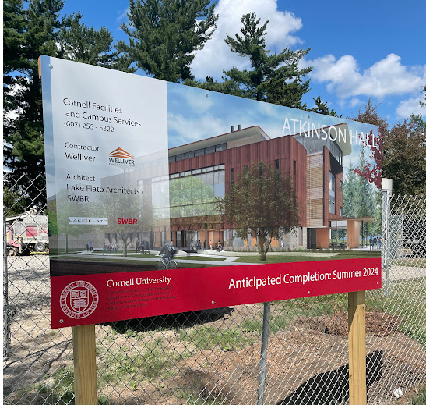
Communication Beyond Meeting Minutes:
Construction Sign:
(See Gdoc)
Notes:
Communicating to broader community

Slide 14
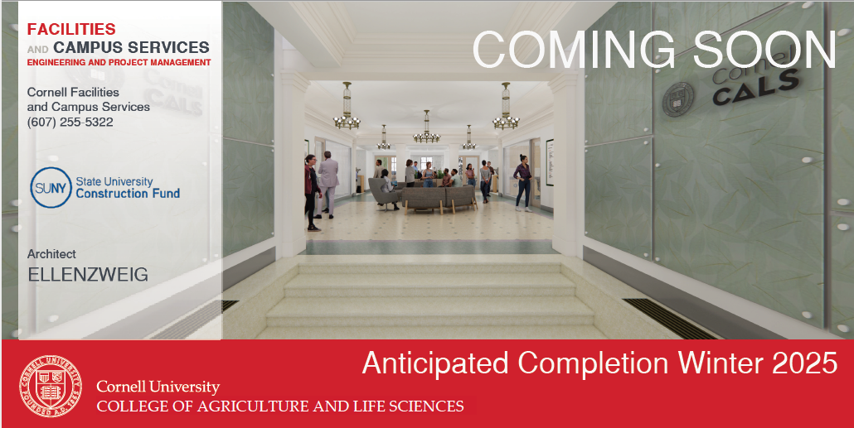
Communication Beyond Meeting Minutes:
Construction Sign:
Version of Exterior Construction Sign – applied to interior barriers at vacated space
Notes:
Communicating to broader community

Slide 15
Communication Beyond Meeting Minutes:
Directional Signage at Buildings / Sidewalks, etc.
Meetings to review upcoming shutdowns or impacts to circulation
Project Impact Statements in eB (Do them early – when known)
Department or College Presentations (PM may facilitate with AE, etc.) (Sometimes referred to as a “Town Hall Meetings”)
Keeping Building Manager and Maintenance Planner in the loop
Ensure project team knows where things are at – even if “spinning” in the background trying to get additional info from AE, Supplier, GC, etc.
What works for some may not for others – are they meeting focused, e-mail, or phone call people?
When info does not travel well (Up or down or across) – how can the PM facilitate or improve communication?
Notes:
Communicating to broader community

Slide 16
PMPD Presentation on Project Communication
Questions?
E&PM
Sept. 27, 2022

Slide 17
Bird Friendly Design Guideline

Slide 18
AV/Network Equipment
Supply Chain and
Lead Times

