Slide 1
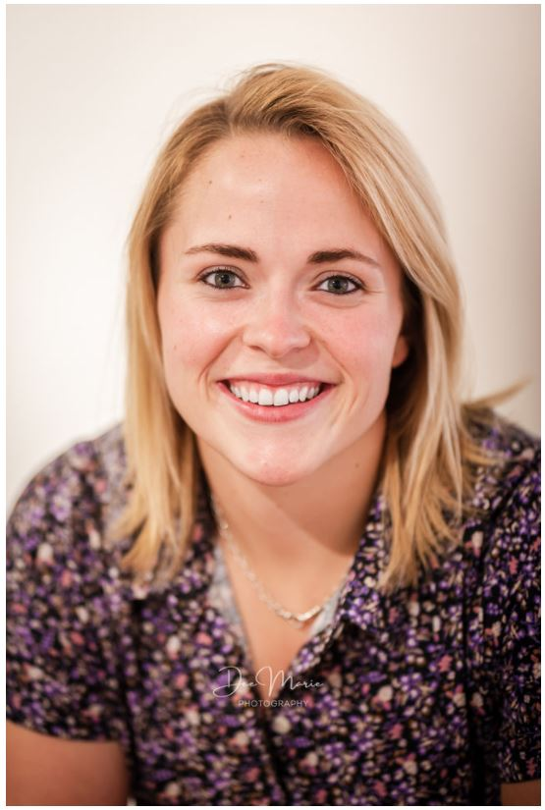
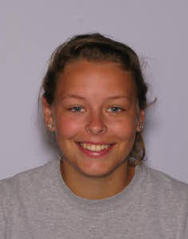
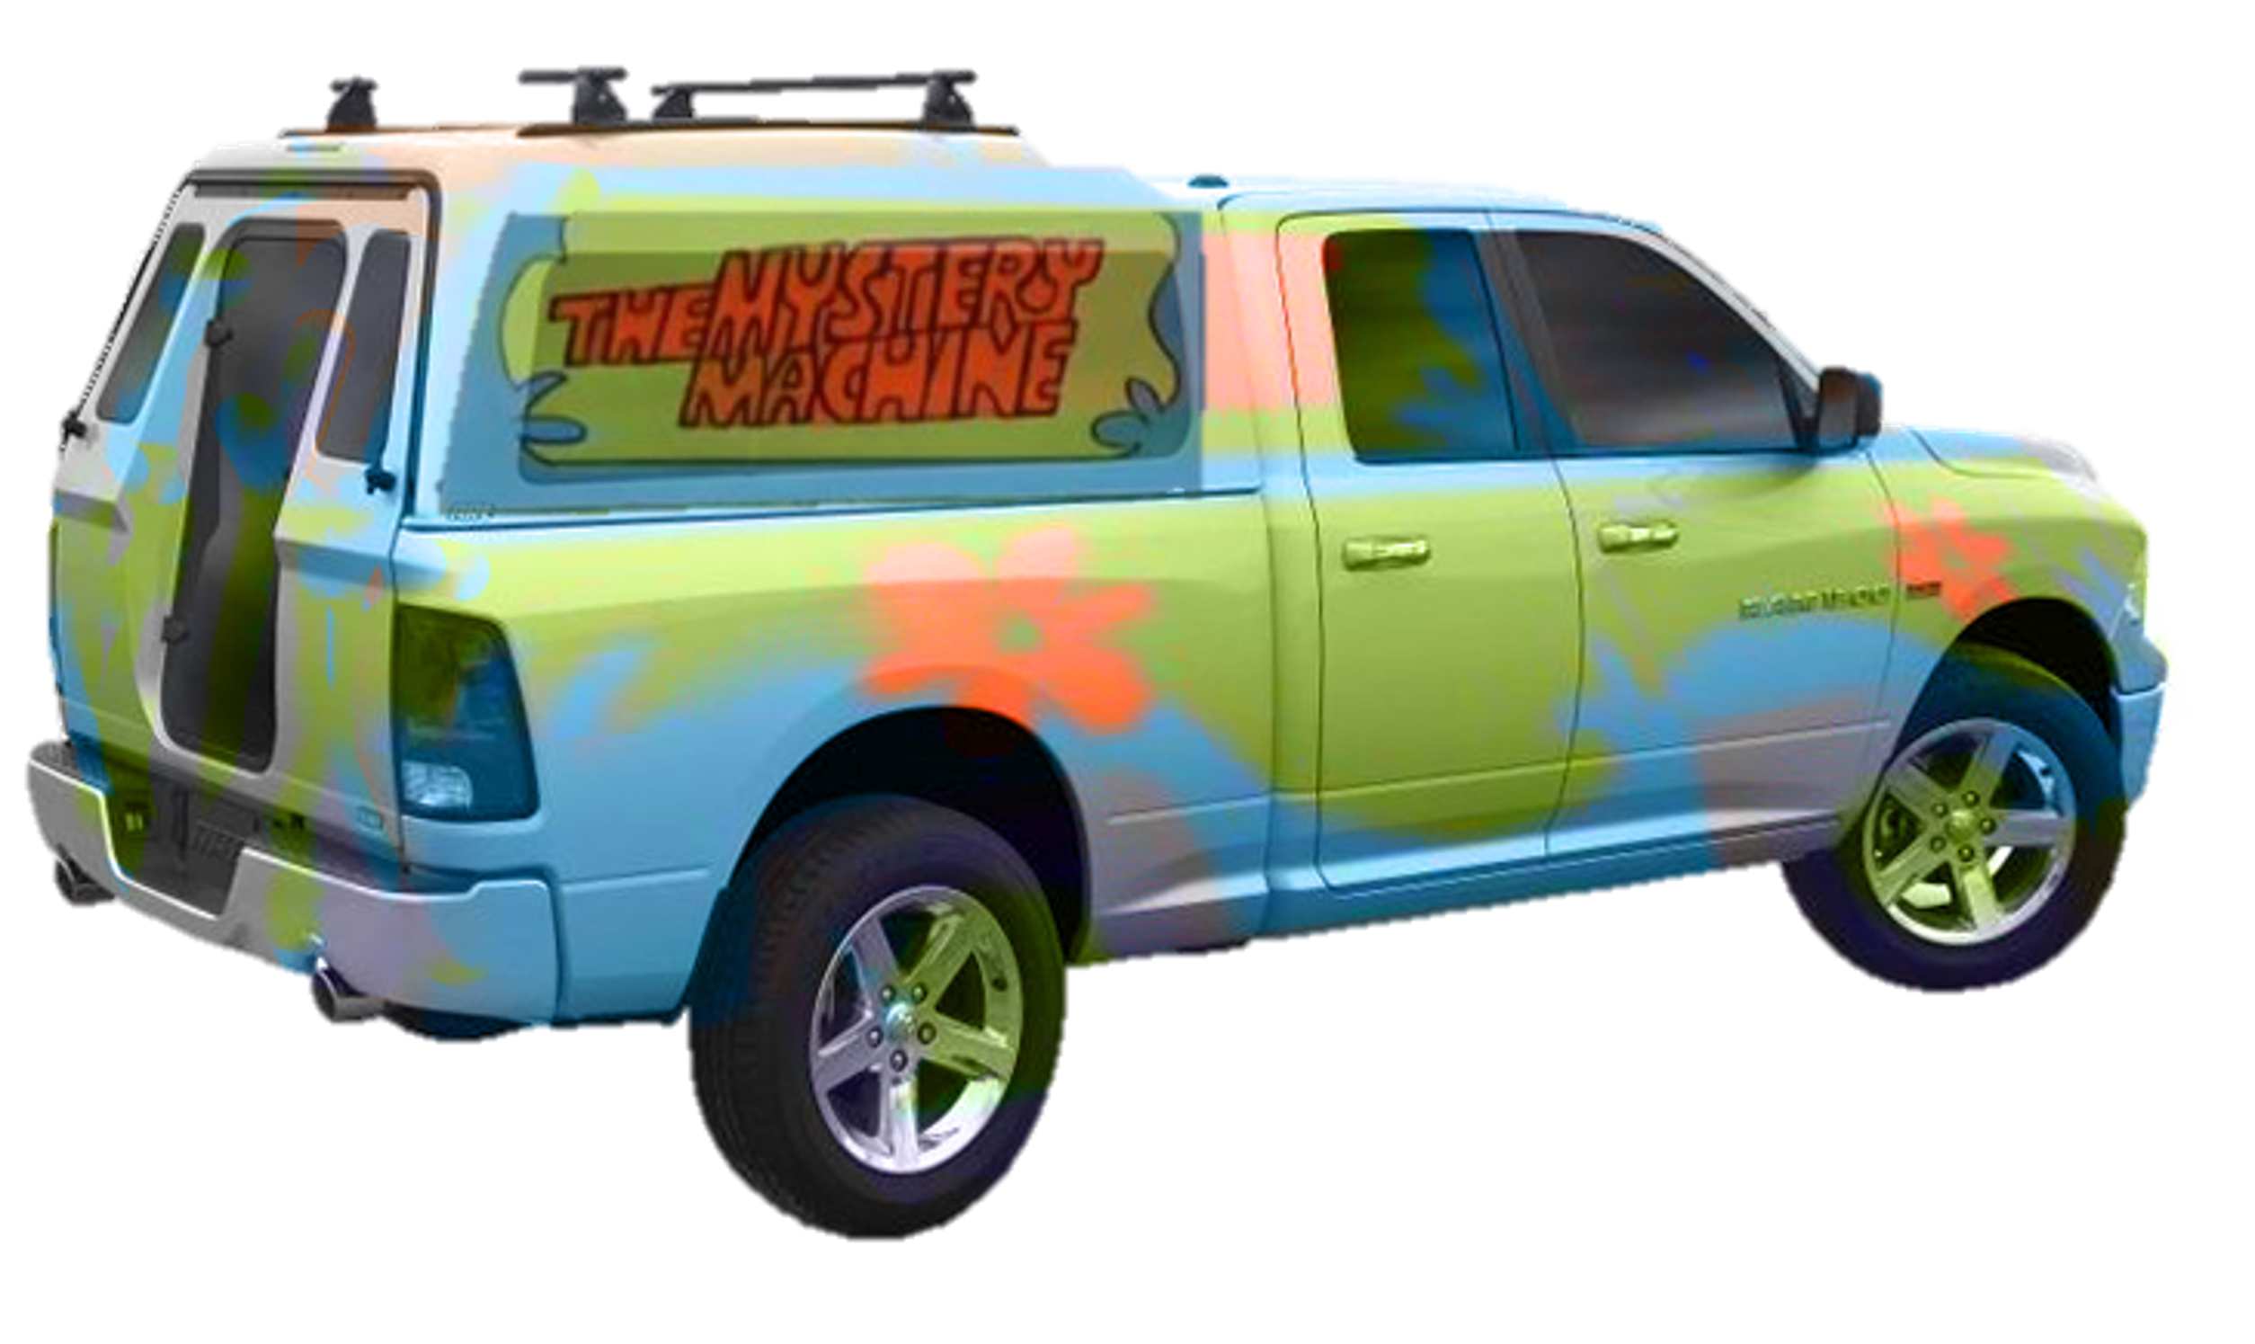
FE Minute - Underground Utility Locating
Mary Colomaio – Utility Mapping Program Manager
Emily Mix – Energy Mapping Coordinator/Principal Utility Locator
UDIG NY (Formerly known as DSNY) acts as communications between excavators and utility owners (Cornell/NYSEG/Bolton Point Etc.)
Why call in a dig request?
It’s the law!
NYS Code Rule 753 requires professional excavators to contact UDig NY before digging.
Safety is always the #1 priority – calling in a ticket takes just a few minutes
An accident on the job can cause delays or even injuries
Any questions that arise during excavation, we have happy to provide any additional details and contacts
Sometimes it feels like we solve underground mysteries

