Slide 1
Facilities Management: Post Construction Asbestos Survey
Facilities and Campus Services
Facilities Management –
Asset Management & Logistics
Date: 8/23/2022

Slide 2
Agenda:
Who we are and what we do
Regulations
Types of surveys
When should you think about Asbestos
Resources

Slide 3
Facilities Environmental Resources Group Update (Formerly FCS Asbestos program)
New program email address
fac-envr-rsrcs@cornell.edu
Expanded services (not just asbestos)
Asbestos - Survey’s, incidental disturbance contamination assessments, abatement design (blanket SOW or Div. 2 specifications), abatement, project and air monitoring services, final report review and document management
LEAD - Survey’s, Abatement Specifications
Mold - Assessments, abatement design, perform pre-bids, abatement, perform final inspections
Mercury - Contamination assessments, abatement design, abatement, perform visual inspections
PCB – Perform survey’s if required, abatement design, abatement and final visual inspections

Slide 4
Asbestos Regulations
Federal, State regulations to comply with.
NYS Code Rule 56
EPA AHERA: 40 CFR Part 763
EPA NESHAPS: 40 CFR Part 61, Subpart M
OSHA Construction Standard: 29 CFR 1926.1101
NYSDEC Part 364 Waste Transporter Permits
NYSDEC 6 NYCRR Part 360 Solid Waste Management Facilities
Cornell University, HS16 Asbestos Management written program
4.6 Project Managers Responsibilities
5.1 Asbestos Survey Requirements
7.0 Newley installed materials
Luke Thomas, Industrial Hygienist
Environment, Health, and Safety Cell number (607) 227 9234
email – Ltt26@cornell.edu

Slide 5
Types of Asbestos Survey’s
Directed Bulk Sampling
Sampling materials for a repair. (fitting insulation, window glazing, floor tile and mastic etc.)
Pre-Renovation Survey
Required by Federal regulation (NESHAPS) prior to any Renovation / Demolition activities.
This is also the document that C.U Contracts Office require prior to a contract going out to bid.
Post Construction Survey
Required for newly installed materials and is covered in section 7.0 of Cornell University EH&S asbestos written program.
Full Building Survey / Facility wide
This type of survey primarily covers walls and ceilings.
Can be modified to include any variation of walls, ceilings, floors, thermal system insulation, mechanicals, roofing window caulks and glazing's etc.
Currently 204 Facilities have significant asbestos survey information available online.
Summaries on the web can be found at: http://www.fs.cornell.edu/fs/fs_facilfind.cfm

Slide 6
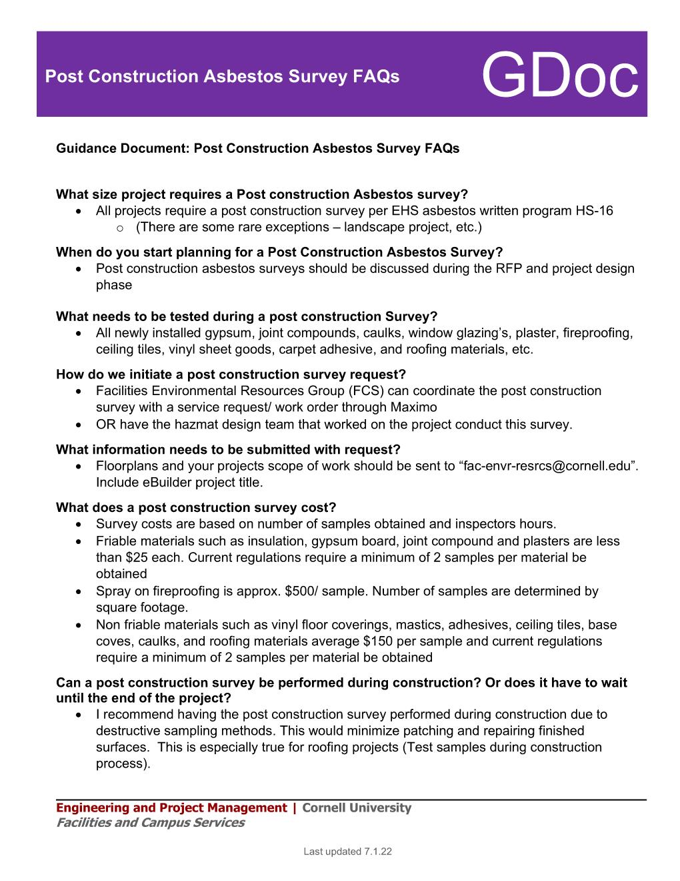
GDoc

Slide 7
When should I think about Asbestos?
As soon as you have a project assigned to you, reach out to the Facilities Environmental Resources Group.
Discuss project scope and schedule
Determine what historic asbestos survey information exists
Determine how your project will proceed. Blanket Consultant vs RFP for environmental services
Determine who will be preforming the Post Construction Survey and when will it be done
When is it appropriate to use Blankets?
When supporting maintenance and repair projects
Pre- Renovation Survey’s
Division 2 specifications
Post Construction Survey’s
When blankets can’t be utilized
When Architect, Environmental Consultant and/or General Contractor is already under contract
When the abatement costs exceed the 25K blanket limit
Barbara Woods Walpole, Program Admin Desk number (607) 254-5465 email - fac-envr-rsrcs@cornell.edu
Dale Houseknecht, Project Coordinator Cell number (607) 327-1359
email - dwh5@cornell.edu

Slide 8
Program resources for 2022
Blanket Environmental Consultants:
Delta Engineers
Arctic Enterprises
Watts Environmental
Labella Associates
Blanket Abatement Contractors:
Northstar dba LVI Services
Sunstream
Abscope Environmental
Genesee
LCP Group

Slide 9
Discussion:

