Slide 1
Project Management – Professional Development Series
Facilities and Campus Services Engineering and Project Management
August 23, 2022

Slide 2
Today’s Agenda
Summer Construction Updates
Andrew Magré
Dig Safe
Mary Colomaio and Emily Mix
Post Construction Asbestos Survey
Dale Houseknecht
Specialty Work Verses BTC
Laurie Johnston
Transportation Team Presentation
Bo Hayes and Reed Huegerich

Slide 3
Summer Construction Updates

Slide 4
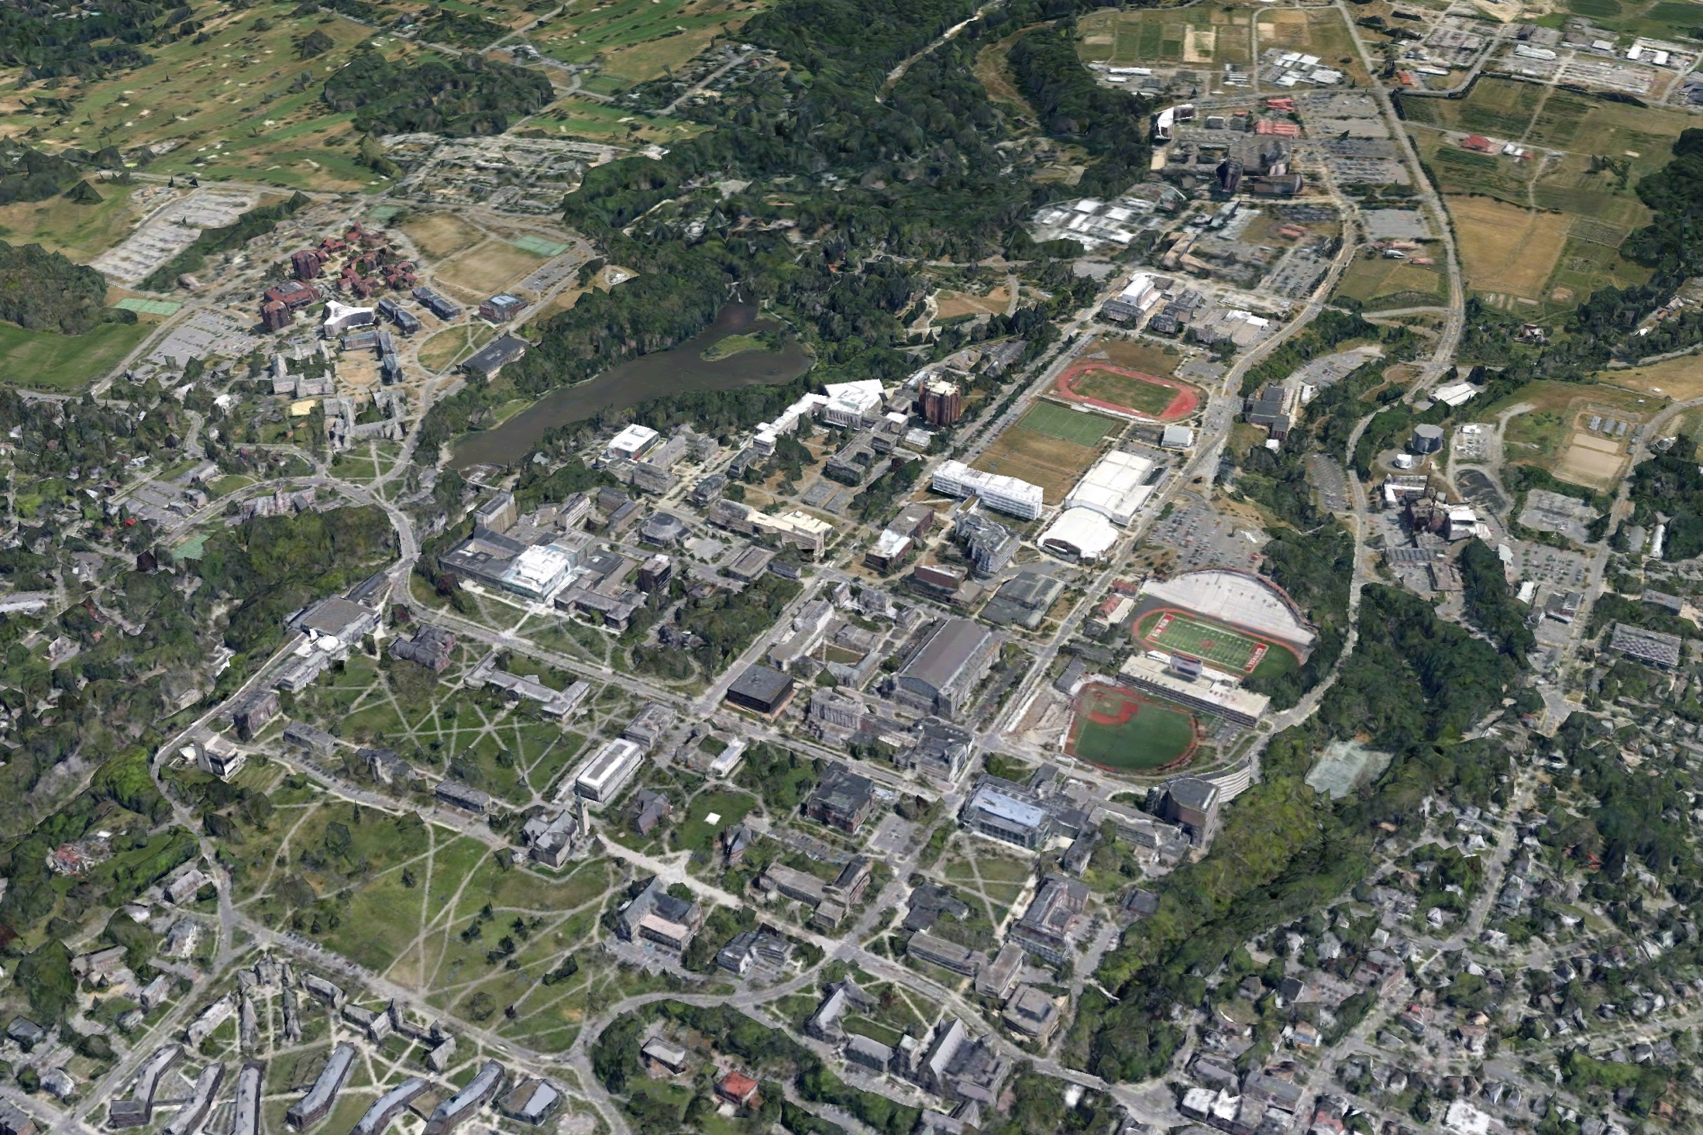
Summer Construction Update
Guterman
Greenhouse
CUBO
Atkinson
Hall
NCRE Completed
May 2022
366
Paving
Rice Hall
Generator Project
Balch Hall
NEH CHESS
Rockefeller
Sprinkler
Suspension Bridge
Feeney Way
Olin Roof & Envelope
Sage Hall Dining
Anabelle Taylor Low Roofs
Paving
Notes:
68 projects $265M total dollar value
I would like to provide an overall update on construction activity for central campus this Summer - Notable construction activity on Central Campus, I will go into a little detail on each of these in follow up slides.
Not showing

Slide 5
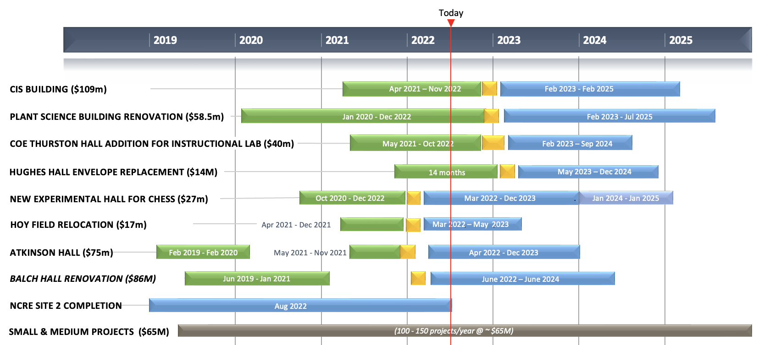
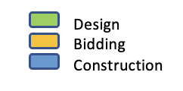
Bidding Six Month Look-ahead
Projects > $10M

Slide 6
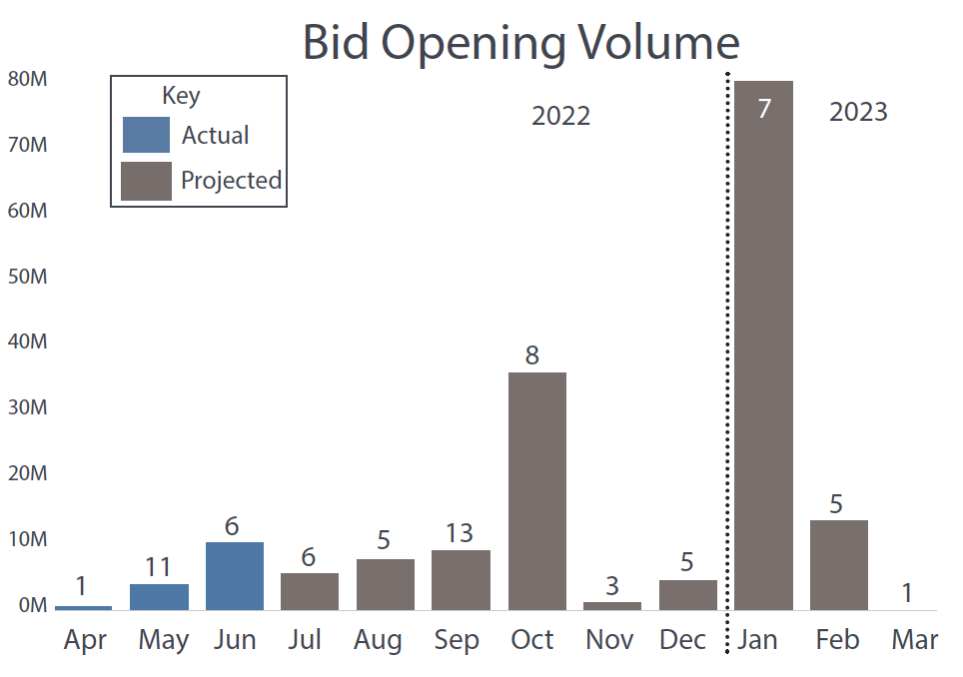
Bidding Six Month Look-ahead
Optimal window for issuing bids shown in green

Slide 7
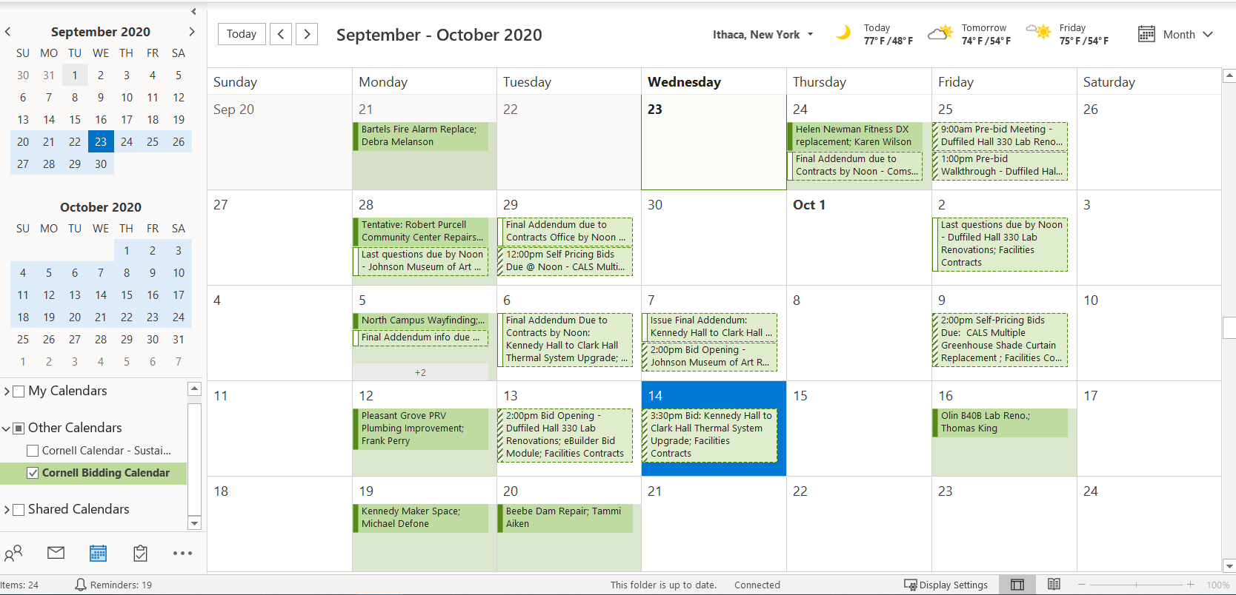
Cornell Bidding Calendar & Monthly Bid Planning Meetings
eBuilder Dates (schedule Module)
Documents Submitted to Facilities Contracts
Facilities Contracts Actual Dates
Bid Invite
Pre- Bid walk through
Last day for questions
Addendum
Bid opening
Monthly Bidding Review Meetings
Strategize Bid timing
Workload leveling
Search for “Cornell Bidding Calendar” in Outlook
Notes:
Updated every Wednesday

Slide 8
Questions?

Slide 9
Dig Safe Contact

Slide 10
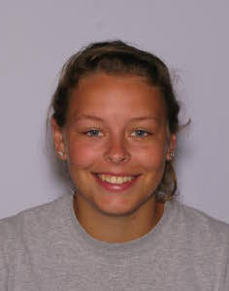
FE Minute - Underground Utility Locating
Mary Colomaio – Utility Mapping Program Manager
Emily Mix – Energy Mapping Coordinator/Principal Utility Locator
UDIG NY (Formerly known as DSNY) acts as communications between excavators and utility owners (Cornell/NYSEG/Bolton Point Etc.)
Why call in a dig request?
It’s the law!
NYS Code Rule 753 requires professional excavators to contact UDig NY before digging.
Safety is always the #1 priority – calling in a ticket takes just a few minutes
An accident on the job can cause delays or even injuries
Any questions that arise during excavation, we have happy to provide any additional details and contacts
Sometimes it feels like we solve underground mysteries

Slide 11
Questions?

Slide 12
Post Construction Asbestos Survey

Slide 13
Facilities Management: Post Construction Asbestos Survey
Facilities and Campus Services
Facilities Management –
Asset Management & Logistics
Date: 8/23/2022

Slide 14
Agenda:
Who we are and what we do
Regulations
Types of surveys
When should you think about Asbestos
Resources

Slide 15
Facilities Environmental Resources Group Update (Formerly FCS Asbestos program)
New program email address:
fac-envr-rsrcs@cornell.edu
Expanded services (not just asbestos):
Asbestos - Survey’s, incidental disturbance contamination assessments, abatement design (blanket SOW or Div. 2 specifications), abatement, project and air monitoring services, final report review and document management
LEAD - Survey’s, Abatement Specifications
Mold - Assessments, abatement design, perform pre-bids, abatement, perform final inspections
Mercury - Contamination assessments, abatement design, abatement, perform visual inspections
PCB – Perform survey’s if required, abatement design, abatement and final visual inspections

Slide 16
Asbestos Regulations
Federal, State regulations to comply with:
NYS Code Rule 56
EPA AHERA: 40 CFR Part 763
EPA NESHAPS: 40 CFR Part 61, Subpart M
OSHA Construction Standard: 29 CFR 1926.1101
NYSDEC Part 364 Waste Transporter Permits
NYSDEC 6 NYCRR Part 360 Solid Waste Management Facilities
Cornell University, HS16 Asbestos Management written program
4.6 Project Managers Responsibilities
5.1 Asbestos Survey Requirements
7.0 Newley installed materials
Luke Thomas, Industrial Hygienist
Environment, Health, and Safety Cell number (607) 227 9234
email – Ltt26@cornell.edu

Slide 17
Types of Asbestos Survey’s
Directed Bulk Sampling
Sampling materials for a repair. (fitting insulation, window glazing, floor tile and mastic etc.)
Pre-Renovation Survey
Required by Federal regulation (NESHAPS) prior to any Renovation / Demolition activities.
This is also the document that C.U Contracts Office require prior to a contract going out to bid.
Post Construction Survey
Required for newly installed materials and is covered in section 7.0 of Cornell University EH&S asbestos written program.
Full Building Survey / Facility wide
This type of survey primarily covers walls and ceilings.
Can be modified to include any variation of walls, ceilings, floors, thermal system insulation, mechanicals, roofing window caulks and glazing's etc.
Currently 204 Facilities have significant asbestos survey information available online.
Summaries on the web can be found at: http://www.fs.cornell.edu/fs/fs_facilfind.cfm

Slide 18
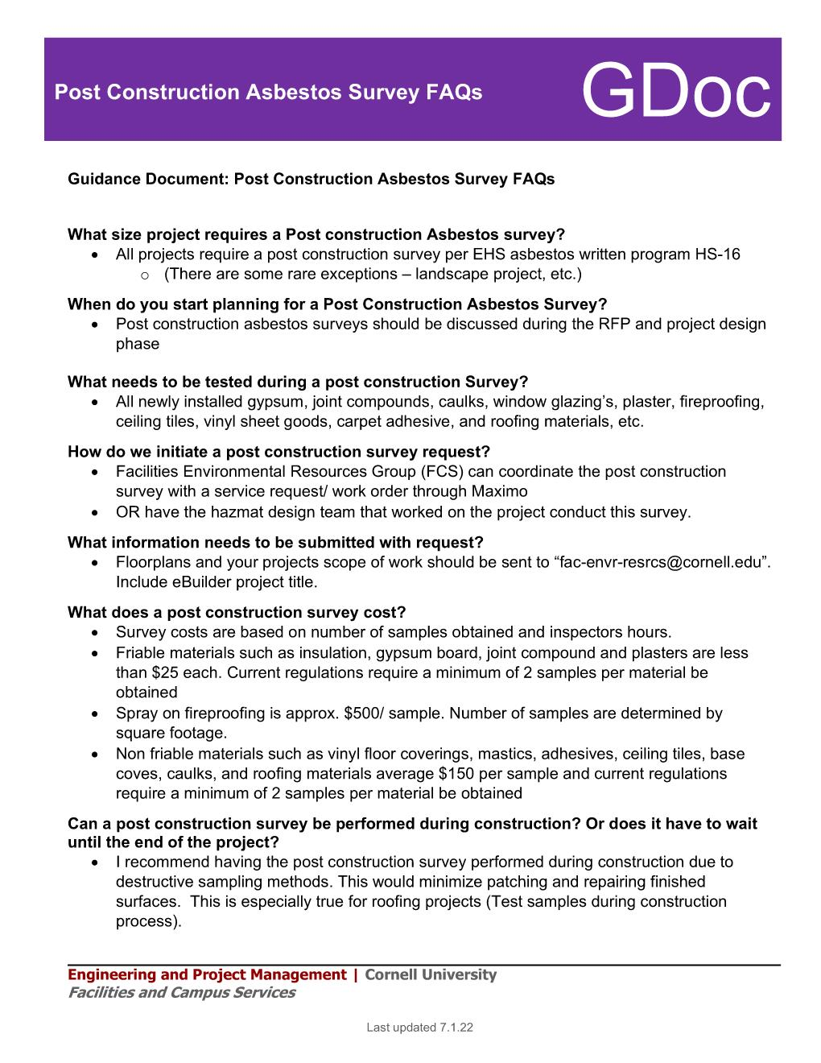
GDoc

Slide 19
When should I think about Asbestos?
As soon as you have a project assigned to you, reach out to the Facilities Environmental Resources Group.
Discuss project scope and schedule
Determine what historic asbestos survey information exists
Determine how your project will proceed. Blanket Consultant vs RFP for environmental services
Determine who will be preforming the Post Construction Survey and when will it be done
When is it appropriate to use Blankets?
When supporting maintenance and repair projects
Pre- Renovation Survey’s
Division 2 specifications
Post Construction Survey’s
When blankets can’t be utilized
When Architect, Environmental Consultant and/or General Contractor is already under contract
When the abatement costs exceed the 25K blanket limit
Barbara Woods Walpole, Program Admin Desk number (607) 254-5465 email - fac-envr-rsrcs@cornell.edu
Dale Houseknecht, Project Coordinator Cell number (607) 327-1359
email - dwh5@cornell.edu

Slide 20
Program resources for 2022
Blanket Environmental Consultants:
Delta Engineers
Arctic Enterprises
Watts Environmental
Labella Associates
Blanket Abatement Contractors:
Northstar dba LVI Services
Sunstream
Abscope Environmental
Genesee
LCP Group

Slide 21
Discussion:

Slide 22
Questions?

Slide 23
Specialty Work vs BTC Presentation

Slide 24
Project Management – Professional Development Series
Facilities and Campus Services Engineering and Project Management
August 23, 2022

Slide 25
Specialty Work and BTC Exclusive Jurisdiction
Best Practices
BTC Exclusive Jurisdiction
Facilities Contracts Projects
Notes:
To address question of whether “specialty work” is outside the exclusive jurisdiction of the BTC Contract (electricians, plumbers, carpenters, painters, masons, sheet metal workers and laborers for those trades)

Slide 26
Exclusive Jurisdiction Work must be done by Covered Trade
Cornell’s collective bargaining agreement (“CBA”) with the Building Trades Council (“BTC”) provides for exclusive jurisdiction for the trades covered by the CBA (electricians, plumbers, carpenters, sheet metal workers, masons, painters and laborers assisting those trades) on work on Endowed University facilities in Tompkins County.
“All work associated with the demolition, repair, replacement, improvement to or construction of equipment, buildings, structures, utilities, and/ or system or components thereof.” (Article 1: Recognition)

Slide 27
Work Performed by Non-BTC Personnel
Only work outside the exclusive jurisdiction of those trades:
By definition,
By past practice at Cornell, or
By permission of the trade,
Can be performed by other unions or non-union labor.

Slide 28
Trades Positions Covered by the BTC CBA
Trades covered by the BTC Contract: | Trades not covered, for example:
Electricians Plumbers/Steamfitters (includes HVAC/Controls) Carpenters Masons Painters Sheet Metal Workers Laborers (assisting covered trades) | Operating Engineers Iron Workers Glaziers Machinists Millwrights
Notes:
Local #241 - International Brotherhood of Electrical Workers
Local #267 - United Association of Plumbers and Steamfitters
Local #277 - Northeast Regional Council of Carpenters
Local #3NY- Bricklayers & Allied Craftworkers
Local #178 - IUPAT Painter District Council No. 4
Local #112 - SMART Twin Tier Sheet Metal Workers
Local #785 - Laborers International Union of North America
Covered: All work associated with the demolition, repair, replacement, improvement to or construction of equipment, buildings, structures, utilities, and/or system or components thereof.
Not included: work associated with the monitoring, tests, lubrication, and other repetitive preventive maintenance work performed by Facilities Management mechanical maintenance staff or qualified technicians of such University offices as Environmental Health & Safety, etc.
- Exclusive representative for electricians and line workers, painters, plumbers, steamfitters, controls mechanics, welders, refrigeration mechanics, carpenters, masons, sheet metal workers; and, building trade laborers, including journeypersons, apprentices and temporary employees

Slide 29
Determination of Exclusive Jurisdiction
There is no "master list” of how every task should be appropriately assigned; Staff and Labor Relations has information on how the tasks have been performed in the past
Multi-pronged analysis is often necessary:
Details of specific job;
Past practice;
Grievance resolution history;
All information can provide is guidance and the guidance may not be definitive.
No automatic exclusion for “specialty” work, “warranty” work or work occurring in a laboratory or classroom
Relevant to consider whether there is an attachment to the fabric/ structure of the building
NOTE: Contract Documents (Technical Specs, Drawings, etc.) should not call out specific Contractors or other items that would effect our Agreement with the BTC.

Slide 30
Examples
Definition:
Glass Installation (not the work of the Painters)
Rigging (not the work of the Laborers)
Low voltage cable (not the work of the Electricians)
Past Practice:
Handrails: claimed work of the Iron Workers, performed at Cornell by sheet metal workers and non-union contractors; not recognized as exclusive work of sheet metal workers at Cornell
Fencing: wire and agricultural fencing are not exclusive work of the BTC; wood fencing is subject to carpenters’ exclusive jurisdiction
Permission
Wood Carving Restoration: Carpenters work, provided permission for non-union wood worker to repair
Slab Jacking: polyurethane foam inserted to level sidewalks; received BTC approval for use with Cornell mason on site

Slide 31
Resources
Consult with Staff and Labor Relations
Laurie Johnston (lmj6) (607-255-6866)
Krassi Hernandez (kh556) (607-254-5974)
Consult with Facilities Contracts
Brenda Frank (bf343) (607-255-7449)
Wendy Hackett (wjh6) (607-255-0120)
Consult with Experienced Cornell Project Staff
Consult with Experienced Cornell Contractors, e.g, Welliver, Lane, Streeter
Consult with Union Business Agents

Slide 32
Questions?

Slide 33
Transportation Team Presentation

Slide 34
Questions?

