Slide 1
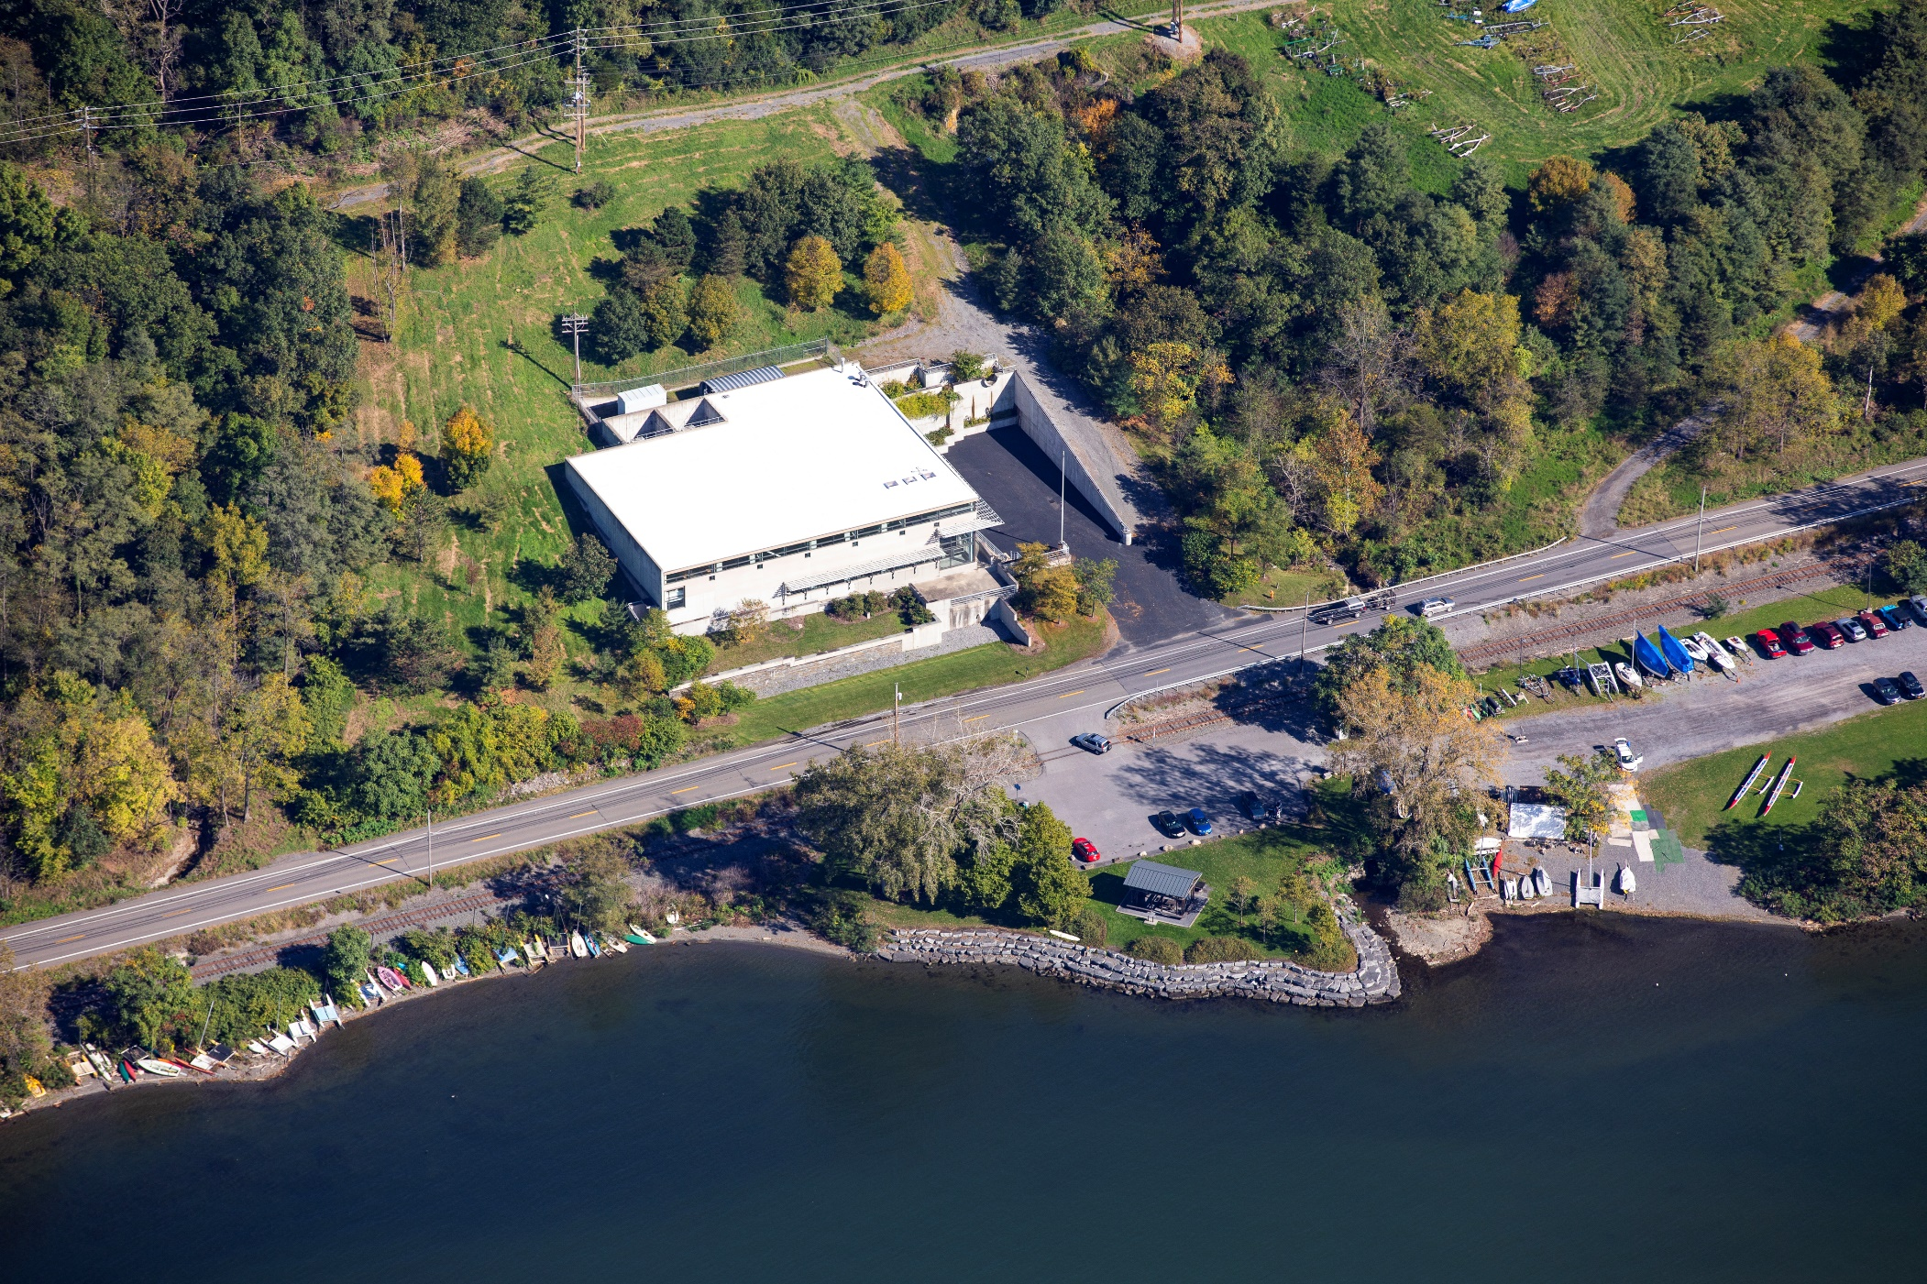
Lake Source Cooling
CORNELL UNIVERSITY
LAKE SOURCE COOLING
Joshua LaPenna, PE
Director of Utilities Production
DEC Total Phosphorus (TP) Offset Requirement for New Building Connections
to Cornell’s District Chilled Water System

Slide 2
Agenda
Understanding new Lake Source Cooling (LSC) State Pollutant Discharge Elimination System (SPDES) Permit Requirements.
How do they impact the use of Cornell’s District Cooling System?
How do they impact Capital Project schedules/budgets?
Ideas on how we can meet this new requirement.

Slide 3
Why is Phosphorus being regulated?
Notes:
NYSDEC recently issued a modified State Pollution Discharge Elimination System (SPDES) permit (NY0244741) for the Cornell University Lake Source Cooling (LSC) facility. The revised permit requires that new building connections to Cornell’s district chilled water system use an approved Offset Best Management Practice (Offset BMP) to offset any additional mass of Total Phosphorus (TP) transferred into the southern shelf of Cayuga Lake (Segment 4), annually between May 1 and September 30, via the LSC outfall.
Clean Water Act Section 303(d): Impaired Waters and Total Maximum Daily Loads (TMDLs)
The goal of the Clean Water Act (CWA) is "to restore and maintain the chemical, physical, and biological integrity of the Nation's waters" (33 U.S.C §1251(a)). Under section 303(d) of the CWA, states, territories and authorized tribes, collectively referred to in the act as "states," are required to develop lists of impaired waters.
As part of the CWA, states must establish water quality standards (WQS) for waters within their borders. Such standards designate the use of the particular waterbody (e.g., recreation or protection of aquatic life), establish water quality criteria to protect the waterbody, and adopt requirements to protect and maintain healthy waters.
States then must develop a TMDL for every pollutant/waterbody combination on the list. An essential component of a TMDL is the calculation of the maximum amount of a pollutant that can occur in waterbody and still meet WQS. Within the TMDL the state allocates this loading capacity among the various point sources and non-point sources. Permits for point sources are issued through EPA’s National Pollutant Discharge Elimination System, or NPDES program.

Slide 4
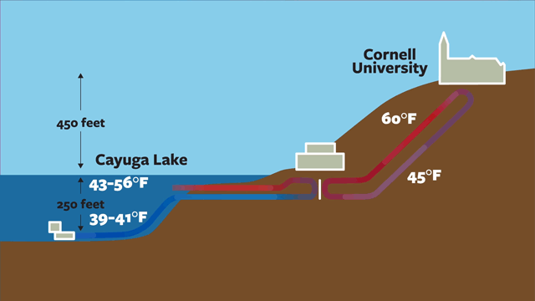
How is Total Phosphorus (TP) Involved in Cooling?

Slide 5
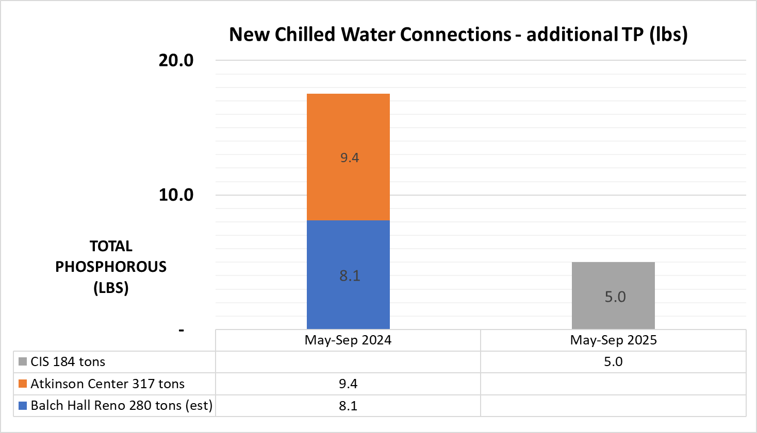
Planned New Connections
Notes:
The TP offset requirement will apply to new facilities that have not received a building permit, and existing facilities that were not previously connected to the LSC system before the effective date of the SPDES permit modification (6/1/2020).
Planned CW connections that will result in a TP offset requirement:
CIS: 184 tons peak per the energy model
Atkinson MDB: 317 tons peak per the energy model
Balch: 280 peak tons (which is my estimate since still waiting for a number from consultant

Slide 6
Agenda
Understanding new State Pollutant Discharge Elimination System (SPDES) Permit Requirements.
How do they impact Cornell’s District Cooling System?
How do they impact Capital Project schedules/budgets?
Ideas on how we can meet this new requirement.
Start “banking” TP offsets associated with enhanced storm water controls
Create a process by which projects can be evaluated for TP offset potential
Potential changes to eBuilder checklists and/or design standards
Notes:
Stormwater enhanced phosphorus offset timeline is as follows:
The Cayuga Lake Southern End Phosphorus Impairment TMDL draft was issued by DEC for review and comment last summer. They are reviewing comments and will either issue a second draft or final TMDL, date TBD. There were many comments objecting to their data and conclusions, so the review period could end as early as this summer or may take over five years.
Once the TMDL is final, the next layer of regulation is the SPDES Stormwater Permit for Construction Activities. There are specific regulations that apply to watersheds that are deemed impaired with a TMDL. TMDL’s that are finalized are included in an Appendix of that permit and given specific conditions for phosphorus impairment, at that point we would not be able to claim credit for extra phosphorus removal because it would be what is already required by permit and not above and beyond. DEC has stated that developers would not need to meet enhanced phosphorus design requirements until the watershed was specifically included in that Appendix of the permit. The next issuance of a revision of this permit will be in 2025 and is on 5 year cycles. If the TMDL is not final before 2025, it will not be included until the next revision in 2030 – unless they modify the permit during that cycle to specifically include the TMDL once it’s been finalized, which NYSDEC stated was unlikely.

Slide 7
Cornell District Cooling System
CHILLED WATER
PLANT 3
THERMAL
ENERGY
STORAGE
DISTRICT COOLING SYSTEM
LAKE FLOW
CAMPUS
LAKE SOURCE COOLING

