Slide 1
Project Management – Professional Development Series
Facilities and Campus Services Engineering and Project Management
June 29, 2022

Slide 2
Today’s Agenda
PM Lessons Learned
Paul Stemkoski
DEC Total Phosphorus (TP) Requirement Presentation
Josh LaPenna
SAMP Update
Jim Gibbs

Slide 3
PM Lessons Learned

Slide 4
Questions?

Slide 5
DEC Total Phosporus (TP) Requirement Presentation

Slide 6
Questions?

Slide 7
SAMP Update

Slide 8
Strategic Asset Management Plan
Accurate and complete data is required to effectively manage assets. This requires everyone involved with assets to consider themselves a “data steward” and feel personally responsible for collecting and maintaining reliable data.
A written asset management plan (AMP) for each asset class, eg, roofs or backflow preventor, will document details about each asset class and how data will be used to manage the asset class.

Slide 9
What is an “asset”?
Anything that has value to the institution – people, reputation, endowment, facilities……

Slide 10
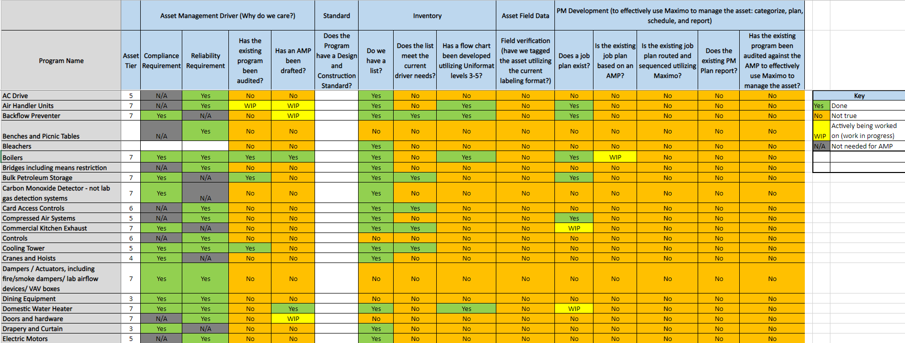

Slide 12
Questions?

