Slide 1
Asbestos Project Management May 2022 PMPD Training
Luke Thomas
LTT26@cornell.edu
607-227-9234
Cornell University
Environment, Health and Safety

Slide 2
Objectives
Background
HS16 requirements
Project Manager Responsibilities
Facility Manager Responsibilities
Facility Survey Webpage
Incidental disturbance
Resources
Contact Info

Slide 3
Background
Asbestos is used in a variety of building materials
Used as a binder, fire/heat/chemical resistance, an insulator
Can be found floor tile, sheet goods, mastics, roofing, pipe insulation, ceiling tiles, drywall, taping compounds, etc.
See code rule 56-5.1(f) for more examples on suspect materials
https://dol.ny.gov/system/files/documents/2021/03/icr56.pdf
Regulated by OSHA, EPA, NYS DOL

Slide 4
HS 16 Asbestos Management Program
Covers roles and responsibilities for various groups
Regulatory requirements pertaining to surveys and abatement
Notifications
Building Occupants
Regulatory Agencies
Contractors
Labeling and Signage
Training

Slide 5
Project Management Guidance Documents
Project Hazmat Procedure:
Asbestos
PCBs
Universal Waste
Mercury
FCS Asbestos Program Services
Pre-Design Phase: Task Authorization - Asbestos
CCF SUNY Asbestos Abatement Permit Request

Slide 6
Project Manager Responsibilities
Identifying asbestos-containing building materials prior to maintenance, renovation, or other activities
Contracting with approved licensed asbestos consulting firms and abatement contractors
Issuing service requests for asbestos-related services
Report any incidental disturbances of asbestos-containing material as defined in the Project Hazmat Procedures and the Incidental Disturbance (SP 002) listed on the Asbestos webpage

Slide 7
Project Manager Responsibilities – Newly Installed Materials
Ensuring contractor provides documentation to verify all new buildings and building renovation projects are asbestos-free as specified in section 7.0 (Newly Installed Materials) of the asbestos program and submit such documents to the Asbestos Coordinator
Pre-installed or installed materials are to be surveyed and sampled by third party asbestos certified inspection firm for verification all building materials are asbestos-free material. Results sent to the FM Asbestos Coordinator
PM responsible for scheduling post surveys.

Slide 8
Facility Manager Responsibilities
Review work requests and evaluate the potential for work requested to impact ACM/PACM
Identifying, with the assistance of the Asbestos Coordinator, asbestos-containing building materials prior to maintenance, renovation, or other activities where asbestos-containing materials may be disturbed
Scheduling project dates with sufficient lead times for asbestos abatement
Where projects may impact or disturb ACM notify contractor or Cornell personnel performing the work of the presence of ACM
Maintain required asbestos signage as specified in section 6.0 of the asbestos program and in Asbestos Material Labeling (SP 003)
Posted asbestos project occupant notifications on entrances to the facility
Posted signage on mechanical room entrances

Slide 9
Facility Asbestos Survey Webpage
To access the specific building information, go to Find Facility Information
Currently 196 buildings complete
Wall and ceiling survey summary only - Does not include floor tile or other materials unless specified
Contact the FCS Asbestos Coordinator if the material is not listed
A work order request will need to be issued to the FCS Asbestos coordinator to conduct sampling
Once received the Asbestos coordinator will contact the Environmental contractor to perform the survey and sampling for asbestos material
The results will be relayed to the requestor

Slide 10
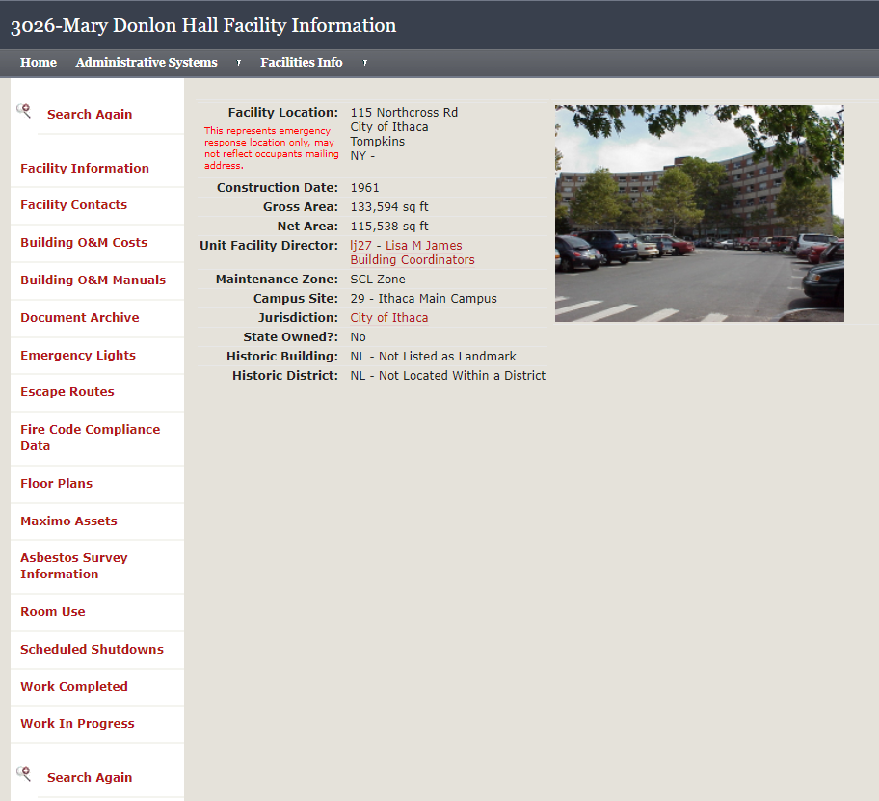
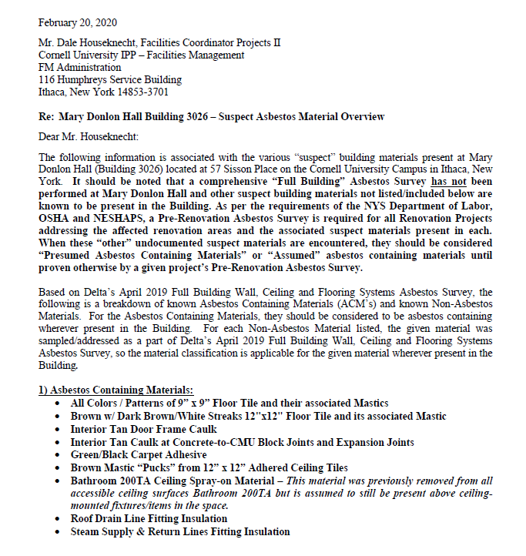
Asbestos Surveys
Click on Asbestos Survey Information

Slide 11
Incidental Disturbance
Unintentional disturbance of asbestos-containing material (ACM) or presumed asbestos-containing material (PACM).
The clean-up of an incidental disturbance must be conducted by a licensed asbestos abatement contractor.
An environmental consultant under the direction of the Asbestos Coordinator will oversee the clean-up response.
In the event an incidental disturbance of asbestos is encountered, the following protocol shall be followed:
Do not attempt to clean up the ACM or PACM
Immediately vacate the room and restrict access to the room using signage and barrier/caution tape
Issue an emergency Request for Service to the Asbestos Coordinator by contacting Customer Service at 255-5322. State that you have an “asbestos incidental disturbance”

Slide 12
References and Resources
EHS Asbestos Webpage
HS16 Asbestos Program
Incidental Asbestos Disturbance
Asbestos Material Labelling
Potential Asbestos Containing Material Building Products
Facilities Lookup – Asbestos Surveys
NYS DOL Code Rule 56
Project Hazmat Guidelines
FCS Asbestos Program Services
Pre-Design Phase – Task Authorization – Asbestos
CCF SUNY Asbestos Abatement Permit Request
CU Learn – Asbestos Awareness Training (EHS 2384)

Slide 13
Contact Information
Facilities Environmental Resources Group – New for 2022
Fac-envr-rscs@cornell.edu
Dale Houseknecht
DWH5@cornell.edu
607-327-1359
Barbara Woods Walpole
607-254-5465
Luke Thomas
LTT26@cornell.edu
607-227-9234

