Slide 1
Project Management – Professional Development Series
Facilities and Campus Services Engineering and Project Management
May 23, 2022

Slide 2
Today’s Agenda
-PM Lessons Learned
Ruth Howell
-Storm Water Presentation
Kara Bugis
-Asbestos – Facilities/Environmental Program Presentation
Luke Thomas
-Summer Construction Updates
Andrew Magré

Slide 3
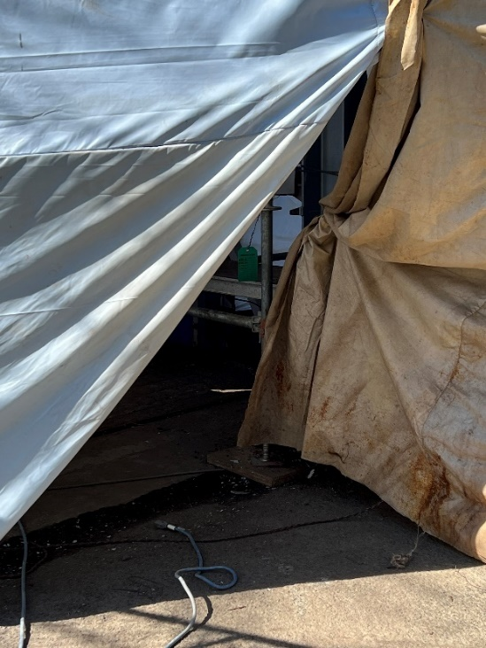
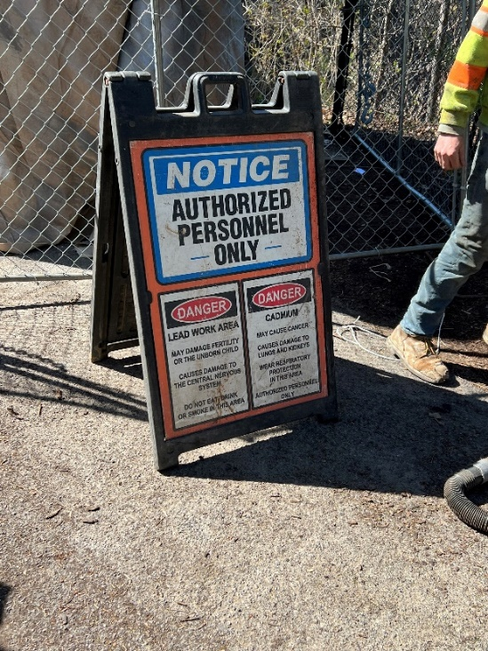
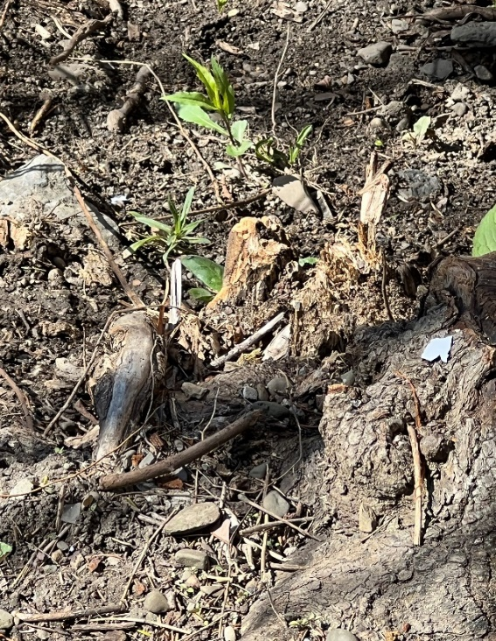
PM Lessons Learned – PM Presence
Project Manager’s presence on the job site is essential to quality performance
Project specific site safety plans (PSSSP)
Ensure that you read them and understand the parameters the Contractor said they would be following – then Trust but Verify
Our Contractors will provide detailed plans but then not follow through, it is our responsibility to ensure that they do. Engage EHS for a site visit early on

Slide 4
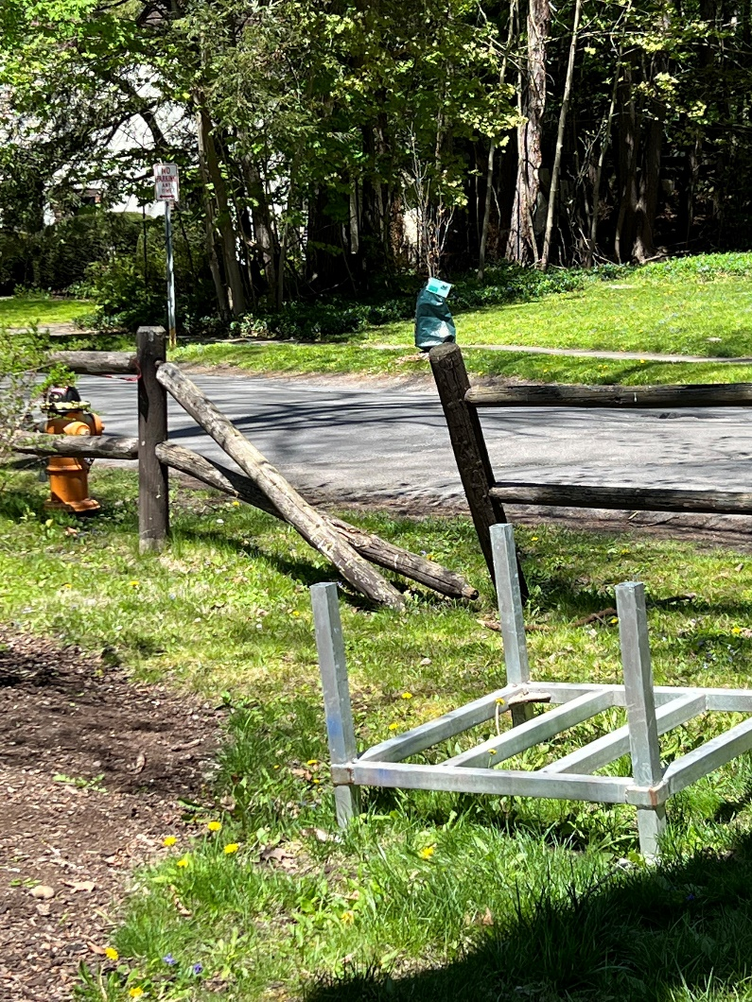
PM Lessons Learned – Incident Reporting
Job site vandalism
Take photos & assess damage
Contact CUPD @ 255-1111 to report incident
They will respond to site or take information via phone
CUPD uses info for trending purposes
Contractor should include incident in daily log report

Slide 5
Questions?

Slide 6
Storm Water Presentation

Slide 7
Questions?

Slide 8
Asbestos Presentation

Slide 9
Questions?

Slide 10
Summer Construction Updates

Slide 11
Summer Construction Activity Overview
PMPD
May 23, 2022

Slide 12
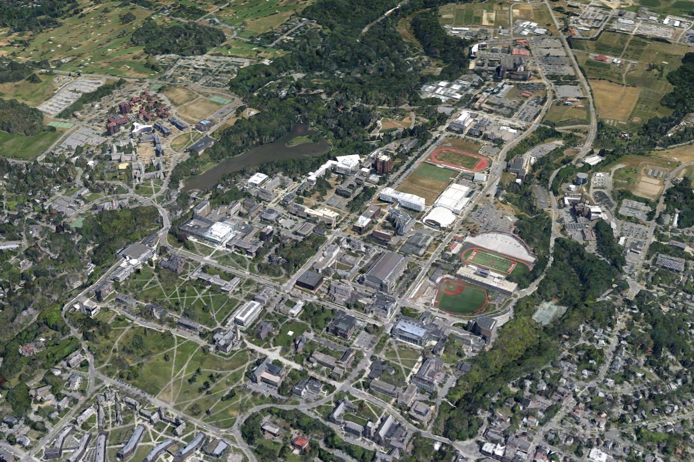
Summer Construction Activity Overview
Guterman
Greenhouse
CUBO
Atkinson
Hall
NCRE Completed
May 2022
366
Paving
Rice Hall
Generator Project
Balch Hall
NEH CHESS
Rockefeller
Sprinkler
Suspension Bridge
Feeney Way
Olin Roof & Envelope
Sage Hall Dining
Anabelle Taylor Low Roofs
Paving
Notes:
68 projects $265M total dollar value
I would like to provide an overall update on construction activity for central campus this Summer - Notable construction activity on Central Campus, I will go into a little detail on each of these in follow up slides.

Slide 13
Questions?

