Slide 1
PMPD Presentation on Value Engineering
E&PM
April 26, 2022

Slide 2
Let’s Get Started!
OK – right out of the gate:
We are behind schedule and over budget!
Sound familiar?
This is not where Value Engineering should begin! Take the time early in the project to understand the goals/expectations and the budget. Was this a placeholder budget and schedule that needs to be updated? From the time of the feasibility study, were the costs escalated to the projected construction mid-point?
Notes:
Key focus on Value Engineering – not making project “cheaper”, but optimizing choices made to meet needs. Stewardship of funding AND deliver projects that meet or exceed requirements.

Slide 3
Value Engineering Definitions:
Value Engineering as a function-oriented, systematic, team approach to provide value in a product, system, or service. (The Society of American Value Engineers International)
Value Engineering is a conscious and explicit set of disciplined procedures designed to seek out optimum value for both initial and long-term investment. (National Institute for Building Sciences)
Value Engineering can be defined as an organized effort directed at analyzing designed building features, systems, equipment, and material selections for the purpose of achieving essential functions at the lowest life cycle cost consistent with required performance, quality, reliability, and safety. (U.S. General Services Administration)
Value Engineering can have a positive outcome for all stakeholders (architects, designers, building-product manufacturers) when everyone embraces and actively participates in the value analysis. Creativity can be used in many ways to meet the overall goal. This process is used to solve problems, identify, and eliminate unwanted costs and improve function and quality. The set of disciplined steps in the value engineering process is meant to optimize initial and long-term investment, seeking the best possible value for the lowest cost.
Notes:
Key focus on Value Engineering – not making project “cheaper”, but optimizing choices made to meet needs. Stewardship of funding AND deliver projects that meet or exceed requirements.

Slide 4
Beginning of Value Engineering - History
Created in a Crises:
World War II: Lawrence Miles with GE was responsible for purchasing raw materials and experienced extreme material shortages. He searched for suitable alternatives that functioned similarly. Found some substitutions that were more cost-effective AND performed better. This new technique called “value analysis” is more commonly known today as value engineering.
PMs Typically Uses VE in a “Crises” – Project Budget Crises:
Structured VE process often conducted when a project estimate or bid is significantly over (no additional funds available)
Similar principals are applied during the study & design of any project.
GSA and other entities conduct VE processes as a matter of course.

Slide 5
FCS Stewardship Responsibility
Part of Our PM Role:
Facilitate a project to meet goals / expectations - while being mindful of the overall budget, longevity, sustainability, maintainability, etc.
Notes:
PM Resources – there is both a GDoc on Value Engineering and a suggested Excel Spreadsheet

Slide 6
Design versus Value Engineering
We are Making “Value Engineering Like” Decisions All the Time:
Feasibility or Space Study - explores multiple strategies , pros/cons, associated costs. Ultimately a preferred direction is stood up as the project. Team evaluates effective solutions for the budget.
Pre-Schematic Design or Concept Phase – looks at multiple solutions (Often 3) to determine best path forward. (Meeting criteria, life-cycle-cost, budget, sustainability, working with constraints, etc.)
Design Process – the Design and Stakeholder Team + subject matter expert’s review options during mtgs & Design Milestones. What is the appropriate roof or mechanical system, lab casework, or floor finish for the project? Not done in a vacuum without understanding life cycle cost, energy performance, durability, and program/performance, etc.
Checking Scope back to key project goals/requirements and what is necessary versus nice to have. What moves forward in design, as an add alternate, or parked until we have a better handle on budget.
Notes:
PM is constantly facilitating meetings and design reviews where the AE team develops the Basis of Design and then solutions to best meet the needs of the project. Evaluation on approach is a continuous process with broader ideas presented early and fine tuned later in design.

Slide 7
Value Engineering – When to Conduct
Best Times to conduct VE study:
Completion of Concept Design (Pre-Schematic, Feasibility Study)
Completion of Design Development
VE Study to identify and evaluate changes (Or options) that could result in increased functional value (including stakeholder satisfaction) in the completed facility while reducing construction or operation and maintenance costs. This effort should be scaled to the project size, complexity, and status.
Worst Times:
Conclusion of Construction Documents
During or after Bidding, requiring bid-addendum, etc.
Notes:
Value engineering has a diminishing return on “investment” (Of time/effort) as you get further into design for example. The opportunity to combine programs spaces or simplify building footprint, etc. gets more difficult after concept phase, etc.

Slide 8
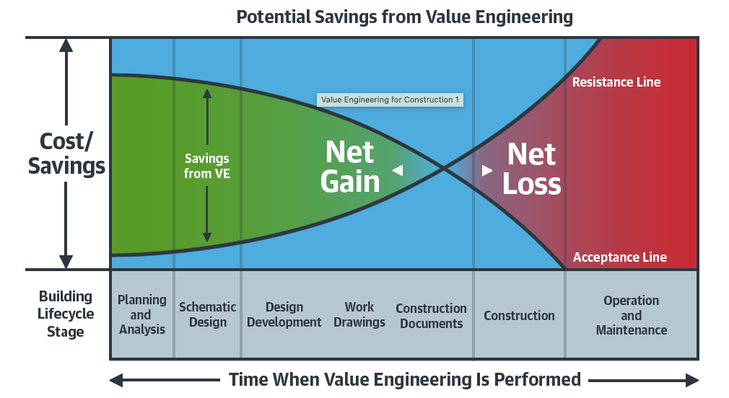
Value Engineering – Why Earlier is Better
Concentrating value engineering efforts in the early stages of project design affords greater savings and allows a change of direction, if appropriate, without affecting project schedule. (Emphasis on max. life cycle value)
Notes:
Illustrates the importance of earlier decisions versus re-directing efforts later. Cost of VE during construction often get pennies on the dollar. Creating additional bid alternates may make project more complicated to estimator and incur additional AE fees, etc.

Slide 9
Value Engineering – Early (Group Collaborating)
Notes:
VE in early phases still has time on their side to pull together meetings, gather addition ideas and associated costs/implications, etc.

Slide 10
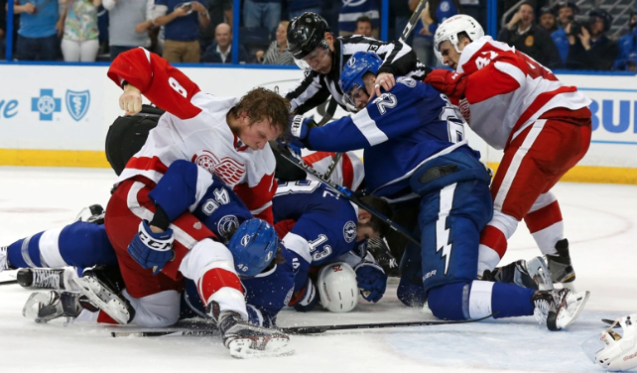
Value Engineering – Late (N0 – Still Need Collaboration)
Notes:
Blowout OPC prior to bidding or Bid results way out of control – can feel stressful, overtime period, crushed, tough or unpopular decisions, BUT - still room for collaboration and input

Slide 11
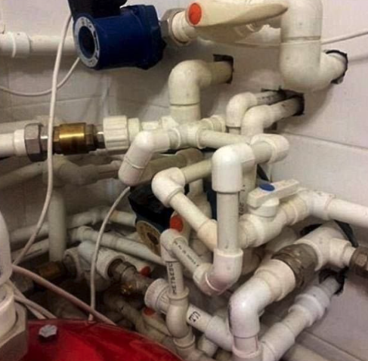
What Value Engineering is Not
Not compromised safety, building code, health and well-being of people
Not a knee-jerk reaction to avoid going over budget. Maximize function at the lowest possible cost.
Not reducing quality and increasing operational costs. (Not over-paying for quality when an equally effective, less expensive option exists)

Slide 12
Methodology:
Step 1: Information Gathering Phase
Collect data and get a clear understanding of the project. (Milestone when owner requirements, drawings, specifications, cost estimate, etc. are available to fully understand project)
Step 2: Function Analysis Phase
Analyze the functions of the elements identified in the previous step and evaluate their necessity to the goals of the project.
Primary Functions – vital to the existence of the final product/project
Secondary Functions – notable but not critical to the core of the project
Notes:
Owner varies at Cornell University depending on the subject:
Academic Program – College/Unit and the Sub-Department, etc.
Building Systems – FE, E&S, and FM (Plus College/Unit program function/needs)
Exterior Building and Site Esthetic – OUA (Plus College/Unit program function/needs)
Opportunity to Deliver Value:
Scaled to the type and size of project – but the meaning is the same.
VE options to cut a small amount of the cost overage is often not effective. (Example: $10M project is over by $2M. Ideas to save $5 - $10k are not significant enough to address the overage. Initially focus on solutions that produce much higher cost savings)

Slide 13
Methodology:
Step 3: Creative (Speculation) Phase
Develop alternative solutions for delivering necessary building functions. The value engineering team brainstorms to generate potential design solutions to reach the project functions.
Focus on the big-ticket items that have the most opportunity to deliver value.
All viable options are outlined at this step.
Next, designers and their team will eliminate the “weak plays” to present only the strongest options in Step 4.
Notes:
Weak Plays to be Eliminated:
Before presenting VE options to a broader committee or group, the Core Team and Design Professionals need to perform a level of investigation to determine if the intended outcome is true. This weeds out ideas that will not yield the intended results better than other strategies.
Example: VE option to eliminate a suspended ceiling system in a high-bay research addition to save costs. After the AE team evaluated that idea, they found that it would cost the project more. (Would then need to fireproof steel, increase volume of conditioned space, impact acoustics and lighting, etc.). (Weak Play)

Slide 14
Methodology:
Step 4: Evaluation Phase
Assess the alternative solutions. Subject matter experts evaluate and question the available options and weigh them against each other.
How well can each alternative perform the function of the original solution?
Owner expectations also matter and must be discussed.
Holistic evaluation of each choice since a change in one area of a facility can affect any or all other areas of a facility.
Step 5: Cost Analysis
Allocate costs to the alternative solutions (First cost and over facility’s life cycle)
Notes:
Owner varies at Cornell University depending on the subject:
Academic Program – College/Unit and the Sub-Department, etc.
Building Systems – FE, E&S, and FM (Plus College/Unit program function/needs)
Exterior Building and Site Esthetic – OUA (Plus College/Unit program function/needs)
Reducing the performance of the building envelope and reducing exterior solar shading devices may increase the heating and cooling loads, size of MEP equipment, require the introduction of interior window treatments, not meet EUI goals, etc.

Slide 15
Methodology:
Step 6: Development Phase
Team assembles all recommendations, their advantages, disadvantages and implements plans to present to the project stakeholders.
Decisions are made on which VE options to incorporate into the documents.
Deciders typically involve core project team and SME’s based on VE scope.
Some ideas may allow them to be incorporated as a bid alternate. (Either an alternative product or distinct scope that could be added or removed depending on bid results or if alternative funding becoming available, etc.).
Post-bid addendum can also be used when bids come in high, but less effective and delays project award.
Notes:
Critical period to make decisions on the VE items with a boarder group to ensure buy-in and sign off. Hopefully, people have been engaged earlier in the process, so this is not a total surprise to anyone.

Slide 16
Spreadsheet:
Notes:
Suggested VE Spreadsheet. Many AE teams or Pre-Construction Firms may have their own documents to track changes and associated costs. The important take away here is the identification of impact and who internally has to “approve” the item if we plan to take it.
If there are going to be a lot of VE items – for ease of review by FE and FM – it is preferred to group them based on Uniformat
Where to save this file so everyone is working off the same VE list? During design – save in the Design Submission folder. In the Bid phase – save in the VE folder in that phase.

Slide 17
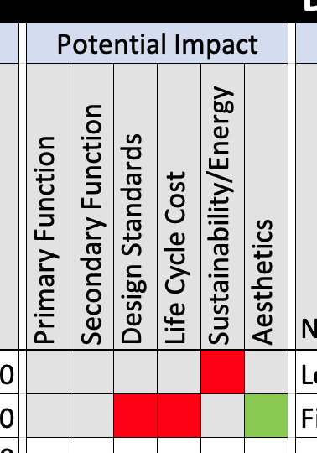
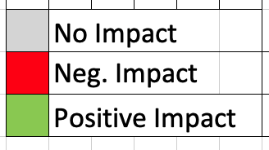
Primary Function: vital to the existence of final project.
Secondary Function: notable but not critical to the core of the project.
Notes:
Key items to evaluate the VE list under – and does it have any impact?

Slide 18
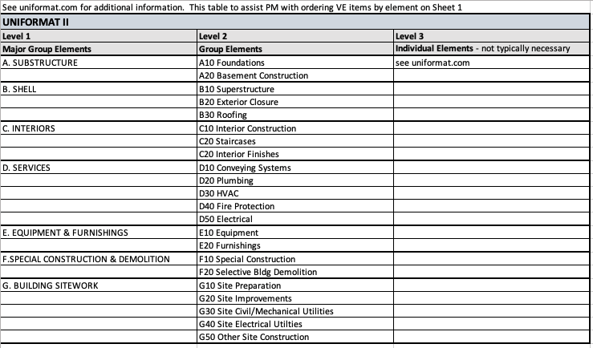
Long VE lists – group around Uniformat II
.
Notes:
Tab in the VE Spreadsheet for assistance on grouping items for consideration

Slide 19
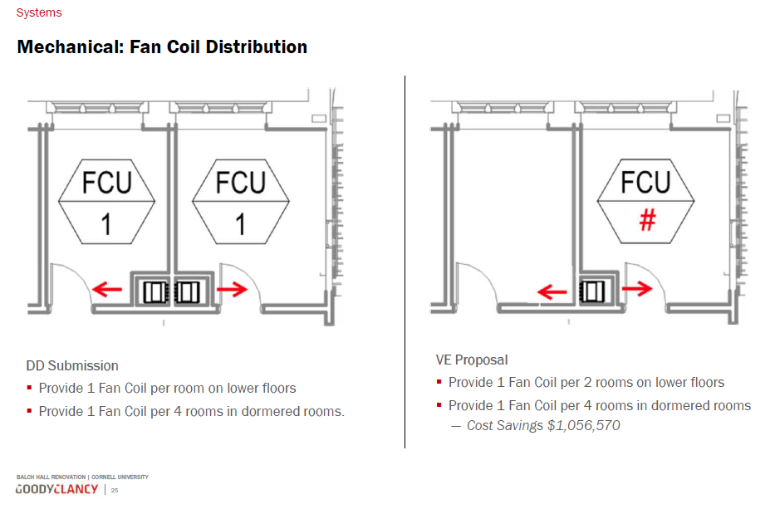
VE Examples
Notes:
There are so many examples of VE items. A very limited scope maintenance project will have less VE ideas than a large gut renovation project for example.

Slide 20
PMPD Presentation on Value Engineering
Questions?
E&PM
April 26, 2022

