Slide 1
eB Minute
April 2022

Slide 2
RFP Final Review Process
Replaces emails to/from Facilities Contracts and others with a trackable process for submission/final review/preparation of RFP Packages for professional architectural or engineering services for Cornell University funded contracts.
Initiated by Project Manager or Project Coordinator
Engages Unit Representative and University Architect roles as needed
Do Not Use for Campus Let RFP Package submission – a separate process will be deployed for those soon.

Slide 3
RFP Final Review Process
A/E - Full Design Services
Audio/Visual Consulting/Design Services
Code or Fire Protection Engineering
Cx or BECx Services
Construction Management Services
Engineering Risk Assessment
Estimating Services
Furniture Design Services
Geotech Services
Hazmat Design/Air Test Monitoring Services
Lidar Survey, 3D Laser Scanning Services
Lighting Design Services
PQ-AFR Design Services
Pre-Construction Services
Rock Scaling/Rockfall Mitigation - NDA Required!
Signage/Wayfinding/Branding Services
Site and Topo Surveys
Space Study
Special Inspections & Testing Services
Other Consulting Services

Slide 4
RFP Final Review Process
Notes:
Start Step (top)

Slide 5
RFP Final Review Process
If this project is >$2m a Procurement Plan (PP) process is required for A/E - Full Design Services, Preconstruction Services, Construction Management Services. If a PP exists attach it on the Attached Process Tab above, and enter "See PP" in Requested Firms box below. If a PP does not yet exist use the Start PP button below and attach that process to this one. Otherwise, list at least 5 firms to solicit in the Requested Firms field below.
Notes:
Start Step (bottom) - Procurement

Slide 6
RFP Final Review Process

Slide 7
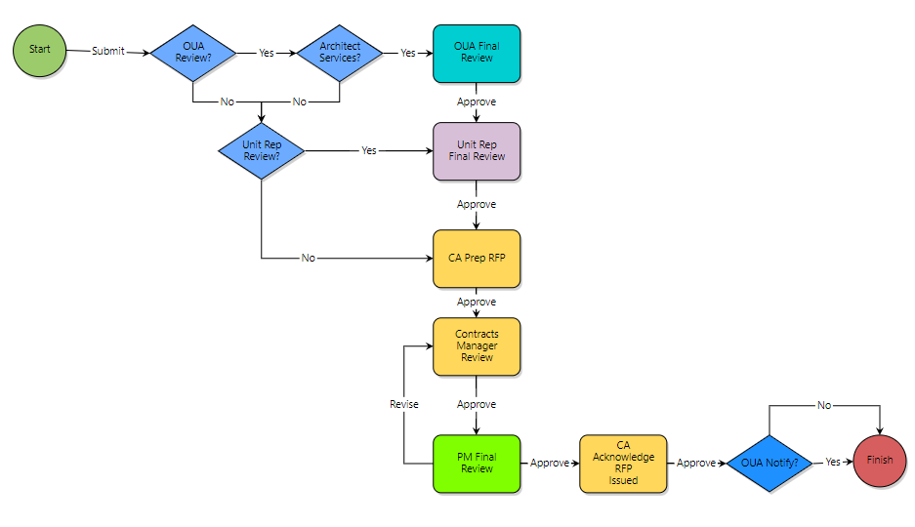
RFP Final Review Process
IF:
AND IF:
Service Being Requested is:
A/E - Full Design Services
Furniture Design Services
Signage/Wayfinding/Branding Services
Space Study

Slide 8
RFP Final Review Process
IF:
Service Being Requested is:
A/E - Full Design Services
Audio/Visual Consulting/Design Services
Engineering Risk Assessment
Furniture Design Services
Signage/Wayfinding/Branding Services
Space Study
Other Consulting Services
PQ-AFR Design Services

Slide 9
RFP Final Review Process

Slide 10
COMING SOON!
RFP Campus Let Final Review (RFPCL) Process
LOI Request (LOI) Process
Contract or Small Project Input (CSPI) Process (replacing PIR process)

Slide 11
REMINDER
For help at any time, please email:
e-buildergroup@cornell.edu

