Slide 1
Project Management – Professional Development Series
Air Handler Filtration

Slide 2
Outline
Air Filtration: WHAT, WHY, & HOW?
Relevant Standards & MERV
Filter Types On Campus
Challenges Across Campus
CU Filtration Standard Updates

Slide 3
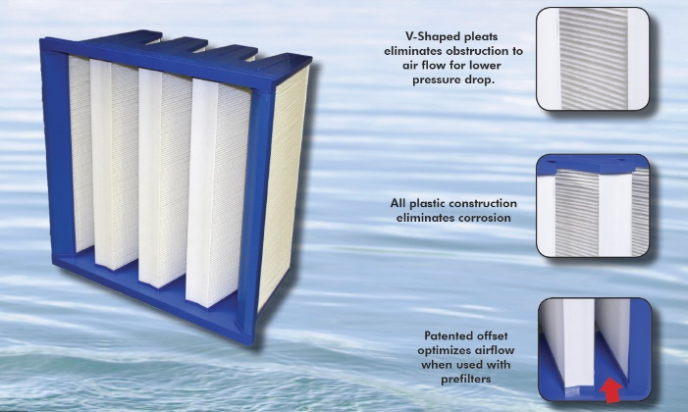
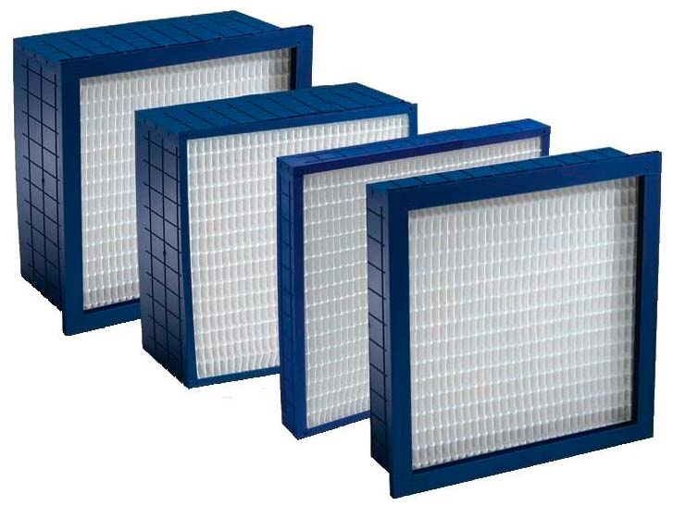
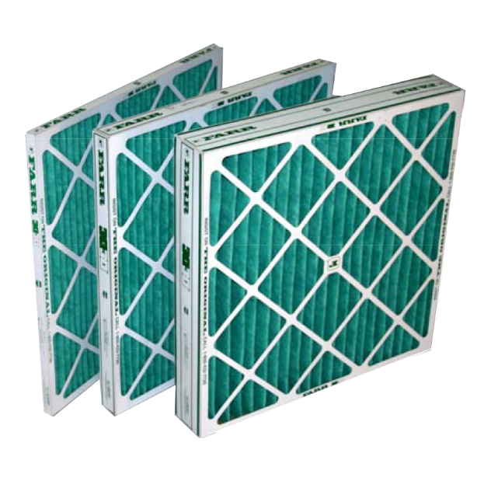
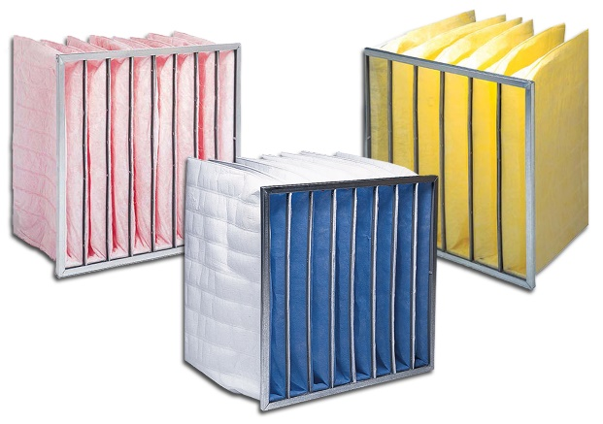
Air filtration: WHAT, WHY, and HOW?
WHAT is a filter?
Devices comprised up of:
Metal, plastic, or cardboard frames
Organic or synthetic media

Slide 4
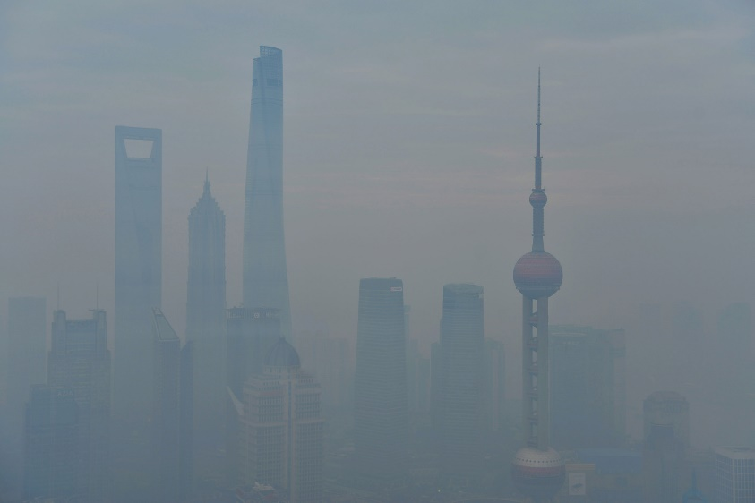
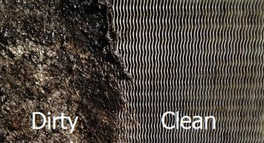
Air filtration: WHAT, WHY, and HOW?
WHY do we filter air?
Captures particulates (dust, mold, viruses)
Protects occupants
Protects equipment

Slide 5
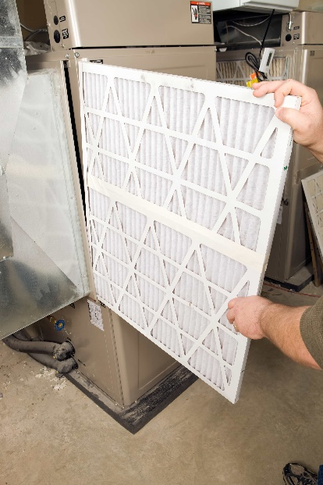
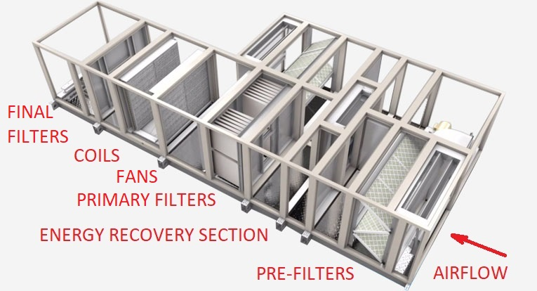
Air filtration: WHAT, WHY, and HOW?
HOW do we implement?
Pre-Filters
Primary-Filters
Final-Filters

Slide 6
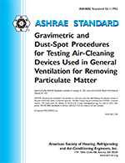
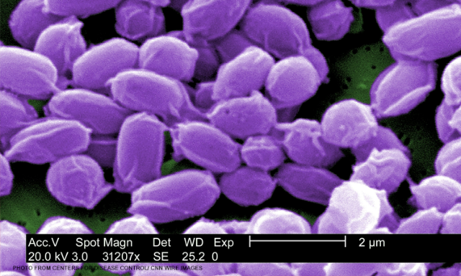
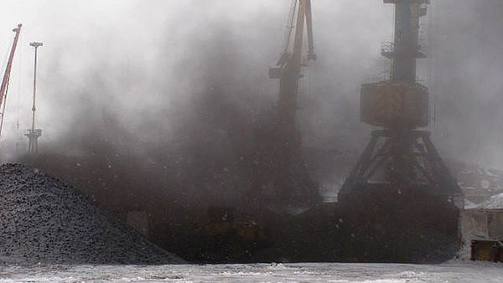
Relevant Standards
Old – ANSI/ASHRAE 52.1 “dust spot” efficiency
Percentages
85% filter – captures 85% of 1 micron particles
1 micron
Coal dust
Anthrax

Slide 7
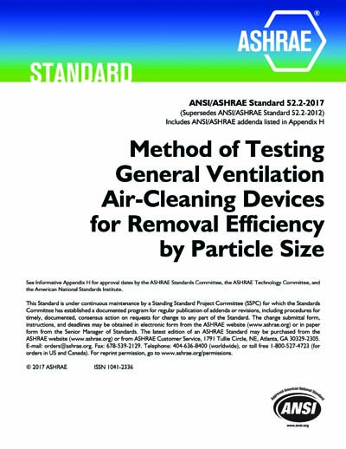
Relevant Standards
New (2009) – ANSI/ASHRAE 52.2
MERV (Minimum Efficiency Reporting Value)
MERV 13 equates to 85%

Slide 8
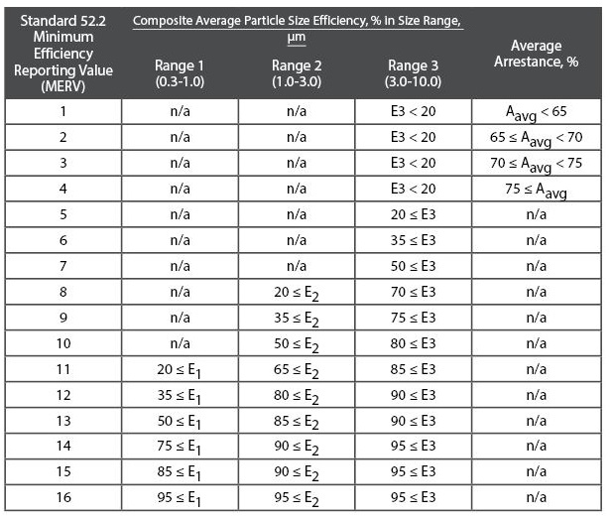
Relevant Standards
ANSI/ASHRAE 52.2

Slide 9
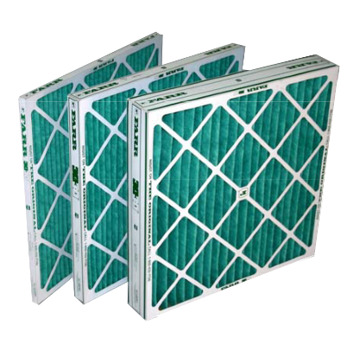
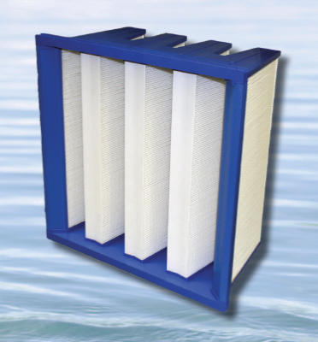
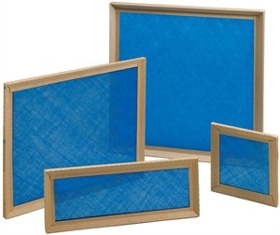
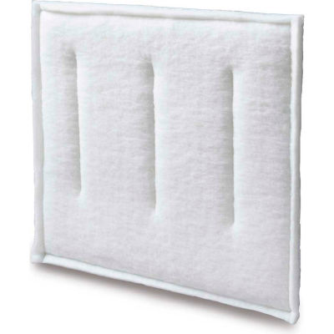
Filters Cornell Uses
Pleated (1”, 2”, 4”, 12” deep)
Panel (1” deep)
Cassettes (12” deep)
Pocket Filters (15”, 22”, 30” deep)
Commercial & Industrial – C&I (1” deep)

Slide 10
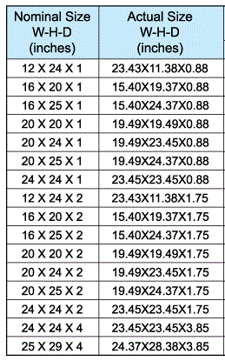
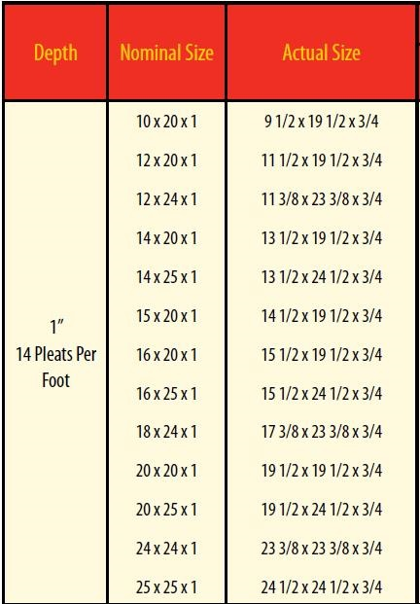
Sizes
So, so many…
24x24, 24x12, 25x20, 25x16, 20x20, 20x16, etc., etc., etc…
There’s a real need to standardize sizes
Reduces strain on procurement team and mechanics

Slide 11
Sizes
Reality – Standardization not so easy.
Too many small terminal units with non-standard filter sizes
Especially when utilizing C&I pleated filters
7”x66”…
Good news is 99% of building AHUs from the 90s to Now utilize 24” x 24” and 24” x 12” filters.

Slide 12
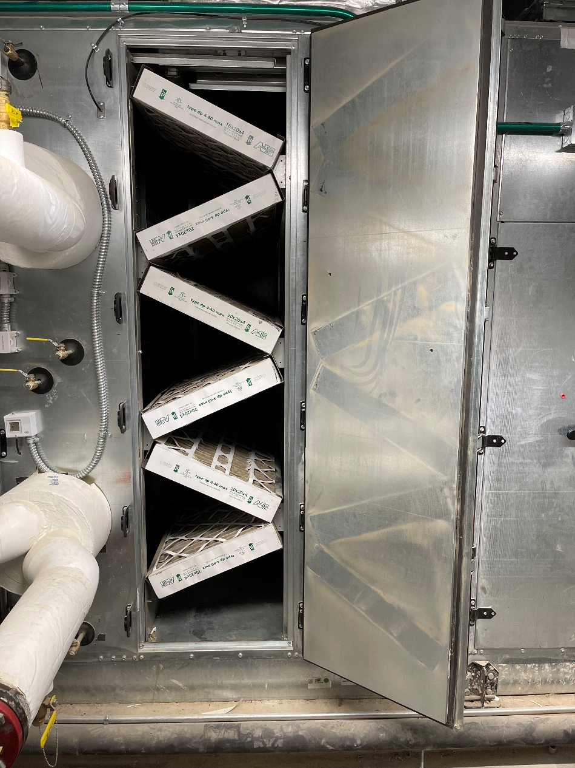
Current Filtration Challenges
Older Air Handlers
One filter rack
Shallow filters (1” or 2”)
Lower MERV (8)
Leaky filter racks (air bypass)

Slide 13
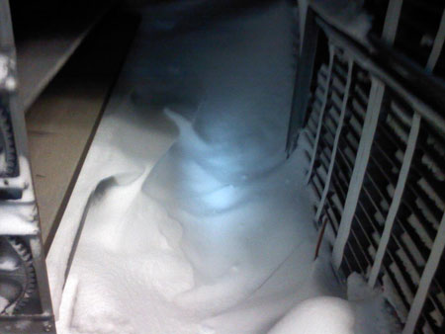
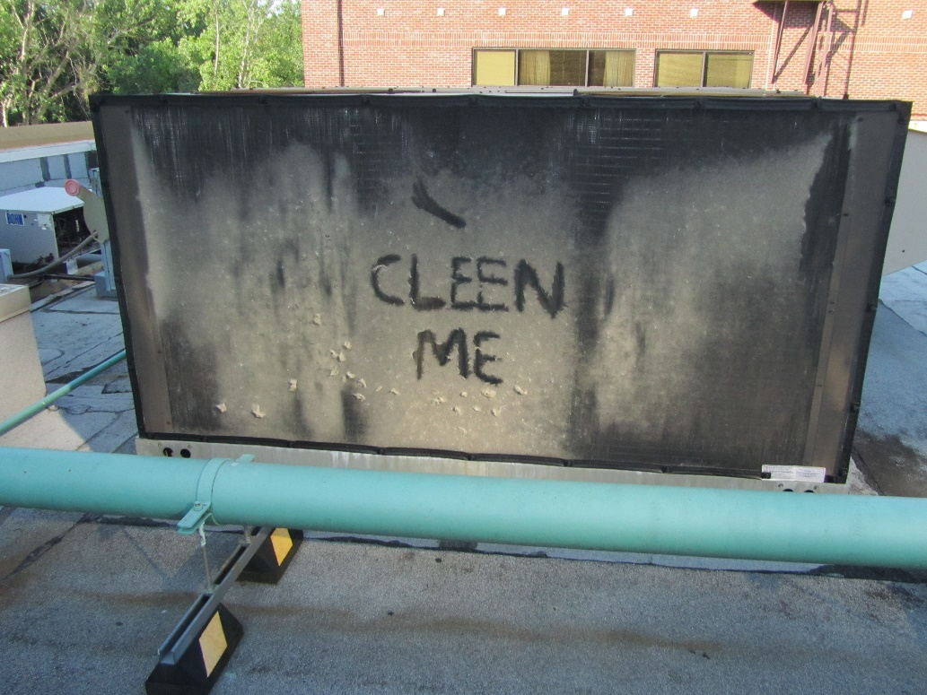
Current Filtration Challenges
Snow/Rain/Cottonwood Entrainment
Clogs filters
Mechanics scramble during harsh weather
Synthetics and snow screens help mitigate failures

Slide 14
Current Filtration Challenges
Upgrading to higher a MERV rating
Higher resistance to flow
Requires more horsepower to maintain airflow
Could lead to lower airflow in AHUs without VSDs
Increase in replacement costs

Slide 15
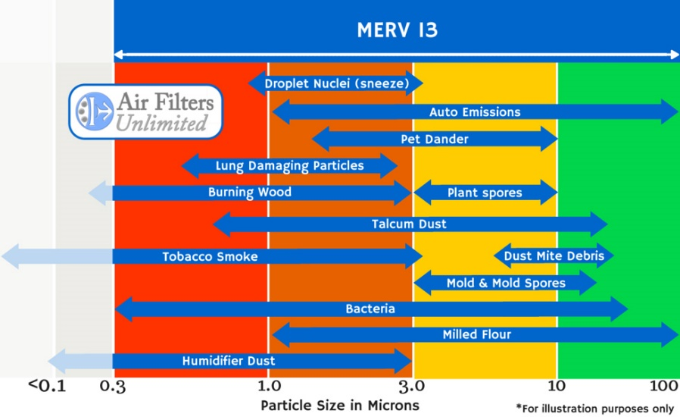
Cornell Filtration Standard
Pertains to New Installations, Only
MERV 13 for all typical occupancies
Previously
Offices/Classes MERV 11
Laboratories MERV 13
Current
LEED MERV 13
All MERV 13

Slide 16
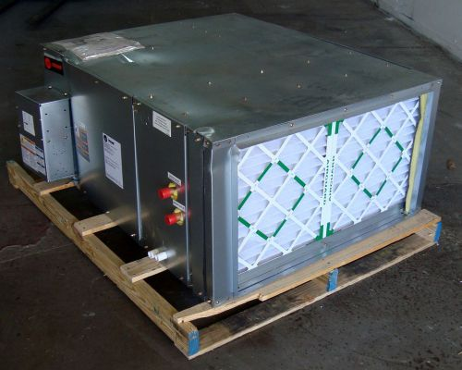
Cornell Filtration Standard
Additional standardization language
Smaller Units
16” x 16”
16” x 20”
16” x 24”
16” x 25”
18” x 24”
18” x 25”
20” x 20”
20” x 24”
20” x 25”

Slide 17
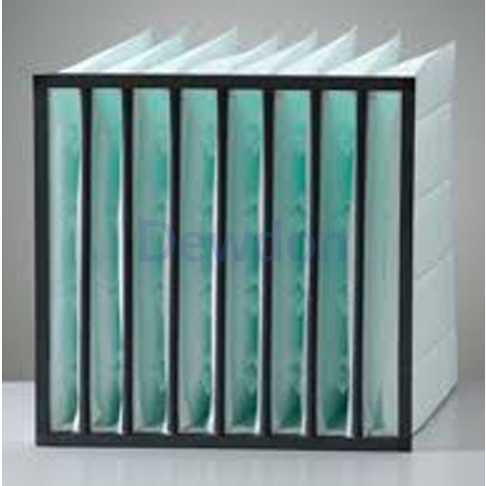
Cornell Filtration Standard
Additional standardization language
Type – Cassette vs. Pocket
vs.

Slide 18
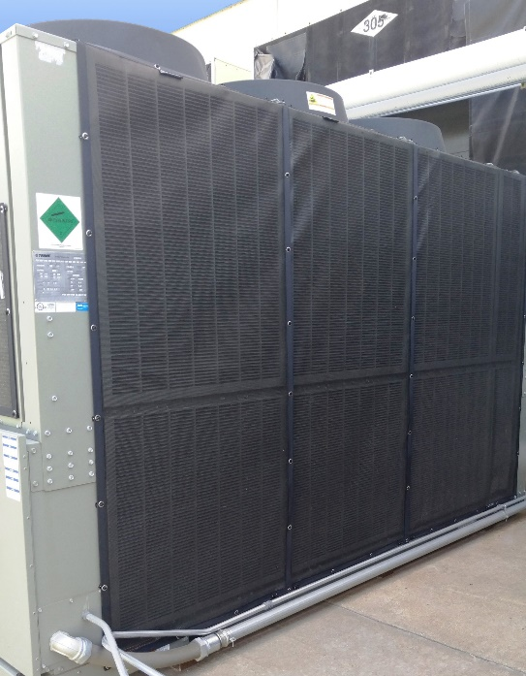
Cornell Filtration Standard
Application-specific snow screen language

Slide 19
Thank You!

