Slide 1
eB Minute
February 2022

Slide 2
Notification Settings
Notes:
Notification Settings: Changes are beginning to occur in the way projects are activated and assigned to PMs in the system. Colleges/Units will be able to add planned capital projects to e-Builder well in advance of being activated/assigned to a PM. A new process called Project Activation (PACTV) is replacing the PIR for capital projects. The Project Activation (PACTV) process changes a planned project to an active project. On the finish step of this process a FYI Notification will go out to the Project Manager, Project Director, Unit Rep and Finance Manager. It is important for all who are in these roles to understand Notification Settings – especially Summary Notifications.

Slide 3
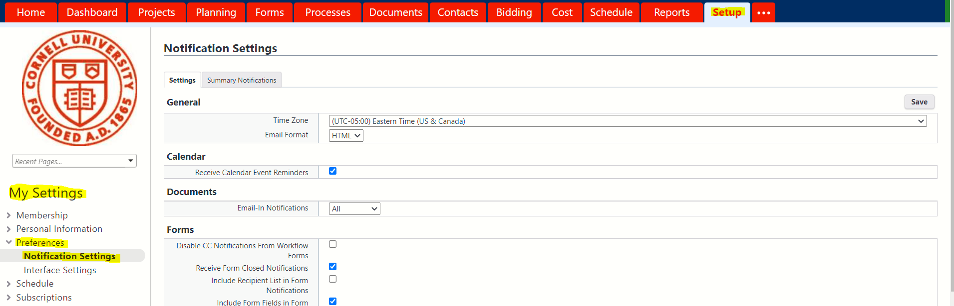
Notification Settings
It is recommended that these setting be left as default settings as shown on the “Settings” tab.
Click on the Setup tab
Go to My Settings on the left Navigation pane
Click on Preferences
Click on Notification Settings to customize your personal notification settings and create summary notification settings.
Notes:
To create a notification setting click on the Setup tab on the tool bar.
Go to My Settings on the left pane, Click on Preferences, then Click on Notification settings.

Slide 4
Summary Notification creation
Creating Personal Summary Notifications
Click on the Summary Notifications tab
Click Create

Slide 5
Summary Notification creation
Enter the name of the notification in the Subject field.

Slide 6
Summary Notification creation
In the Module(s) field, choose Processes.

Slide 7
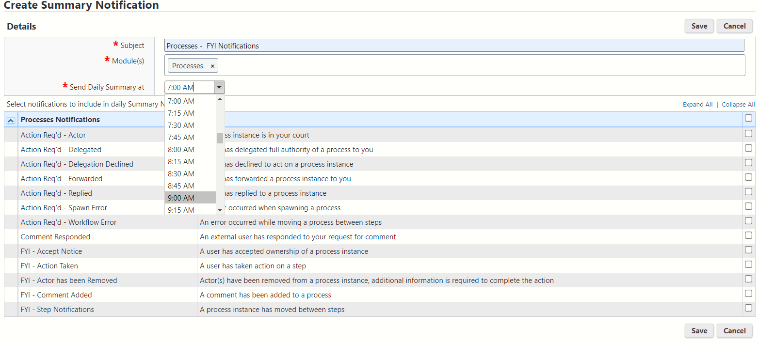
Summary Notification creation
Under the Send Daily Summary at click on the drop-down menu to choose a delivery time for your summary notification.

Slide 8
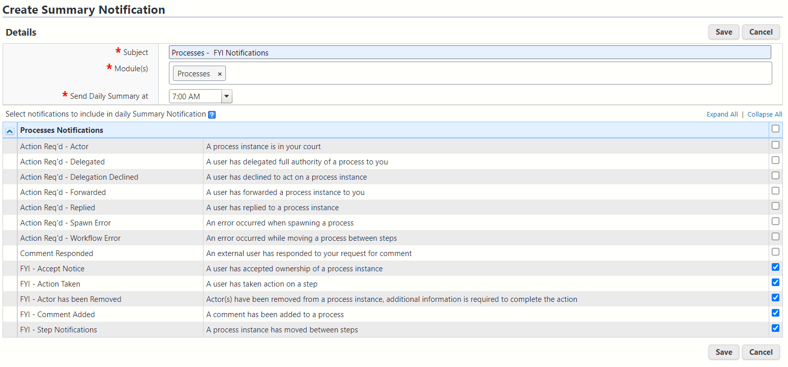
Summary Notification creation
Select the check box next to the specific notifications you wish to include in the summary. Anything not selected will send as normal, if it is something you normally receive.

Slide 9
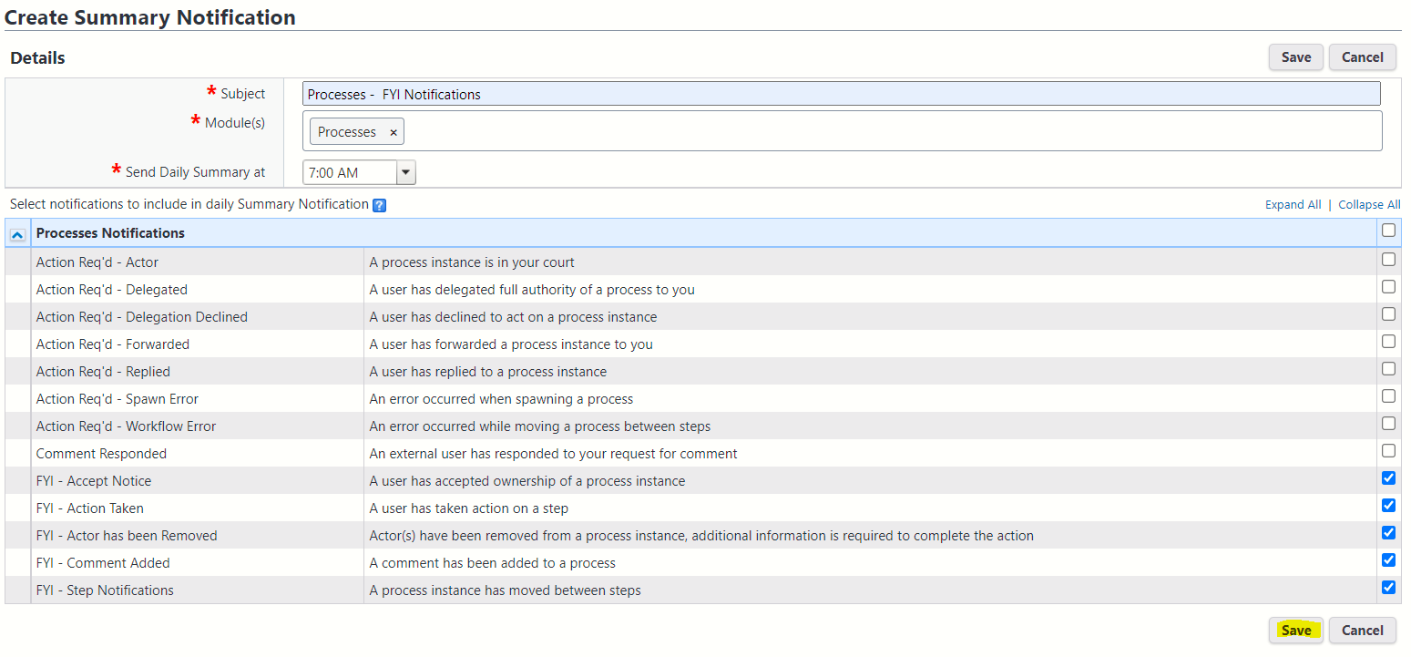
Summary Notification creation
Click on Save to save the Summary Notification created.
FYI notifications will not show up on your home page only Action items do.

Slide 10
Summary Notification creation
If you set a Summary Notification for FYI’s do not ignore them read them.
If you are not getting individual email notifications that you think you should, you may have set up a summary notification in the past, check your settings.
Notes:
TIP – You may find it helpful to set a rule in your Outlook for notifications from bounces@eBuilder.net to go to a separate folder. This will keep these notifications separate and not mixed into your other email.

Slide 11
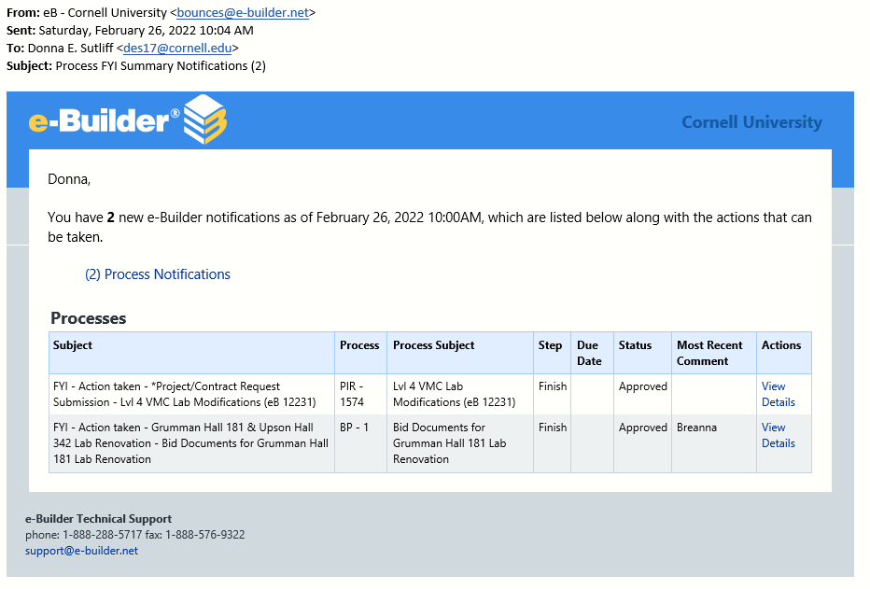
Email FYI Summary Notification
FYI Summary Notification will look like this when it comes into your email, if you have an FYI Process Notification setup.

Slide 12
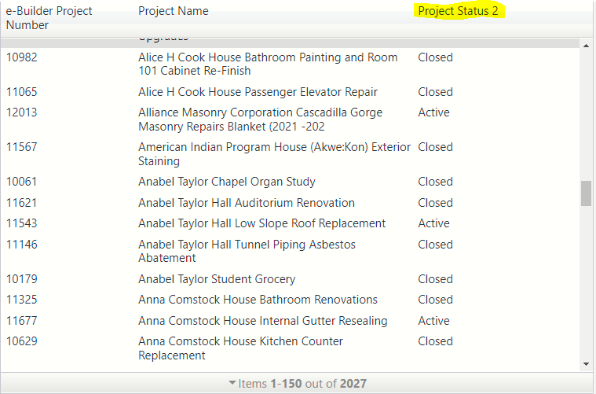
eBuilder Update
Project status now shows up on the project drop down menu.

Slide 13
eBuilder Reminder
On the Project Status Update(PSU)process include an Impact Statement and an Impact Visualization Document if your project requires it.
Consult your director if you have questions about whether your project requires it.
Once it is added you do not need to do another, unless impact changes.

