Slide 1
Window Washing Plan Requirements

Slide 2
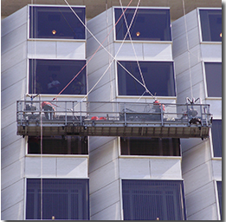
Overview
Why is a Window Washing Plan (WWP) required?
When is a WWP required?
What elements must be included in a WWP?
How do I submit a WWP?
How does the WWP approval process work?
Source: www.dir.ca.gov
Notes:
Photo Source: https://www.dir.ca.gov/dosh/research-and-standards-unit.html

Slide 3
Why is a Window Washing Plan required?
New York Code Rule 21: Protection of Persons Employed at Window Cleaning – Structural Requirements, Equipment and Procedures
“The board finds that the trade, occupation or process of cleaning the windows of public buildings involves such elements of danger to the lives, health or safety of persons employed therein as to require special regulations for the protection of such persons…”
The code specifically highlights the constant hazard of falling from dangerous heights as creating a substantial risk of serious injury to such persons and others.

Slide 4
Why is a Window Washing Plan required?
Special regulations for the protection of individuals employed in window washing includes:
“…a sufficient statement of the proposed means and methods of cleaning such windows shall be submitted by the owner (as defined) to the commissioner.”
The purpose of the WWP is to ensure the window cleaner is using safe and authorized window cleaning means and methods on Cornell University buildings according to the requirements set forth by the New York State Department of Labor.

Slide 5
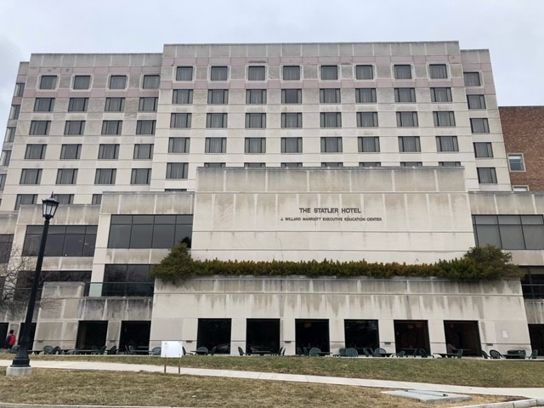
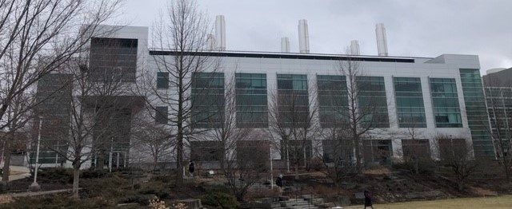
When is a Window Washing Plan required?
A WWP is required when Cornell employees or contractors are engaged in exterior window washing activities involving Cornell University facilities operating in the state of New York which meet any of the following criteria:
The building is a multiple-dwelling that is 7 stories or greater; OR
The building is 4 stories or more.

Slide 6
When is a Window Washing Plan required?
A WWP will need to be submitted and approved for the initial cleaning of a building’s windows before work can begin.
Following the initial building WWP approval, subsequent WWPs on the same building will be required if any of the following conditions change from what was initially included:
Cleaning methods used
Sides of the building(s) cleaned
Equipment used for each cleaning method

Slide 7
What elements must be included in a WWP?
The WWP must include the following information:
Building Height
Sides of the Building Cleaned
Contractor Contact Information (name, email, phone)
Proposed Start Date
Proposed Means and Methods of Cleaning
Must use an authorized means and method of cleaning.

Slide 8
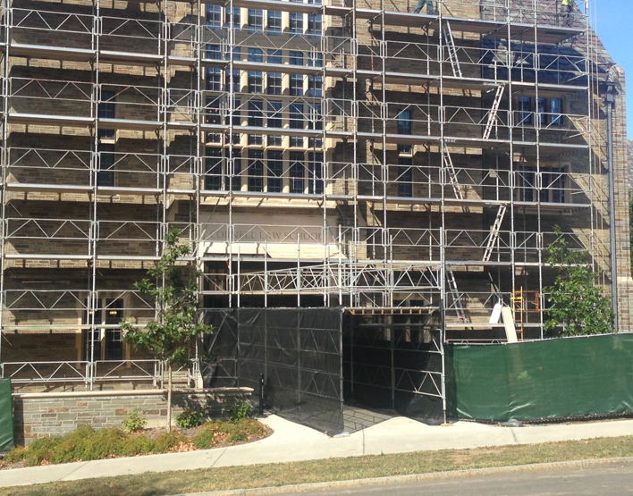
What elements must be included in a WWP?
Authorized Means and Methods include:
Working from safe surfaces
Working from windowsills or ledges
Working from ladders
Working from boatswain’s chairs
Working from scaffolds

Slide 9
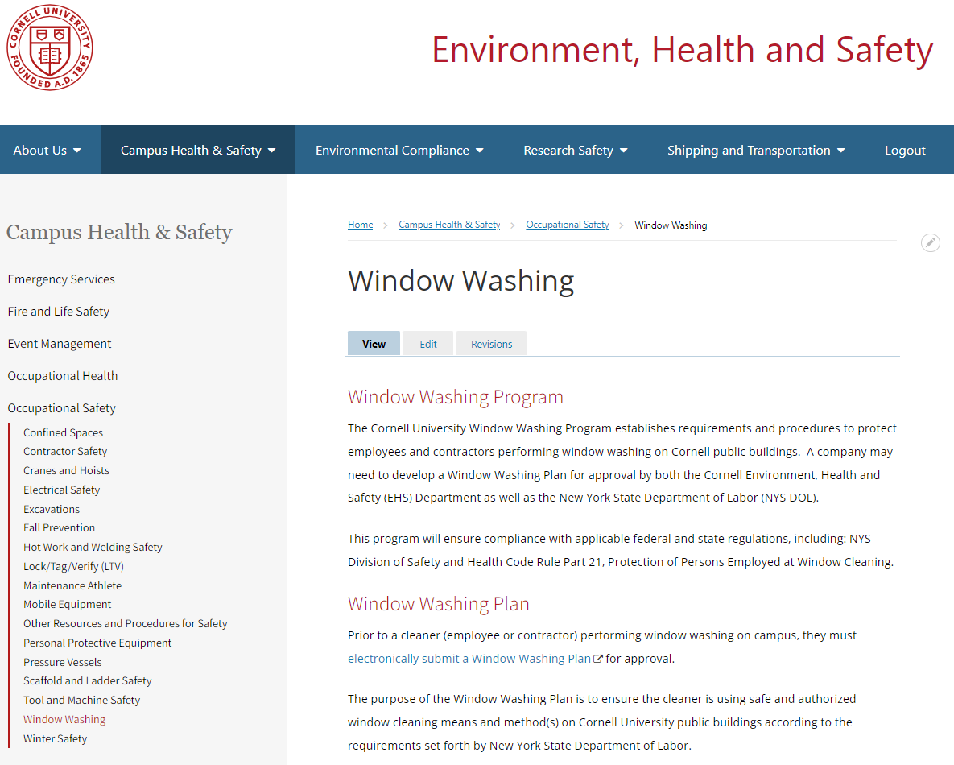
How do I submit a Window Washing Plan?
From the EHS webpage:
Navigate to the Window Washing page located under the Occupational Safety tab.
Select “Electronically Submit a Window Washing Plan” under the Window Washing Plan heading.

Slide 10
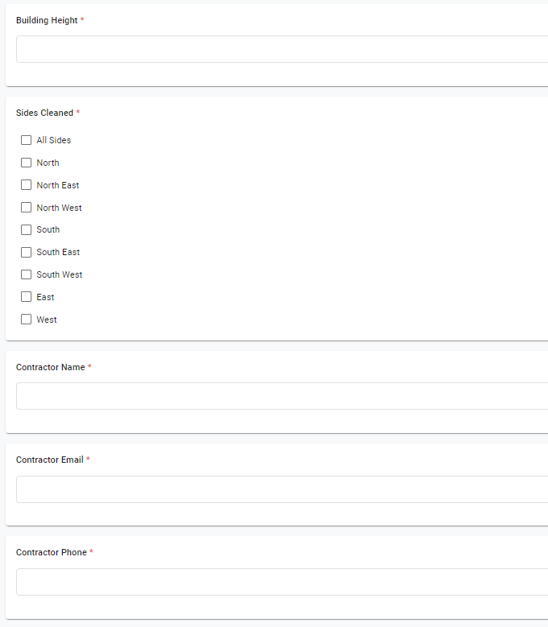
How do I submit a Window Washing Plan?
Complete all of the fields in the questionnaire.
Once all of the fields are completed, select Save and then the Submit button located at the top right of the questionnaire.

Slide 11
How does the WWP approval process work?
EHS will conduct an initial review of questionnaires. EHS approved questionnaires will be sent to the NYS DOL for final review and approval.
Questionnaires that do not pass the initial review or the NYS DOL final review, will be sent back to the submitter to revise and resubmit.
When questionnaires are approved by the NYS DOL, EHS will notify the individual who completed the questionnaire that it was approved, and they may proceed with the proposed work.

Slide 12
Questions?
Nick Genovese
Safety Engineer
Environment, Health and Safety
607-342-8718
npg24@cornell.edu

