Slide 1
eB Minute
January 2022

Slide 2
How to Use the E-Mail In Folder
E-Builder Active Projects – Documents Module – 00 E-Mail In folder
Click the Email Address link to copy it

Slide 3
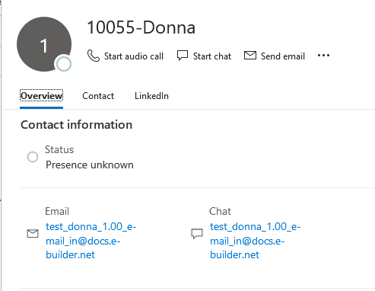
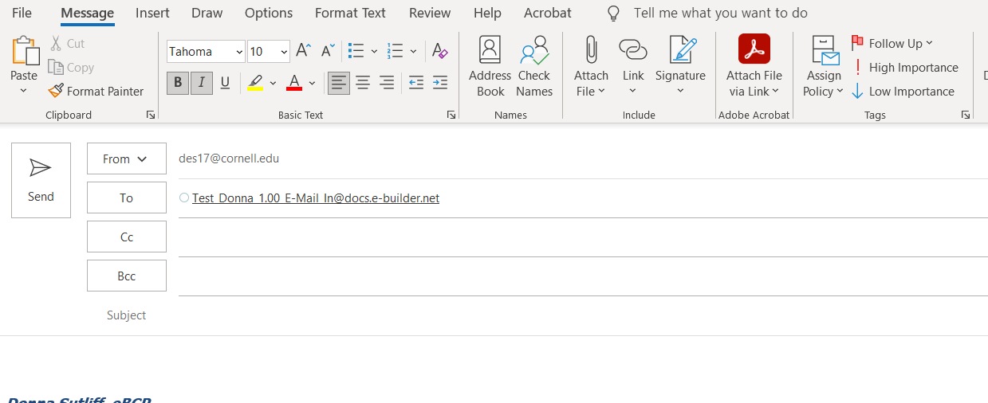
How to Use the E-Mail In Folder
Outlook
Right Click to paste it into the To line of a new email
Save it as new Contact in Outlook
Name it whatever you like
Use it to forward or cc emails to the project at anytime
Provide it to others to use for same purpose
Msg file and attached documents are saved as separate documents in the 00 E-Mail In folder

Slide 4
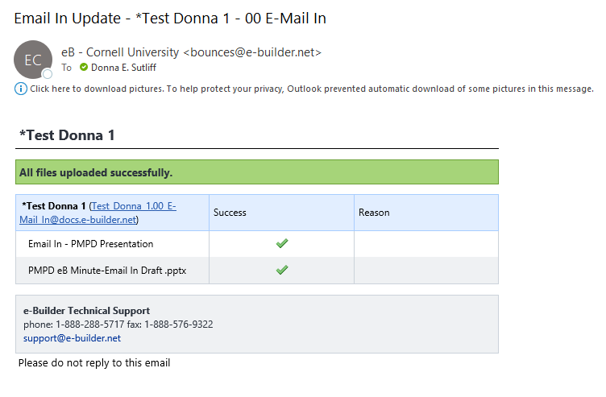
How to Use the E-Mail In Folder
Outlook
Sender will receive an email notification from e-Builder regarding the success or failure of the upload of the files
Msg
Attached Documents
Green band – successful
(as see here)
Red band – will show fail & reason

Slide 5
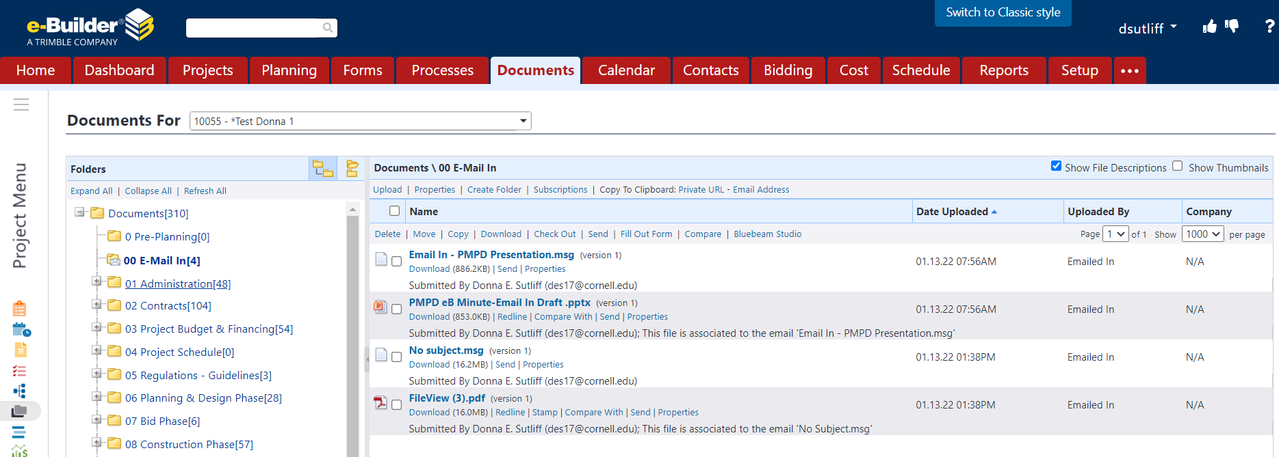
E-Mail In Feature
E-Builder Active Projects – Documents Module – 00 E-Mail In folder
Msg file and attached documents are saved as separate documents in the 00 E-Mail In folder
PM permissions have been updated – may now move/copy/delete files in this folder as needed

Slide 6
Project Details-Custom Fields Glossary REVISED
Revised 1.15.2022
Changes mostly related to a new eB role: Project Advocate
Role needed for Planned project; capital planning & project pre-planning activities
A college/unit user assigned while project is in “Planned” status
Role will have edit permission on some fields of project details page
Available in e-Builder Resources:
Documents\User Resources\A Glossary of Project Details Fields

Slide 7
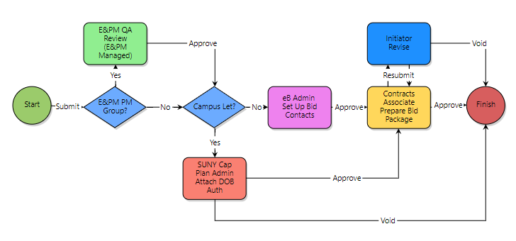
Bid Preparation Process
REVISED
Revised 1.21.2022
New Step Added SUNY Capital Plan Administrator will upload DOB Spending Authorization

Slide 8
COMING SOON!
New Project Activation Process (PACTV) will replace PIR for Capital Projects
PAR Process to be revised
Adding a Step between PAR Prep and Director Review that will allow Courtney Lecky, Capital Analyst, to review
Longview Information
Variance designation
Sources & Uses Information
Send process back to PAR Preparation Step if corrections are warranted
Objective is to avoid further down-the-line changes being required after approvers have already endorsed the PAR.

Slide 9
Questions?

