Slide 1
Concrete Flatwork Construction
Sidewalks
Exterior Slabs on Grade
Concrete Pavement
Presented by: Jim Tofte with Rob Murray
Facilities Engineering Architectural Civil Section

Slide 2
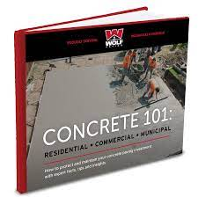
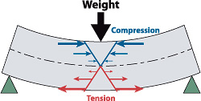
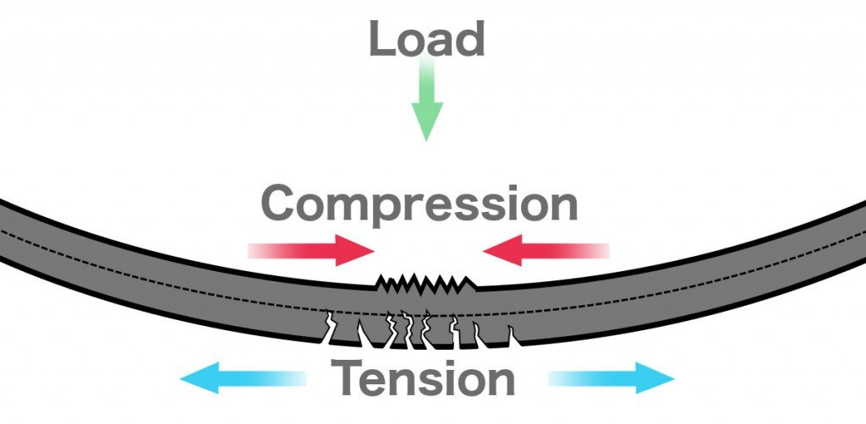
Concrete Principles
Strong in Compression/Weak Tensile Strength
Water/Cement Ratio - Strength - Mixture - Admixtures - Curing
Strength & Durability (Air Entrainment – Freeze/Thaw)
Thickness Slump/Air/Compressive Strength
Most Site Pavements are Not Reinforced
5” Sidewalks –regular traffic (pickup trucks, passenger vehicles) 6”
8” - trucks and buses, Major Interstates 10”-12”
Placed on Compacted Subgrade
Crack Control for Shrinkage (WWF or Fibers)
Load Transfer Dowels
Structural Slabs – Reinforced
(loading docks, crane pads, dumpster pads, poor soils, fire lanes, bridging)

Slide 3
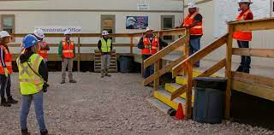
Pre-Placement Meeting
ATTENDEES:
Lead Finisher, Contractor Foreman, PM
FE SME/Maintenance Program Mgr.
Design Engineer Rep., FE or Consultant
Owner/Facility Rep.
Supplier
Testing Lab, in an Ideal World
Others

Slide 4
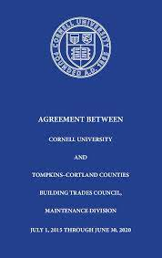
Labor
Union Labor Required for work with concrete materials
Complex! Can Require Official Interpretations.
FCS Contracts, CU Labor Relations
BTC Representative
Qualifications
Ideal is ACI Flatwork Certification in CU Standards
Exam & 1,500 hour for ACI certification
Contractors Flatwork Concrete Resume is the norm.

Slide 5
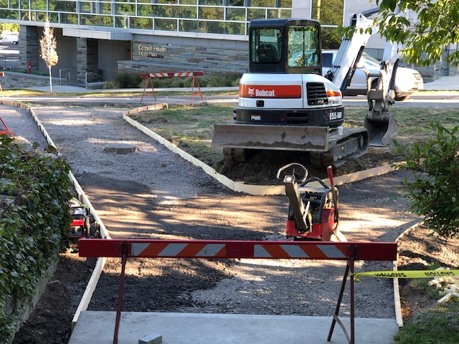
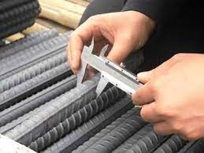
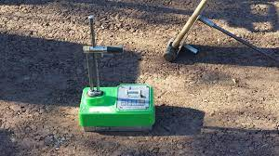
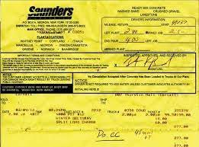
Submittals and Inspections
Submittals
Mix Design (Severe Exposure)
5,000 psi, W/C Ratio 0.40
Aggregates
Admixtures
Compare with Batch Ticket
Crack Control: WWF or Fibers
Reinforcing
Testing Lab
Open Line of Communication
Required Information to Testing Agency
Special Inspections
Form work
Rebar
Subgrade
Concrete Testing
Concrete Sampling (Cylinders)

Slide 6
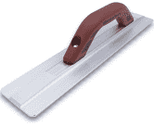
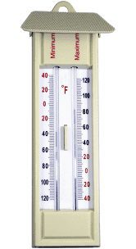
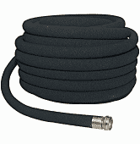
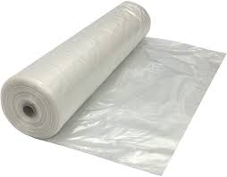
Pre-Placement Materials On Hand
Finishing Tools/Methods
Correct edgers, finishing tools, Concrete Saws
Surface Finish, Broom Type, etc.
Curing Materials
Curing Materials
Water On Site/Available Water, Hoses, Sprayers, etc.
Blankets (if approved)
Intermediate Curing Compound
Spray Cure & Seal (if approved)
High / Low Thermometers
Protection
Poly Sheeting (Rain)
Temperature
Signage and Barricades

Slide 7
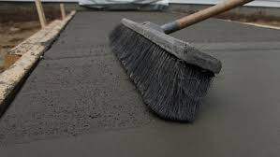
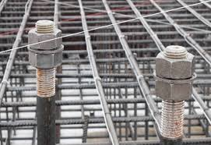
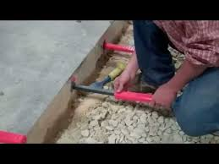
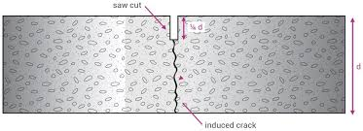
Finishing
Type (broomed, smooth, etc.)
What type of broom finish, rough, smooth, direction.
Joints (Location, Spacing, Layout)
Control (Sawcut is standard), City Standard (Tooled)
Expansion Joints
Fiber Board
Dowels
Mockups?
Embedded Objects (anchor bolts, ADA Tiles, etc.)

Slide 8
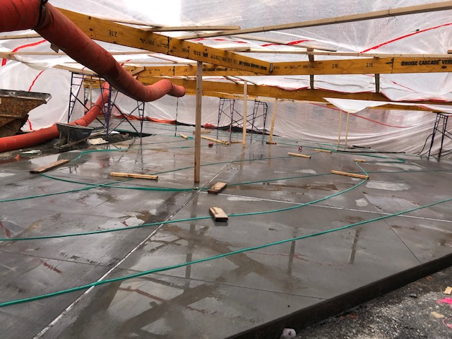
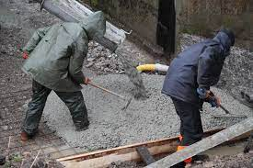
Weather/Mitigation
Forecasted Weather
Extreme Heat Low Humidity
Size of finishing crew (sets up faster)
Intermediate curing, fog or mist spray
Retarders
Cold Weather Concrete
Special Section in Specifications
Heated Mix
Heated subgrade
Tenting
Heat/Blankets
Rain
Poly sheeting
Is runoff directed away from placement?
RM

Slide 9
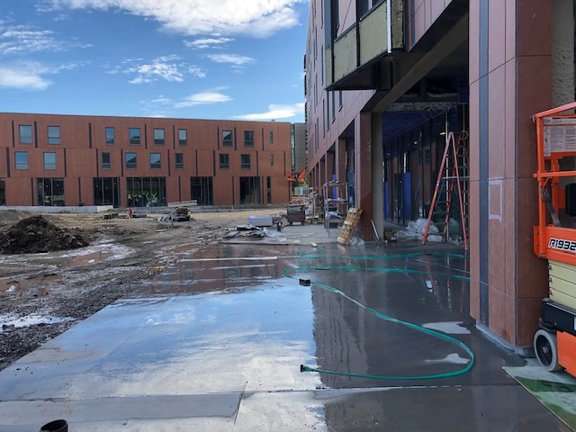
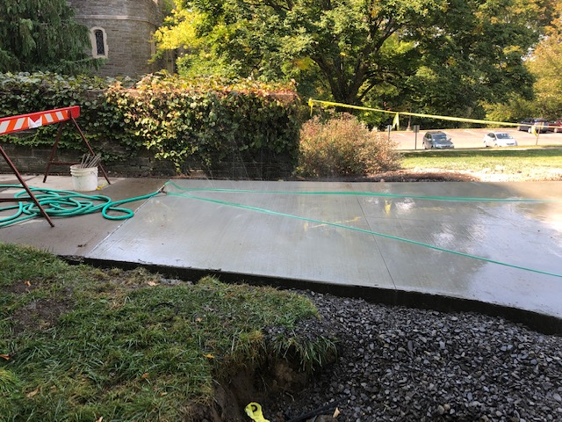
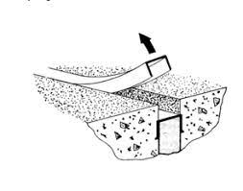
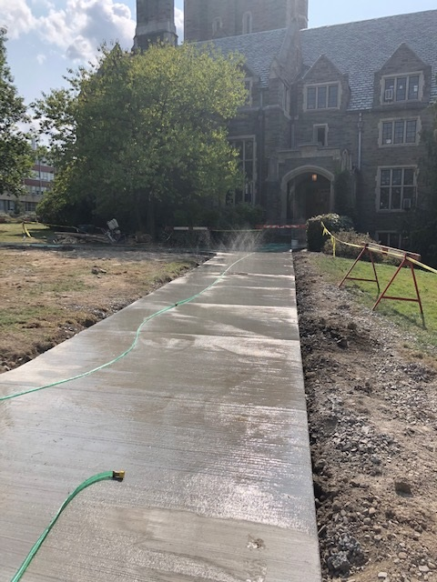
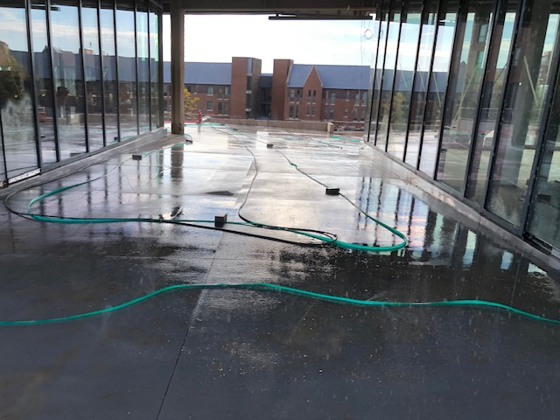
Curing & Protection
Curing
Wet Curing 7 Days (uninterrupted)
Non-Contact Curing is standard in most areas
Maintain Temperature during curing
Liquid Cure and Seal (Egress/Code, Approvals needed)
Cure and Seal Products (ACI C309)
Protection
Sealer, Penetrating Salt Inhibitor
Types
Barricades, Signage, etc.
Caulking Joints
Temperatures
Protection of Caulk
Remove Caps and Application

Slide 10
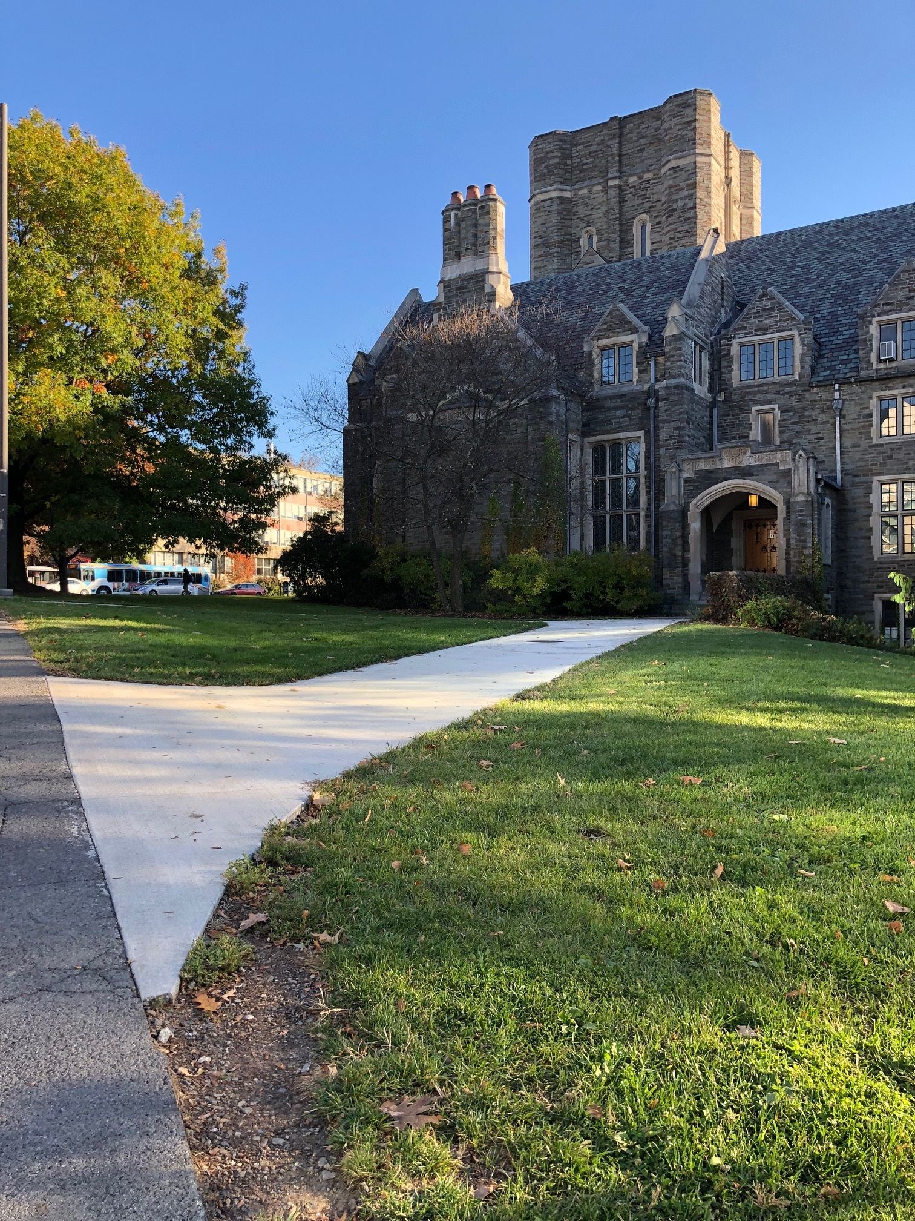
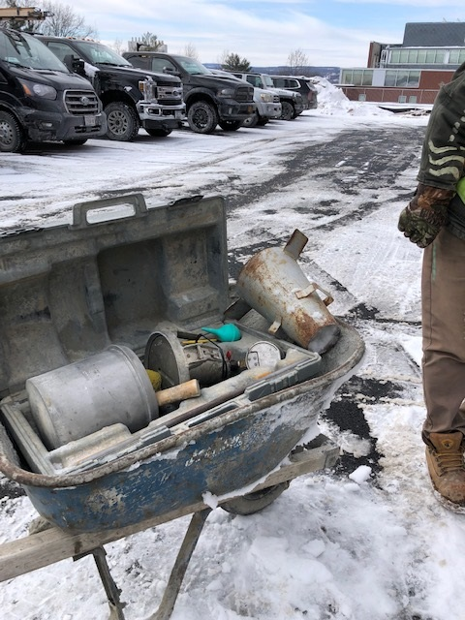
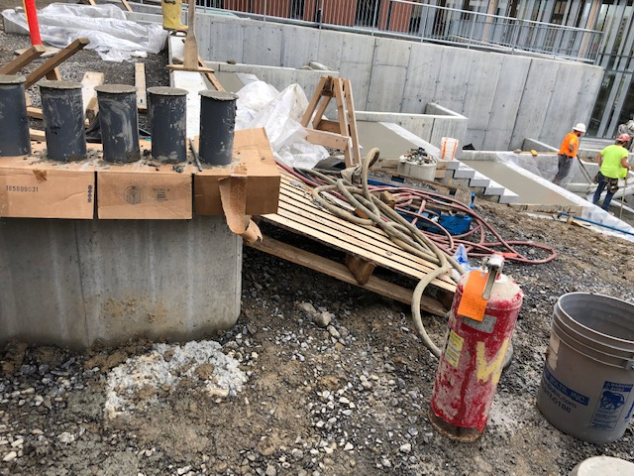
Building Project Success
RM

Slide 11
What keeps us up at night !
Neighbors Dog!
Poor Communication!
Curing Supplies not on site!
Not enough hoses, water source not available!
Not getting cure on same day! It is possible !
Letting pour dry out so you can saw cut it! What?
Proper curing “not always” a priority for contractors, so it seems.
We have Improved! Kudos!
“Cost of Propper Curing is in our Bids, lets make sure it is getting done!”

Slide 12
Engage Facilities Engineering (FE):
FE is here to Help. Campus Stewardship.
Engage FE early in the design process.
Encourage consultants to reach out to FE with any questions regarding our Design and Construction Standards.
Please invite us to pre-placement meetings.
Consider engaging FE more actively in your project.
(Great examples: Statler, NCRE, West Ave, Feeney Way)
FE - Architectural and Civil Section:
Flatwork Concrete/ Sidewalks / Pavements
Jim Tofte jt743@cornell.edu
Structural Engineering / Bridges / Building Systems
Rob Murray rmb234@cornell.edu

