Slide 1
2021 RCM Projects

Slide 2
RCM Team - A Year In Review
Team Updates
Moving on up or out!
Elisabete Godden to Paul Stemkowski's PM Team
Alex Chevallard to Brad Newhouse’s PM Team
Andrew Germain to FM, Director of Asset Management and Logistics
Tammy Johnson completed a rotation with FM Procurement and was promoted to Project Manager
Darlene Hackworth passed the PE exam and is now a licensed Professional Engineer
New Team Members
Michael Kuo, Associate PM
Michael Johnson, Associate PM
Ruth Howell, Associate PM on rotation
2021 Metrics
As a whole, E&PM received over 100 new projects through intake.
56 of these projects were assigned to the RCM Team.
47 projects were closed out
The RCM team is currently managing a portfolio of 108 projects.

Slide 3
The Cornell Store Emergency Power and Emergency Lighting Replacement Project Deb Melanson
Original Lighting
New Lighting

Slide 4
Lynah Rink Hockey Plunge Tanks Michael Johnson

Slide 5
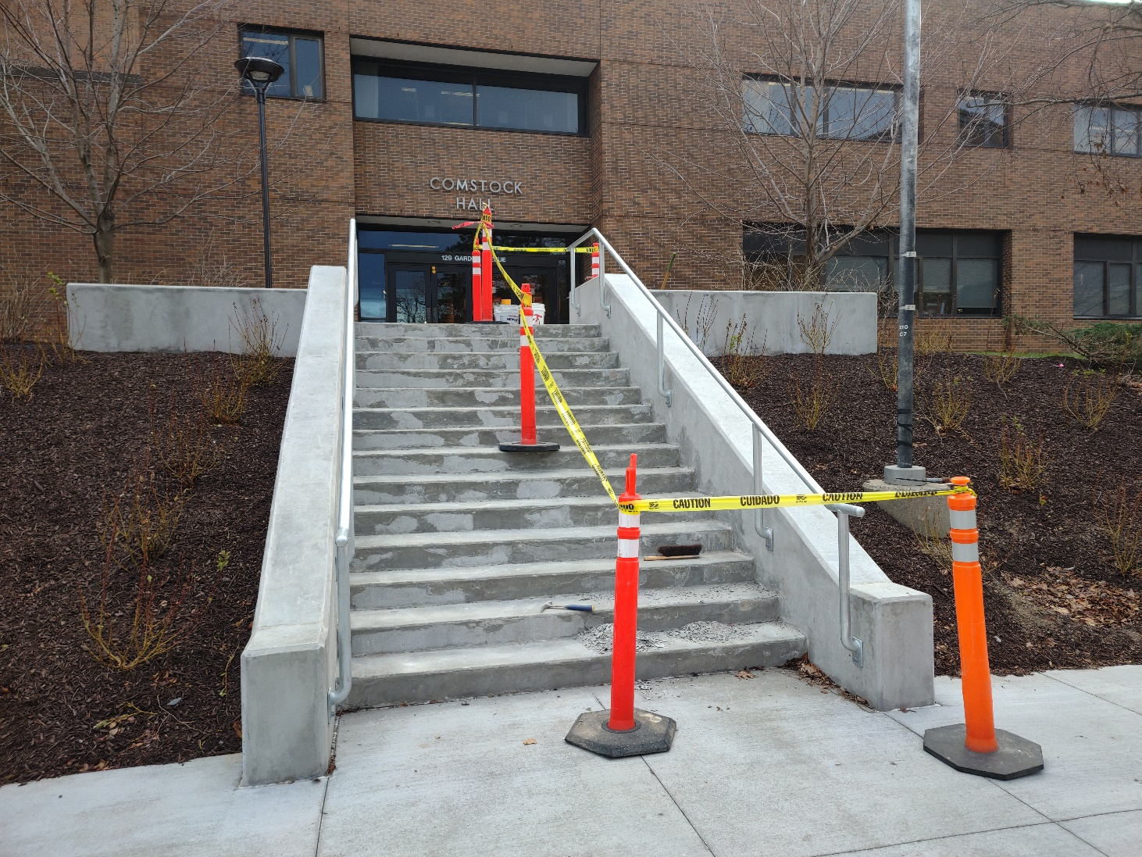
Comstock Hall Planned Maintenance 2019 Darlene Hackworth

Slide 6
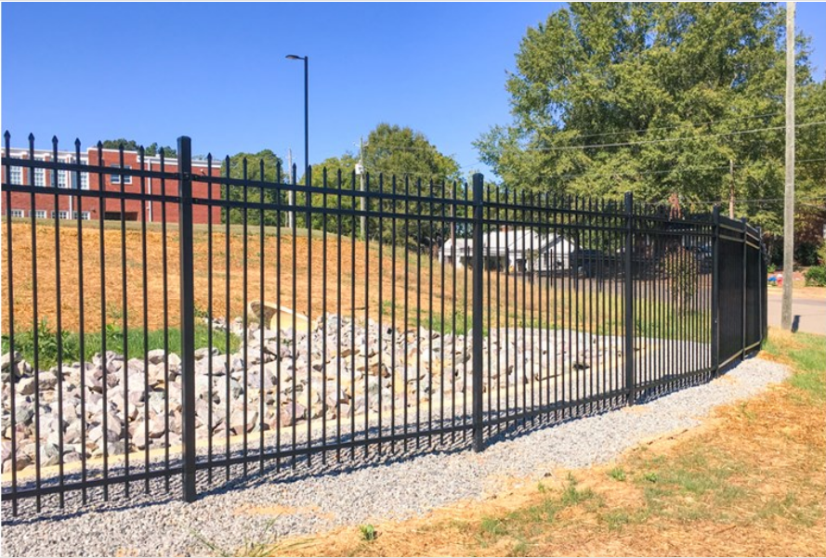
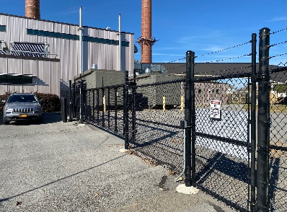
Water Filtration Plant Perimeter Security Fence Michael Kuo

Slide 7
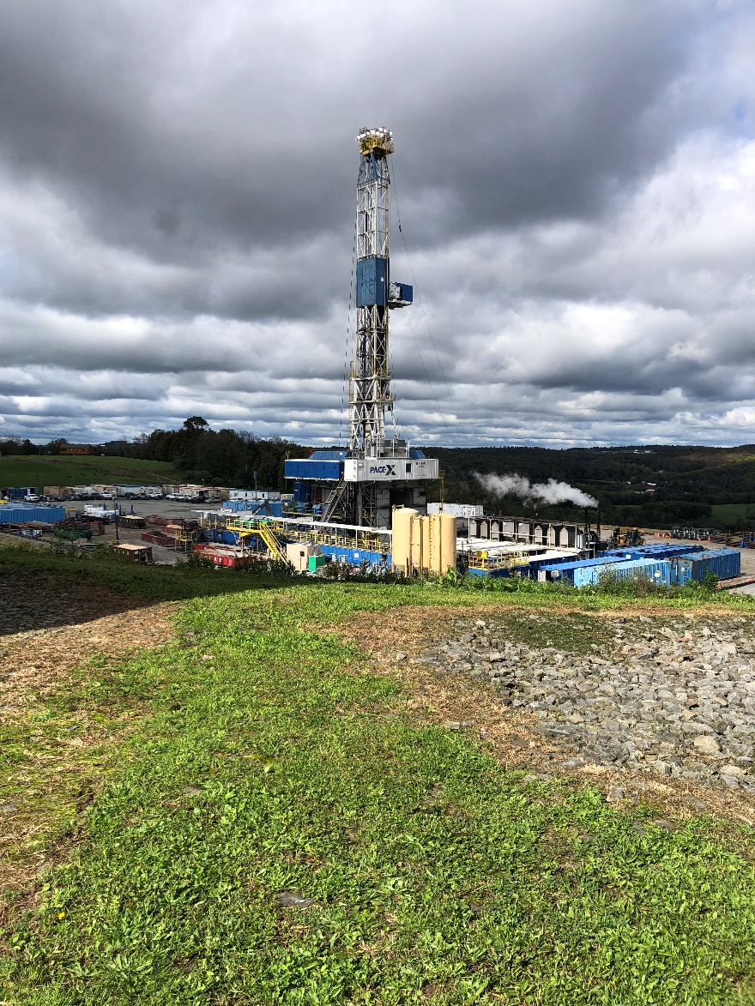
Cornell University Bore Hole Observatory (CUBO) Tammy Johnson

Slide 8
Bartels Hall Newman Arena Bleacher Repairs Ruth Howell

Slide 9
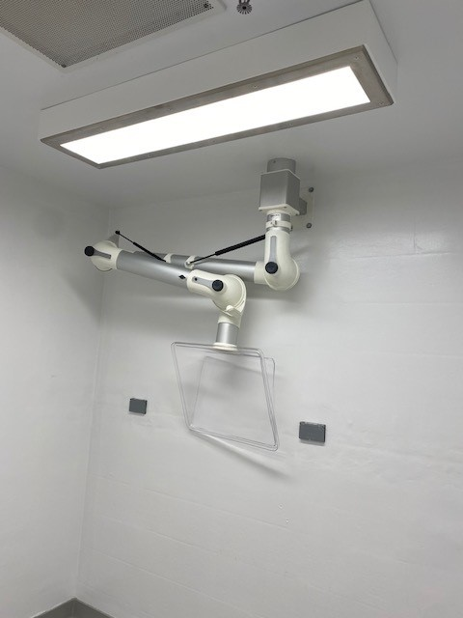
Uris Hall Basement Lab Renovations Jason Cragle

Slide 10
Questions?

