Slide 1
Design Standards Overview

Slide 2
Design Standards Overview

Slide 3
Outline
Why do we need standards?
Philosophy
What are design standards & details?
Definitions
Approach
Statistics
Variance Process

Slide 4
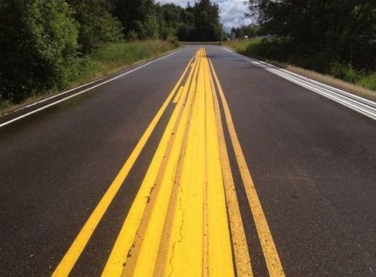
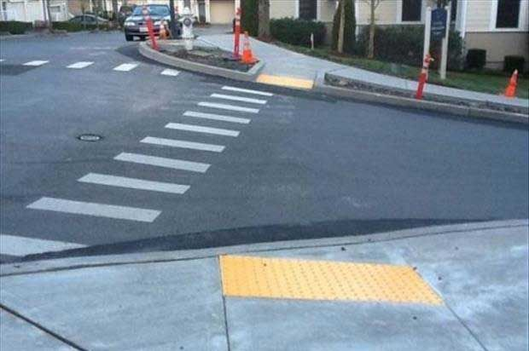
Why do we need standards?

Slide 5
Why do we need standards?
100,000 Sprinklers
225 Sprinkler Systems
60 Miles of Sidewalks
100 Acres of Parking Lots
10 Miles of Roads
280 Elevators
26 LEED Certified Buildings
243,000 Ft of Steam Pipe
6,900 Under-ground Structures
145,000 Ft of Chilled Water Piping
22 Bridges
2,000,000 SF of Laboratory Facilities

Slide 6
Philosophy
Design Standards influence the design phase and are incorporated into the construction documents by the design professional.
Window of Opportunity
Design Standards
SD
DD
CD
BID
BUILD
OCCUPY

Slide 7
Philosophy - Feedback Loop
Design
Construct
Occupy
Learn
Design Standards
Feedback Loop

Slide 8
Philosophy
EXTEND LIFE
REDUCE O&M
HIGH ROI
SECURITY
QUALITY
CU STANDARDS
BUILDING CODE
DESIGN REQUIREMENTS

Slide 9
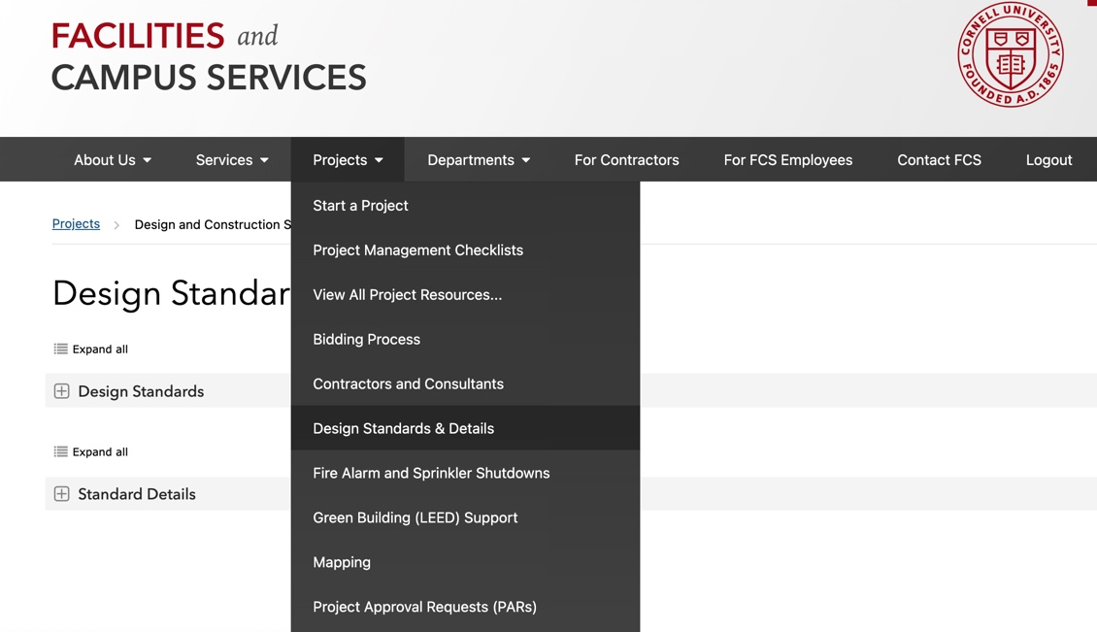
What are Design Standards & Details?
Written Standards & Guidelines
Standard Details
Standards are a contractual requirement for architects and engineers to incorporate in CD’s

Slide 10
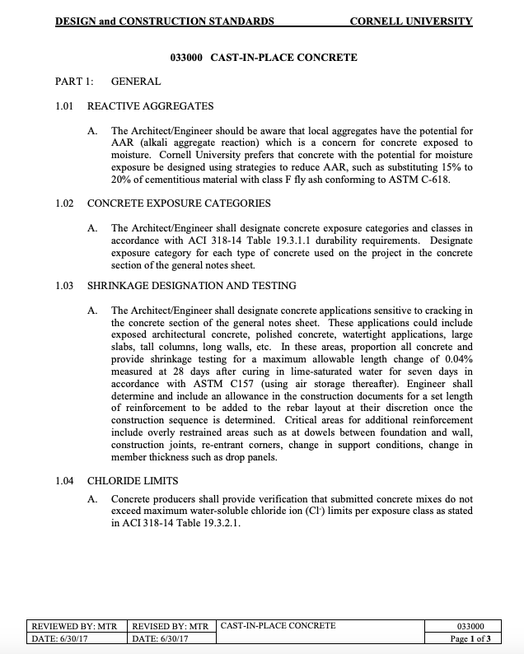
Example Standard
033000 Cast-In-Place Concrete

Slide 11
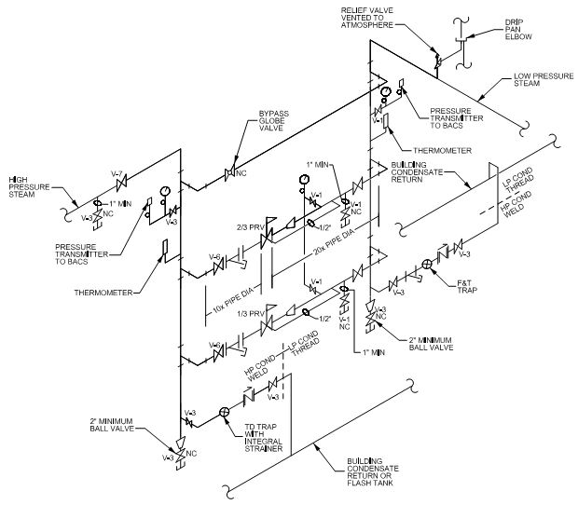
Example Details
High Pressure Steam Schematic
Hydrant Detail

Slide 12
Definitions
Standards
High in authority and set specific minimum quality (Requirements, “Shall”)
No discretion (requires a variance)
Guidelines
Lower in authority, recommendation or best practice (Considerations, “Should”)
Allows for some discretion (discussion required)
“Shall”
“Should”
Standards and Guidelines are integrated into one document by topic based on CSI number.

Slide 13
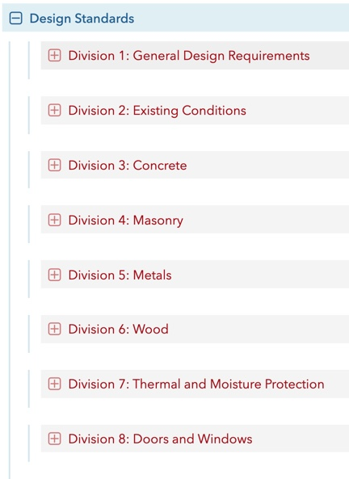
Approach
Organized by CSI Division
Division 1 – General Design
Spaces
Accessibility
Safety
Energy
Programming
Division 2-43 – Technical Divisions
Materials
Systems
Assemblies

Slide 14
Statistics
Design Standards – 103 Total
Informs design and construction documents
Standard Details – 199 Total
Starting point for construction documents
Review Period
Goal to review once every two years
Standards are reviewed, revised or removed
Standards are added as a need is identified

Slide 15
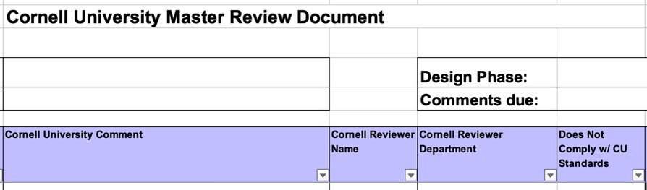
Standard Variance
Design review spreadsheet non-compliant checkbox
Variance request in writing to the University Engineer with description of variance and explanation of need
Facilities Engineering will review the request & consult with the standard point-of-contact & subject matter experts
The UE will respond in writing with a determination

Slide 16
Thank You

