Slide 1
Project Management – Professional Development Series
Facilities and Campus Services Engineering and Project Management

Slide 2
Red Zone Checklist Review of FM section
Project Management Checklists Link

Slide 3
Facilities Management (FM) ☐ Early in the project, schedule a meeting with FM Maintenance Planner and other stakeholders to discuss who should attend the warranty discussion meeting below ☐ Prior to turnover, set up a meeting with the College/Unit and FM to discuss the flow of warranty claims, emergency requests, and maintenance requests. The processes for each should be defined with roles and responsibilities, tracking processes, communication processes, and response times. (Schedule the meeting at least 3 months in advance for complex projects and 1 month for straightforward projects)

Slide 4
Example of the flow of warranty claims, emergency requests, and maintenance requests; the processes for each; with defined roles and responsibilities; tracking processes; communication processes; and response times:
“NCRE Maximo SRs”
via Cliff Horton, Dan Decker, Chris Davenport

Slide 5
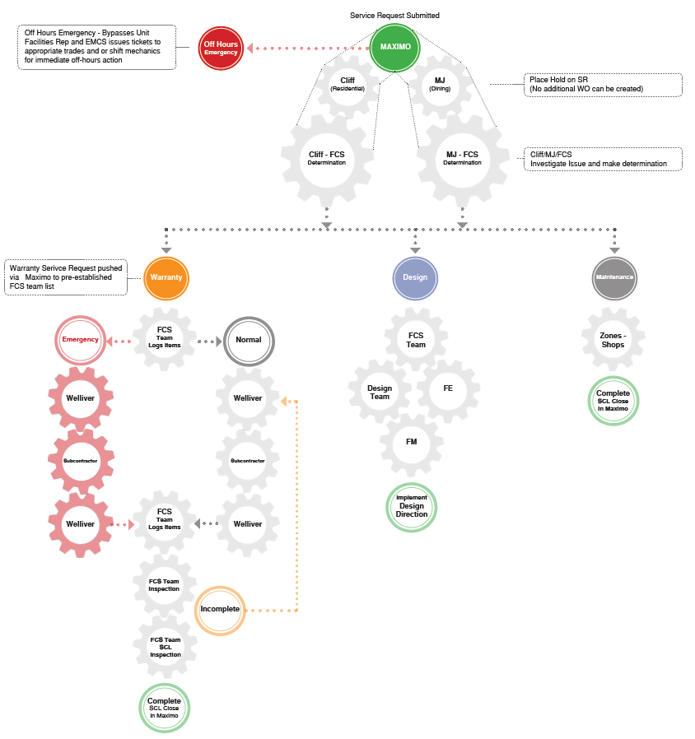

Slide 6
Questions
Is the SR Dining or Residential related?
MJ Johnson and Pat Graham will handle all Dining and Catering SRs
Cliff Horton will handle all other SRs, including Building Care related.
Is the SR NCRE Warranty related? Something the contractor may need to fix?
If yes, then Workflow Internally with NCRE WARRANTY in the Summary.
If no, Workflow it to the Zone, COB Lead or Internally as needed.
If not sure, place the SR on HOLD, with NCRE WARRANTY in the Summary. Follow up with Cliff Horton or Chris Davenport.
Is it an Emergency?
If it is after hours, on the weekend or the contractor is not on Site 2 during the normal work day hours, use the Zone or Customer Service/ EMCS as needed.

Slide 7
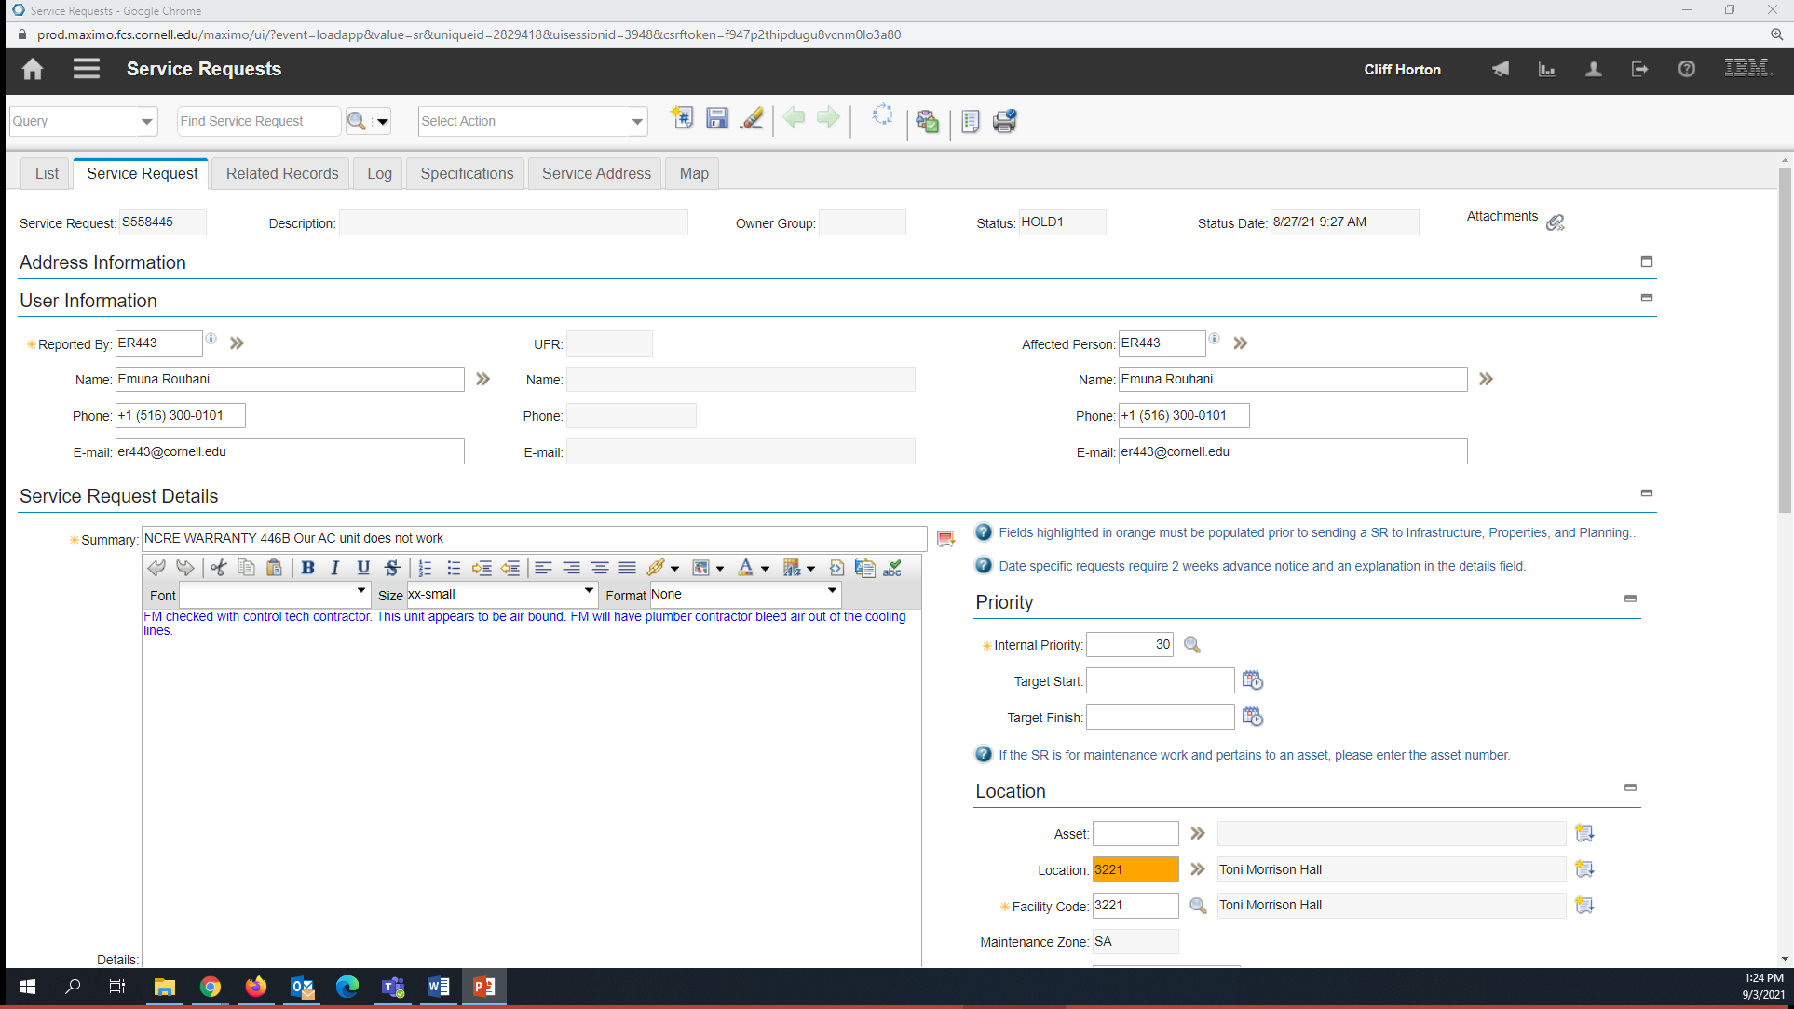
Add NCRE WARRANTY (all caps) with room number to the first half of the Summary:

Slide 8
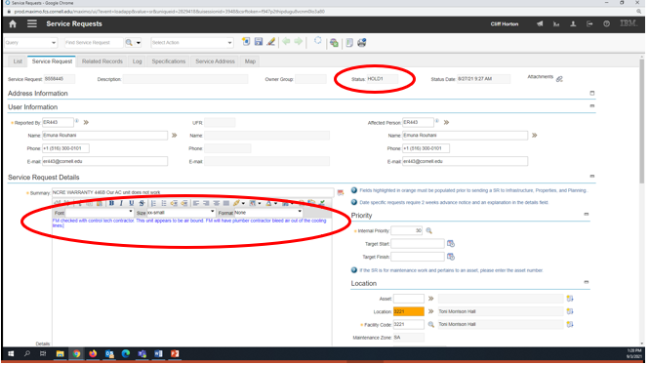
Options, place on Hold or Workflow Internally

Slide 9
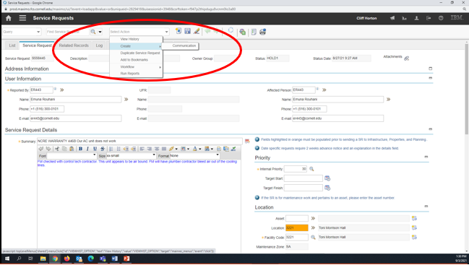
Send Communication to NCRE Group. Click Select Action, Create and then Communication.

Slide 10
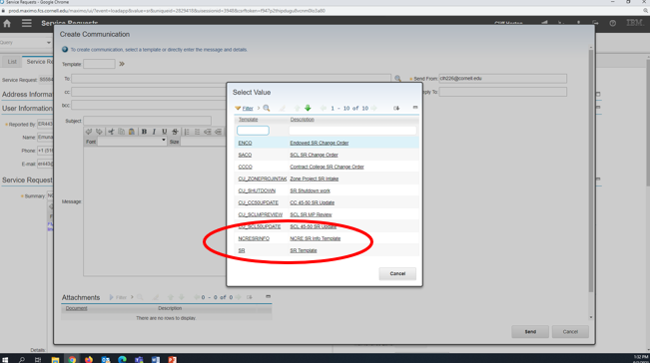
Using the Template: drop down, select: NCRESRINFO Template

Slide 11
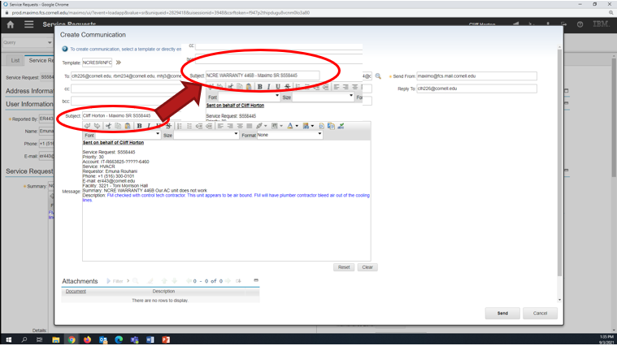
In the Subject: Change your name to NCRE WARRANTY – Maximo SR S558445

Slide 12
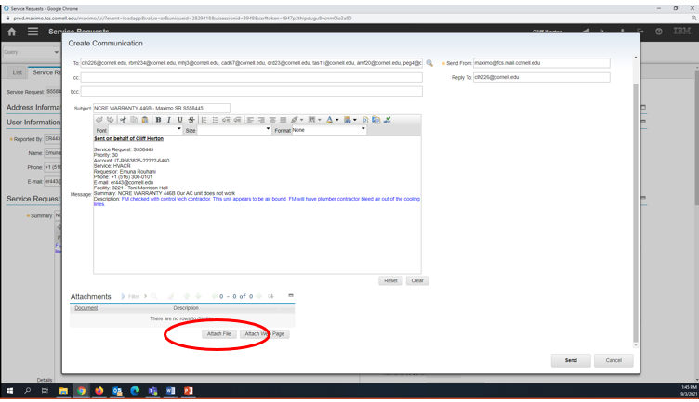
Add additional information to the email body and you can attach photos if needed.

Slide 13
Send the Communication by clicking on send. All needed parties are already in the Send To: line. You can cc: yourself for your own records too.
The NCRE Project Team will get the email and information. They will add it to their spreadsheet and contact the contractors as needed.
Once the work has been completed, the NCRE Project Team will let us know what the problem was and that it is finished.
We need to add that information to the Work Log and then close out the SR in Maximo.

Slide 14
In order to answer the question -
“Is the SR NCRE Warranty related? Something the contractor may need to fix?”
The decider must:
Understand project scope
Know the date(s) of substantial completion
Be objective and diligent
That’s why its important to document roles and responsibilities prior to “turn-over”.

Slide 15
What we own for Warranty:
General Requirements 01 78 36, 1.5 WARRANY REQUIREMENTS
In addition to standard and special warranties described in Divisions 2 through 40, Contractor shall warrant Work included in this project, for a minimum period of one (1) year following acceptance of a Certificate of Substantial Completion by Owner, to cover performance, materials, workmanship and compliance with Contract Documents.

Slide 16
What we own for Warranty:
General Requirements 01 78 36, 1.5 WARRANY REQUIREMENTS
Corrective Work: Provide service within thirty (30) calendar days when requested by Owner. Perform services during normal working hours, unless specifically directed otherwise by Owner. Coordinate with Owner’s representative to schedule performance of corrective work. Where designated service providers cannot perform corrective work within the Owner’s required time frame, engage another qualified service provider. Submit a written statement to Owner upon completion of corrective work; document work performed and list outstanding items, if any.

Slide 17
What we own for Warranty:
General Requirements 01 78 36, 1.5 WARRANY REQUIREMENTS
Corrective Work: -continued-
When a completed breakdown of a piece of equipment occurs of the malfunction of a system affects the environment or program involving 50 or more persons at a time (employees and students combined), or creates a safety or security risk to the Owner, an EMERGENCY may be declared by the Owner. The Owner may declare an emergency as defined above at which time the service response must be within 4 hours and may require action during non-normal working hours.
When an emergency condition occurs, the Owner may take immediate corrective action to relieve the problem by making, a minimum as possible, temporary adjustments and/or repairs when necessary to decrease the problem until the designated Contractor’s representative can respond. These temporary adjustments and repairs will in no way jeopardize the existing warranty.
The Owner’s service staff will advise the Contractor’s Representative of all temporary adjustments and repairs done in relation to the malfunctioning equipment or facility.
If the Contractor fails to respond with actual service within four (4) hours, and/or the necessary repairs or adjustments are not satisfactorily complete twenty-four (24) hours, the Owner will have the authority to make the necessary repairs or adjustments and charge the Contractor for parts and labor.
If all adjustments and repairs done by the Owner in relation to the above conditions are done by authorized district personnel, there will be no negative effect of future warranty claims.

Slide 18
Facilities Management (FM) - continued - ☐ Reference the CCF Pre-Occupancy Checklist for State Projects ☐ Copy the FM Maintenance Planner with Punchlist ☐ Schedule owner training ☐ Project Manager to initiate Turnover Process in e-Builder once TCO/CO is obtained ☐ Coordinate with building care (restroom supplies, etc.) ☐ Notify FIG of space changes for floor plan updates ☐ Notify EH&S and FM Maintenance Planner when Fire Protection Systems or Emergency Power Systems will go live. Confirm any fire pumps, generators, or related equipment has been entered into MAXIMO. Understand and coordinate the required exercising and maintenance that will need to start taking place after the system is live. (For example, generators are generally exercised on a weekly basis)

Slide 19
Assets in Maximo
General Requirements 01 78 22, 1.1 FIXED EQUIPMENT INVENTORY*
The Owner shall provide the Contractor with a list of Equipment Types to be inventoried and an Excel template.
The Contractor shall populate the template (see Example Equipment List to be inventoried in Section 1.2). Once populated, the Contractor shall electronically return to the list to the Owner’s Representative. The initial data to be captured on each piece of equipment shall include:
Name of Product
Equipment Classification
Manufacturer
Model Number
Serial Number
Cost
Location (including Building and Room Number)
Acquisition Date (Date of Installation)
*Gibbs is revising 1.78.22 per the Strategic Asset Management Plan

Slide 20
Questions?

