Slide 1

PM Toolbox for
Cornell’s Ithaca Campus
2021

Slide 2
GOALS
Information Sharing
  Change needed for Waste Collection During Projects? Plan with us!
  Waste Metrics and Reporting
  About Cornell Recycle Center
  Resources for your customers as they prepare for projects
  Compliance factors related to universal and non-hazardous waste
Q&A
LET’S TALK TRASH!
Notes:
This slideshow is intended to highlight the common facility cleanout needs, and cover FAQ’s.
There is MORE than we are covering here… never hesitate to call or check our website!
We are available for walkthroughs!!!!!

Slide 3
Waste Collection Planning
During Projects
  R5 Operations is responsible for Waste Vendor Management (except for resident halls and dining).
  R5 will work with Project Managers to coordinate needed waste collection location changes, changes to collection schedules, etc.
    Will coordinate with Building Care, EHS, and vendors as needed.
    Some changes take time to implement – advance notice needed.

Slide 4

Waste Metrics and Reporting
  R5 Operations is responsible to report on Waste metrics for Ithaca campus (State, Federal, County, and inter-collegiate reporting requirements.

Slide 5
Cornell Recycle Center
R5 Operations
  Is waste transfer center for Ithaca campus
  Location: 251 Solidago Road
  Open 7:30 AM to 4:00 PM, Monday through Friday
  Capacity is limited; not designed for large volume per day
  Have LOTS of STUFF? Have Universal Waste?
  Contact us in advance!
recycle@cornell.edu
254-1666
www.recycle.cornell.edu

Slide 6
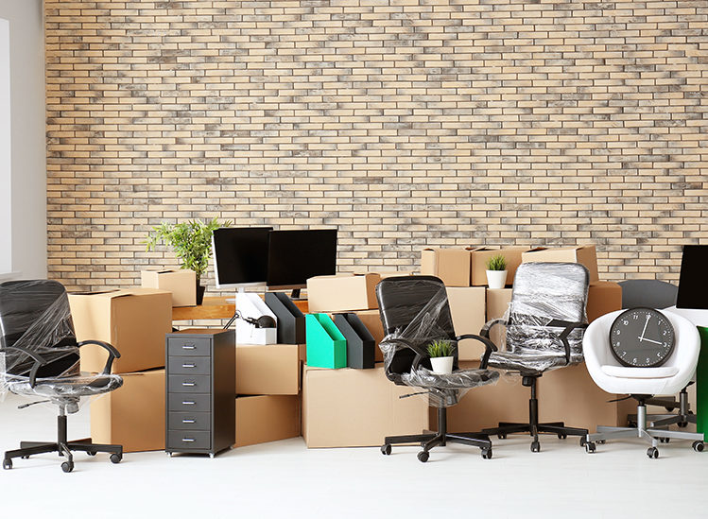
Building Cleanout Resources

Slide 7
Document Shredding
Notes:
Shredding is not provided by R5.
University Contract is with Shred-it (Cintas)
Departments will need to set up an account if they do not have one already.
They are PCI Compliant and Shred on-site.

Slide 8
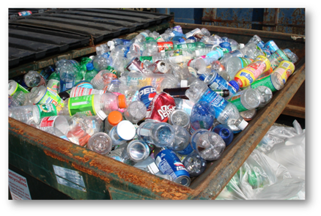
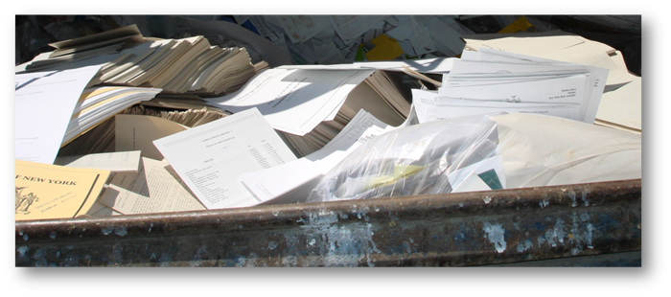
Single Stream Recycling
Notes:
Building Residents often do much of their own “cleaning out” before a project or move. Much of what they do involves single stream recycling.

Slide 9

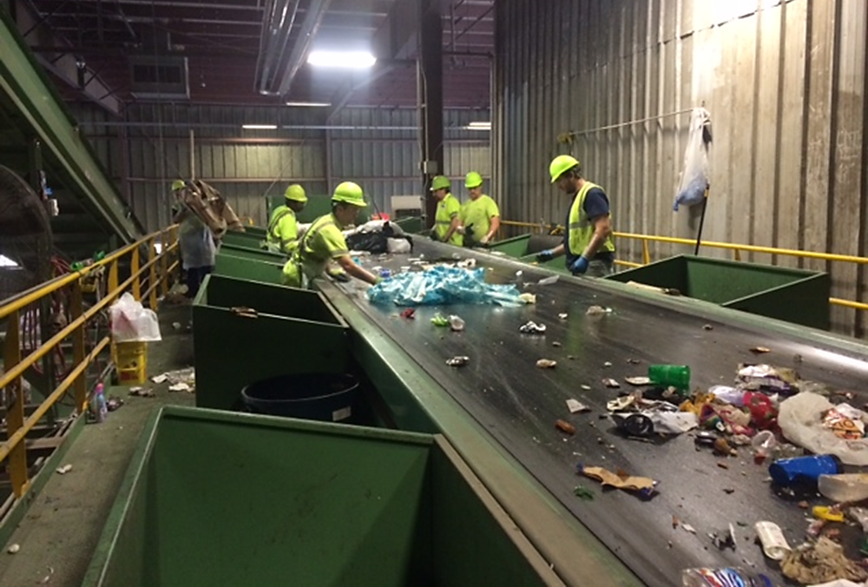
Notes:
Just an FYI that all recycling material from Cornell is hand sorted. Ensuring materials that are not permitted in the Single Stream recycling is key. This is simply following the law.

Slide 10
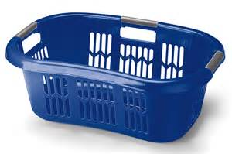
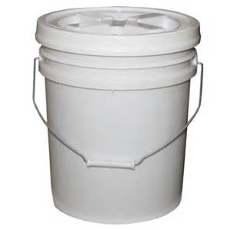
Rigid Plastics
NOW LANDFILL

Slide 11
Landfill
Notes:
Building Residents often do much of their own “cleaning out” before a project or move. Much of what they do involves landfilling material.
Important that laws are followed.

Slide 12
Electronics

Slide 13
Used Oil

Slide 14
Used Glycol

Slide 15
Universal Waste

Slide 16
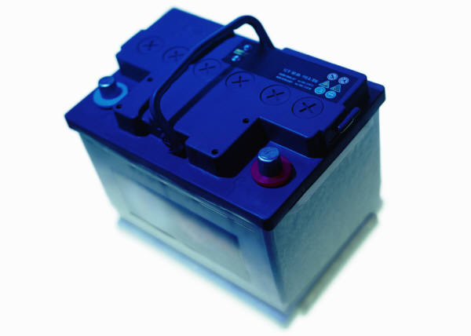
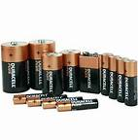
Universal Waste

Slide 17
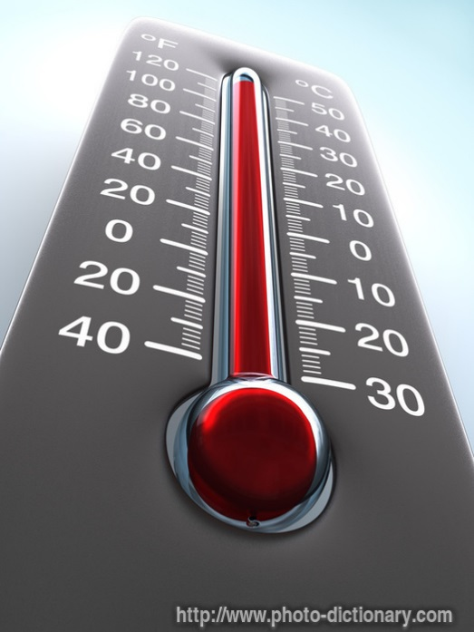
Universal Waste

Slide 18
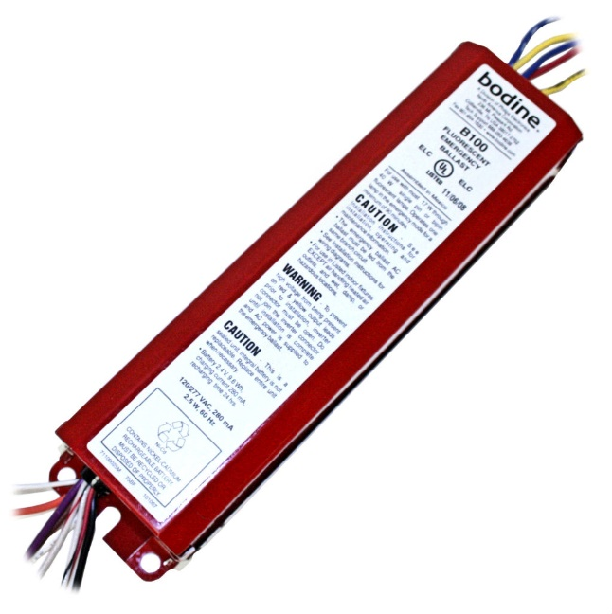
Universal Waste

Slide 19
Refrigerant/Refrigerators

Slide 20
Smoke Detectors

Slide 21
Asbestos
Have something you suspect has asbestos in it?
Contact Dale W. Houseknecht!
Email is dwh5@cornell.edu
Phone is 607-327-1359

Slide 22
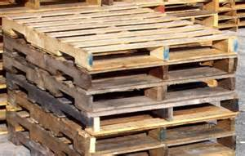
Wood

Slide 23
Scrap Metal

Slide 24
C&D Waste

Slide 25
REUSE
CATS
  Capitol Asset Transfer System
  https://www.dfa.cornell.edu/capitalassets/capital/transfer

Slide 26
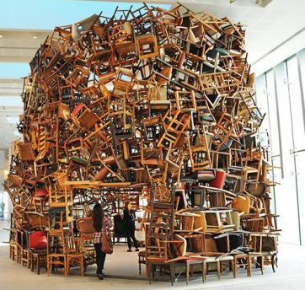
REUSE
STACS
  System for Trade and Auction of Cornell Surplus
  (NOT Capital Assets)
  Internal Reallocation
  Donation to Not for Profit Organizations
  Public Auction
  http://r5.fs.cornell.edu

Slide 27

Chris Mott, R5 Operations Manager
ctm65@cornell.edu
Spring Buck
spring@cornell.edu
R5 Operations
recycle@cornell.edu
254-1666
www.recycle.cornell.edu

