Slide 1
Project Management – Professional Development Series
Facilities and Campus Services Engineering and Project Management
November 17, 2021

Slide 2
Today’s Agenda
EHS Review of COVID-19 Guidance
Tim Fitzpatrick and Levi Harmon
FE Minute: Code Roles and Process
Mike Niechwiadowicz
FM Minute: FM’s Waste Program
Spring Buck
Red Zone Presentation
Jim Gibbs and Paul Stemkoski

Slide 3
COVID-19 Guidance

Slide 4
Questions?

Slide 5
FE Minute: Code Roles and Process

Slide 6
The Authority Having Jurisdiction
Who is it and why are they bothering me?
Facilities Engineering
Ithaca, NY
272133
Notes:
Introduction

Slide 7
What is “the Authority Having Jurisdiction” (AHJ)?
Simply put – it is the person or people that have the authority to tell you what to do regarding your project as defined by law.
Building Code definition:
The governmental unit or agency responsible for administration of the Uniform Code.
The Building Code definition is only concerned with Uniform Code.
It is more complicated than that. There is more to the world than just Uniform Code.

Slide 8
Where does the authority come from?
NYCRR Part 1203 is the NYS law with the requirements for a municipality’s code enforcement program.
Per Part 1203, a municipality must pass local laws that define who is the AHJ and provide for the required components of a code enforcement program.
This is different for each municipality.
NYCRR Part 1204 is the NYS law with the requirements for a State run code enforcement program.

Slide 9
City of Ithaca AHJ’s for Uniform Code
Building Division is the AHJ for all the NYS Uniform Codes including NYS Fire Code.
Mike Aiken is the City Code Official assigned to Cornell.
Building Division is the AHJ for existing residential buildings.
Building Division issues Certificates of Occupancy.
Ithaca Fire Department is also AHJ for NYS Fire Code based on local law.
Ithaca Fire Department is AHJ for existing non-residential buildings.
Ithaca Fire Department issues all Operating Permits.
NYS is proposing changes to the operating permit requirements.

Slide 10
Town of Ithaca AHJ for Uniform Code
Codes Division is the AHJ for all the NYS Uniform Codes including NYS Fire Code
Mark Stonier is the Town Code Official assigned to Cornell.
Ithaca Fire Department is NOT AHJ for NYS Fire Code in the Town, no local law. IFD can only provide input.

Slide 11
NYS Variances
IFD Chief Parsons is the chair of the NYS Board of Review
NYS Board of Review approves or denies all applications for a variance to the NYS Uniform Code
Please review all variance applications with Building Code Program Manager Mike N. and with Associate University Counsel Jared Pitman.
If going for a NYS variance to the Uniform Code you will need the support of the Fire Chief. Do not engage Fire Chief Parsons before reviewing the variance with Mike and Jared.
Cornell will not seek a variance to NYS Fire Code for residential occupancies.

Slide 12
City of Ithaca AHJ meetings
City of Ithaca AHJ weekly meetings
All Cornell Building Permits through this meeting
Attendees: Shops representative, Project Managers, Consultants, Architects, Contractors, City of Ithaca Code officials
Purpose: Present projects for City input, all applications for building permits
Continued Venue for Shops to apply for City permits
Opportunity for city officials to provide input on projects
Focus on code related issues
Project Managers required to attend
Striving toward greater efficiency at the meeting; preliminary code discussion covered during office hours
Notes:
with contractor/consultant/architect so that everyone is on the same page regarding code compliance and conditions for permit issue

Slide 13
Town of Ithaca AHJ meetings
Town of Ithaca monthly meetings
Attendees: Town of Ithaca Code official Mark Stonier, Project Managers, Project Designers
Purpose: Discuss code related issues and problems
Present projects
No final decisions on codes will be provided, only code input
New program for submitting Building Permit
Goal: Implementation end of November
All permits, plans and payments through the program
Will require establishing an account

Slide 14
SUNY Code Enforcement Official
The new Ralph D’Amato is Jim Yarbrough
Jim is the AHJ for the Contract Colleges
Contact information:
607-220-3949
jey38@cornell.edu
Jim comes from the City of Ithaca Building Division where he was the Senior Code Inspector assigned to Cornell.

Slide 15
Other Responsible Parties in the City of Ithaca
Historic Preservation – Bryan McCracken, Planning Dept.
Site Plan Review – Lisa Nicholas , Planning Dept.
Zoning – Gino Leonardi , Planning Dept.
Other Responsible Parties in the Town of Ithaca
Exterior Plumbing Permits – Dan Thaete, Town Engineer
Water and Sewer – Dan Thaete, Town Engineer
Site Plan Review – Sue Ritter, Planning Department
Other Responsible Parties - Cornell
Andrea Haenlin-Mott – ADA
Ron Flynn – University Fire Marshall

Slide 16
Other AHJs for Uniform Code
Town of Dryden
David Sprout
Village of Cayuga Heights
Brent Cross

Slide 17
Building Code Program Manager
That’s me – Mike Niechwiadowicz
Commonly known as Mike N
No longer AHJ for anything
Code advisor for Cornell projects
Consultant on code questions
Liaison with the City Building Division and the Town Codes Division
Conducts weekly meetings with the City Building Division
Conducts monthly meetings with the Town Codes Division Mark Stonier

Slide 18
Thank you
272133
Notes:
Introduction

Slide 19
Questions?

Slide 20
FM Minute: FM’s Waste Program

Slide 21
Questions?

Slide 22
Red Zone Presentation

Slide 23
Red Zone Checklist Review of FM section
Project Management Checklists Link

Slide 24
Facilities Management (FM) ☐ Early in the project, schedule a meeting with FM Maintenance Planner and other stakeholders to discuss who should attend the warranty discussion meeting below ☐ Prior to turnover, set up a meeting with the College/Unit and FM to discuss the flow of warranty claims, emergency requests, and maintenance requests. The processes for each should be defined with roles and responsibilities, tracking processes, communication processes, and response times. (Schedule the meeting at least 3 months in advance for complex projects and 1 month for straightforward projects)

Slide 25
Example of the flow of warranty claims, emergency requests, and maintenance requests; the processes for each; with defined roles and responsibilities; tracking processes; communication processes; and response times:
“NCRE Maximo SRs”
via Cliff Horton, Dan Decker, Chris Davenport

Slide 26
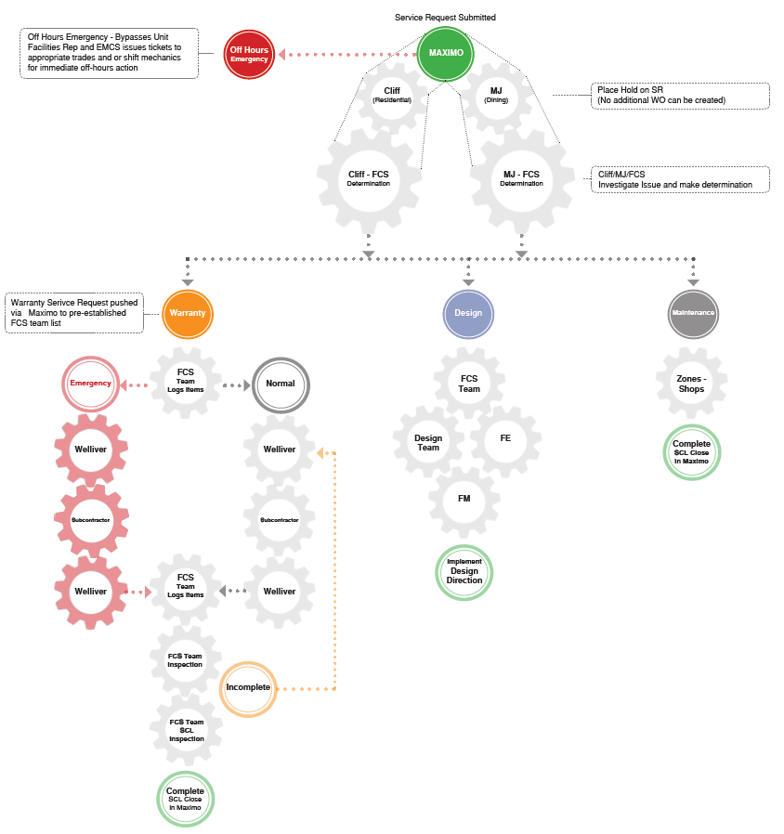

Slide 27
Questions
Is the SR Dining or Residential related?
MJ Johnson and Pat Graham will handle all Dining and Catering SRs
Cliff Horton will handle all other SRs, including Building Care related.
Is the SR NCRE Warranty related? Something the contractor may need to fix?
If yes, then Workflow Internally with NCRE WARRANTY in the Summary.
If no, Workflow it to the Zone, COB Lead or Internally as needed.
If not sure, place the SR on HOLD, with NCRE WARRANTY in the Summary. Follow up with Cliff Horton or Chris Davenport.
Is it an Emergency?
If it is after hours, on the weekend or the contractor is not on Site 2 during the normal work day hours, use the Zone or Customer Service/ EMCS as needed.

Slide 28
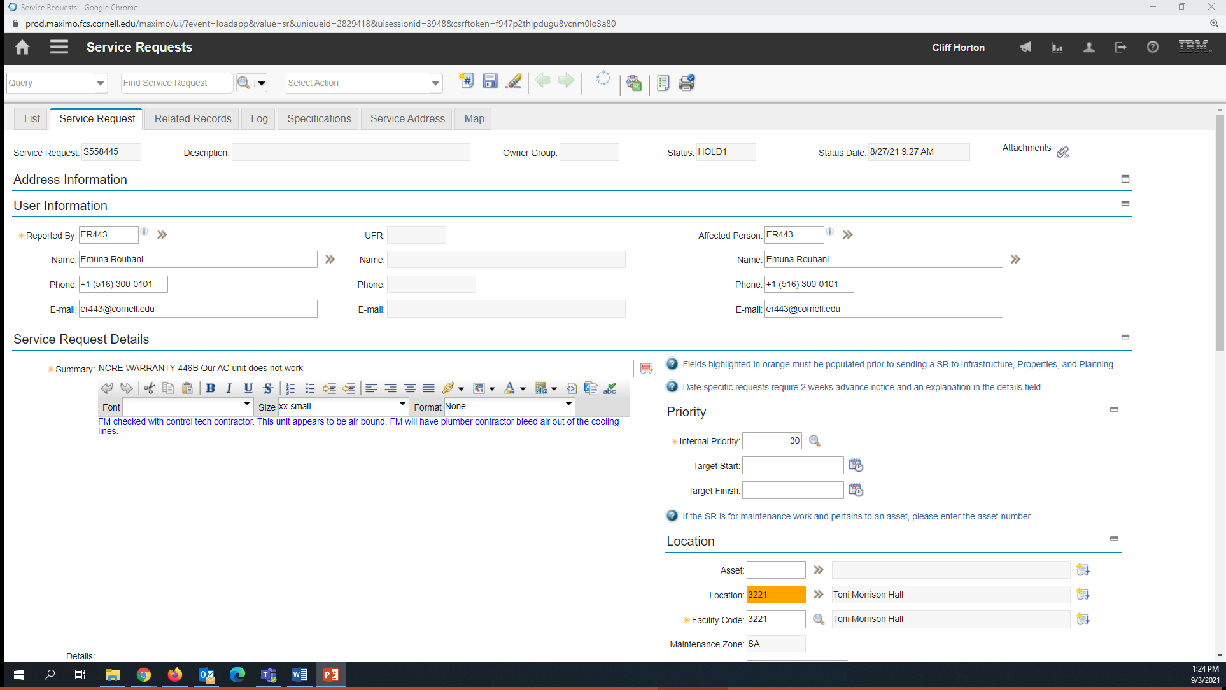
Add NCRE WARRANTY (all caps) with room number to the first half of the Summary:

Slide 29
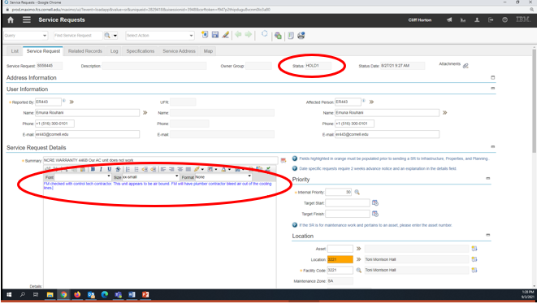
Options, place on Hold or Workflow Internally

Slide 30
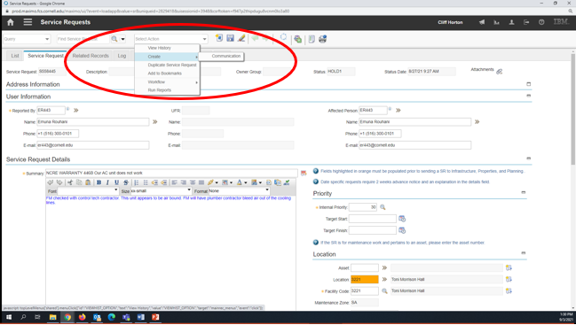
Send Communication to NCRE Group. Click Select Action, Create and then Communication.

Slide 31
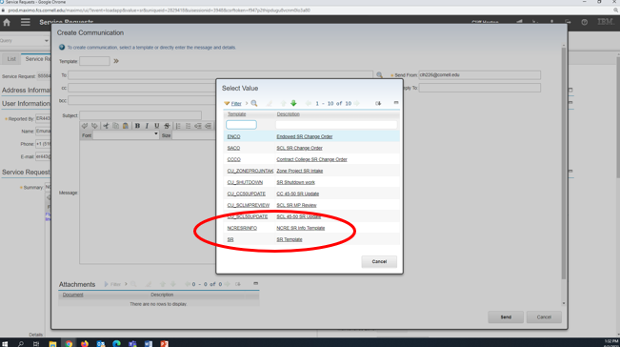
Using the Template: drop down, select: NCRESRINFO Template

Slide 32
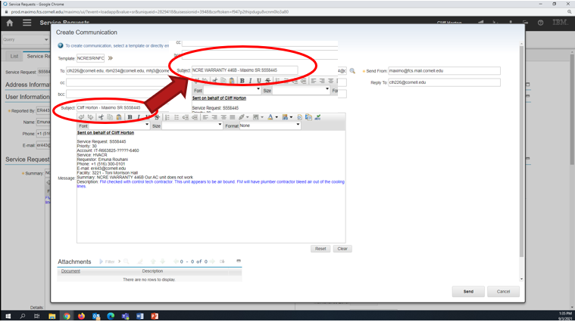
In the Subject: Change your name to NCRE WARRANTY – Maximo SR S558445

Slide 33
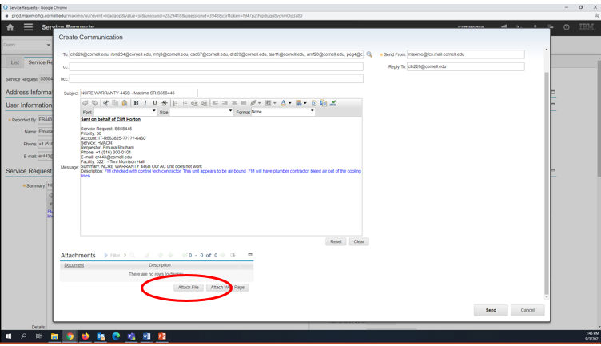
Add additional information to the email body and you can attach photos if needed.

Slide 34
Send the Communication by clicking on send. All needed parties are already in the Send To: line. You can cc: yourself for your own records too.
The NCRE Project Team will get the email and information. They will add it to their spreadsheet and contact the contractors as needed.
Once the work has been completed, the NCRE Project Team will let us know what the problem was and that it is finished.
We need to add that information to the Work Log and then close out the SR in Maximo.

Slide 35
In order to answer the question -
“Is the SR NCRE Warranty related? Something the contractor may need to fix?”
The decider must:
Understand project scope
Know the date(s) of substantial completion
Be objective and diligent
That’s why its important to document roles and responsibilities prior to “turn-over”.

Slide 36
What we own for Warranty:
General Requirements 01 78 36, 1.5 WARRANY REQUIREMENTS
In addition to standard and special warranties described in Divisions 2 through 40, Contractor shall warrant Work included in this project, for a minimum period of one (1) year following acceptance of a Certificate of Substantial Completion by Owner, to cover performance, materials, workmanship and compliance with Contract Documents.

Slide 37
What we own for Warranty:
General Requirements 01 78 36, 1.5 WARRANY REQUIREMENTS
Corrective Work: Provide service within thirty (30) calendar days when requested by Owner. Perform services during normal working hours, unless specifically directed otherwise by Owner. Coordinate with Owner’s representative to schedule performance of corrective work. Where designated service providers cannot perform corrective work within the Owner’s required time frame, engage another qualified service provider. Submit a written statement to Owner upon completion of corrective work; document work performed and list outstanding items, if any.

Slide 38
What we own for Warranty:
General Requirements 01 78 36, 1.5 WARRANY REQUIREMENTS
Corrective Work: -continued-
When a completed breakdown of a piece of equipment occurs of the malfunction of a system affects the environment or program involving 50 or more persons at a time (employees and students combined), or creates a safety or security risk to the Owner, an EMERGENCY may be declared by the Owner. The Owner may declare an emergency as defined above at which time the service response must be within 4 hours and may require action during non-normal working hours.
When an emergency condition occurs, the Owner may take immediate corrective action to relieve the problem by making, a minimum as possible, temporary adjustments and/or repairs when necessary to decrease the problem until the designated Contractor’s representative can respond. These temporary adjustments and repairs will in no way jeopardize the existing warranty.
The Owner’s service staff will advise the Contractor’s Representative of all temporary adjustments and repairs done in relation to the malfunctioning equipment or facility.
If the Contractor fails to respond with actual service within four (4) hours, and/or the necessary repairs or adjustments are not satisfactorily complete twenty-four (24) hours, the Owner will have the authority to make the necessary repairs or adjustments and charge the Contractor for parts and labor.
If all adjustments and repairs done by the Owner in relation to the above conditions are done by authorized district personnel, there will be no negative effect of future warranty claims.

Slide 39
Facilities Management (FM) - continued - ☐ Reference the CCF Pre-Occupancy Checklist for State Projects ☐ Copy the FM Maintenance Planner with Punchlist ☐ Schedule owner training ☐ Project Manager to initiate Turnover Process in e-Builder once TCO/CO is obtained ☐ Coordinate with building care (restroom supplies, etc.) ☐ Notify FIG of space changes for floor plan updates ☐ Notify EH&S and FM Maintenance Planner when Fire Protection Systems or Emergency Power Systems will go live. Confirm any fire pumps, generators, or related equipment has been entered into MAXIMO. Understand and coordinate the required exercising and maintenance that will need to start taking place after the system is live. (For example, generators are generally exercised on a weekly basis)

Slide 40
Assets in Maximo
General Requirements 01 78 22, 1.1 FIXED EQUIPMENT INVENTORY*
The Owner shall provide the Contractor with a list of Equipment Types to be inventoried and an Excel template.
The Contractor shall populate the template (see Example Equipment List to be inventoried in Section 1.2). Once populated, the Contractor shall electronically return to the list to the Owner’s Representative. The initial data to be captured on each piece of equipment shall include:
Name of Product
Equipment Classification
Manufacturer
Model Number
Serial Number
Cost
Location (including Building and Room Number)
Acquisition Date (Date of Installation)
*Gibbs is revising 1.78.22 per the Strategic Asset Management Plan

Slide 41
Questions?

