Slide 1
eB Minute
October 2021

Slide 2
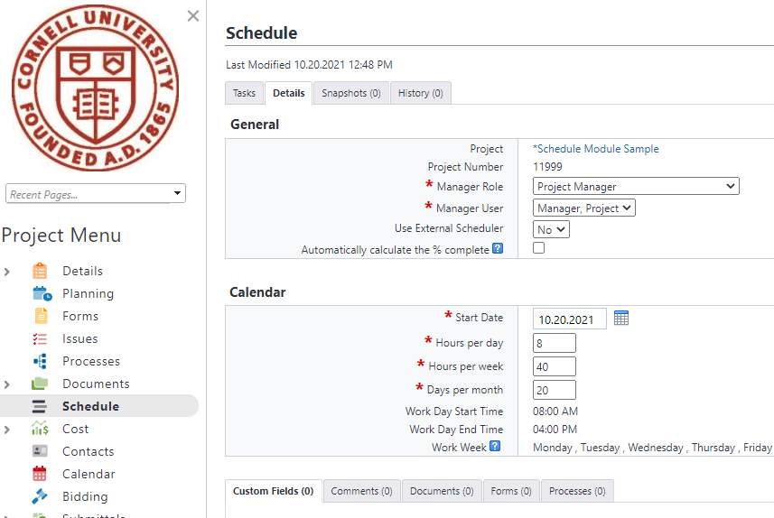
Schedule Refresher
Schedule Details
Most important:
Project Start Date
All others are default settings
Schedule Manager Role can re-assign that role to another user who is on the project
Don’t forget to click the Save button (top, right)

Slide 3
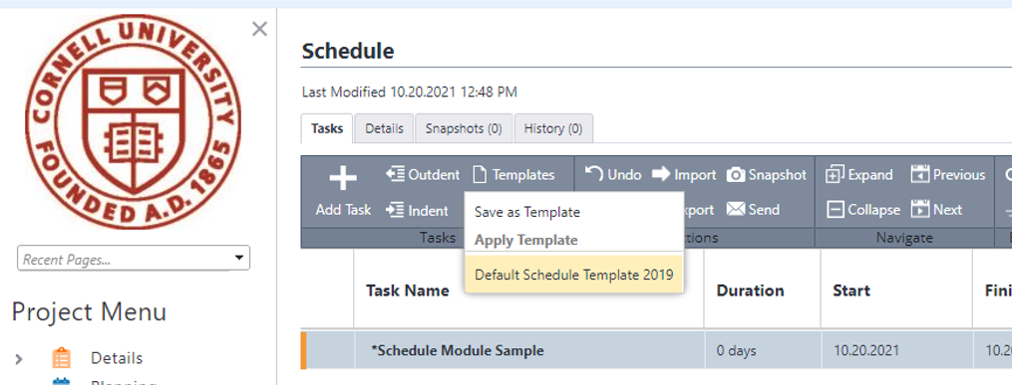
Schedule Refresher
Schedule Tasks
Most important:
Apply Template
Only one template available that contains required Master Tasks
Do not use Import function to bring schedule in from other programs: WHY? Master Tasks will not be included
Important: Master Tasks are used throughout reports and dashboards

Slide 4
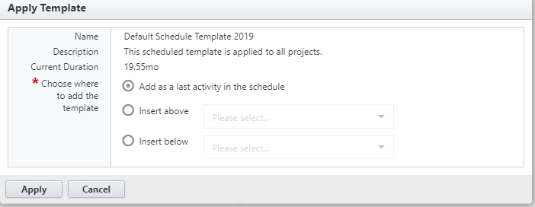
Schedule Refresher
Schedule Tasks
Dialog Box
Keep Default selection
“Add as a last activity . . .”
Click the Apply button

Slide 5
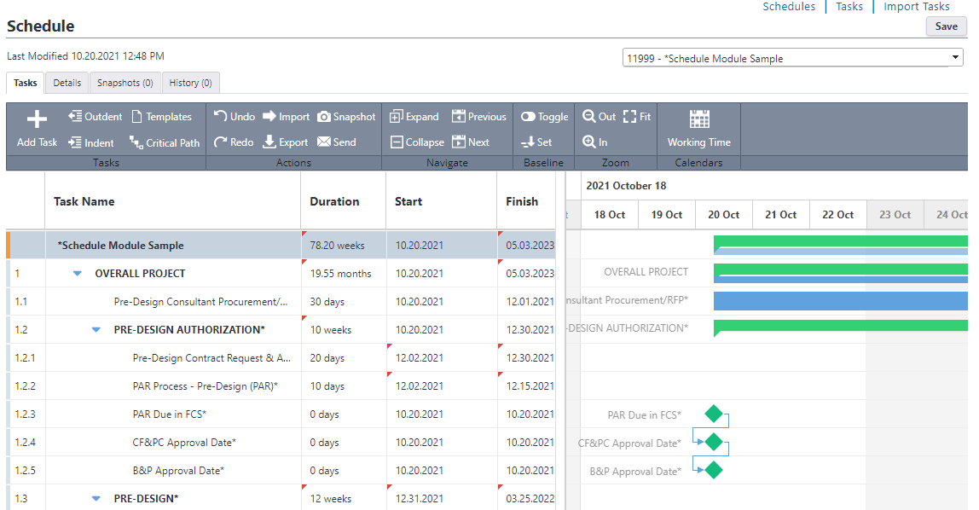
Schedule Refresher
Result Don’t forget to click the Save button (top, right)

Slide 6
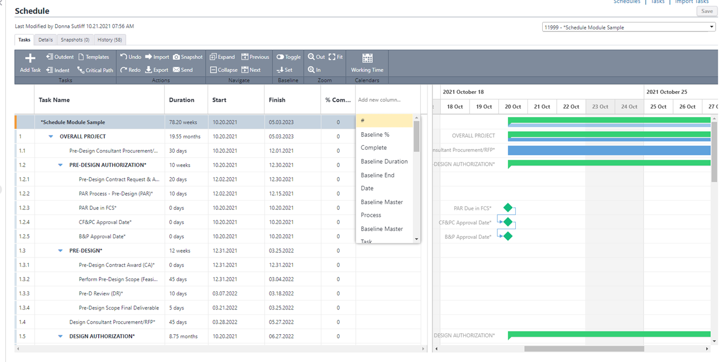
Schedule Refresher
Adding
Columns
(each project)
#
Master Task
Predecessor
Save is not required to keep added columns in view
Important: Master Tasks are used throughout reports and dashboards

Slide 7
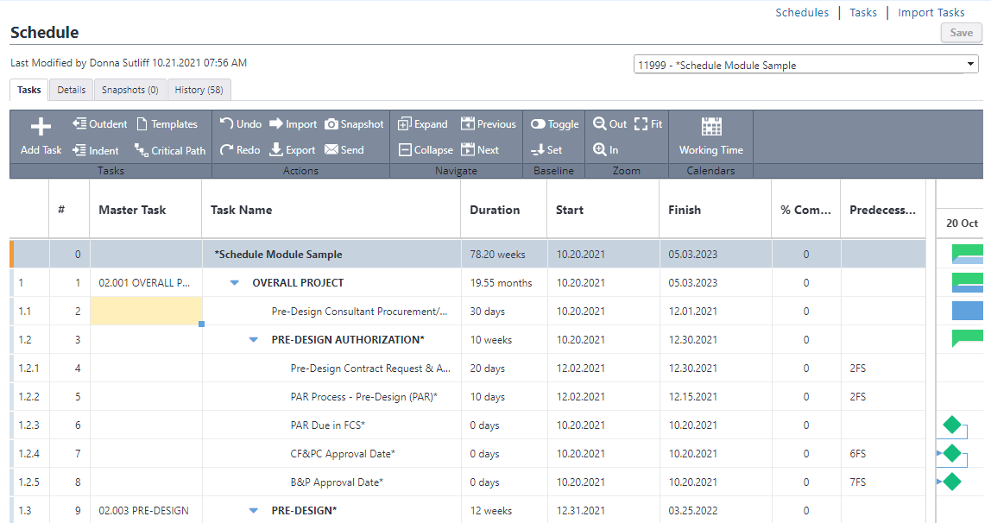
Schedule Refresher
Rearranging
Columns
Drag and Drop to
Create the View You
Prefer
Edit
Schedule
Tasks
Don’t forget to click the Save button (top, right)
Important: Master Tasks are used throughout reports and dashboards

Slide 8
Schedule Refresher
Master Tasks
2.001 OVERALL PROJECT
2.003 PRE-DESIGN
2.004 ARCHITECT SELECTION
2.005 DESIGN
2.006 BID
2.007 CONSTRUCTION
2.008 SUBSTANTIAL COMPLETION
2.009 CLOSE OUT
Important: Master Tasks are used throughout reports and dashboards

Slide 9
Reports – Contractor Information
High Level Report Filter - Find potential companies to invite to bid
https://app.e-builder.net/da2/Reports/index.aspx

Slide 10
Questions?

