Slide 1
Video Engineering and Event Services
Standards & Services

Slide 2
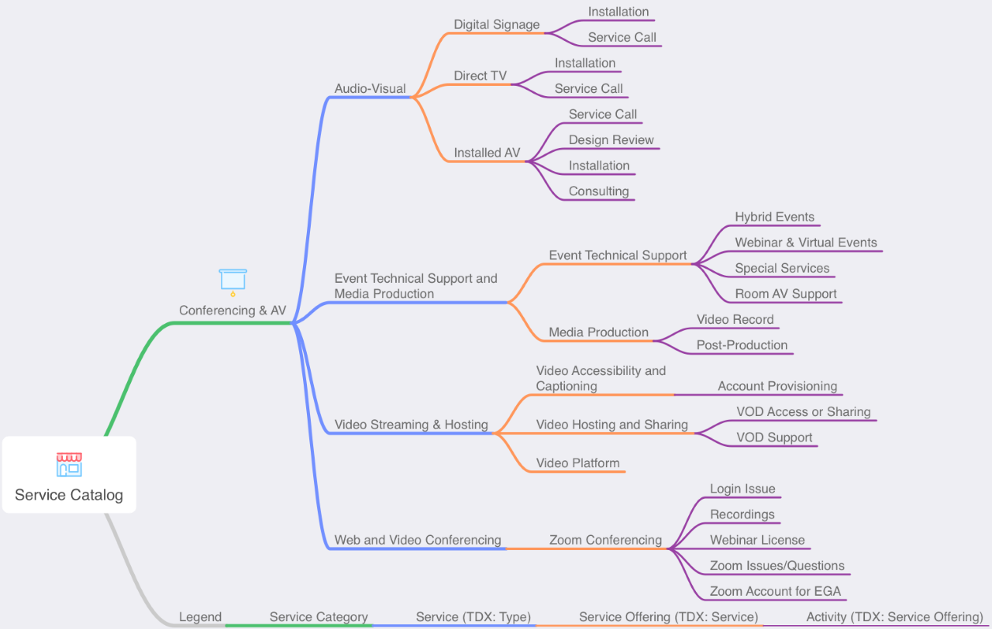
Video Engineering & Event Technical Support All Services

Slide 3
Requesting Services
Installed AV
Consulting and/or Installation – Request form – engage early
Design Review – via eBuilder
Digital Signage
Consulting and/or Installation – Request form
Joe Blasz jlb222@cornell.edu is CIT’s single point of contact
Can direct you to the appropriate individual or process within CIT
Coordinates all CIT design review

Slide 4
Room Technology Types
Types
Conference Rooms and Office AV
Type 50
Classrooms
Type 100
Type 200
Type 300
Type 400
Documentation
Room Technology Types
Room Technology Types Matrix pdf password: CUDesign

Slide 5
AV Standards
Guidance Doc
CIT Voice, Data, Audio-Visual Guidance
Design and Construction Standards
274000 Audio-Video Communications
098000 Acoustics
Room Technology Types & AV Technology Standards
https://it.cornell.edu/av-installation/av-standards
pdf password: CUDesign

Slide 6
Questions?

