Slide 1
Project Management – Professional Development Series Enterprise Asset Management
Facilities and Campus Services
Facilities Management –
Asset Management & Logistics
October 21, 2021
Notes:
January 2021…. SAMP Overview
CMMS – Computerized Maintenance Management System
Enterprise asset management (EAM) is a combination of software, systems and services used to maintain and control operational assets and equipment. The aim is to optimize the quality and utilization of assets throughout their lifecycle, increase productive uptime and reduce operational costs.
Enterprise Asset Management involves:
- work management,
- asset maintenance,
planning and scheduling,
supply chain management

Slide 2
Asset Management:
What is an Asset?
What is Enterprise Asset Management?
Development of the Foundation of our Program
So What? (Why does a Project Manager Care?)

Slide 3
What is an Asset?
All CU Assets
- Cash
- Investments
- Brand
- License
- Reputation
- Leases
- Intellectual Property
Current Universe of FM
Strategic Asset Management Plan
Land, Buildings, Building Systems and
Infrastructure
People, Vehicles, Equipment, and Supplies
- Water Power Development - Fall Creek
- Industry Research Park
- Farmlands and Woodlots
- Cornell in Washington D.C.
- Weill Cornell Medicine
- Cornell Tech Campus
- Collegetown
- East Ithaca
FCS Stewards of CU Assets
-Transportation Infrastructure
-Utility Distribution/Collection Systems
-Building Systems/Components
FCS Assigned CU Assets
- FCS Vehicles
- FCS Equipment
- FCS Supplies
Notes:
Jim pmpd Jan

Slide 4
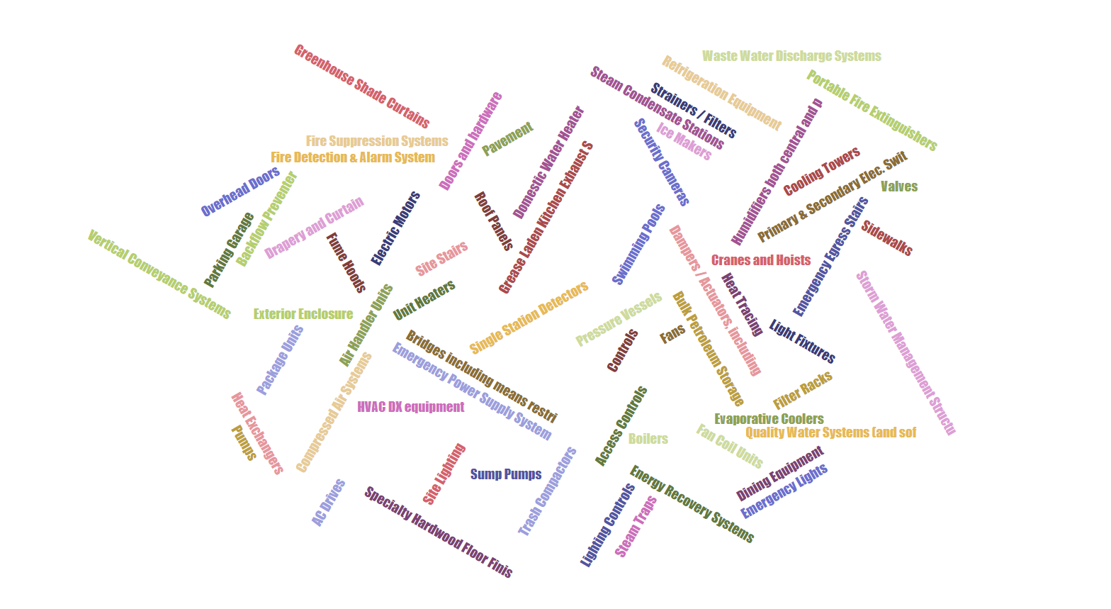
What is an Asset? (within FM)
An asset is any item that has potential or actual value to Cornell…. “pick a thing”
“Over sixty-nine asset management programs have been identified…”
Notes:
Over 69 different Asset Management Programs have been identified.
This word cloud is a representation of the identified programs

Slide 5
Enterprise Asset Management (EAM)
Enterprise Asset Management:
Work Management
Asset Maintenance
Planning and Scheduling
Supply Chain Management
“Through a combination of software, systems, and services,…
… the intent is to optimize the quality and the utilization of assets throughout their lifecycle, increase productive uptime, and reduce operational costs”
Program Foundational Development
Notes:
CMMS – Computerized Maintenance Management System
Enterprise asset management (EAM) is a combination of software, systems and services used to maintain and control operational assets and equipment. The aim is to optimize the quality and utilization of assets throughout their lifecycle, increase productive uptime and reduce operational costs.
Enterprise Asset Management involves:
- work management,
- asset maintenance,
planning and scheduling,
supply chain management
Asset management does not just focus on the asset itself, but on the value that the asset can provide.
Asset management gives assurance that assets will fulfil their required purpose or function.

Slide 6
Enterprise Asset Management Program –
Program Foundation Development:
Documentation
Standardization
Classification
Organization
Process
Roles & Responsibilities
“In essence we are building the car while driving it…”
“To perform the tasks associated with EAM effectively, an organizational structure was defined...
… to consistently identify and classify of our assets.”
Notes:
Identifying existing assets
Adding new assets
Developing standards
Performing maintenance
Managing our CMMS (Tool) Maximo
Etc…
Asset management does not just focus on the asset itself, but on the value that the asset can provide.
Asset management gives assurance that assets will fulfil their required purpose or function.

Slide 7
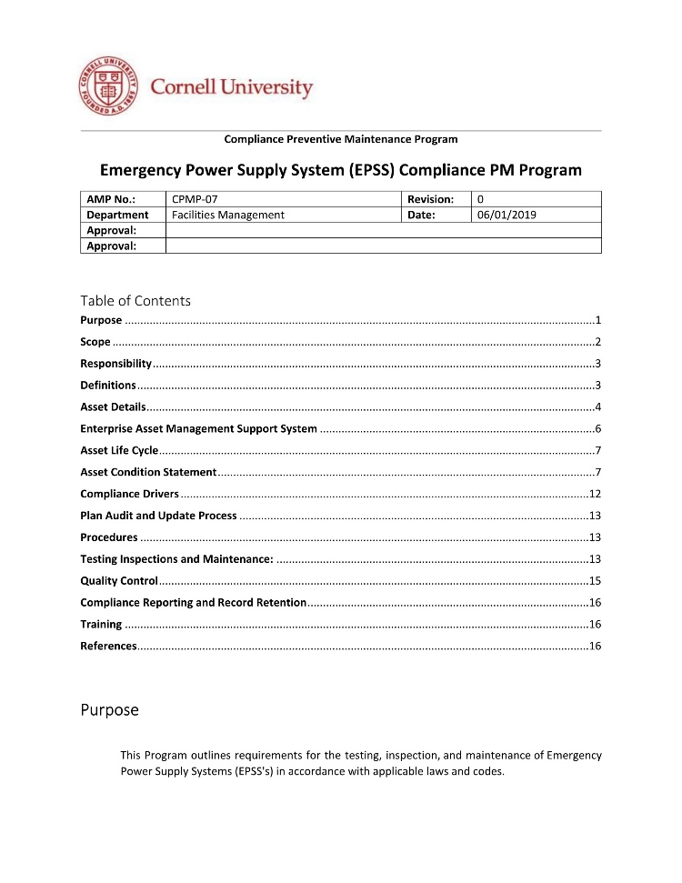
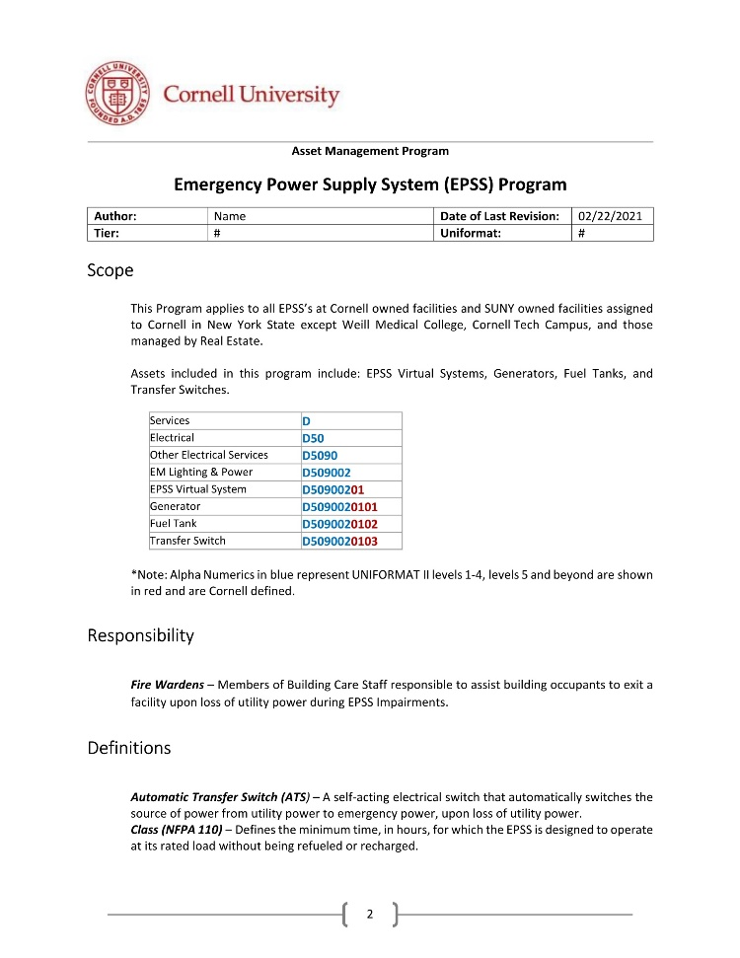
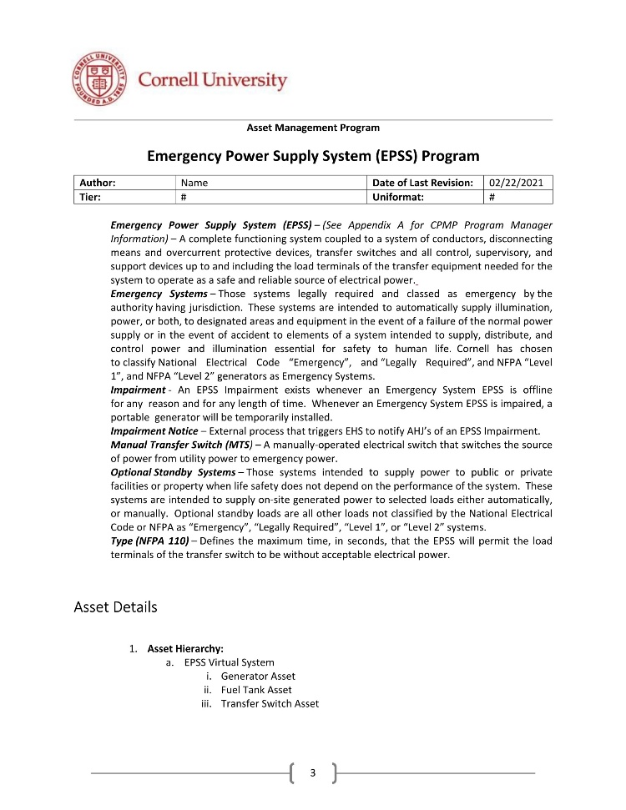
EAMP Foundation – Documentation: Expectations & Identification
Strategic Asset Management Plan (SAMP)
Accurate and complete data is required to effectively manage assets.
Everyone involved with assets to consider themselves a “data steward”
Individual Asset Management Programs (AMPs) (Template)
Individual programs for asset classes
Function
Tier
Classification (Uniformat II)
Notes:
Jim had previously shared the SAMP behind back and January
Everyone involved with assets to consider themselves a “data steward”
feel personally responsible for collecting and maintaining reliable data.
Focusing on the elemental foundation of the EAM today, will need to another time to share discuss the …. Development and Status of
Computer Maintenance Management System (CMMS) Optimization
Maximo optimization & upgrade
Planning & Scheduling
Supply Chain Management

Slide 8
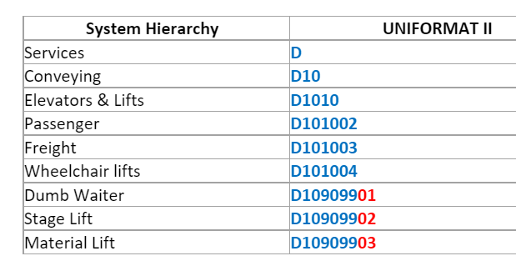
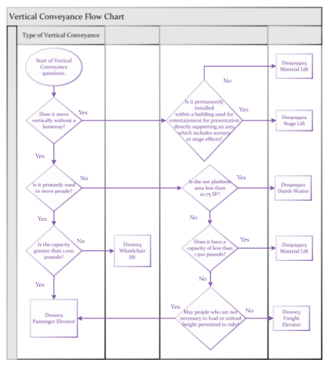
EAMP Foundation – Standardization: Identification of Asset Type (Examples of Format)
Uniformat II Asset Flow Charts
Alpha Numeric in blue represent UNIFORMAT II levels 1-4, Levels 5 and beyond are in red as defined by Cornell EAMP

Slide 9
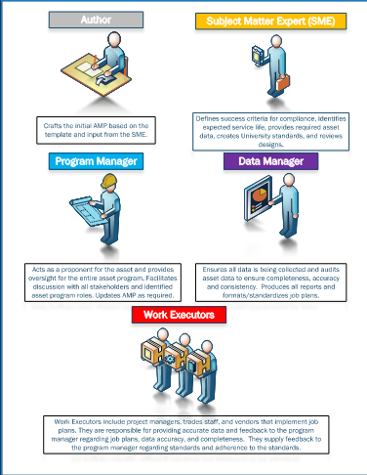
EAM Foundation – Roles & Responsibilities
Program Author
Subject Matter Expert (SME)
Program Manager
Data Manager
Work Executors
https://fcs.cornell.edu/strategic-asset-management-program
Notes:
Program Author
Utilizes the template to draft the plan with input from the SME.
Subject Matter Expert
Define success, useful life, and data needs, create job plan elements, review designs, author design and construction standards
Program Manager
Creates and manages budget, uses metrics to measure success
Data Manager
Produce reports, audit the data, produce job plans
Work Executor
Follow the job plans, collect data

Slide 10
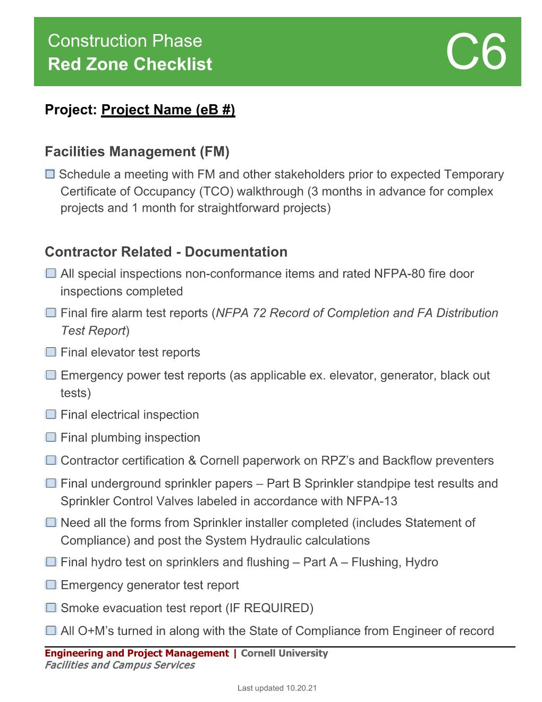
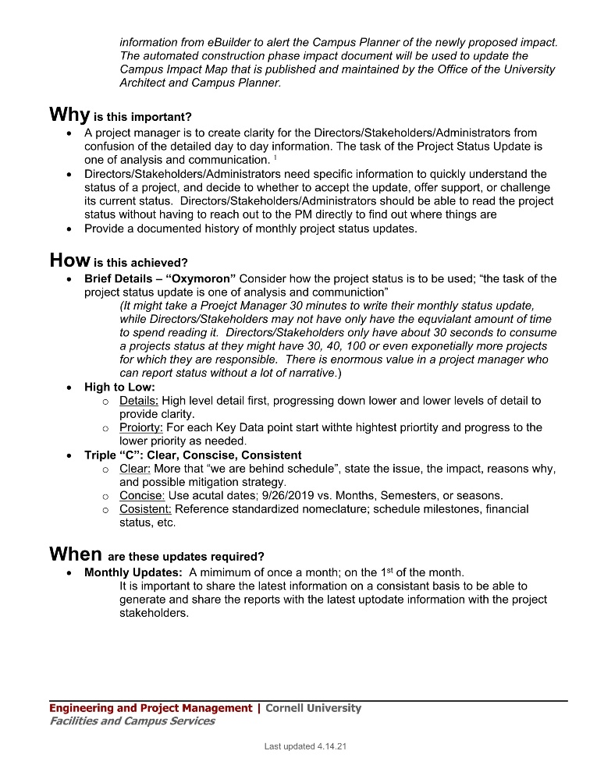
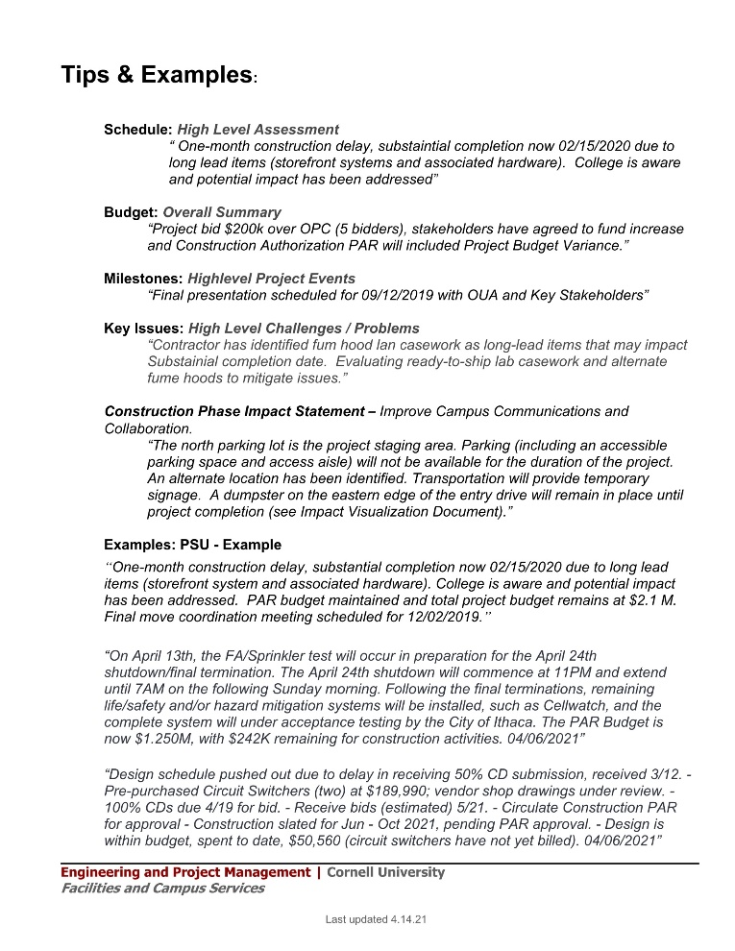
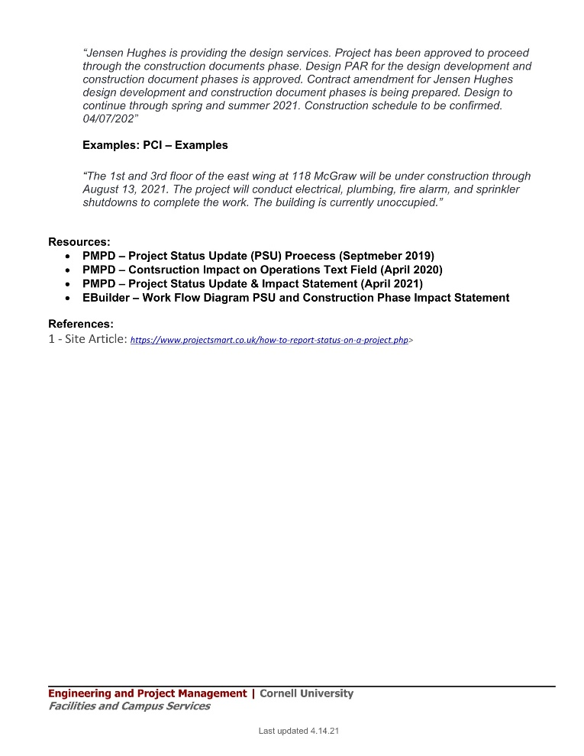
So What? (Why should a PM Care?)
Project Data: (Asset Specific)
Project Data is part of a much bigger picture
Value of Data and how it will be utilized
QA/QC: (Asset & Data)
Design Phase
Standards
Construction Phase
Submittals
Inspections
Closeout Phase
Punchlist / Warranty
Transfer of Data: (Project Turnover)
Providing data is useful for EAMP
Timely Data Transfer

Slide 11
So What? – (Why should a PM Care?)
TEMPORARY
CERTIFICATE OF OCCUPANCY (TCO/CO)
10 MONTH
WALK THROUGH
PROJECT
MANAGER
THE RED ZONE
Setting the
Project up for a
Successful
Transition
BREAK IN PERIOD
PROJECT DATA COLLECTION
QA/QC
Transfer of Data
SCOPE REQUESTS
WARRANTY
PUNCHLIST
CLOSEOUT
FM REP
“CONSTRUCTION PHASE”
“POST OCCUPANCY PHASE”
1 YEAR WARRANTY PERIOD

Slide 12
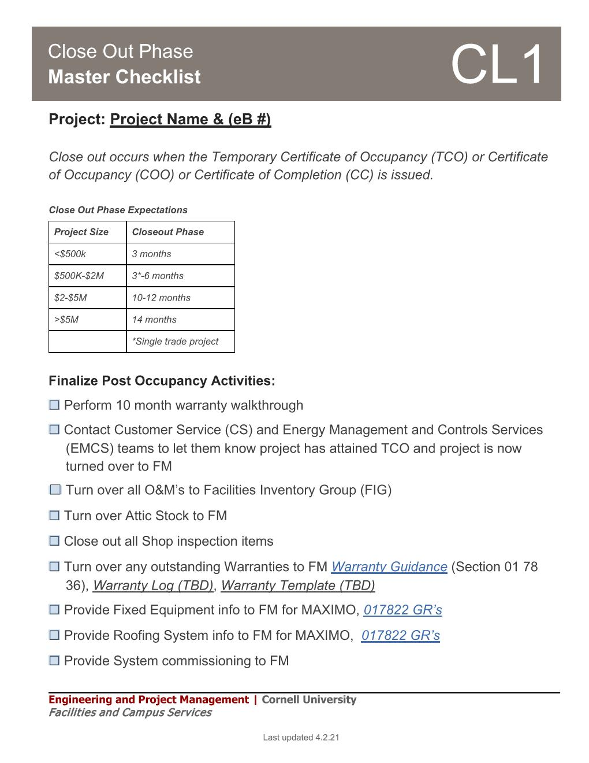
Project Management: How can PM’s Help? (Tools & Guidance)
Contract Documents:
General Conditions
Leverage Document for QA/QC
General Requirements
Asset Data (017822)
Design Standards:
“Pick a thing”
PM Checklists:
D5: Design Reviews
C6: Red Zone
CL1: Close Out Master
Notes:
One of the many items on Jim’s Phased retirement list is to review and update the data

Slide 13
Enterprise Asset Management (EAM)
Acquisition
Operations & Maintenance
Planning
Commission& Identification
Demolition
Enterprise Asset Management:
Work Management
Asset Maintenance
Planning and Scheduling
Supply Chain Management
“Through a combination of software, systems, and services,… … the intent is to optimize the quality and the utilization of assets throughout their lifecycle, increase productive uptime, and reduce operational costs”
Notes:
Asset management does not just focus on the asset itself, but on the value that the asset can provide.
Asset management gives assurance that assets will fulfil their required purpose or function.

Slide 14
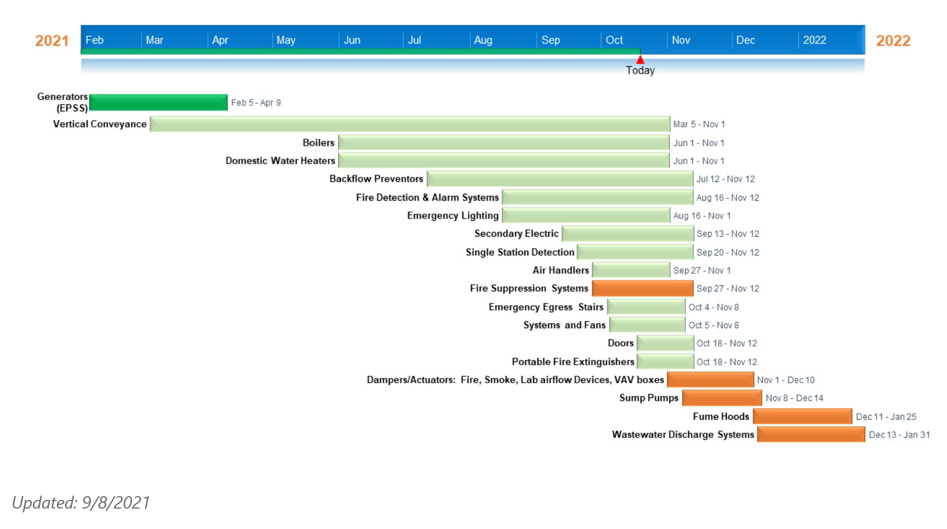
EAMP Foundation – Identification & Classification
Tier 7: Asset Management Plan Development Schedule
https://fcs.cornell.edu/strategic-asset-management-program

Slide 15
EAMP Foundation – Standardization: Asset Classification (Tiers)
Tier 7- assets required by statute
Tier 6 – assets that serve multiple facilities without redundancy
Tier 5 – assets that serve an entire facility or program without redundancy OR multiple facilities or programs with redundancy
Tier 4 – assets that serve floor or wing of a facility without redundancy OR an entire facility with redundancy
Tier 3 – assets that serve individual spaces without redundancy OR a floor or wing of a facility with redundancy
Tier 2 – assets that serve individual spaces with redundancy
Tier 1 – assets that serve aesthetic needs
https://fcs.cornell.edu/strategic-asset-management-program

Slide 16
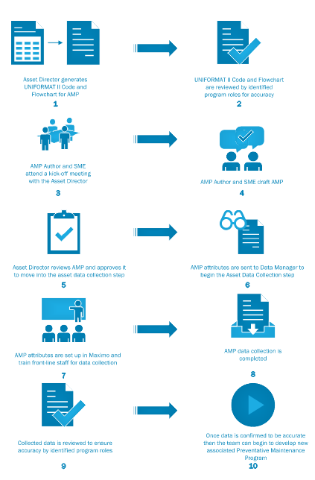
EAMP Foundation – Process: AMP Development, Data Collection & PM Program Development
Plan Development: (1- 4)
Uniformat
Flow Chart
Draft AMP
Review Plan
Program Development: (5-10)
Approved Plan
Attributes identified
Training & Data Collection
Data Audited
Development of Preventative Maintenance Program
https://fcs.cornell.edu/strategic-asset-management-program

