Slide 1
E&PM Staffing Update
February 2021
Phase | # Proj | Project $
Pre-Design | 36 | $114,175,000
Design Phase | 40 | $128,734,000
Construction | 51 | $460,943,000
Current Workload
Phase | # Proj | Project $
Pre-Design | 67 | $63,919,000
Design Phase | 79 | $441,765,000
Construction | 67 | $419,425,000
2 PMs returned from rotations July 1st
Five strategic promotions - increased workload capacity
2 Assoc PMs recently hired
PM search in progress - CM skillset focus
Assoc PM Rotation
PC 2 Search Underway
Open Senior PM to be filled

Slide 2
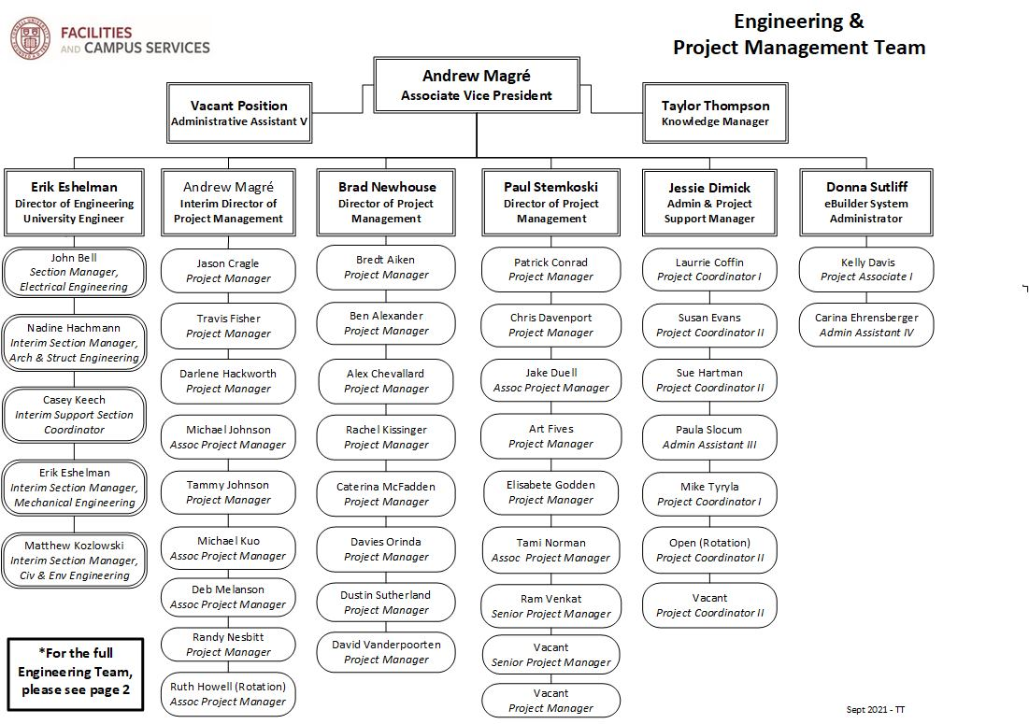
E&PM Staffing Update

Slide 3
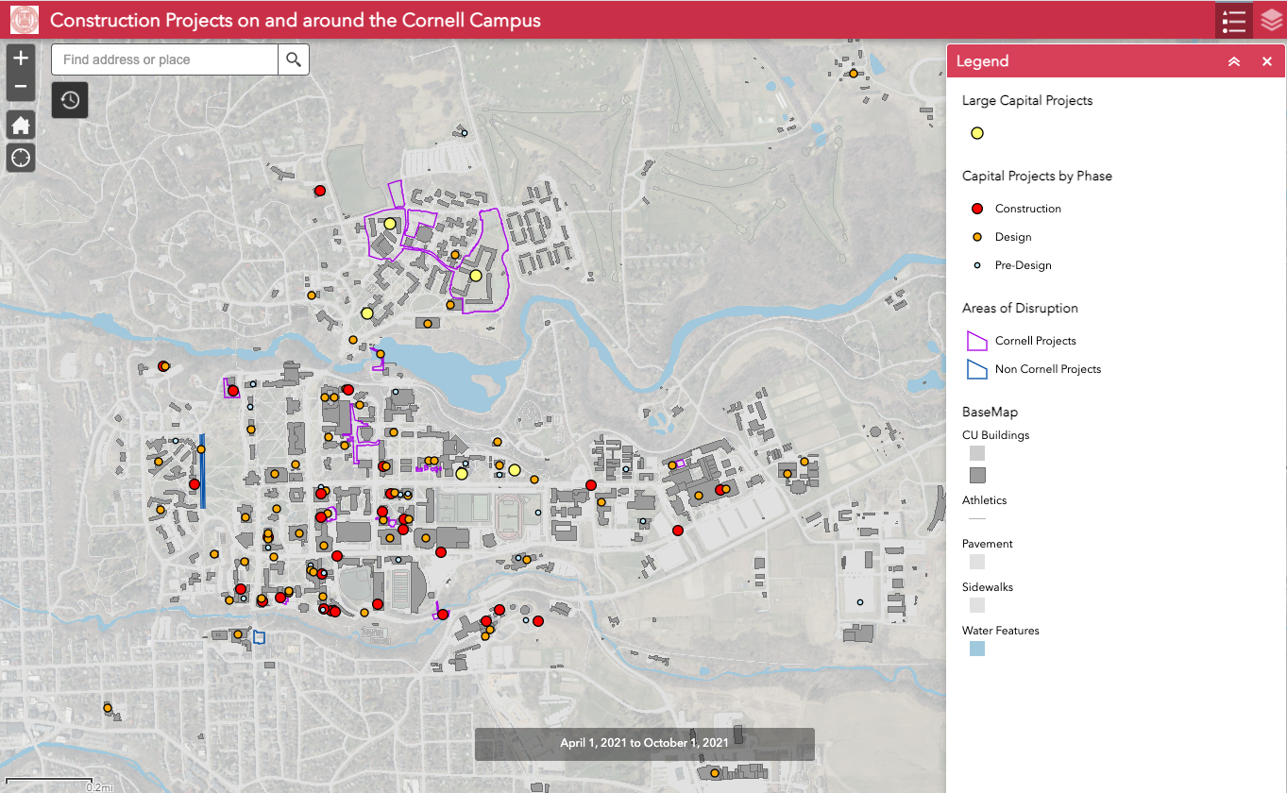
Construction Phase Impact Statement - ArcGIS Map

Slide 4
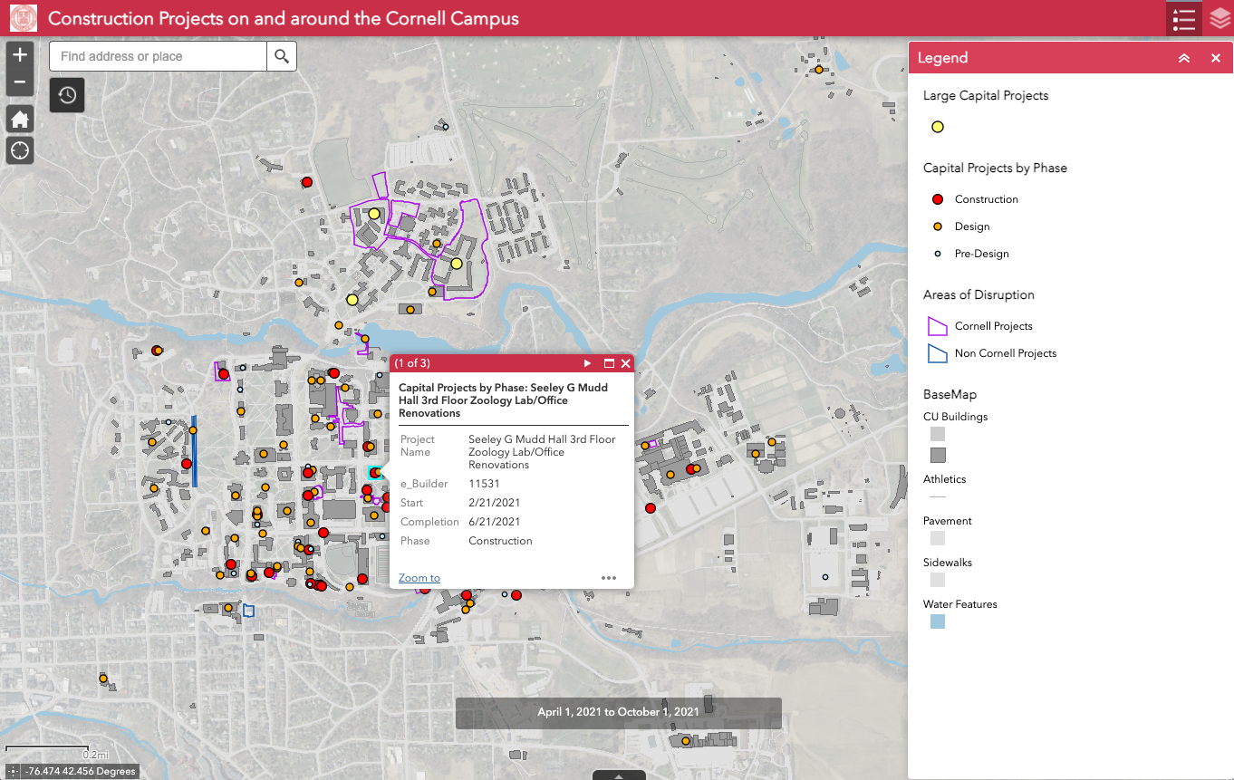
Construction Phase Impact Statement - ArcGIS Map

Slide 5
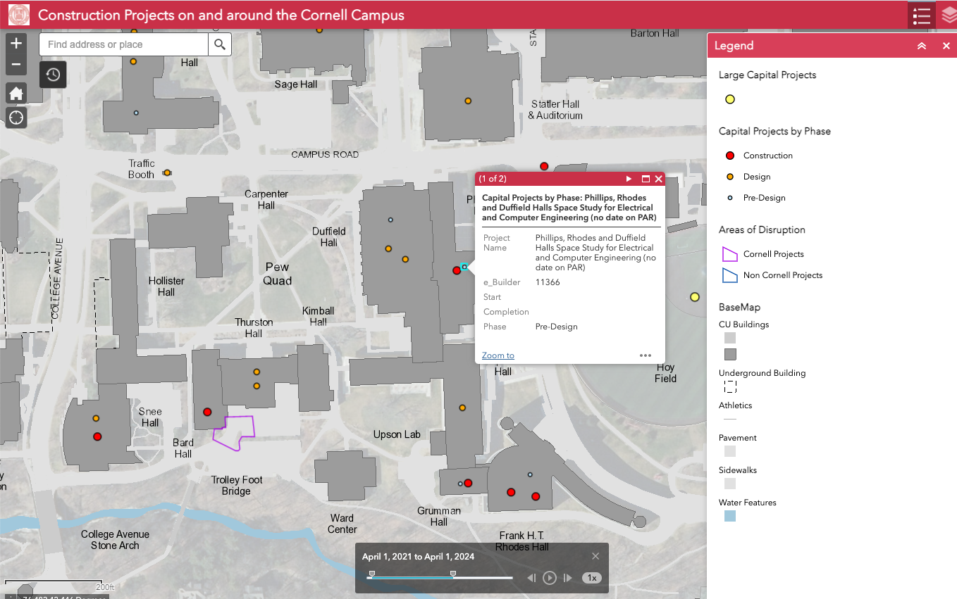
Construction Phase Impact Statement - ArcGIS Map

