Slide 1
OSHA Construction Focus Four

Slide 2
Construction Industry’s Focus Four
In the construction industry, the four leading causes of worker deaths are known as the “Focus Four”.
The Focus Four includes:
falls;
being struck by objects;
electrocutions; and
getting caught in/between objects.
Source: OSHA

Slide 3
Construction Industry’s Focus Four
There were 937 worker deaths in the construction industry in 2015 (1 out of 5 worker deaths).
The Focus Four accounted for 602 (64%) worker deaths in 2015
Falls – 364 (38.8%)
Struck by Object – 90 (9.6%)
Electrocutions – 81 (8.6%)
Caught in/between – 67 (7.2%)

Slide 4
Falls
Anything at a worksite that could cause someone to lose their balance or lose bodily support resulting in a fall.
Fall Protection Requirements: 4’ – General Industry, 6’ – Construction, 10’ on scaffolding.
Examples:
Falls from elevation or ground level to lower levels
Falls through the floor or roof surface
Falls on same level

Slide 5
Falls
Major types of fall hazards in construction include:
Unprotected roof edges, roof and floor openings, structural steel and leading edges, etc.
Improper scaffold construction
Unsafe portable ladders

Slide 6
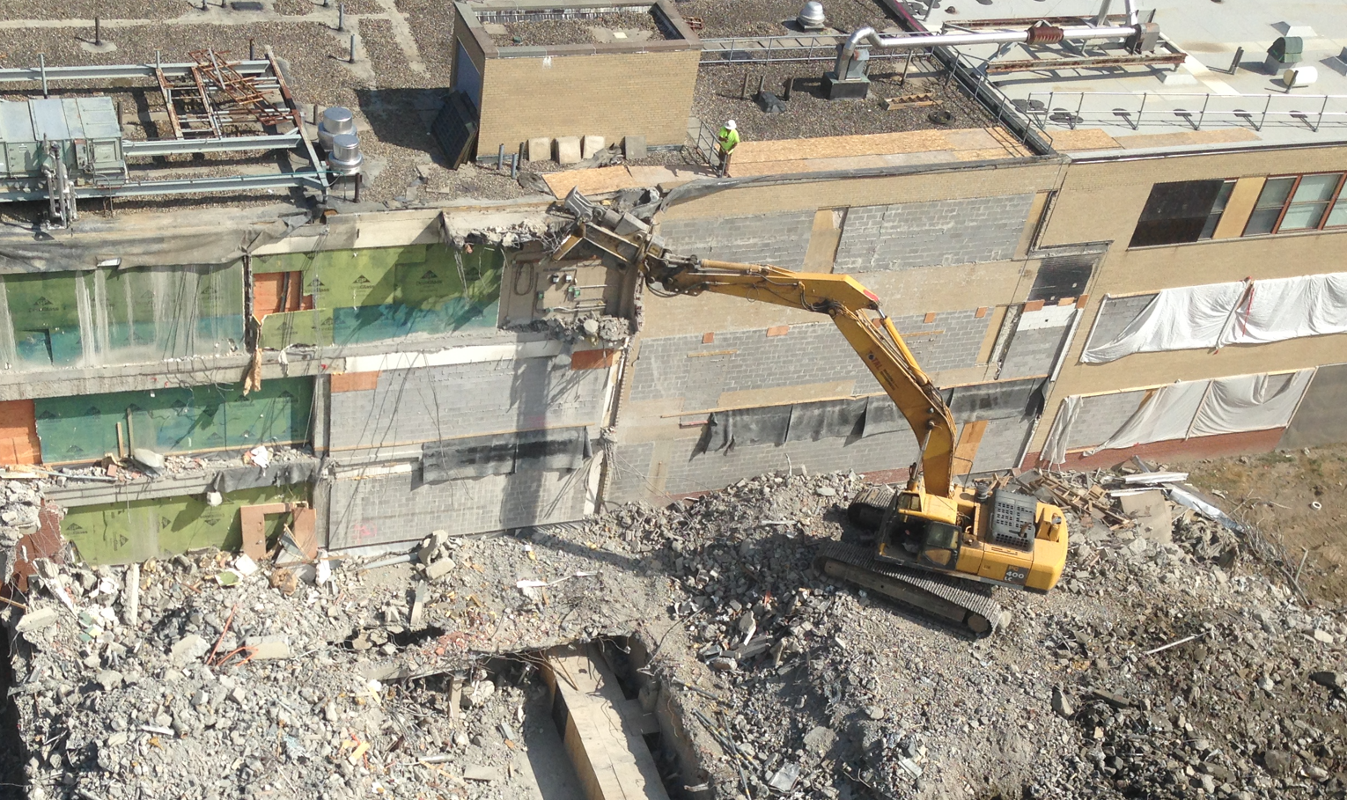
Falls

Slide 7
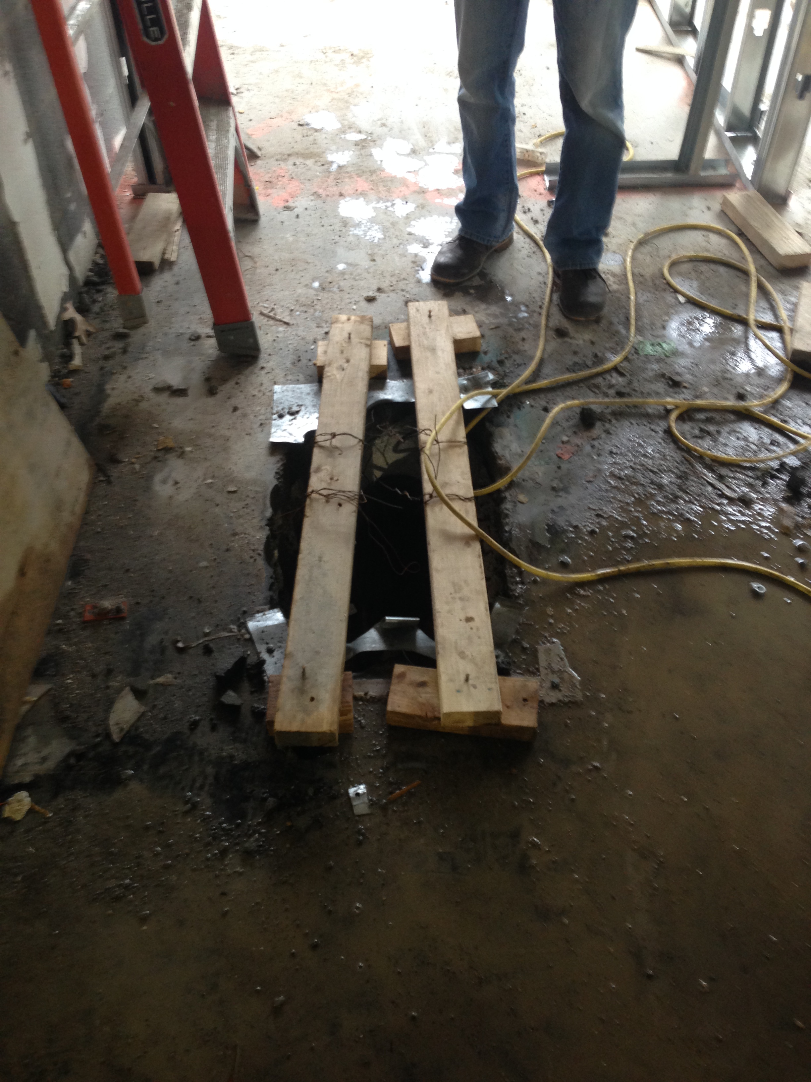
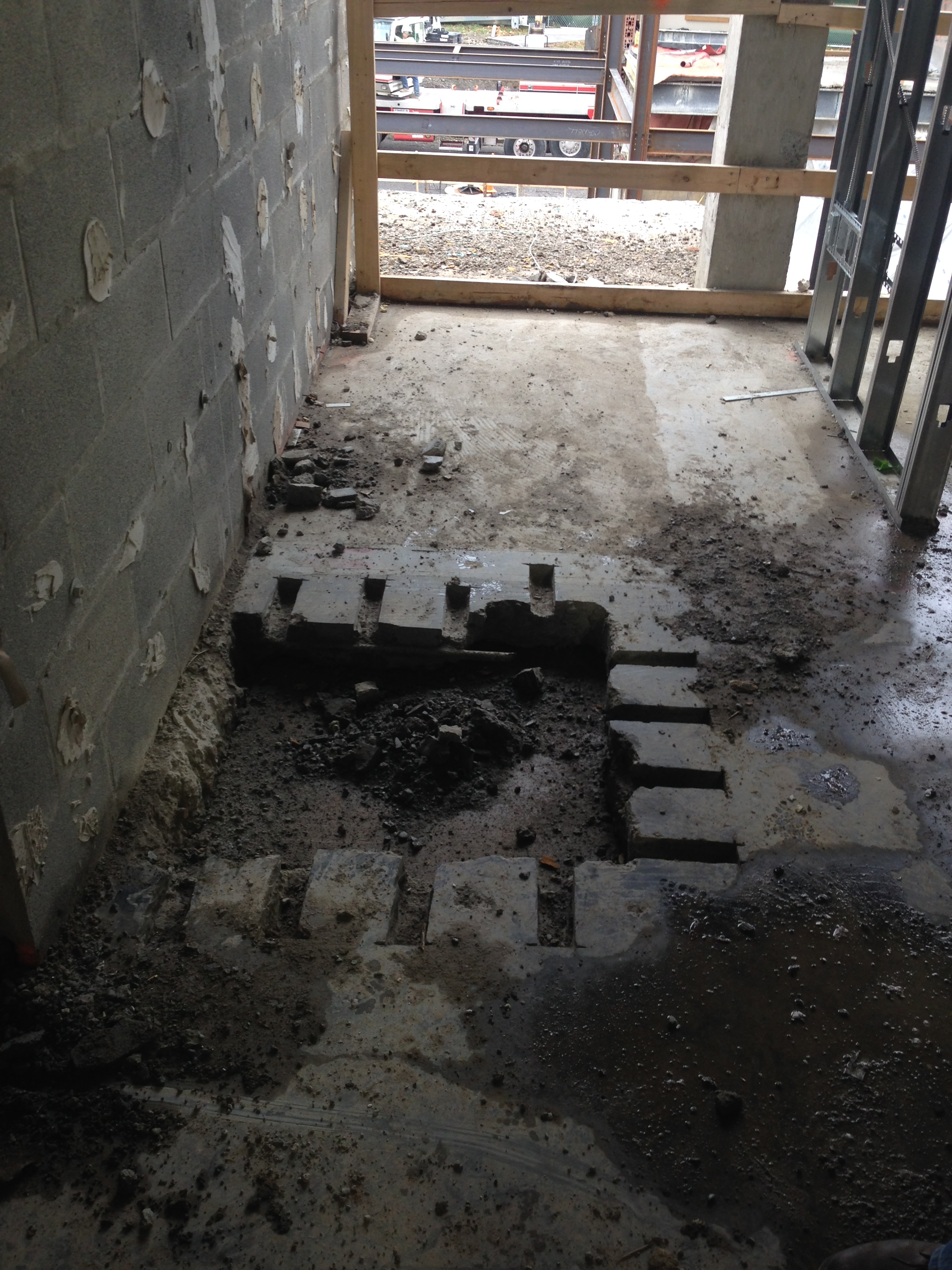
Falls

Slide 8
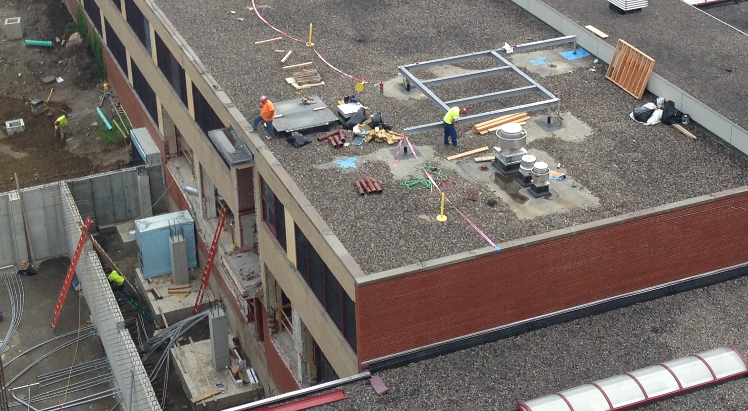
Falls

Slide 9
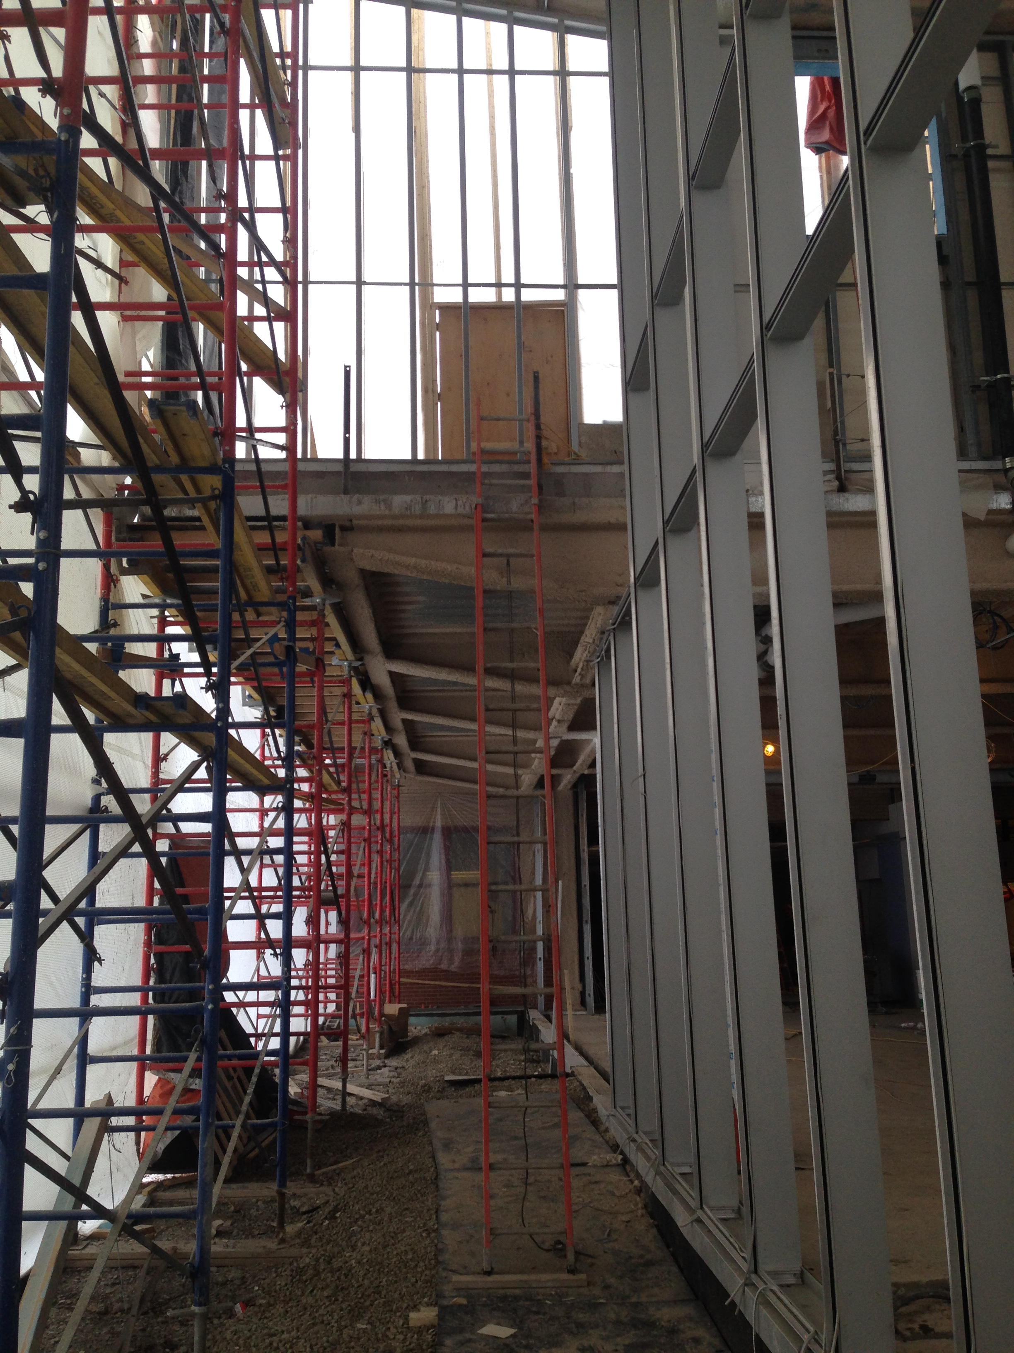
Falls

Slide 10
Struck By Object
Produced by forcible contact or impact between the injured person and an object or piece of equipment (the impact alone creates the injury).
Types of struck-by hazards include:
Struck-by flying object
Struck-by falling object
Struck-by swinging object
Struck-by rolling object

Slide 11
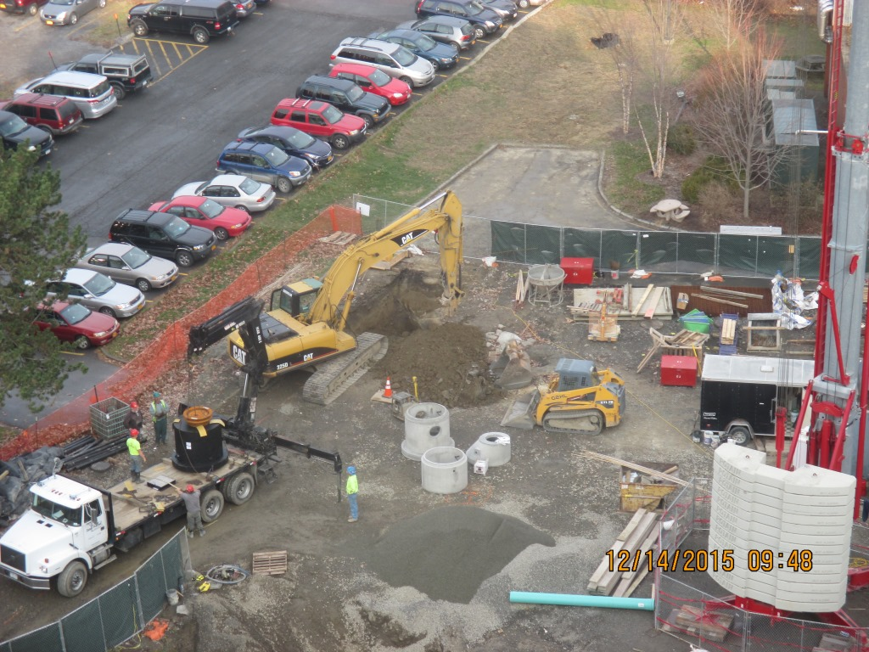
Struck By Object

Slide 12
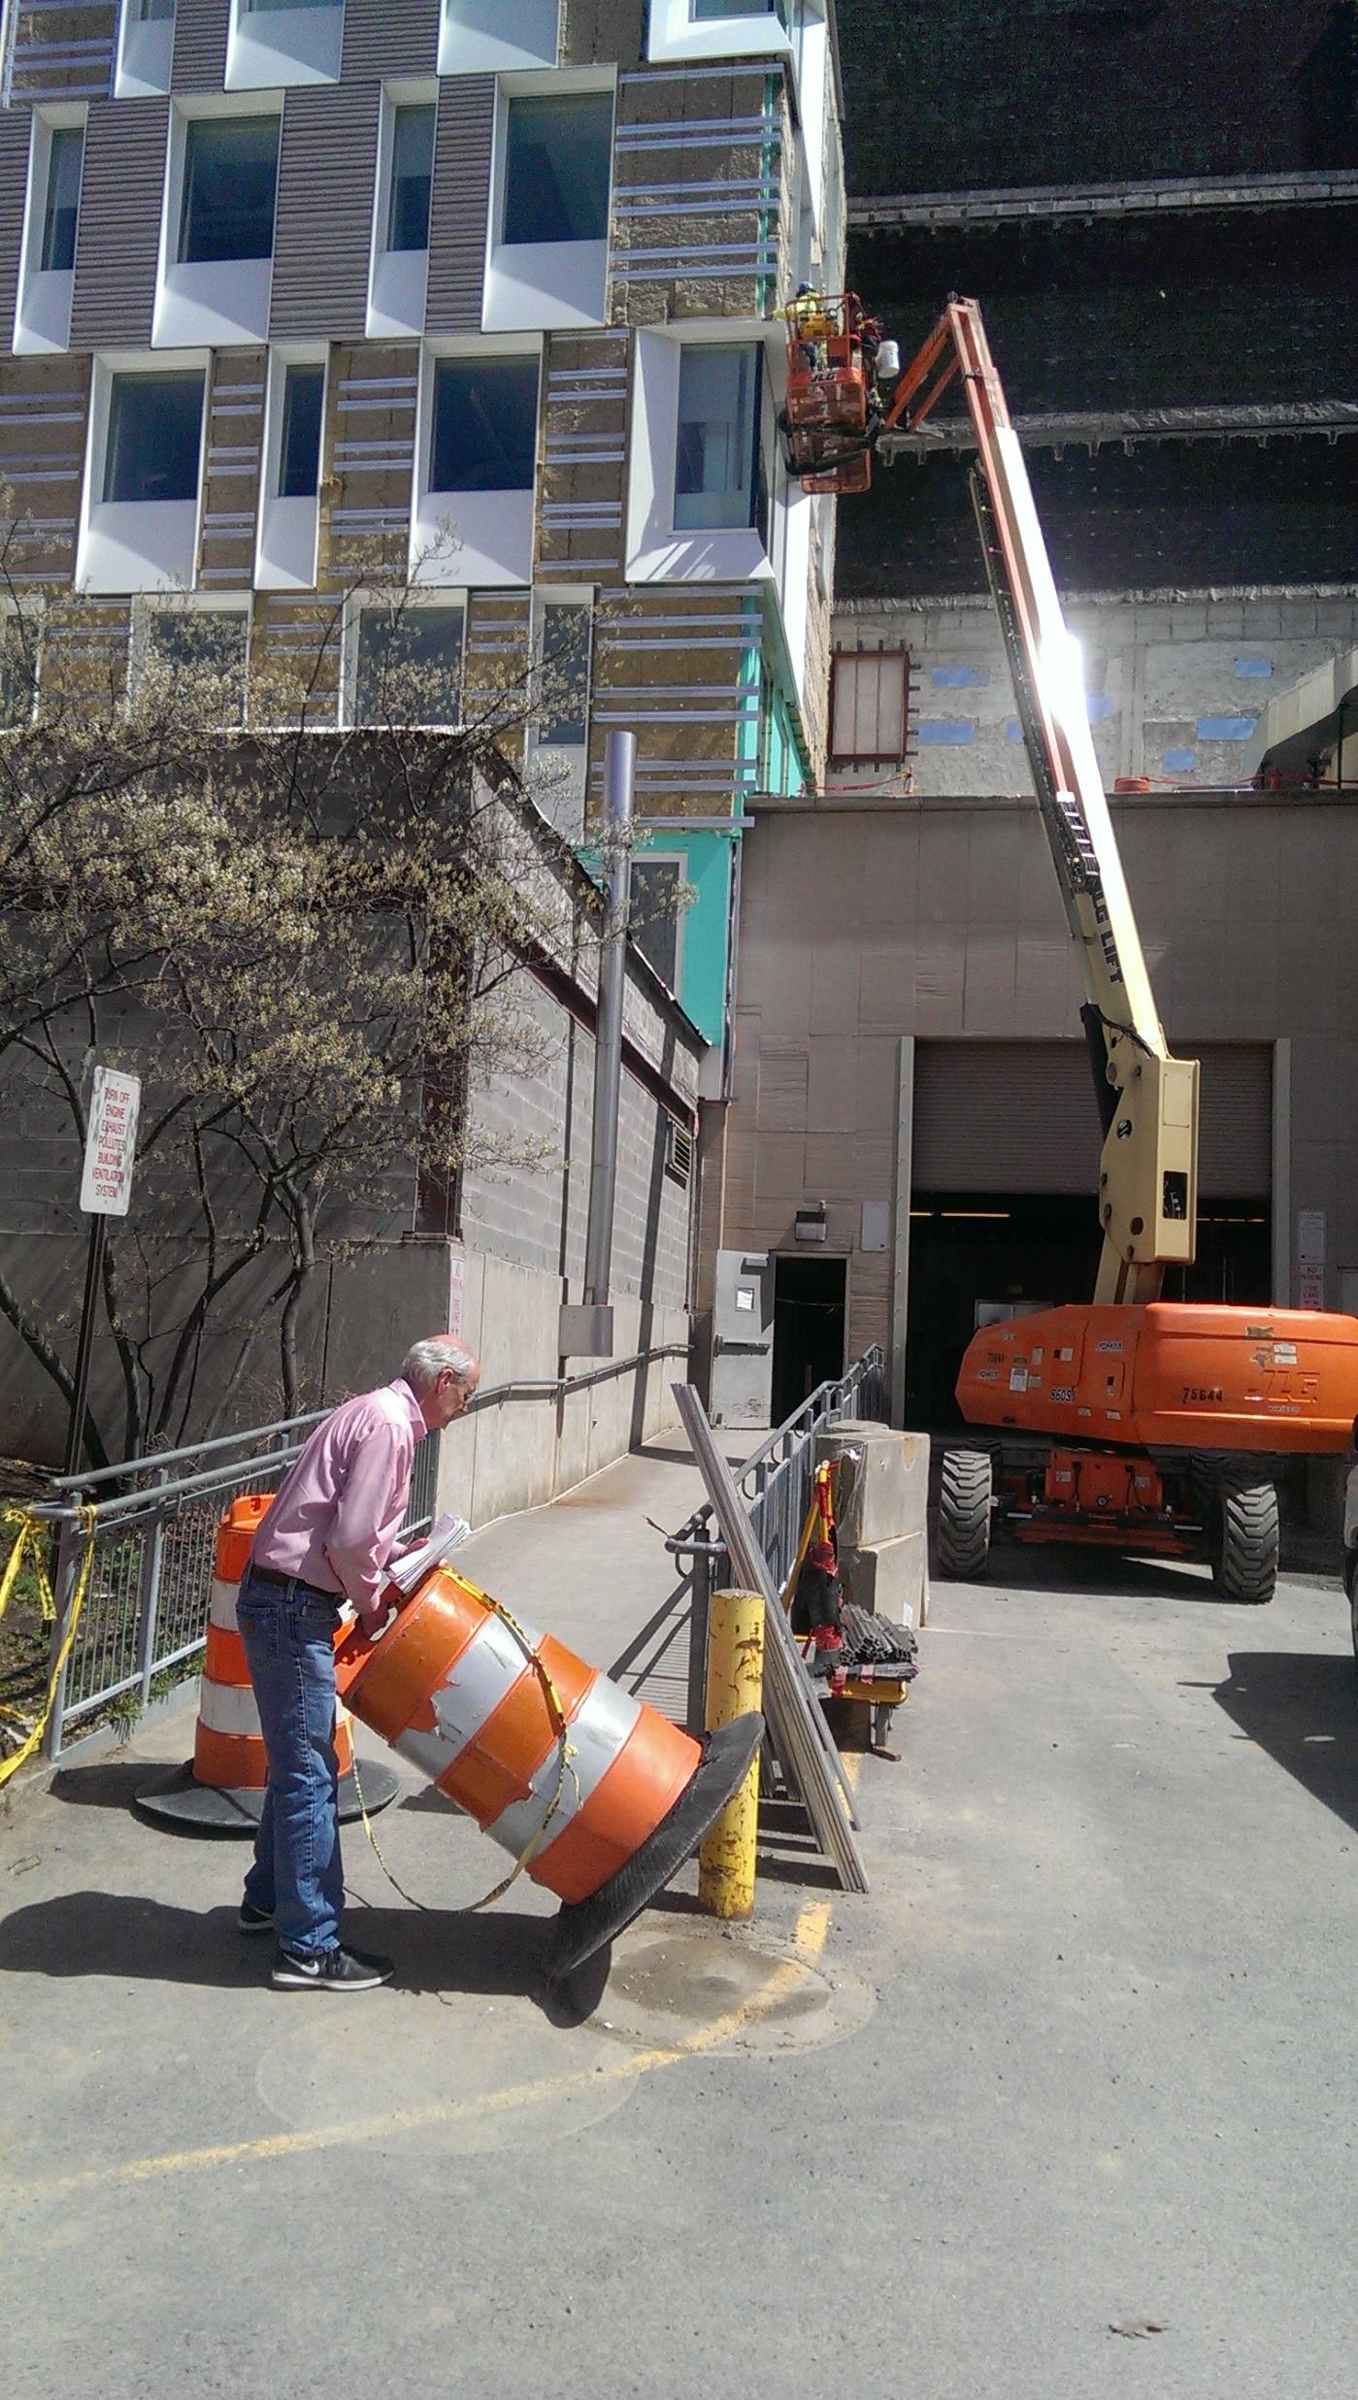
Struck By Object

Slide 13
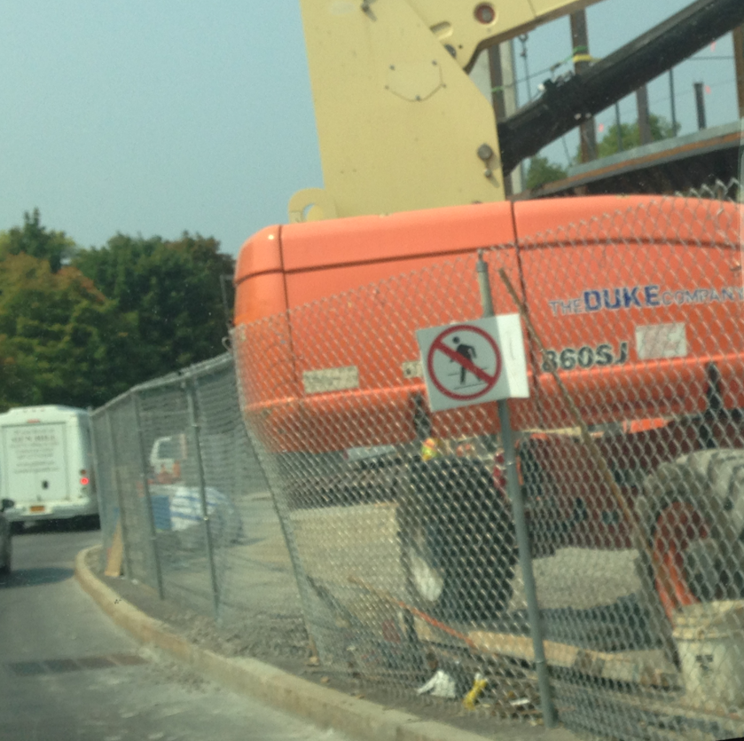
Struck By Object

Slide 14
Electrocutions
Occurs when a person is exposed to a lethal amount of electrical energy.
Common types of electrocution hazards in include:
Contact with overhead power lines
Contact with energized sources (e.g., live parts, damaged or bare wires, defective equipment or tools)
Improper use of extension and flexible cords

Slide 15
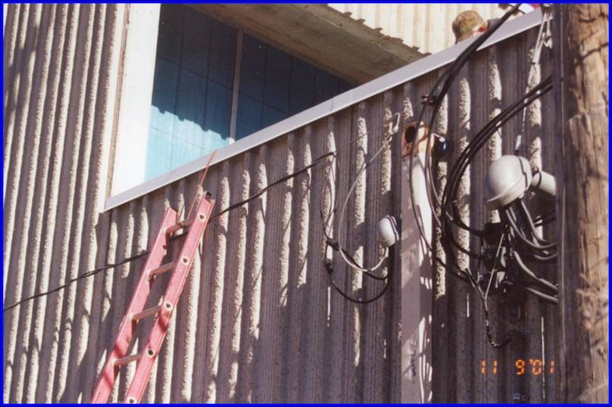
Electrocutions
Source: OSHA

Slide 16
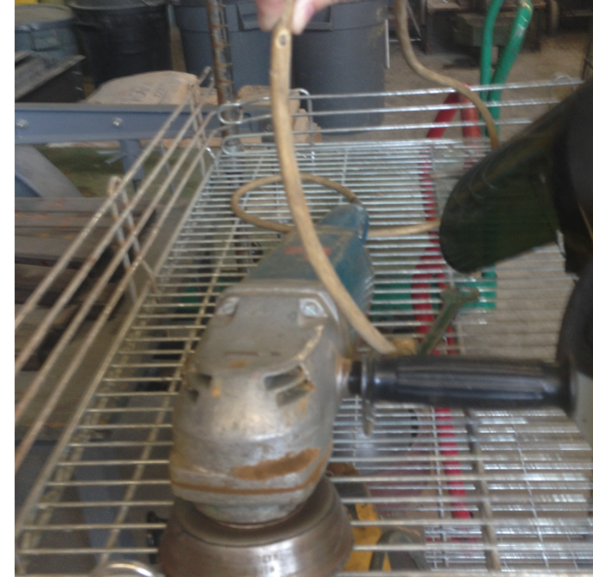
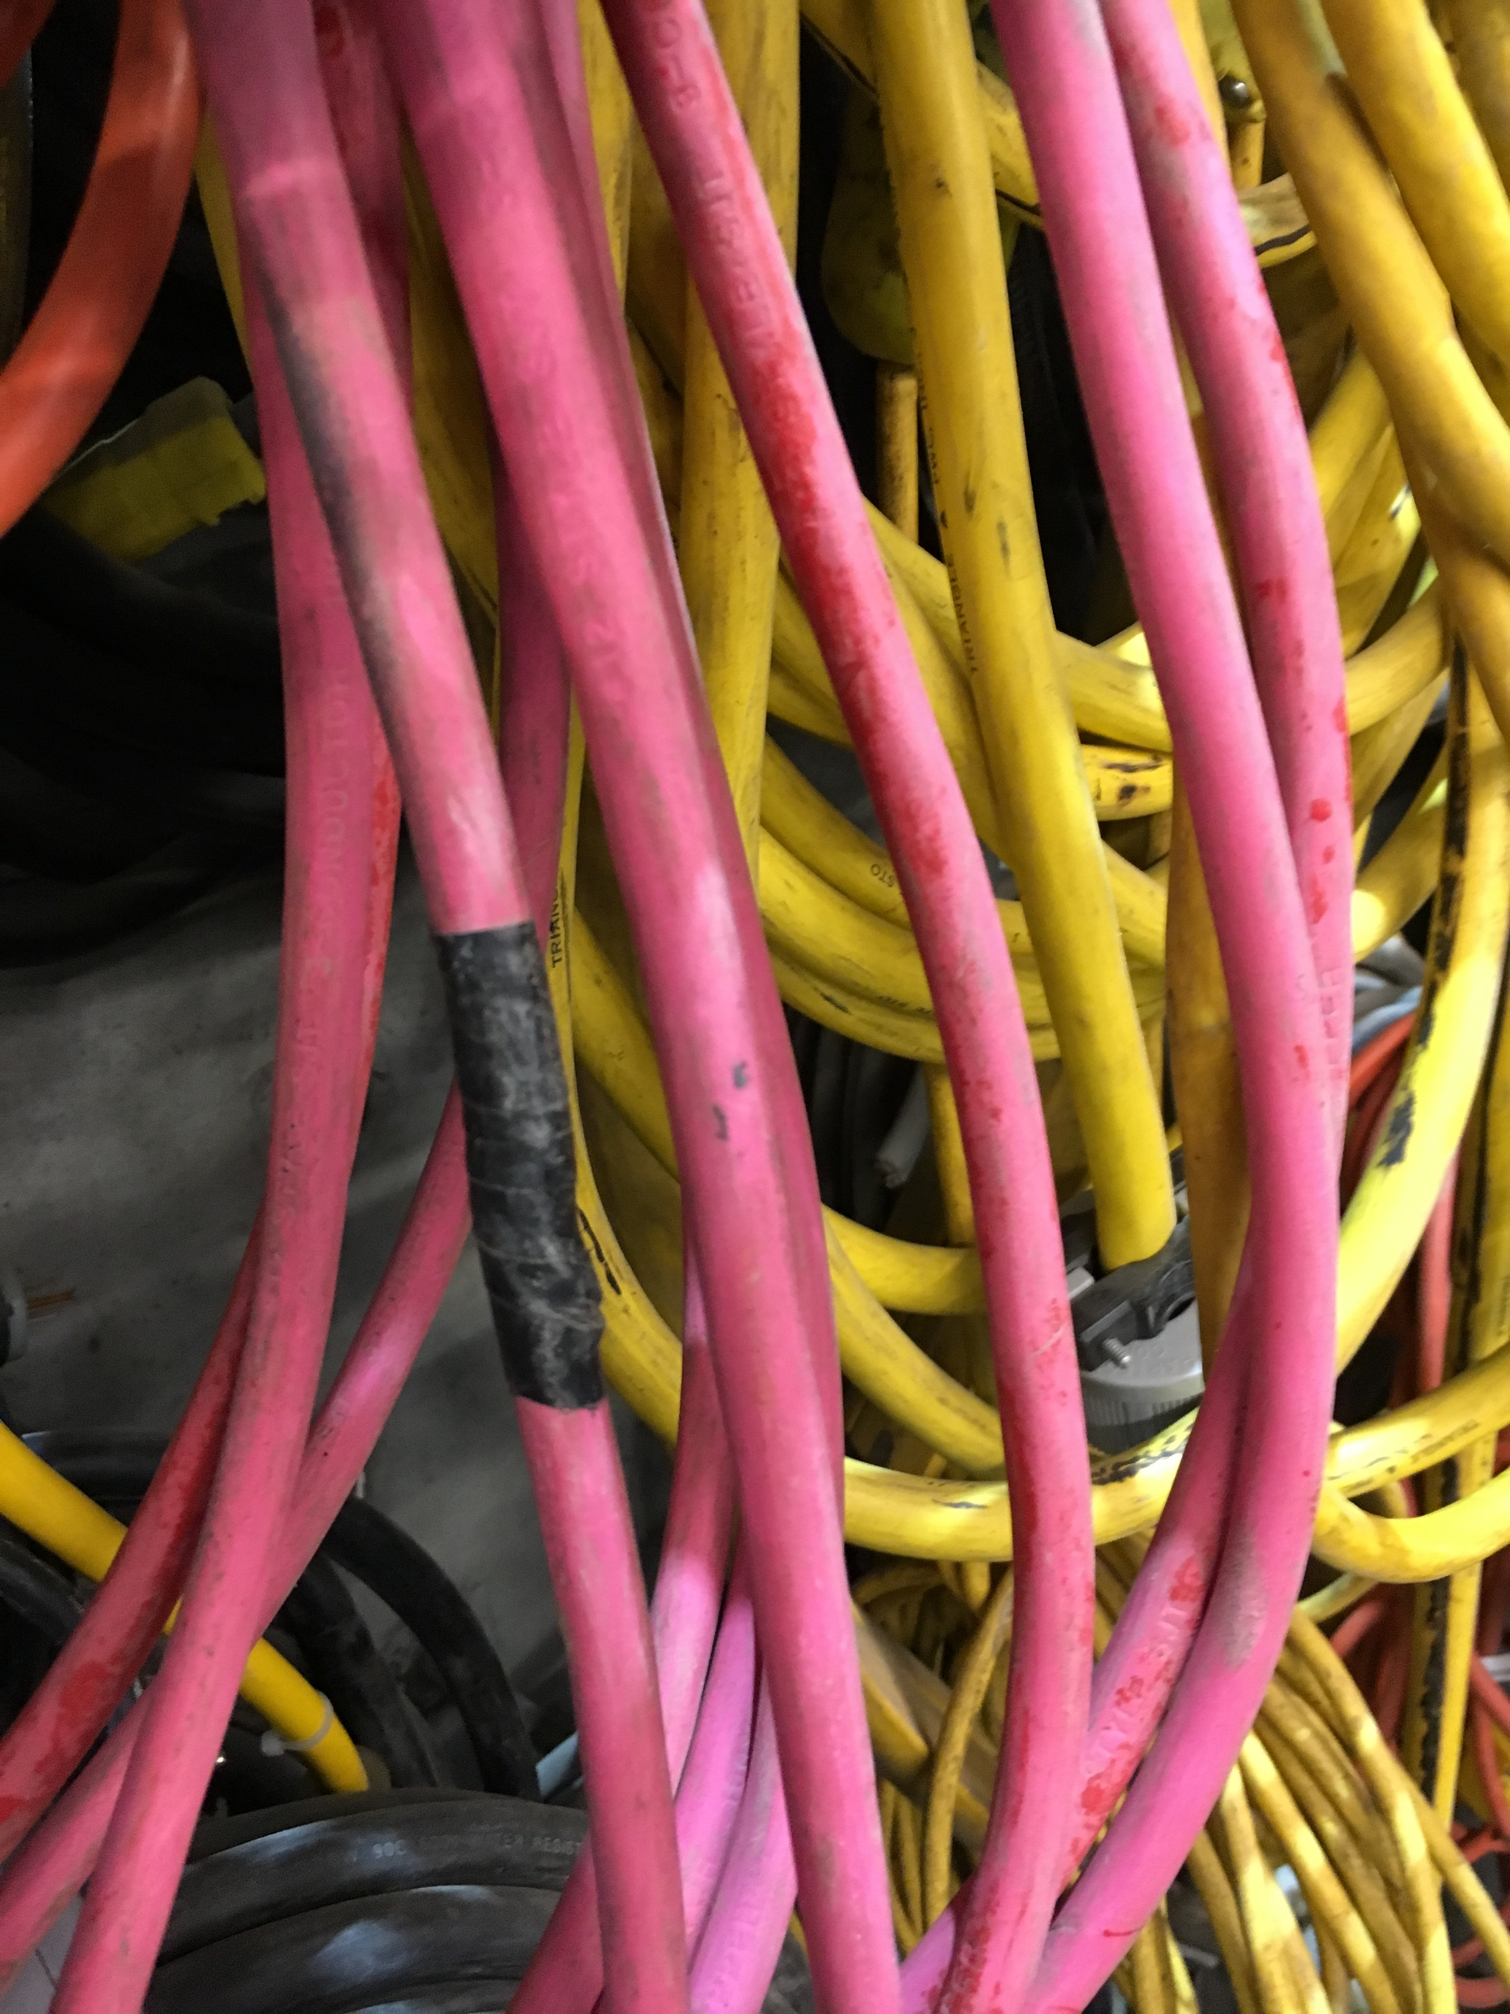
Electrocutions

Slide 17
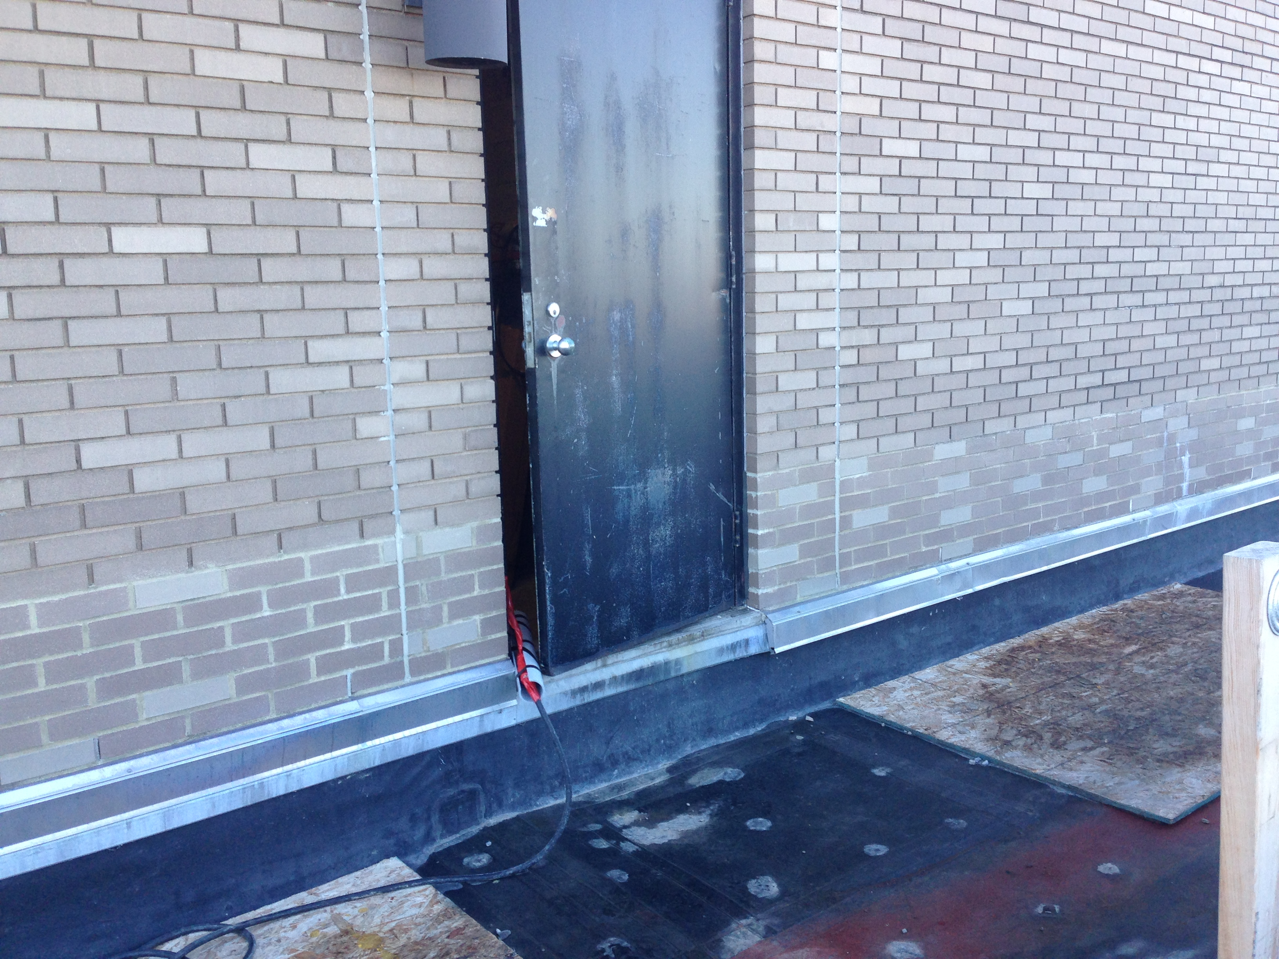
Electrocutions

Slide 18
Caught In/Between Objects
Injury is caused as a result of crushing between objects.
Examples include:
Cave-ins (trenching)
Being pulled into or caught in machinery and equipment
Being compressed or crushed between rolling, sliding, or shifting objects such as semi-trailers and a dock wall, or between a truck frame and a hydraulic bed that is lowering

Slide 19
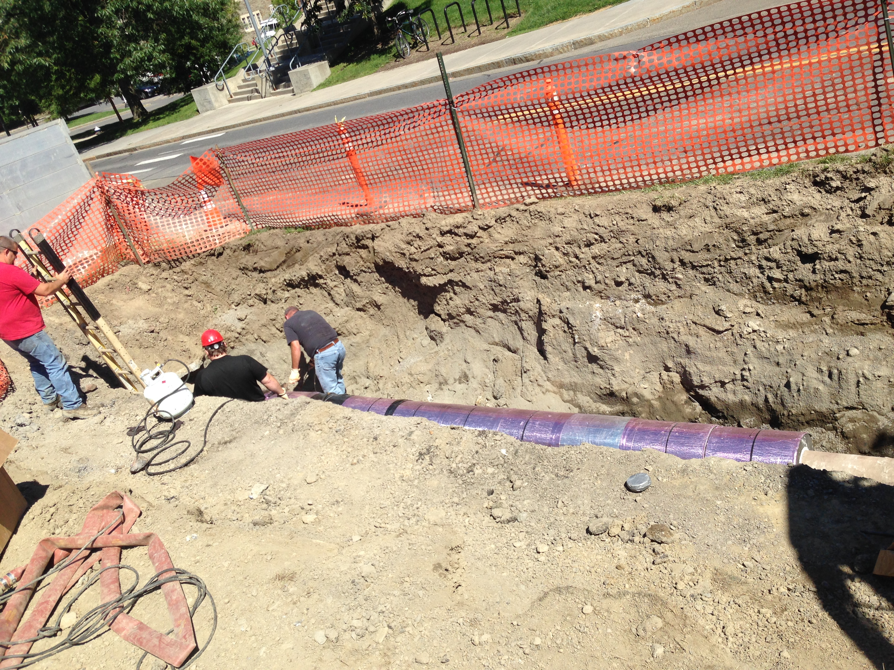
Caught In/Between Objects

Slide 20
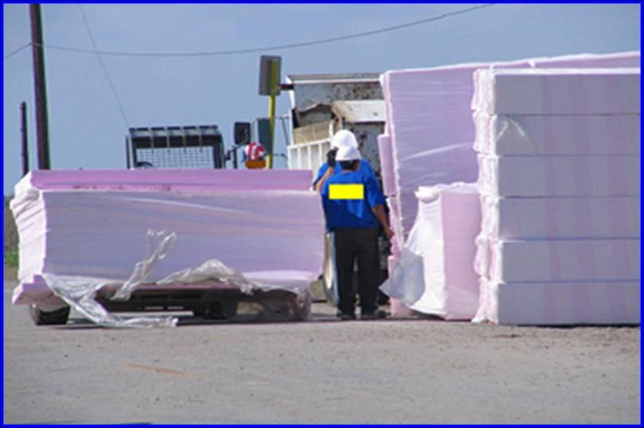
Caught In/Between Objects
Source: OSHA

Slide 21
Questions?

Slide 22
Sources:
https://www.osha.gov/dte/outreach/construction/focus_four/
https://www.osha.gov/oshstats/commonstats.html
https://www.osha.gov/dte/outreach/construction/focus_four/struckby/struckby_ig.pdf
https://www.osha.gov/dte/outreach/construction/focus_four/electrocution/electr_ig.pdf
https://www.osha.gov/dte/outreach/construction/focus_four/caught/caught_iorb_ig.pdf
https://www.osha.gov/dte/outreach/construction/focus_four/falls/falls_ig.pdf

