Slide 1
HERO Act Designation of COVID-19 as an Airborne Infectious Disease Update
Cornell University
Environment, Health and Safety
Notes:
On May 5, 2021, the HERO Act was signed into law. This law mandates workplace health and safety protections in response to the COVID-19 pandemic and is to protect employees against exposure and disease during a future airborne infectious disease outbreak.
September 6, 2021, Governor Kathy Hochul announced the designation of COVID-19 as an airborne infectious disease under the HERO Act. This designation requires all New York State employers to implement their workplace safety plans and train employees on the minimum workplace requirements to combat the spread of COVID-19.
Many of these public health requirements have been in place since the start of the pandemic at Cornell.

Slide 2
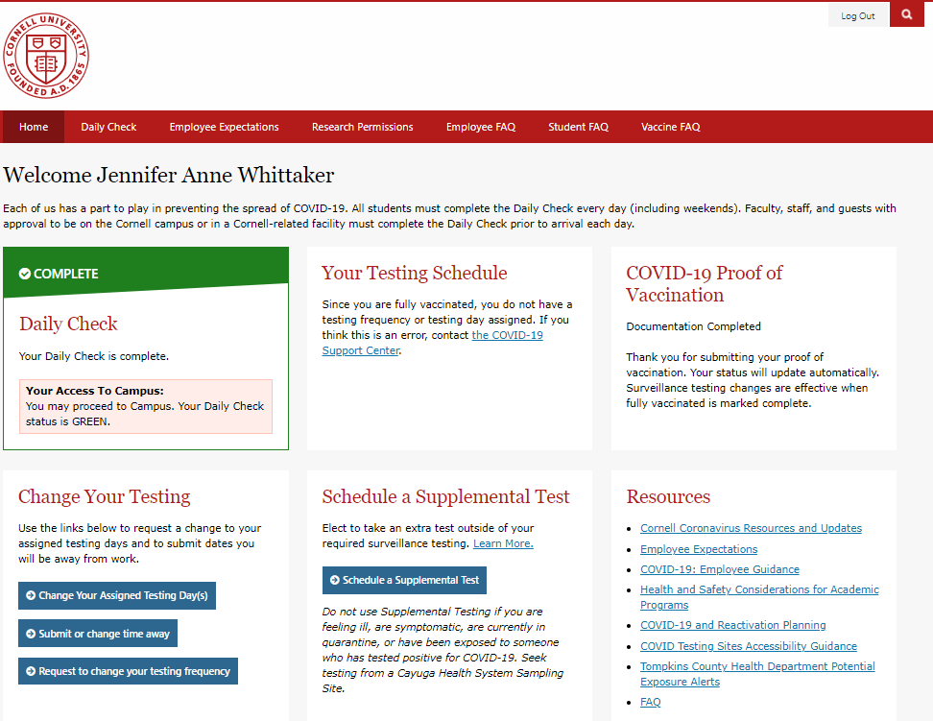
What you need to know.
Employees training on agent/ disease
Health Screening
Other elements of the HERO Act which are NOT new to the Cornell.
Face Coverings and Masks
Physical Distancing
Cleaning Procedures
Hand, Cough, and Sneeze Hygiene
Personal Protective Equipment
Medical Accommodations
Notes:
EHS 2021 - HERO Act Designation of COVID-19 as an Airborne Infectious Disease Compliance Training

