Slide 1
Project Management – Professional Development Series
Facilities and Campus Services Engineering and Project Management
September 22, 2021

Slide 2
Today’s Agenda
  E&PM Monthly Updates
    Andrew Magré
    Levi Harmon
  Furniture Procurement Presentation
    Simeon Hendrickson
  CARE Presentation
    Dan Viviano
  Safety Presentation
    Nick Genovese

Slide 3

E&PM Staffing Update
February 2021
Phase | # Proj | Project $
Pre-Design | 36 | $114,175,000
Design Phase | 40 | $128,734,000
Construction | 51 | $460,943,000
Current Workload
Phase | # Proj | Project $
Pre-Design | 67 | $63,919,000
Design Phase | 79 | $441,765,000
Construction | 67 | $419,425,000
2 PMs returned from rotations July 1st
Five strategic promotions - increased workload capacity
2 Assoc PMs recently hired
PM search in progress - CM skillset focus
Assoc PM Rotation
PC 2 Search Underway

Slide 4
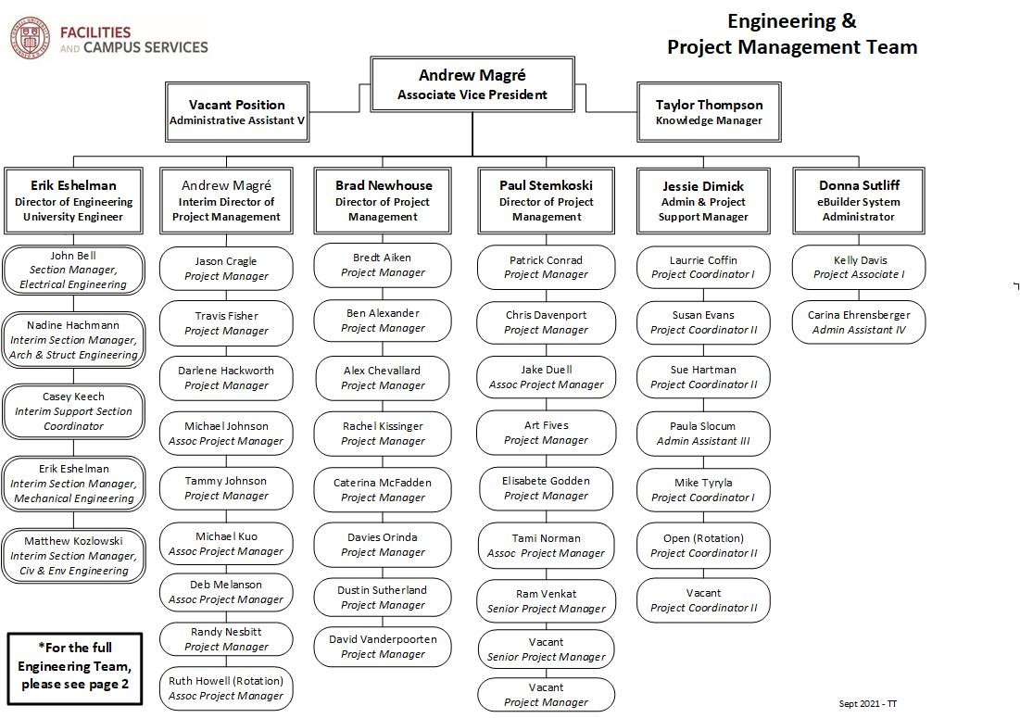
E&PM Staffing Update

Slide 5
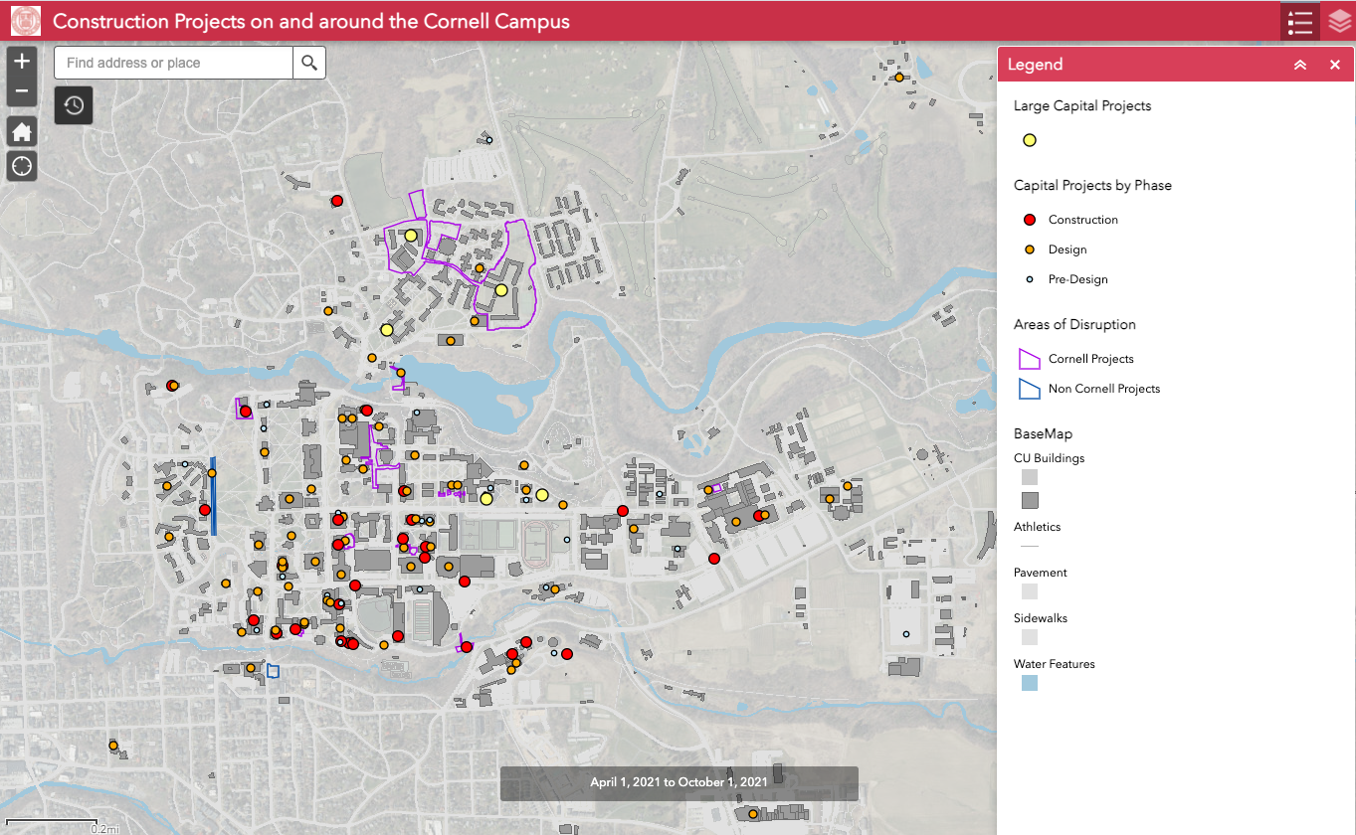
Construction Phase Impact Statement - ArcGIS Map

Slide 6
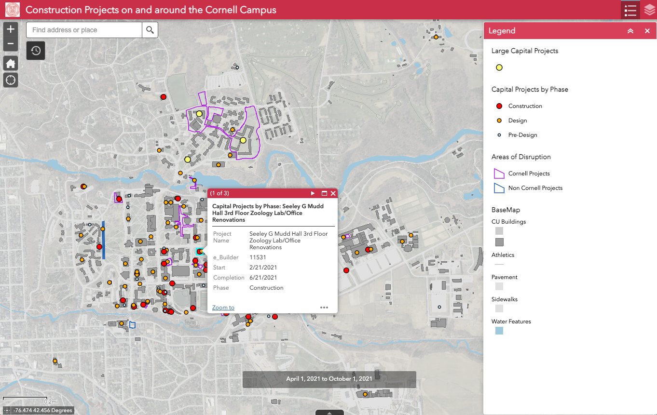
Construction Phase Impact Statement - ArcGIS Map

Slide 7
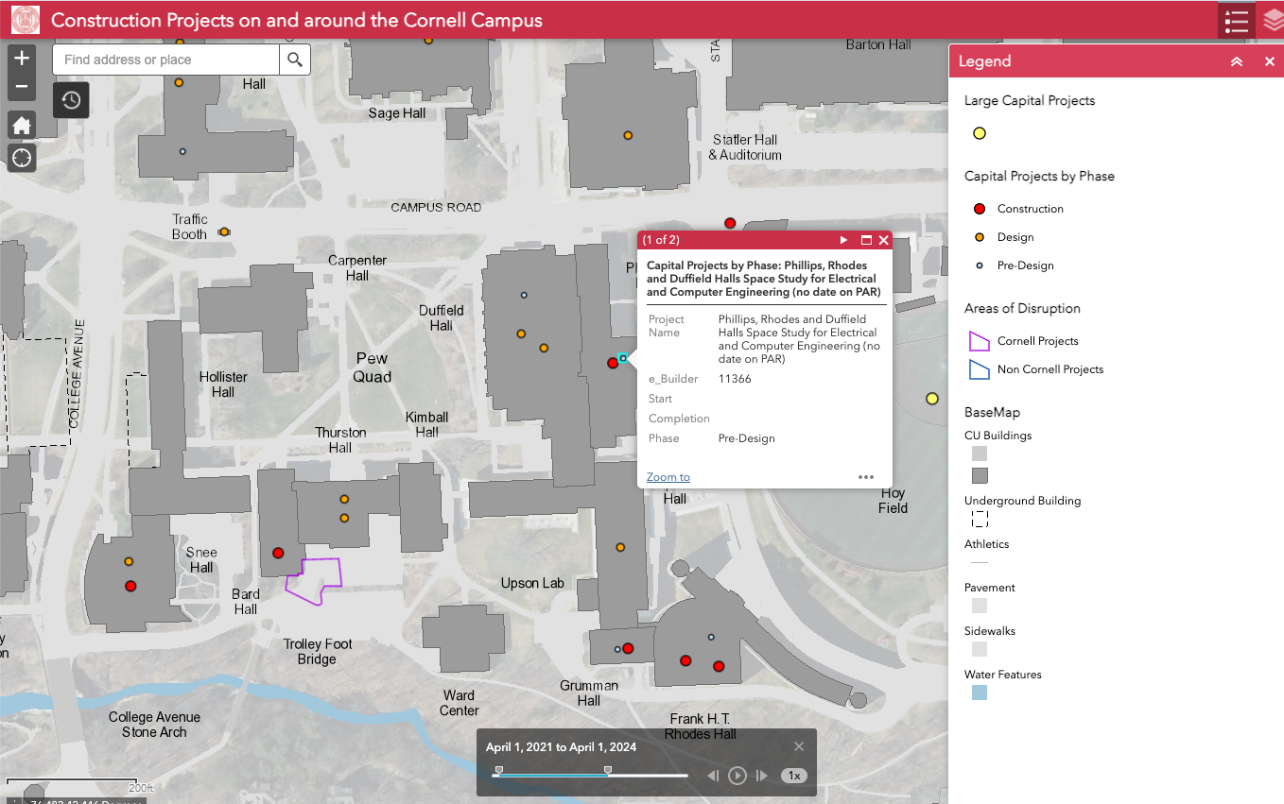
Construction Phase Impact Statement - ArcGIS Map

Slide 8
HERO Act Designation of COVID-19 as an Airborne Infectious Disease Update
Cornell University
Environment, Health and Safety
Notes:
On May 5, 2021, the HERO Act was signed into law. This law mandates workplace health and safety protections in response to the COVID-19 pandemic and is to protect employees against exposure and disease during a future airborne infectious disease outbreak.
September 6, 2021, Governor Kathy Hochul announced the designation of COVID-19 as an airborne infectious disease under the HERO Act. This designation requires all New York State employers to implement their workplace safety plans and train employees on the minimum workplace requirements to combat the spread of COVID-19.
Many of these public health requirements have been in place since the start of the pandemic at Cornell.

Slide 9
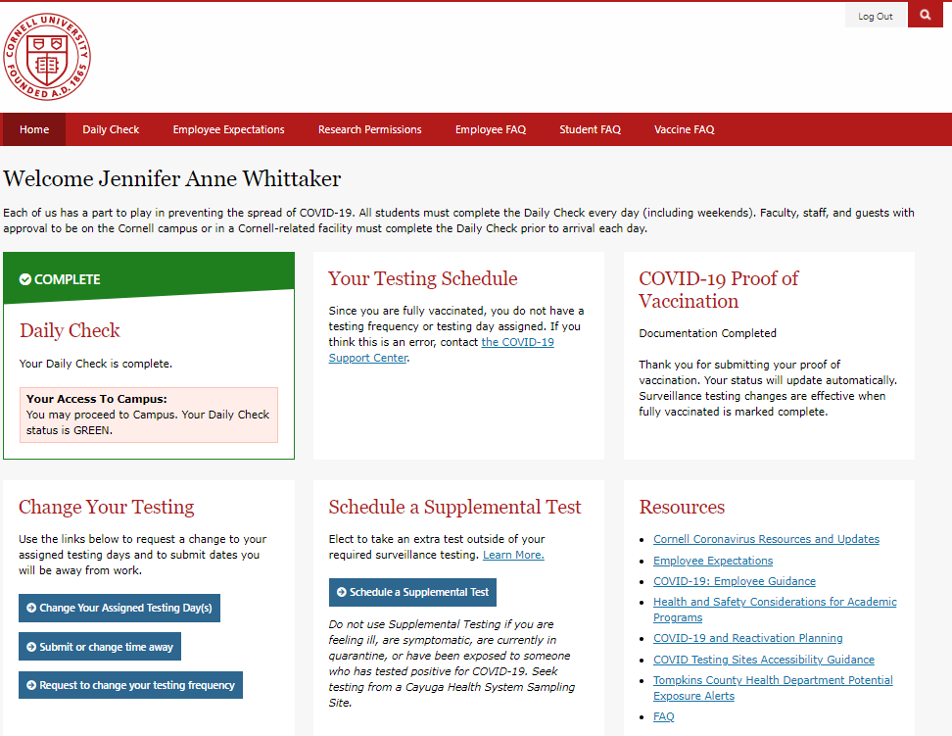
What you need to know.
Employees training on agent/ disease
Health Screening
Other elements of the HERO Act which are NOT new to the Cornell.
  Face Coverings and Masks
  Physical Distancing
  Cleaning Procedures
  Hand, Cough, and Sneeze Hygiene
  Personal Protective Equipment
  Medical Accommodations
Notes:
EHS 2021 - HERO Act Designation of COVID-19 as an Airborne Infectious Disease Compliance Training

Slide 10
Furniture Procurement Presentation

Slide 11
Questions?

Slide 12
CARE
Presentation

Slide 13
PMPD
CARE Project Involvement
Dan Viviano
Assistant Director, Animal Facility Projects

Slide 14
Physical Plant
Building materials should be selected to facilitate efficient and hygienic operation of animal facilities
  Durable, moisture-proof, fire-resistant, seamless materials are most desirable for interior surfaces
  Surfaces should be highly resistant to the effects of cleaning agents, scrubbing, high-pressure sprays, and impact

Slide 15
Construction Guidelines
Corridors
Animal-Room Doors
Exterior Windows
Floors
Drainage
Walls
Ceilings
Heating, Ventilation, and Air-Conditioning
Power
Lighting
Storage Areas
Noise Control
Facilities for Sanitizing Materials

Slide 16
Corridors
Corridors should be wide enough to facilitate the movement of personnel and equipment (6-8 ft)
In corridors leading to high noise areas double door entry or other noise traps should be considered
Wherever possible, water lines, drainpipes, electric-service connections, etc should be accessible through access panels in corridors outside the animal rooms

Slide 17
Animal Room Doors
Doors should be large enough to allow the easy passage of racks and equipment (42 x 84 in)
Doors should fit tightly within their frames, and both doors and frames should be appropriately sealed to prevent vermin entry or harborage
Self-closing doors equipped with recessed or shielded handles, threshold sweeps, and kickplates are usually preferred
Room doors should be equipped with locks

Slide 18
Exterior Windows
Windows are acceptable in some animal rooms and can constitute a type of environmental enrichment for some species
  Nonhuman primates, dogs
The effects of windows on temperature, photoperiod control, and security should be considered in design decisions

Slide 19
Floors
Floors should be moisture-resistant, nonabsorbent, impact-resistant, and relatively smooth
Floors should be resistant to the action of urine and other biologic materials, and to the adverse effects of hot water and cleaning agents

Slide 20
Drainage
The floors should be sloped and drain traps kept filled with liquid
To minimize humidity, drainage should allow rapid removal of water and drying of surfaces
Drainpipes should be at least 4 in. in diameter
Floor drains are not essential in all animal rooms, particularly those housing rodents
  Floors can be sanitized satisfactorily by wet vacuuming or mopping with appropriate cleaning compounds or disinfectants

Slide 21
Walls
Walls should be
  Smooth Surfaces
  moisture-resistant
  nonabsorbent
  resistant to damage from impact
  free of cracks
  free of unsealed utility penetrations
  coved wall-floor junctions 3 to 5 inch radius
  free of imperfect junctions with doors, ceilings, floors, and corners

Slide 22
Ceilings
Ceilings should be smooth, moisture-resistant, and free of imperfect junctions
Surface materials should be capable of withstanding cleaning with detergents and disinfectants
Suspended ceilings are generally undesirable in animal holding rooms unless they are sealed from the space above with gaskets and clips. When used, they should be fabricated of impervious materials, have a washable surface, and be free of imperfect junctions.
Exposed plumbing, ductwork, and light fixtures are undesirable unless the surfaces can be readily cleaned.

Slide 23
Heating, Ventilation, and
Air-Conditioning (HVAC)
Temperature is best regulated by having thermostatic control for each room
It is essential that life-threatening heat accumulation or loss be prevented during mechanical failure
Consideration should be given to the regulation of air-pressure differentials in surgical, procedural, housing, and service areas
A system should be capable of adjustments in temperatures of ±1ºC

Slide 24
Lighting
Light fixtures, timers, switches, and outlets should be properly sealed to prevent vermin from living there
Light bulbs or fixtures should be equipped with protective covers to ensure the safety of the animals and personnel

Slide 25
Storage Areas
Corridors used for passage of personnel or equipment are not appropriate storage areas
Bedding and food should be stored in a separate area in which materials that pose a risk of contamination from toxic or hazardous substances are not stored
Refuse storage areas should be seperated from other storage areas
Refrigerated storage, separated from other cold storage, is essential for storage of dead animals and animal tissue waste, and should be kept below 7°C to reduce putrefaction of wastes and animal carcasses

Slide 26
Noise Control
If sound attenuating materials are used, they should be sanitizable
Attention should be paid to attenuating noise generated by equipment
Fire and environmental monitoring alarm systems and public-address systems should be selected and located to minimize potential animal exposure

Slide 27
Facilities for Sanitizing Materials
Factors to consider
  Location with respect to animal rooms and waste-disposal and storage areas
  Ease of access
  Sufficient space
  Provision for safe bedding disposal and prewashing activities
  Traffic flow that separates animals and equipment moving between clean and soiled areas
  Insulation of walls and ceilings
  Sound attenuation
  Utilities
  Ventilation

Slide 28
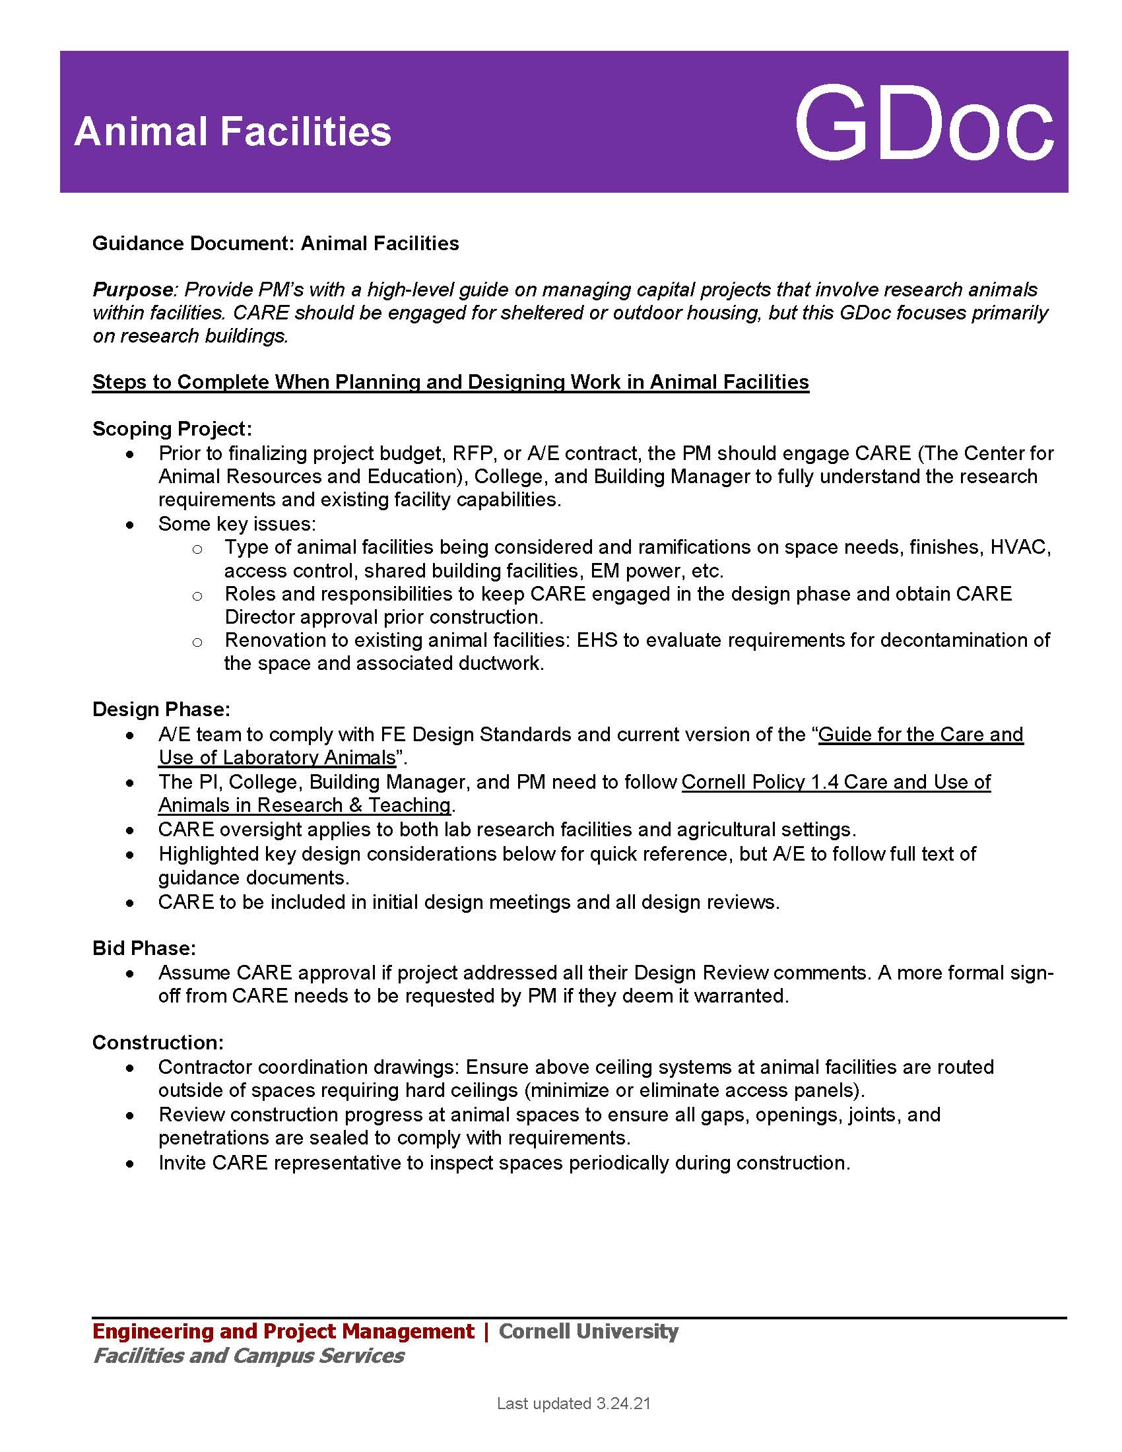
Animal Facilities
Guidance Document

Slide 29
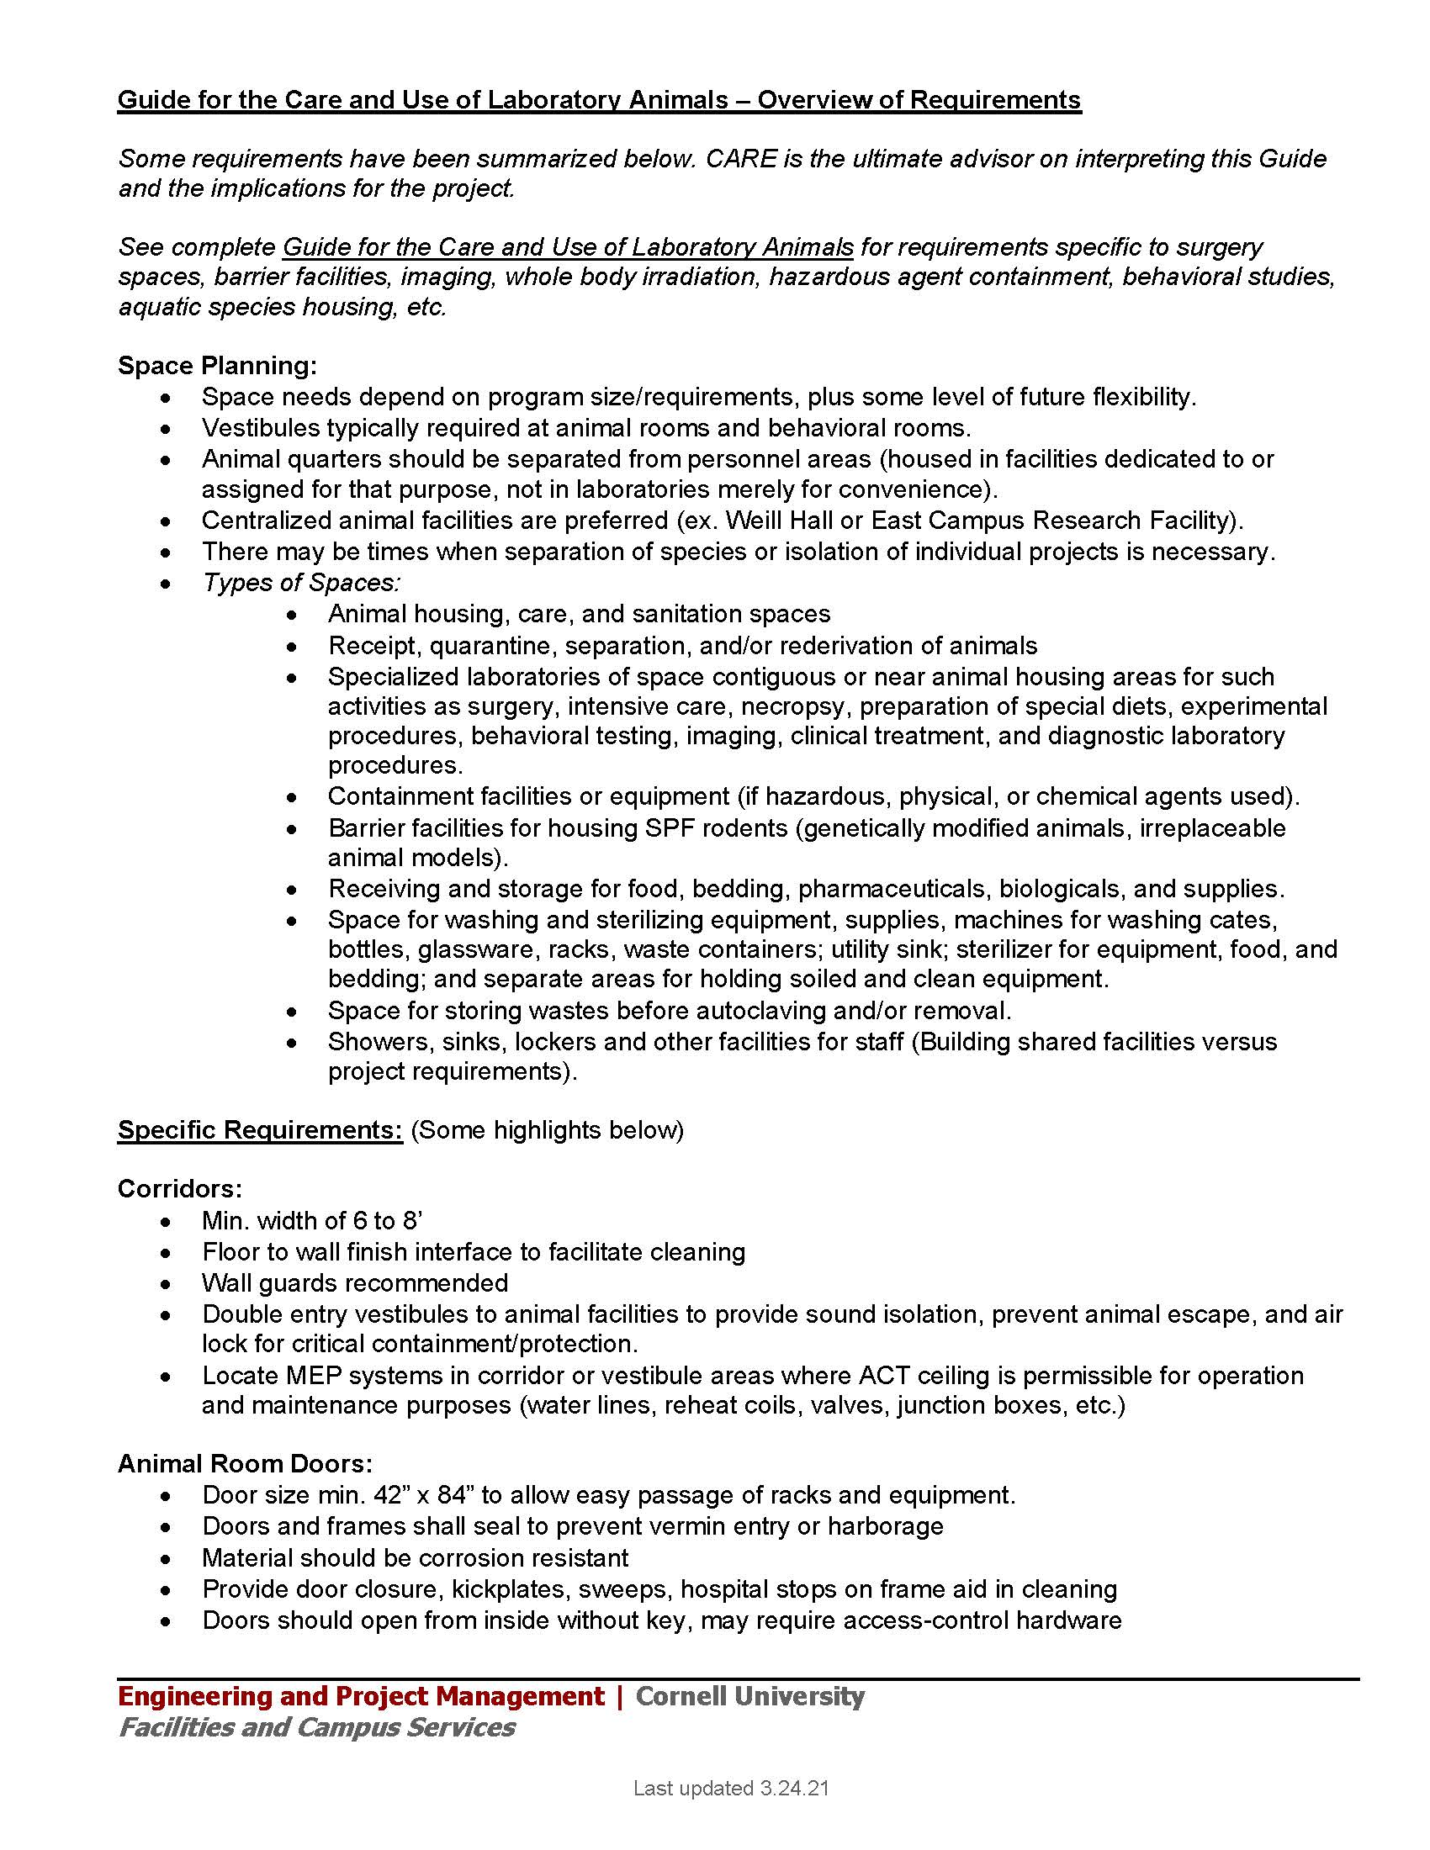
Animal Facilities
Guidance Document
(cont.)

Slide 30
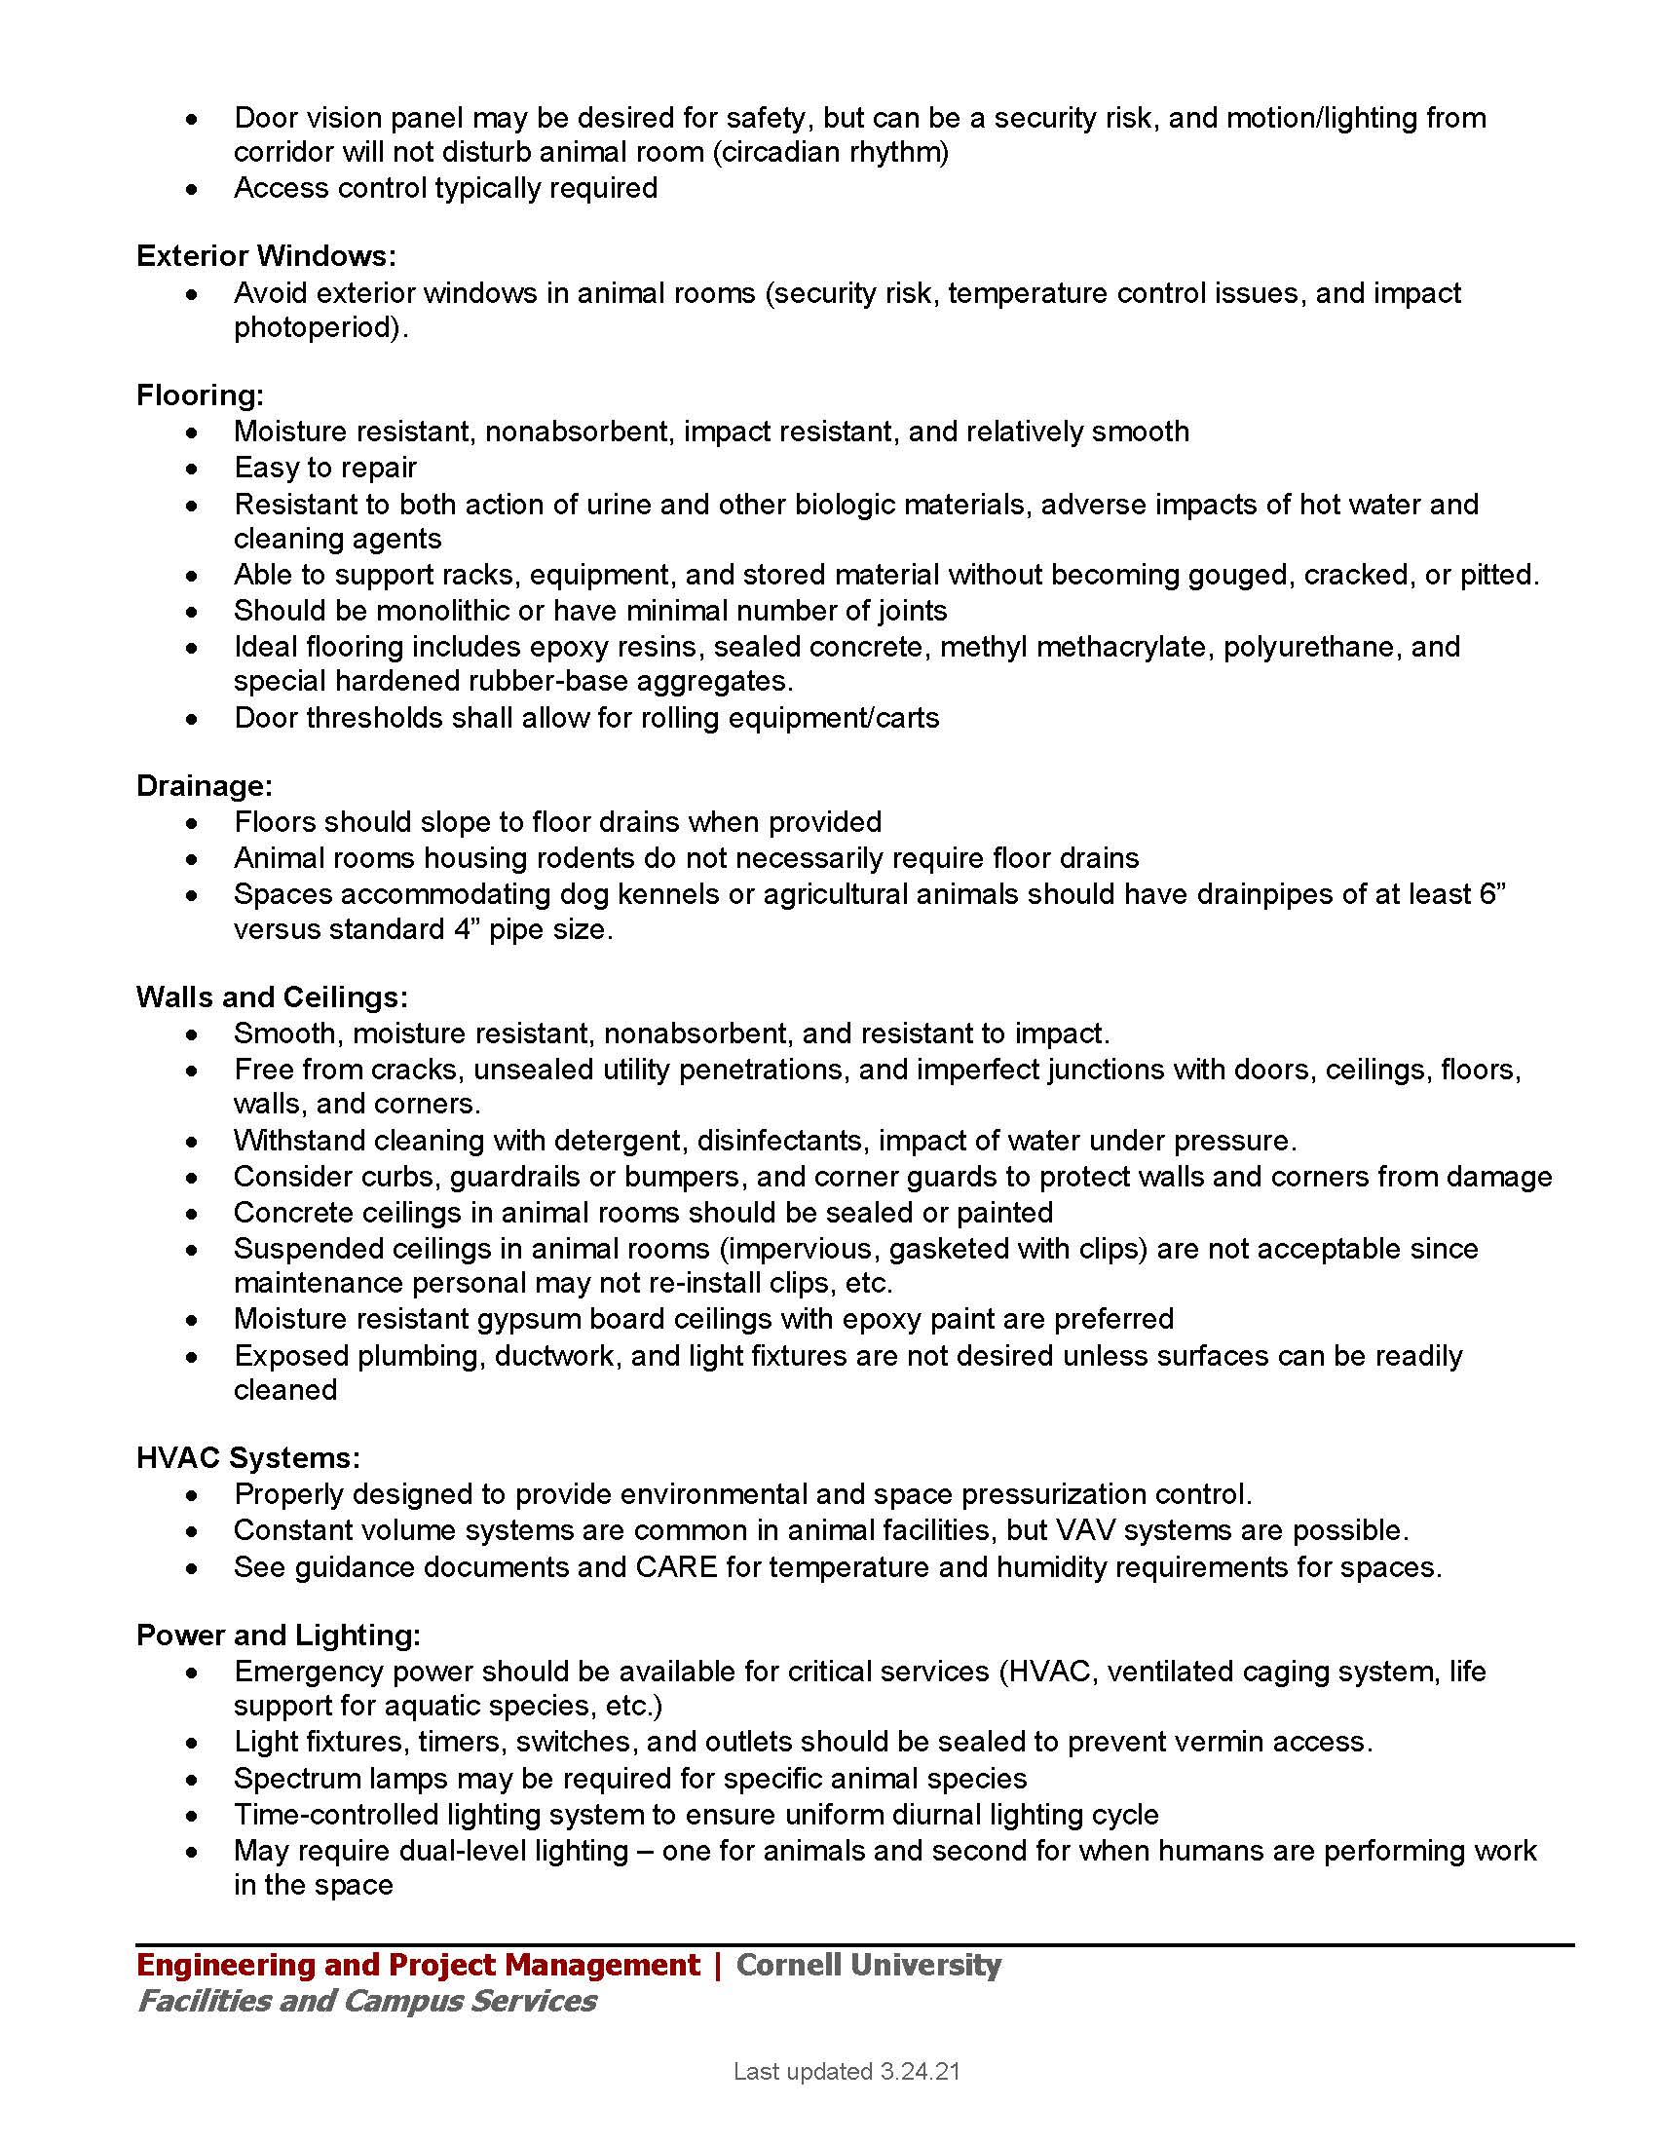
Animal Facilities
Guidance Document
(cont.)

Slide 31
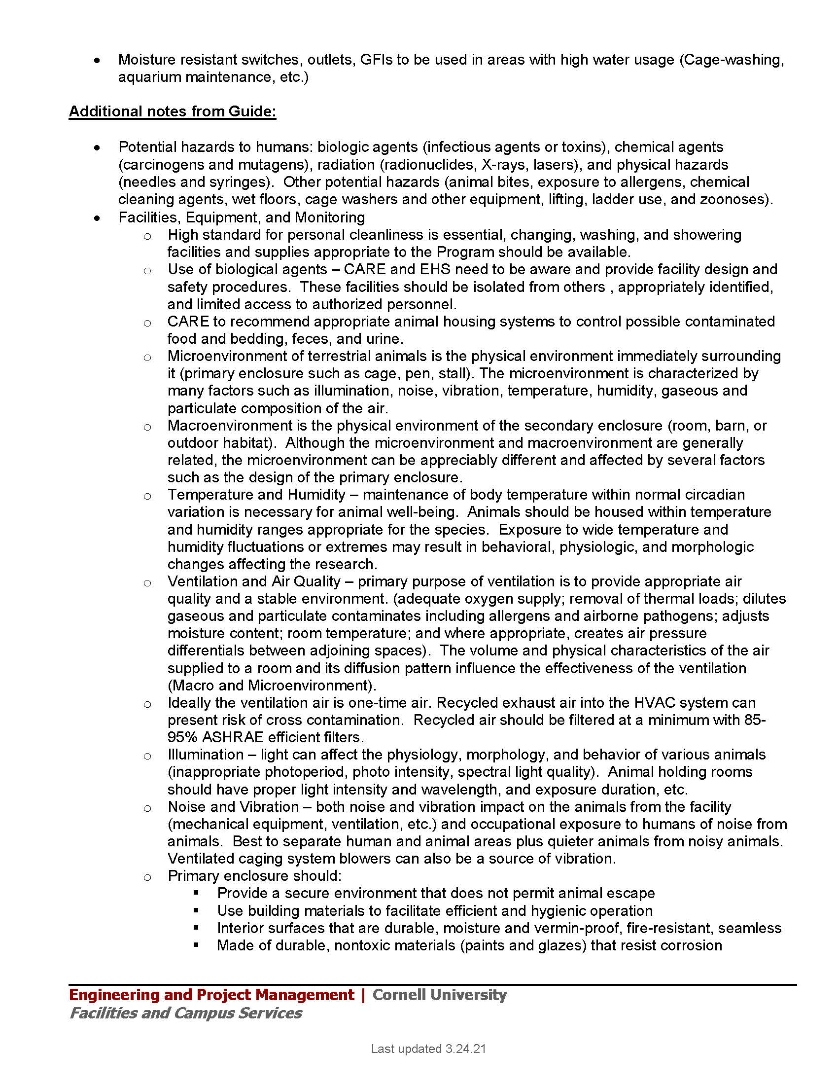
Animal Facilities
Guidance Document
(cont.)

Slide 32
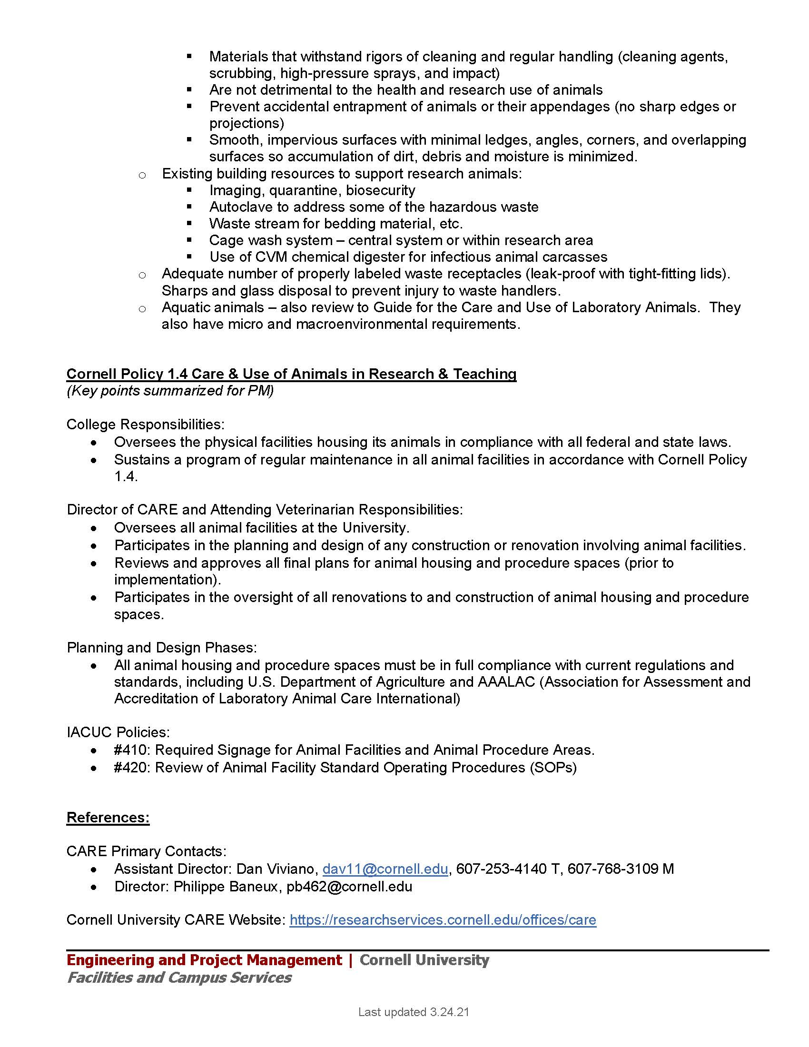
Animal Facilities
Guidance Document
(cont.)

Slide 33
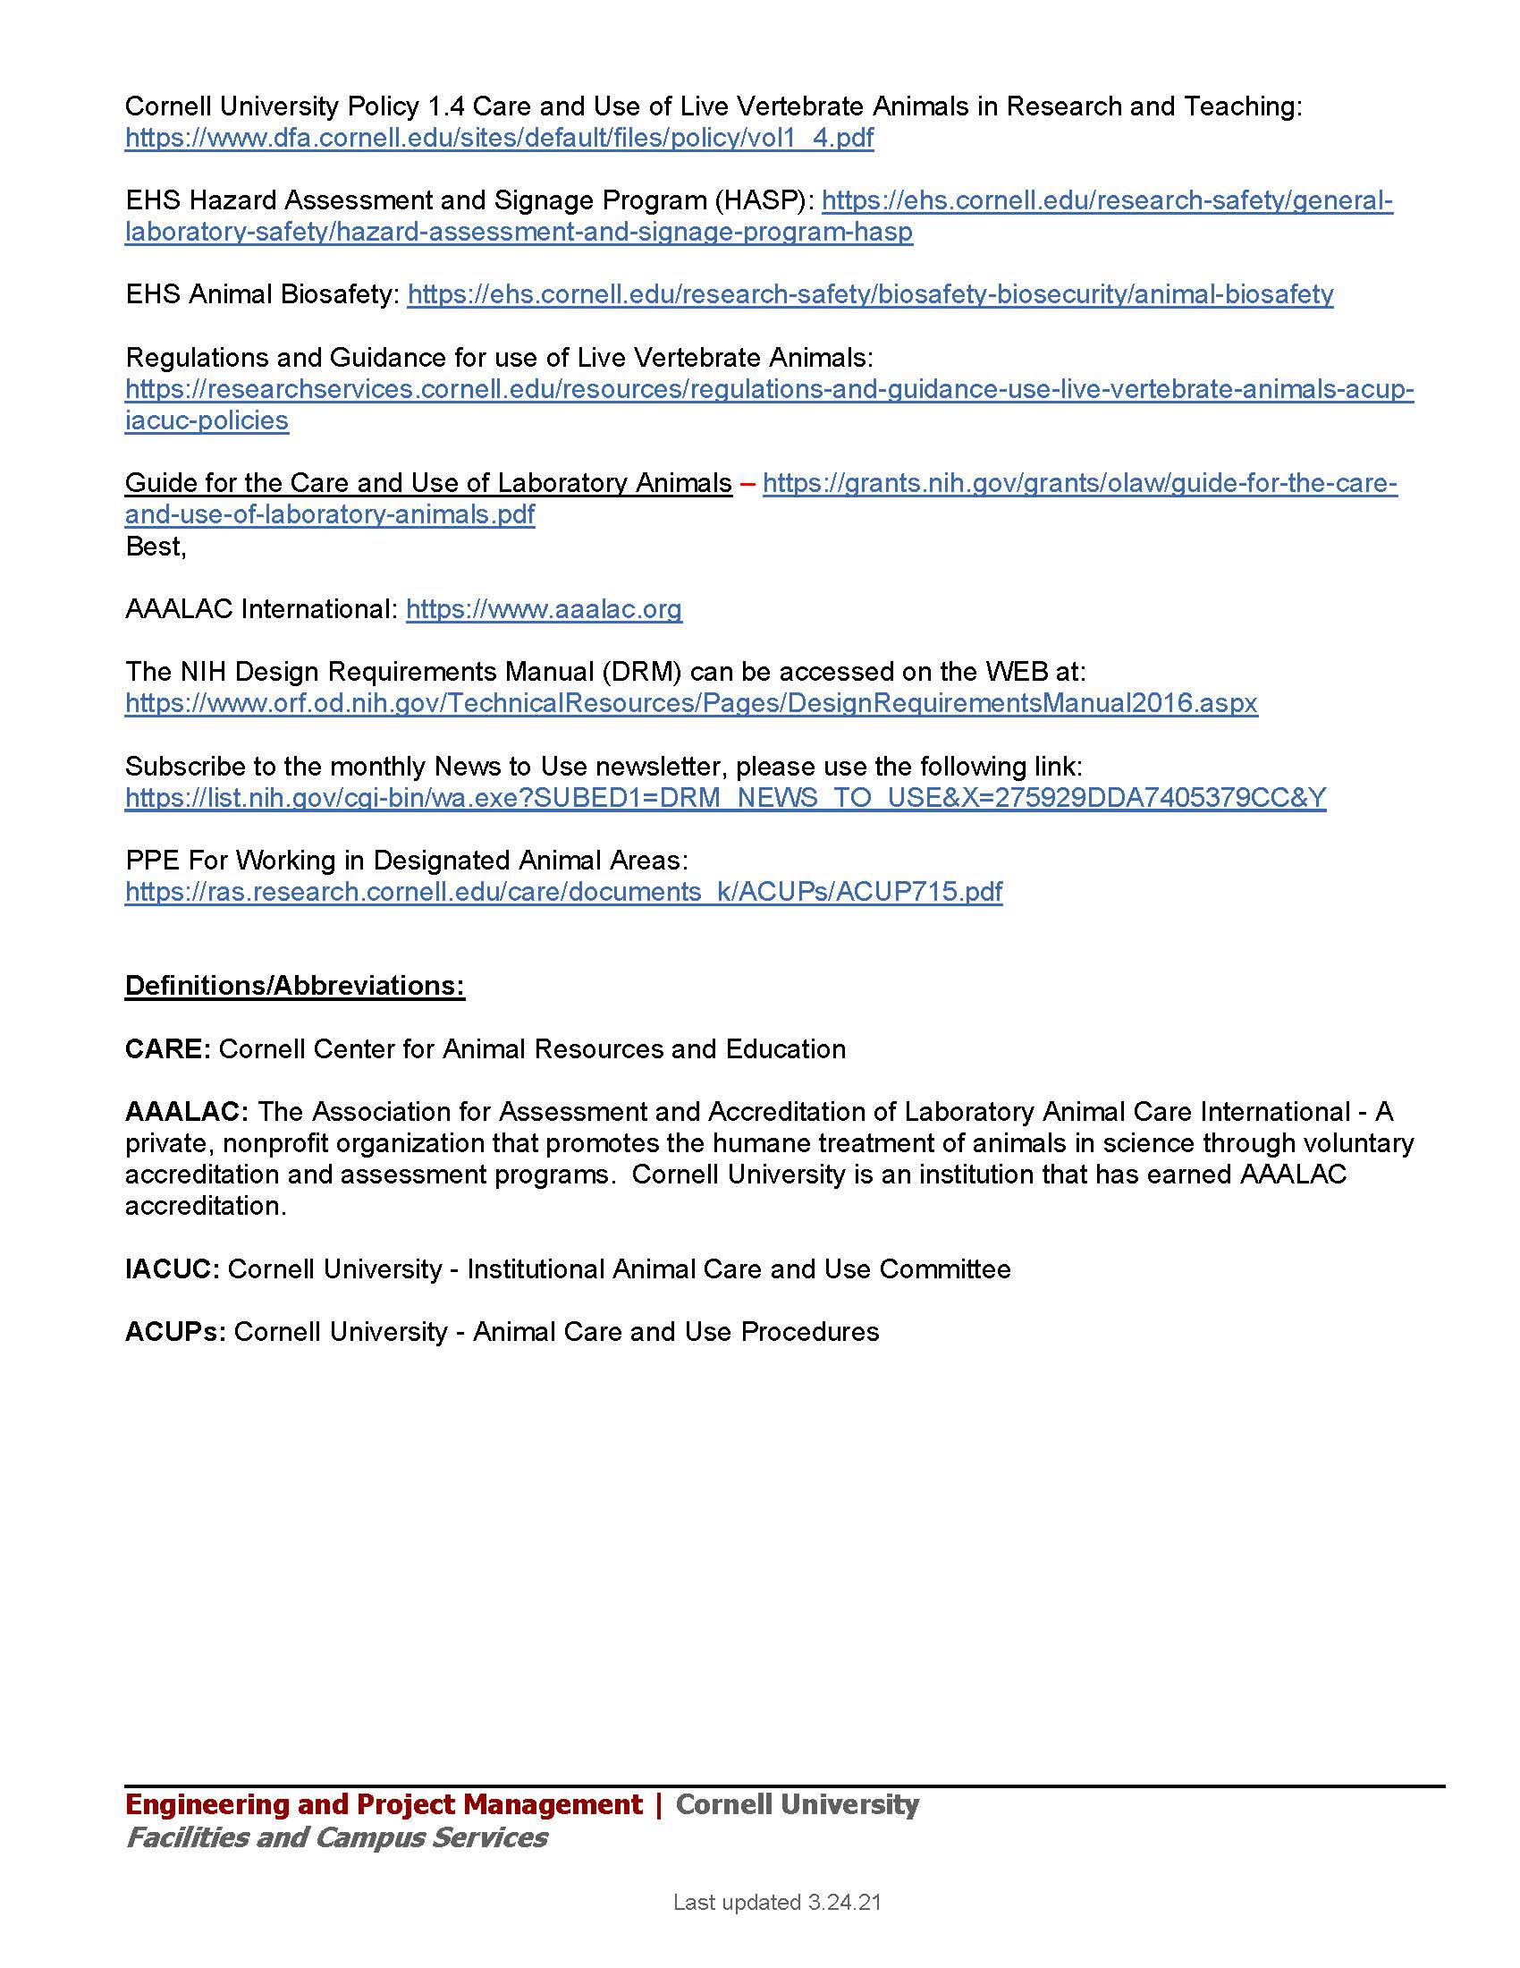
Animal Facilities
Guidance Document
(cont.)

Slide 34
The IACUC at Cornell
Mandated by Federal law and regulations
Responsible for oversight of the animal program
Sets policies and procedures
Reviews proposed animal use protocols, and approves them once acceptable
Monitors protocol compliance and incidents of non-compliance or unexpected animal welfare concerns
IACUC must approve a protocol describing all animal procedures BEFORE the study can begin
IACUC must inspect all animal facilities semi-annually
The Attending Veterinarian at Cornell is responsible for oversight of animal health and maintenance of facilities

Slide 35
AAALAC Accreditation
Voluntary
Peer review
Confidential
Performance-based
Triennial

Slide 36
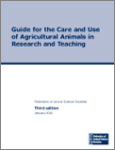
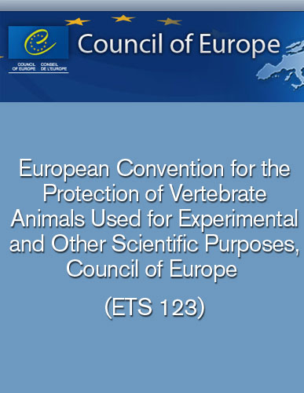
AAALAC Accreditation (cont.)
Three Primary Standards
Plus multiple reference resources.

Slide 37
AAALAC Accreditation (cont.)
The Program Description
  Introduction
    Mission
    Organizational Structure
  Description
    All chapters of the Guide
  Appendices
    Forms, Org. Charts, HVAC data, Protocols, etc.

Slide 38
Questions?

Slide 39
Safety
Presentation

Slide 40
Questions?

