Slide 1
S.M.A.R.T Goal: Strengthening the Early Stages of the Project Life Cycle e-Builder Planning Module
August 2021 – Project Manager Professional Development
Co-Chairs: Andrew Germain, Jeanne Boodley-Buchanan
Committee:
Tom King, Donna Sutliff, Taylor Thompson, Jessie Dimick, Brenda Frank, J Shermeta, Matt Johnston, Mark Howe, Brian Fish, Michael Stewart, Erik Eshelman
Sponsors:
Rick Burgess, Keith Barton, Kelley Cooper,
Margaret McFadden Carney, Andrew Magre

Slide 2
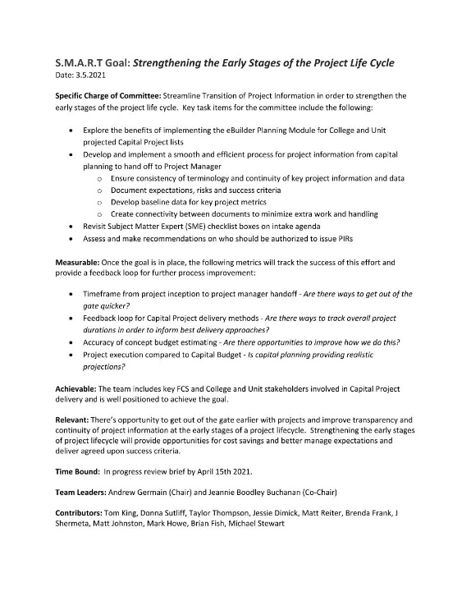
S.M.A.R.T. Goal – Strengthen Early Stages of
Project Life Cycle
Specific –
Measurable –
Achievable –
Relevant –
Time Bound –
“At the early stages of a project lifecycle, create a better integrated and transparent process to enable continuity of project information, a timelier project launch, and alignment of expectations for better outcomes.”
Strengthen the development and assessment phase of capital projects to ensure projects are set up for success.

Slide 3
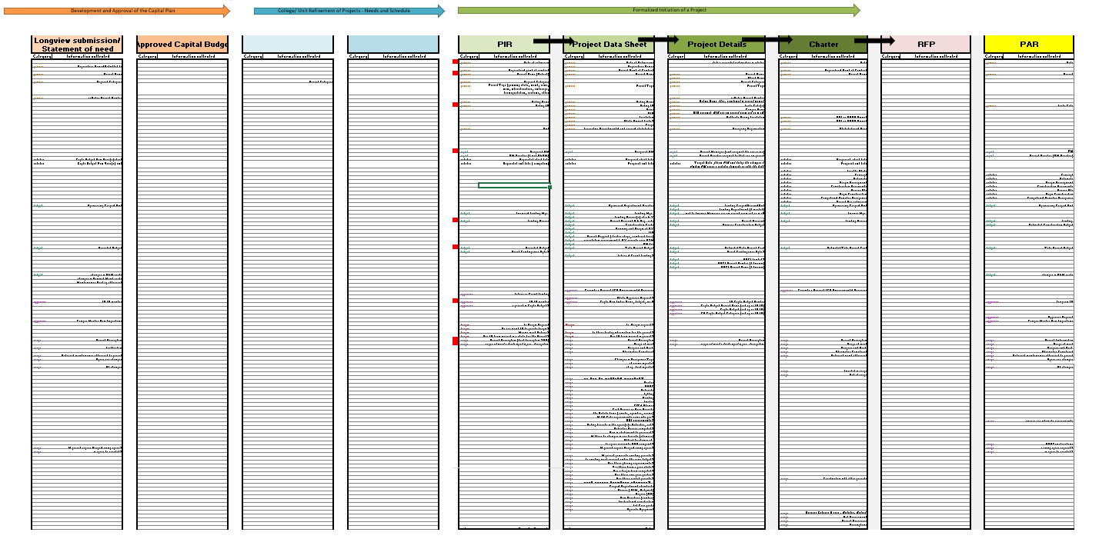
S.M.A.R.T. Goal – Strengthen Early Stages of
Project Life Cycle
“As-Is” Condition
  Data Overlap & Redundant Assessments:
  Separate analyses performed:
    (List Owner & Campus Steward formulating their own interpretation)
  No transparency; Loss of context creating delays.
(Longview)
(College & Unit)
(Intake)
(Project Team)

Slide 4
S.M.A.R.T. Goal – Strengthen Early Stages of
Project Life Cycle
Capital Budgeting
“Ideal” Condition
Annual Capital Budget
Development Cycle “Early Stages of a Project”
Development & Assessment Phase:
Project Launch Phase
Prioritization
Socialization
Identification Phase Academic Program & Master Plans
(Longview)
Analysis & Planning:
Program Management:
Consistency
Transparency
Engagement/ Discussion
Consistent Assessments
Data Management:
Wants & Needs
Timeliness
Continuity (Single Location)
Space Utilization
Proactive Capital Planning

Slide 5
Annual Capital Budget Development Cycle
“Early Stages of a Project”
Development & Assessment
Identification
Project Launch
Identification
List Owners: Develop List of Needs & Wants
Development & Assessment - Development - Support - Prioritization
Project Launch
List Owners: Maintain List
Use Template to Standardize Data Input
Complete Submission into Longview
Campus Stewards: Project Launch
Launch the Projects
Project to move forward
Project Advocate: Socialize List of Needs & Wants
Socialize List (Campus Liaison: Qtrly, Monthly Sessions)
Provide Context to Longview Submissions
Populate Project Charter (Success Criteria, etc..)
Campus Stewards: Assess Projects on List
Perform initial assessments, gain context,
Further Define Need (Internal / External SME)
Campus wide view of planned projects (Identify Synergies)
Acquisition Planning, Bundling (similar scope/adjacency)
Procurement Opportunities (FE, FM, external)

Slide 6
Assessment
Identification
Project Launch
Comparison of “As-Is” vs “Ideal”
Assessment & Data Management: Continuity & Transparency
  Eliminate Data Overlap & Redundancy
    Transparent & Additive vs. Siloed & Repetitive
  Identify Responsibilities & Accountability (Inflection Points and “Swim Lanes”)
    Responsible Parties: “List Owner vs. PM”; Campus Steward Assessments (consistency)
Identification
Assessments: (Development, Support, Prioritization)
Project Launch
Project Pre-Design
Assessments
Assessments
Assessments
Assessments
Project Advocate
PM

Slide 7
Assessment
Identification
Project Launch
Comparison of “As-Is” vs “Ideal”
“One size does not fit all”
Process: Assessment Variability
  Projects may be on a fast track and engage a PM quickly
Identification
Assessments: (Development, Support, Prioritization)
Project Launch
Project Pre-Design
Project Advocate
PM

Slide 8
Assessment
Identification
Project Launch
Comparison of “As-Is” vs “Ideal”
“One size does not fit all”
Process: Assessment Variability
  Projects may not need a PM during the assessment phase and are managed by List owner until a Design PAR or Contract is needed
Identification
Assessments: (Development, Support, Prioritization)
Project Launch
Project Pre-Design
Project Advocate
PM

Slide 9
eBuilder Tool
Planning Module

Slide 10
Exploration of Current
Project Management Planning Tools
eBuilder Planning Module: Explore Benefits of Implementation
  Facilitates Transparency, Continuity, and sharing of information to encourage planning conversations
Transparency, continuity & sharing of information

Slide 11
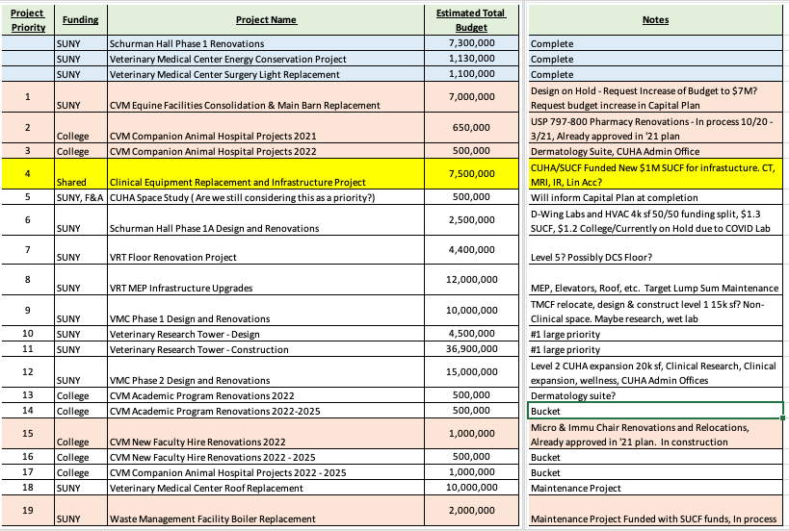
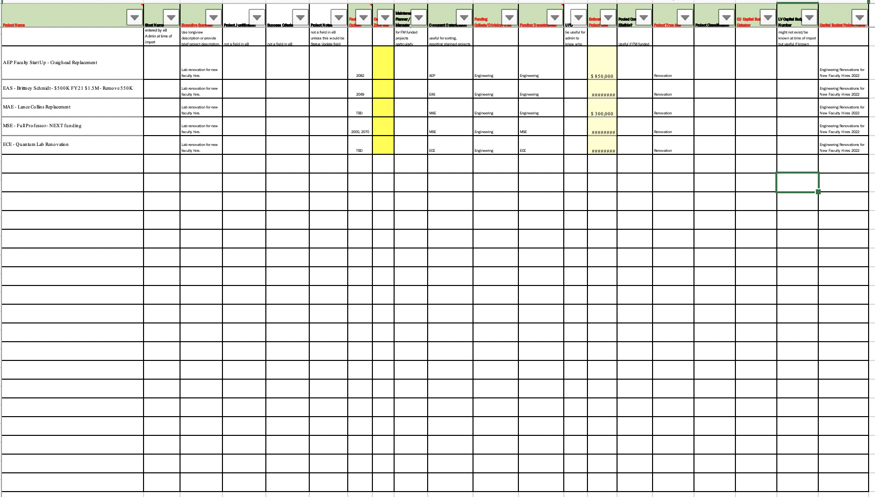
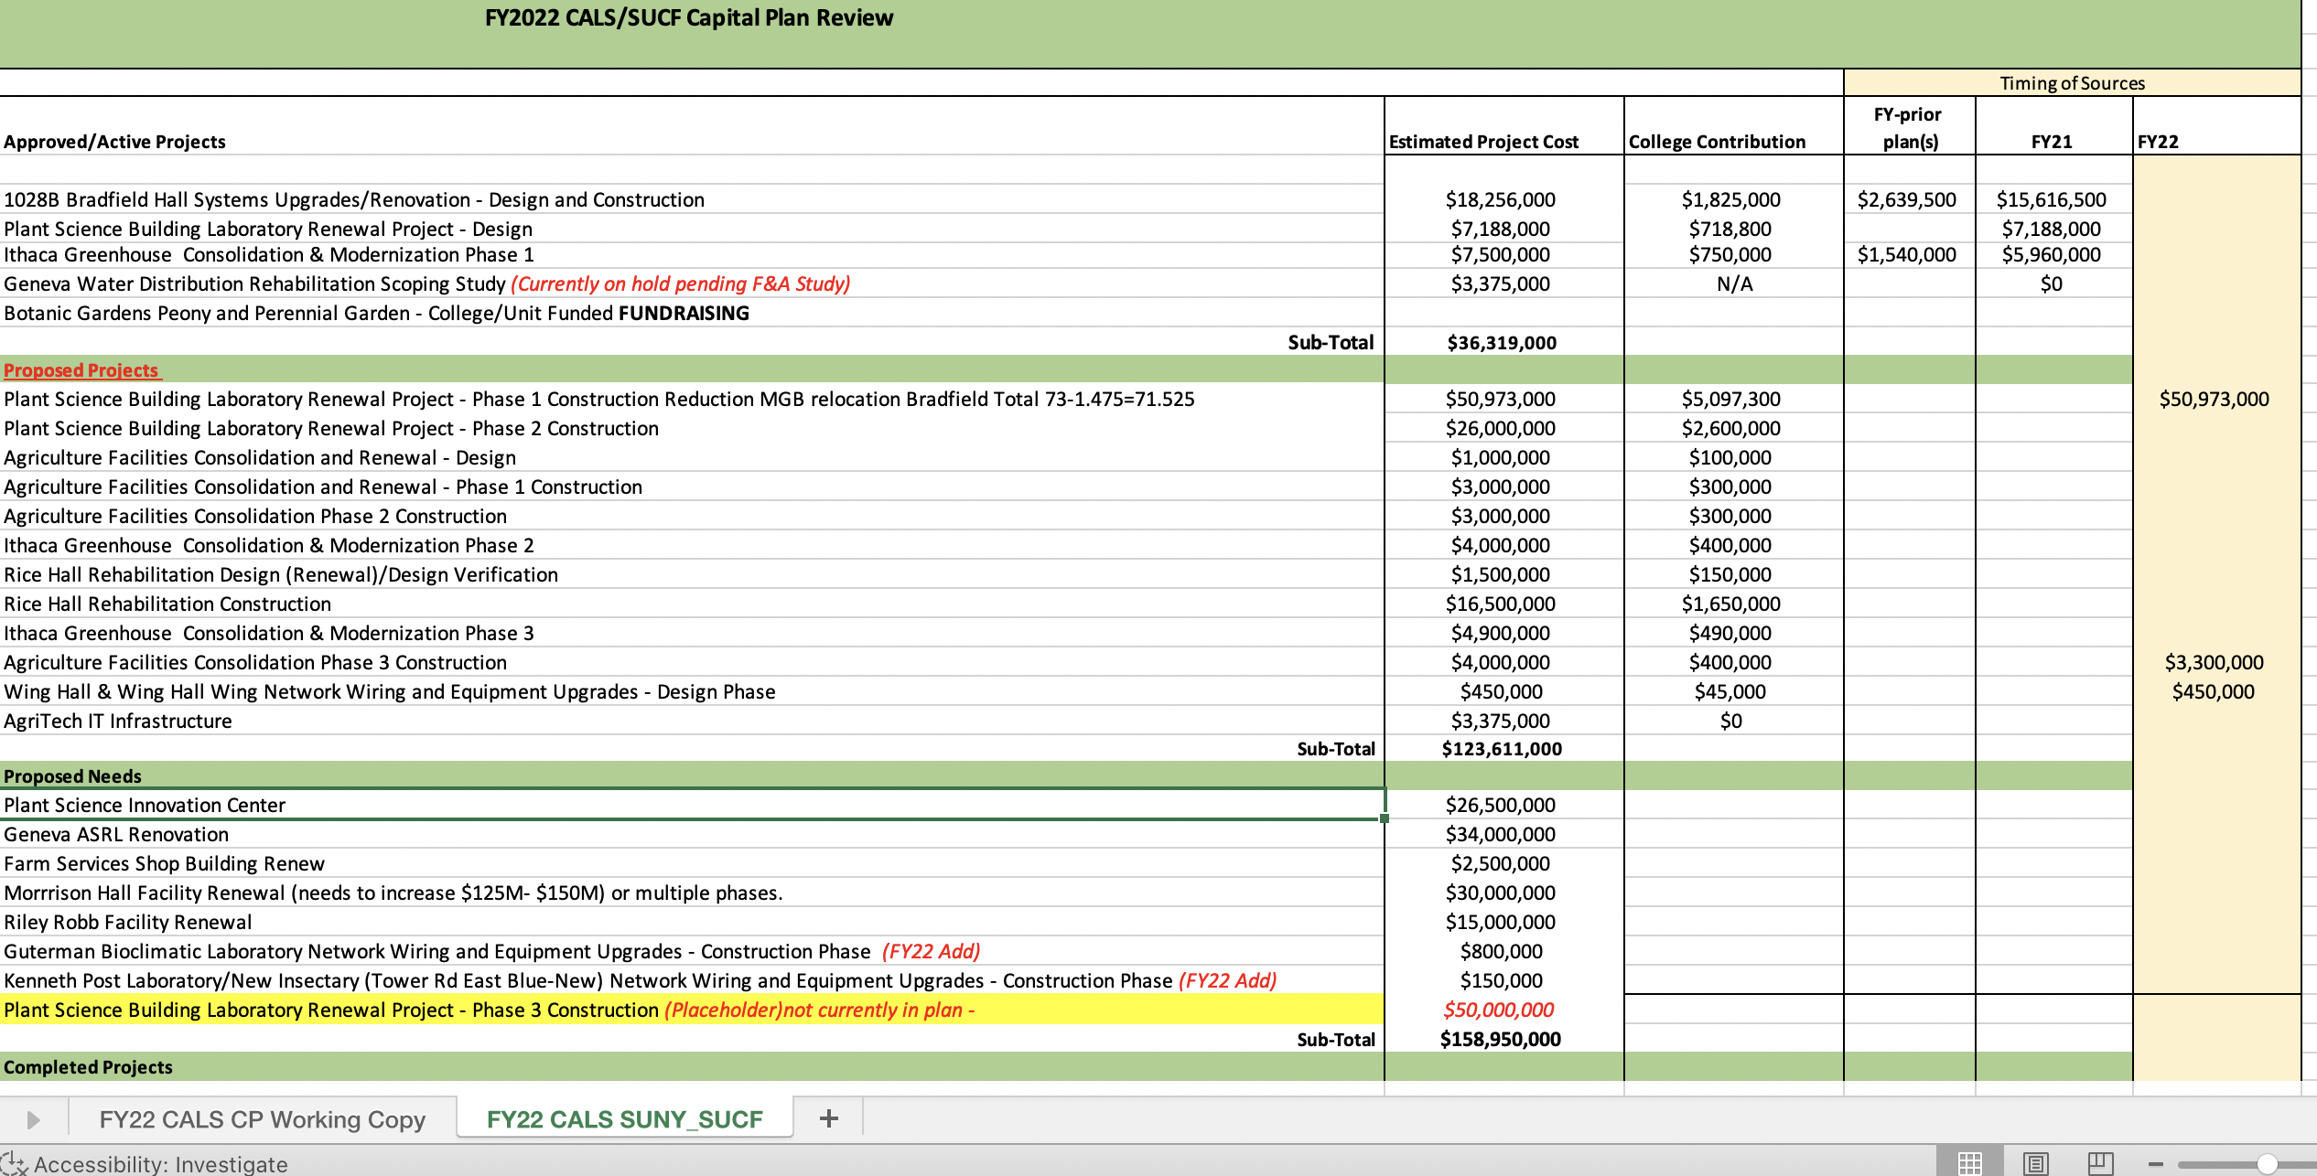
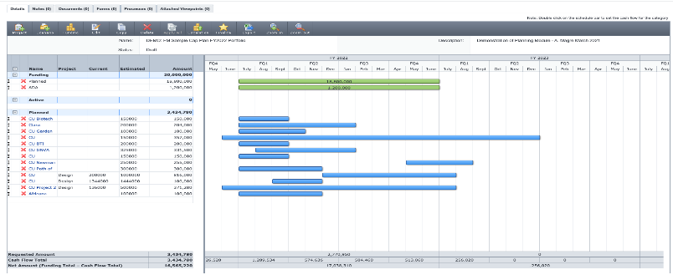
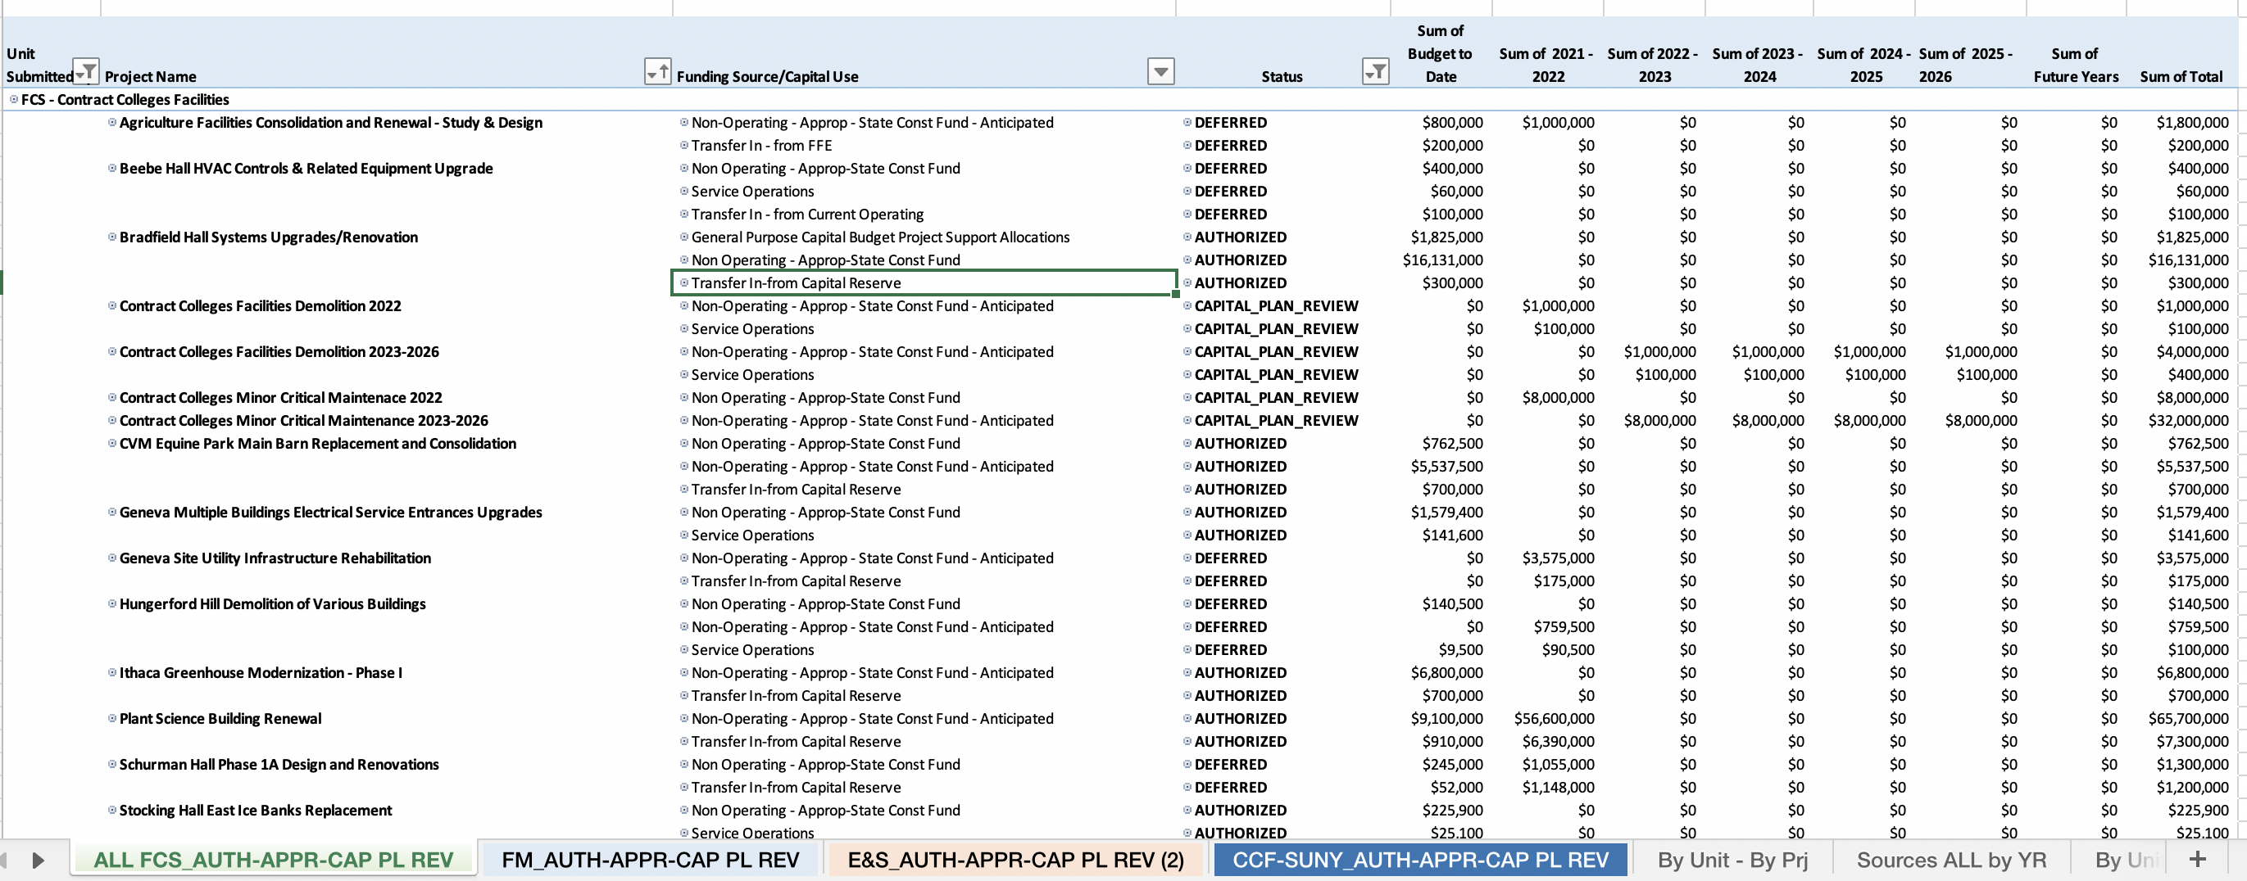
Exploration of Current
Project Management Planning Tools
eBuilder Planning Module: Standardization of Project Portfolio Lists
CVM List
Proposed standard template
CALS List
Import shell projects & create planning scenarios
FCS & Contract College (Longview export)

Slide 12
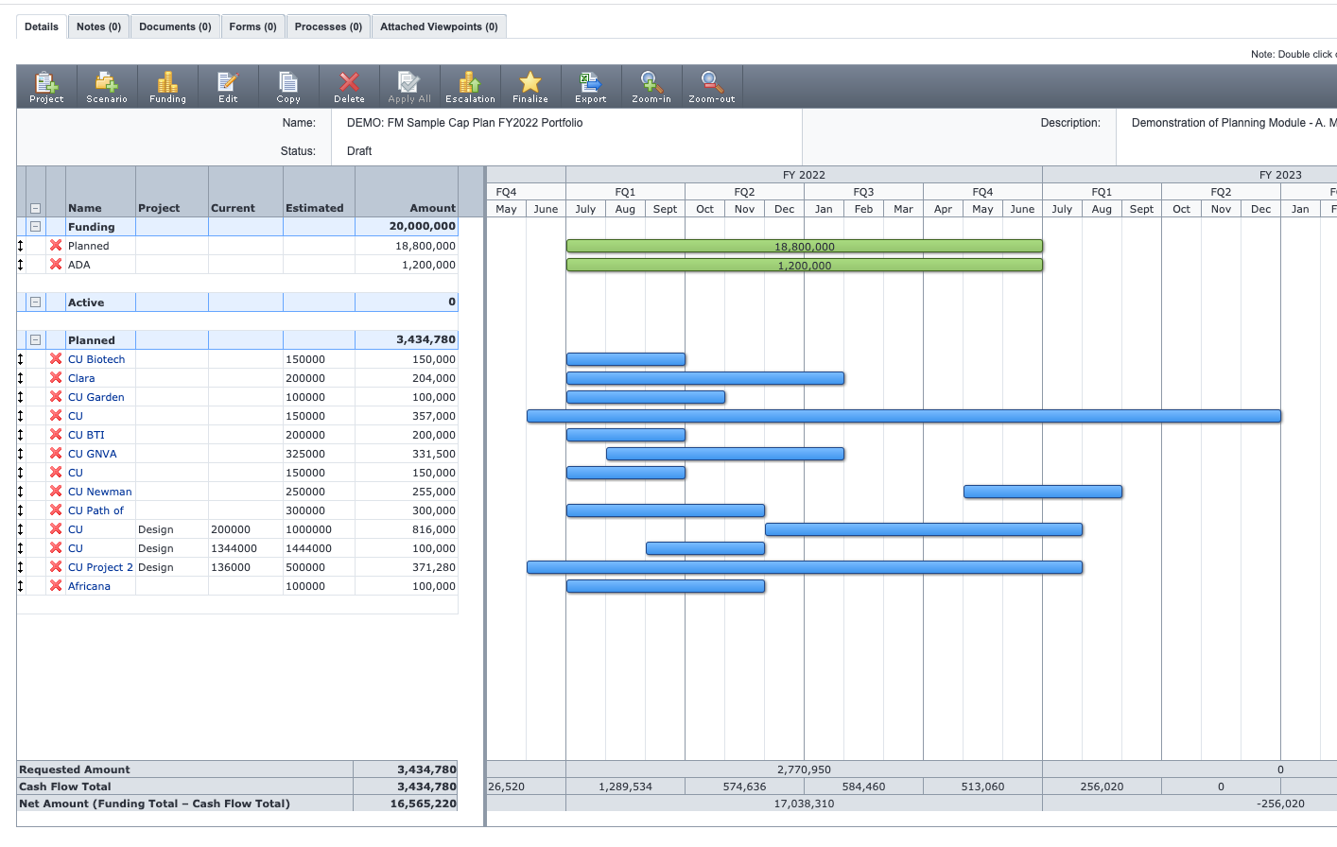
Exploration of Current
Project Management Planning Tools
eBuilder Planning Module: Standardization of Project Portfolios
  Consistency supports centralized dashboards and metrics, to promote feedback loops for improved project planning and execution and possible synergies across colleges and units campus wide.

Slide 13
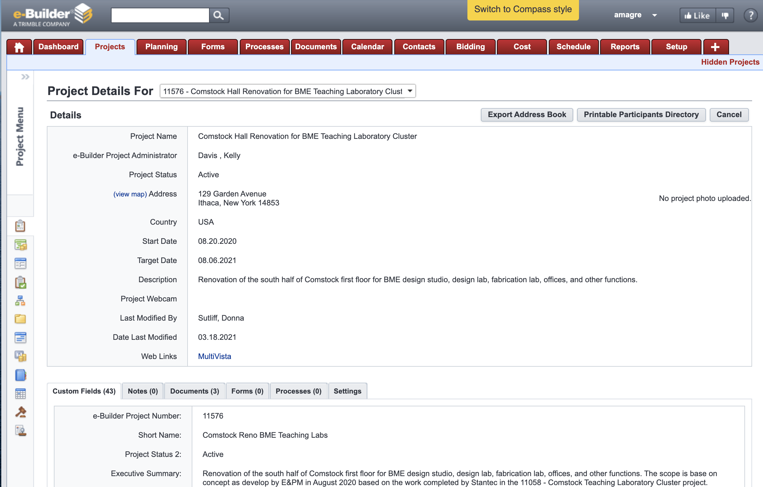
Exploration of Current
Project Management Planning Tools
eBuilder Planning Module: Shell Project – Details Page
  Development of a standardized project list allows or the input of multiple projects at once allowing project information to be modular.
  Information can be aggregated over time through an iterative planning process and populate future documents and approvals (Project Charter, RFP, PARs, etc.)
Proposed standard template
Project Details Page

Slide 14
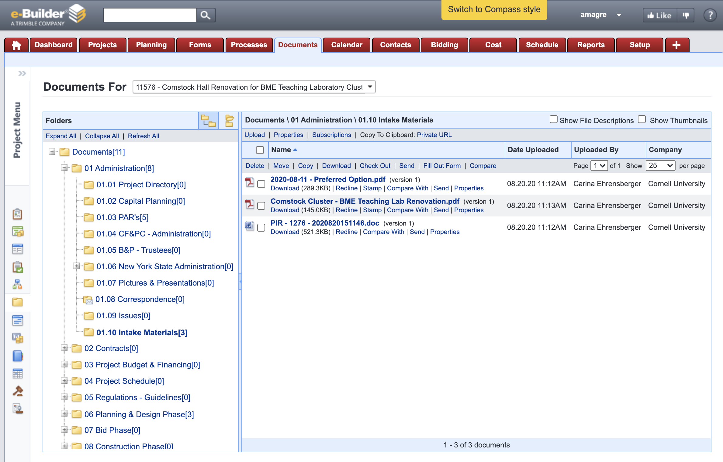
Exploration of Current
Project Management Planning Tools
eBuilder Planning Module: Standardized File Structure
  Keep all Planning Documents & Document Dialogue in single location
  Shell Project accessible for Project & Campus Stakeholders
  Promotes continuity and sharing of information allowing for greater project context to get out of the gate sooner

Slide 15
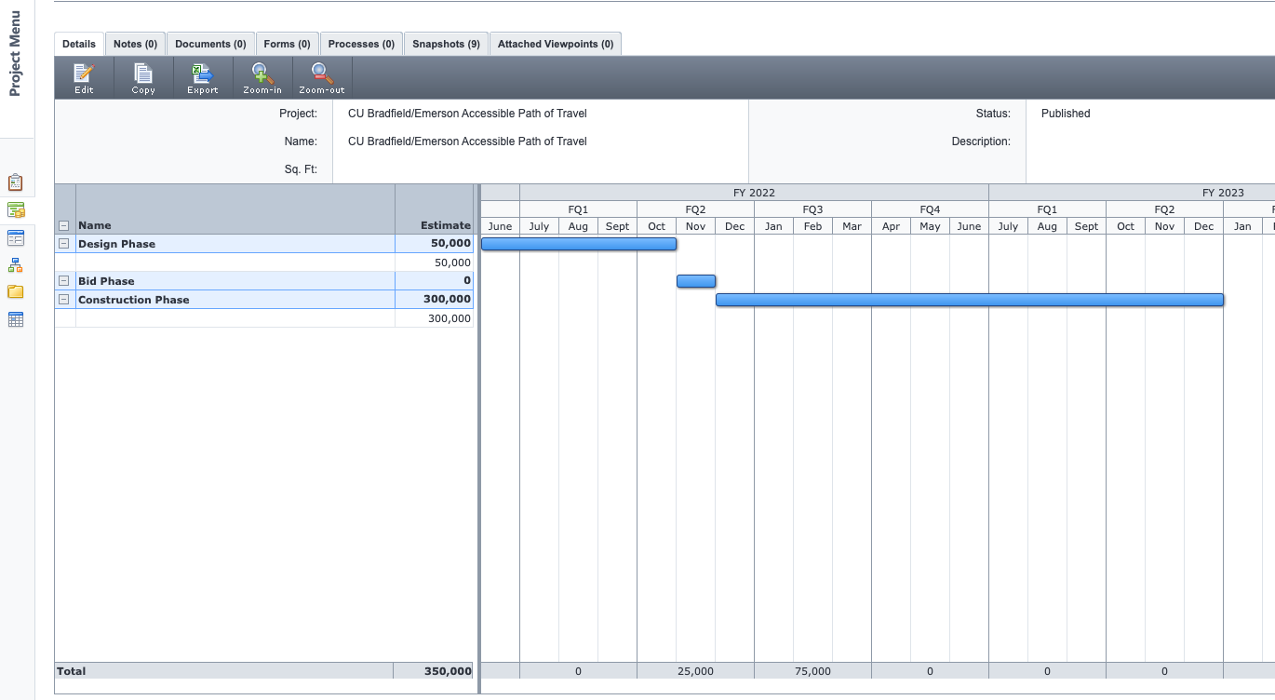
Exploration of Current
Project Management Planning Tools
eBuilder Planning Module: Acquisition Planning
  Planning Scenarios within a Shell Project to support bid planning and optimization and workload leveling efforts.

